Slide 1
ESP32 gyroscope gesture recognition with edge AI
Made by Marta Viñas and Mateu Magem

Slide 2
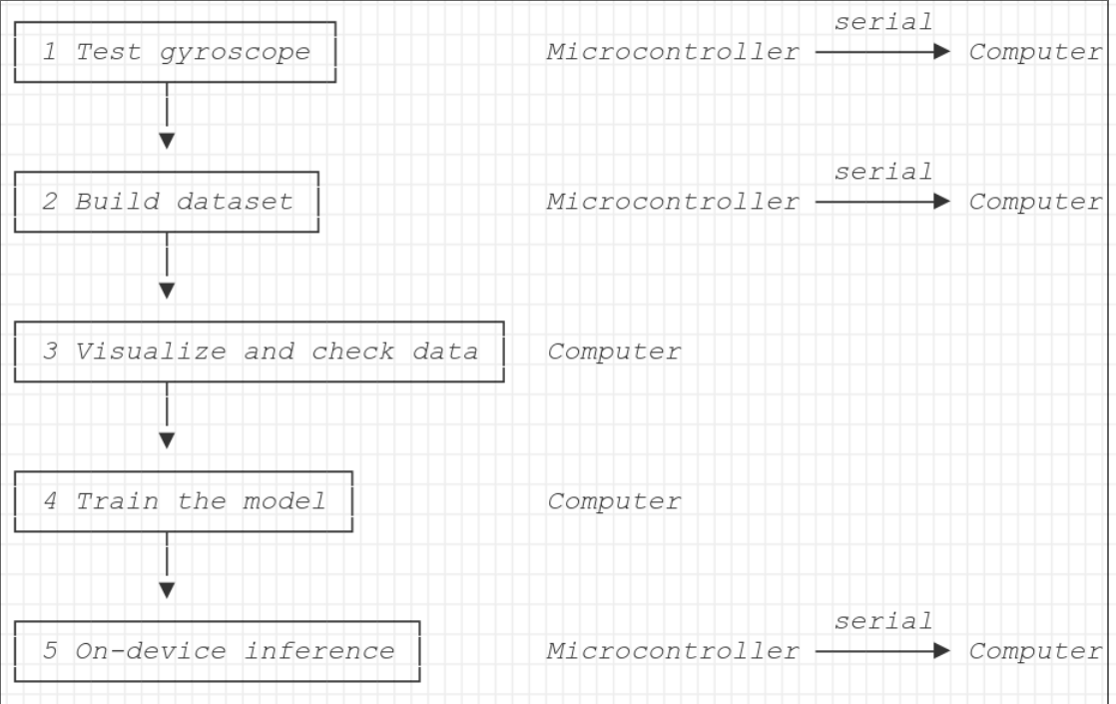
Project workflow and structure

Slide 3
Challenges
Finding the right architecture
Tried CNNs
A feedforward neural network was a simpler approach
Preventing overfitting
Gesture simplicity vs. number of gesture data points
Selecting proper set of movements
Added “still” class

Slide 4
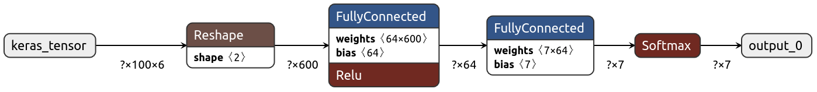
Model
Quantization
Both float32 and int8 models are generated.
float32 is used since it is small enough to fit into memory

Slide 5
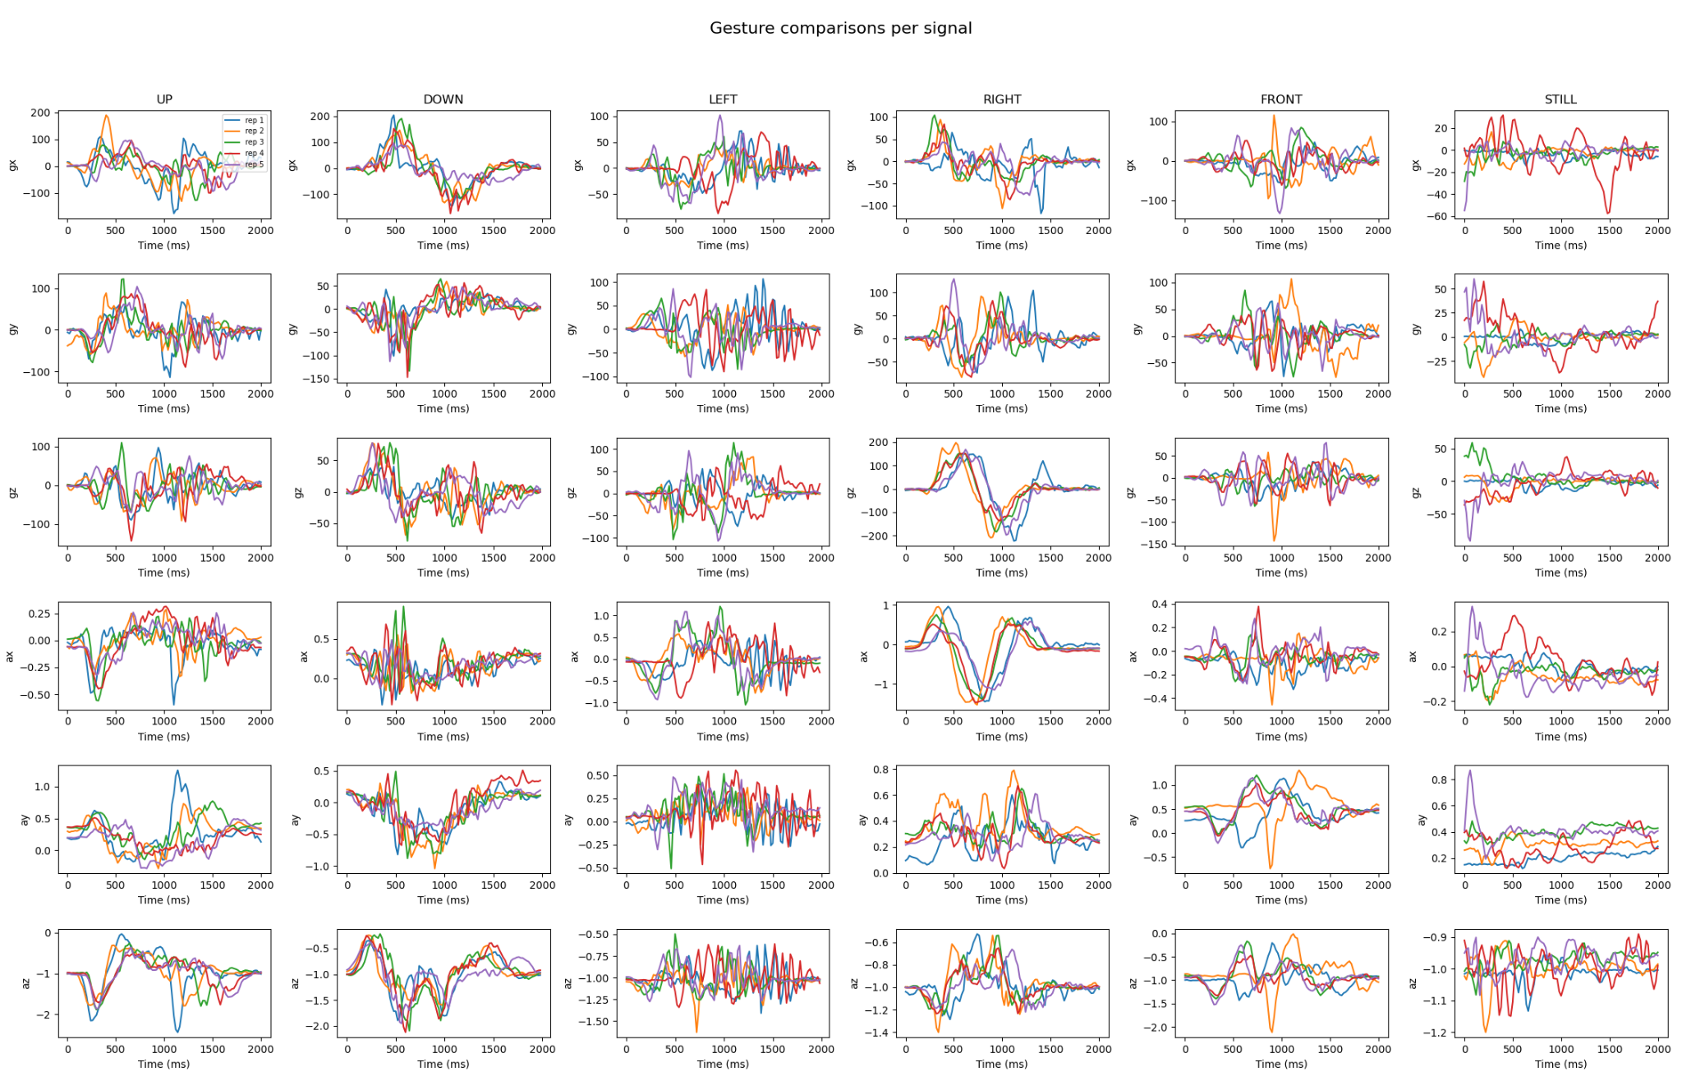
Data visualization

Slide 6
Demonstration

