Slide 1
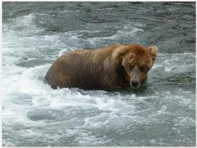
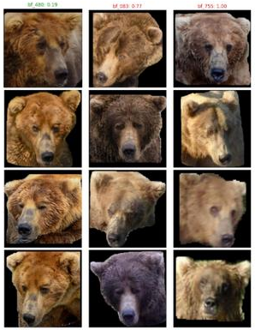
GROUP MLM · WILDLIFEREID-10K
Calibrated Multi-Scale Similarity Fusion for Wildlife Re-ID
Can combining a global, a general and a local view of an animal identify individuals more reliably than any single one?
Which of these individuals is it, by ID?
CLASSIFICATION
RE-ID, CLOSED SET
RE-ID, OPEN SET
What species is this?
Which known individual is this?
Or is it a new animal?
Tshephang Matlala · Kamohelo Lebjane · Denzel Zimba
1 / 5
Notes:
~1.5 min. Re-ID is not species classification: we ask which individual animal this is, among animals we have already seen. Closed set: the animal is guaranteed to be in the gallery, so the best match is the answer. Open set: it may be new, so we add a threshold tau; if the best score is below tau we answer 'new individual'. Our question: does fusing global, complementary and local evidence beat any single representation on WildlifeReID-10k? (Photos on this slide are from the example figure in your notes; swap in your own dataset images if you prefer.)

Slide 2
Data and processing
140,488
10,772
37
~33
images
individuals
datasets
species
Splits without leakage
Augmentation
Compression
Validation is carved out of train
10% of identities held out as “new” animals
Near-duplicate photo clusters move together
Mild crops, ±10° rotation, small hue jitter
Blur and random erasing for wild conditions
No horizontal flips: mirroring invents fake identities
PCA with whitening, fitted on train only
Sweep 32, 64, 128, 256 and 512 dimensions
Find where retrieval starts to degrade
Source: WildlifeReID-10k benchmark
2 / 5
Notes:
~2 min. The benchmark has 140k images of about 10.8k individuals across 37 datasets. There is no validation split, so we carve one out of train: whole identities are held out to mimic new animals, and whole clusters of near-identical photos are held out together, otherwise validation is too easy (leakage). Test is run once at the end. Augmentation is mild because identity cues must survive; no horizontal flips because mirrored patterns create fake identities. Compression: PCA fitted on training data only, then sweep dimensions and watch BAKS and BAUS. (Dataset counts come from your earlier draft decks; please verify.)

Slide 3
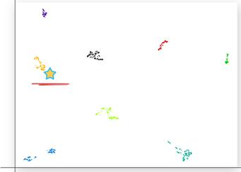
Pipeline: three views, one score
1
2
3
4
5
Spots, stripes and scars matched keypoint by keypoint
S = 0.4·Sg + 0.3·Sc +0.3·Sl
▶
▶
▶
▶
Query image
Embed: global + EVA02
Shortlist top-K by cosine
ALIKED + LightGlue on best 20
Calibrate, fuse, re-rank
Global MegaDescriptor or MiewID: the overall look
Complementary EVA02: generic features, a second opinion
Local ALIKED: tiny patterns the others miss
Scores live on different scales, so each is calibrated to P(same animal) and then fused. If the best fused score ≥ τ, we return that identity; otherwise, NEW.
3 / 5
Notes:
~3 min. Walk left to right. Every image becomes an embedding from the global model and from EVA02. Cosine similarity over the whole gallery gives a shortlist of K candidates. ALIKED with LightGlue works on pairs, not vectors, so it cannot be indexed: it only runs on the best 20. Why it matters: global captures overall look, EVA02 is a general second opinion, local matching catches tiny patterns. Raw scores are on different scales (cosines roughly 0.2-0.9, EVA02 squeezed near 0.8-0.95, ALIKED an inlier count up to 1000), so we calibrate each with isotonic regression into a probability of same animal, combine with a weighted sum (start 0.4/0.3/0.3, tuned on validation), re-rank, then apply tau. Images on steps 1-3 are from the example figure in your notes (a bear face re-ID illustration); replace with your own dataset crops if you want.

Slide 4
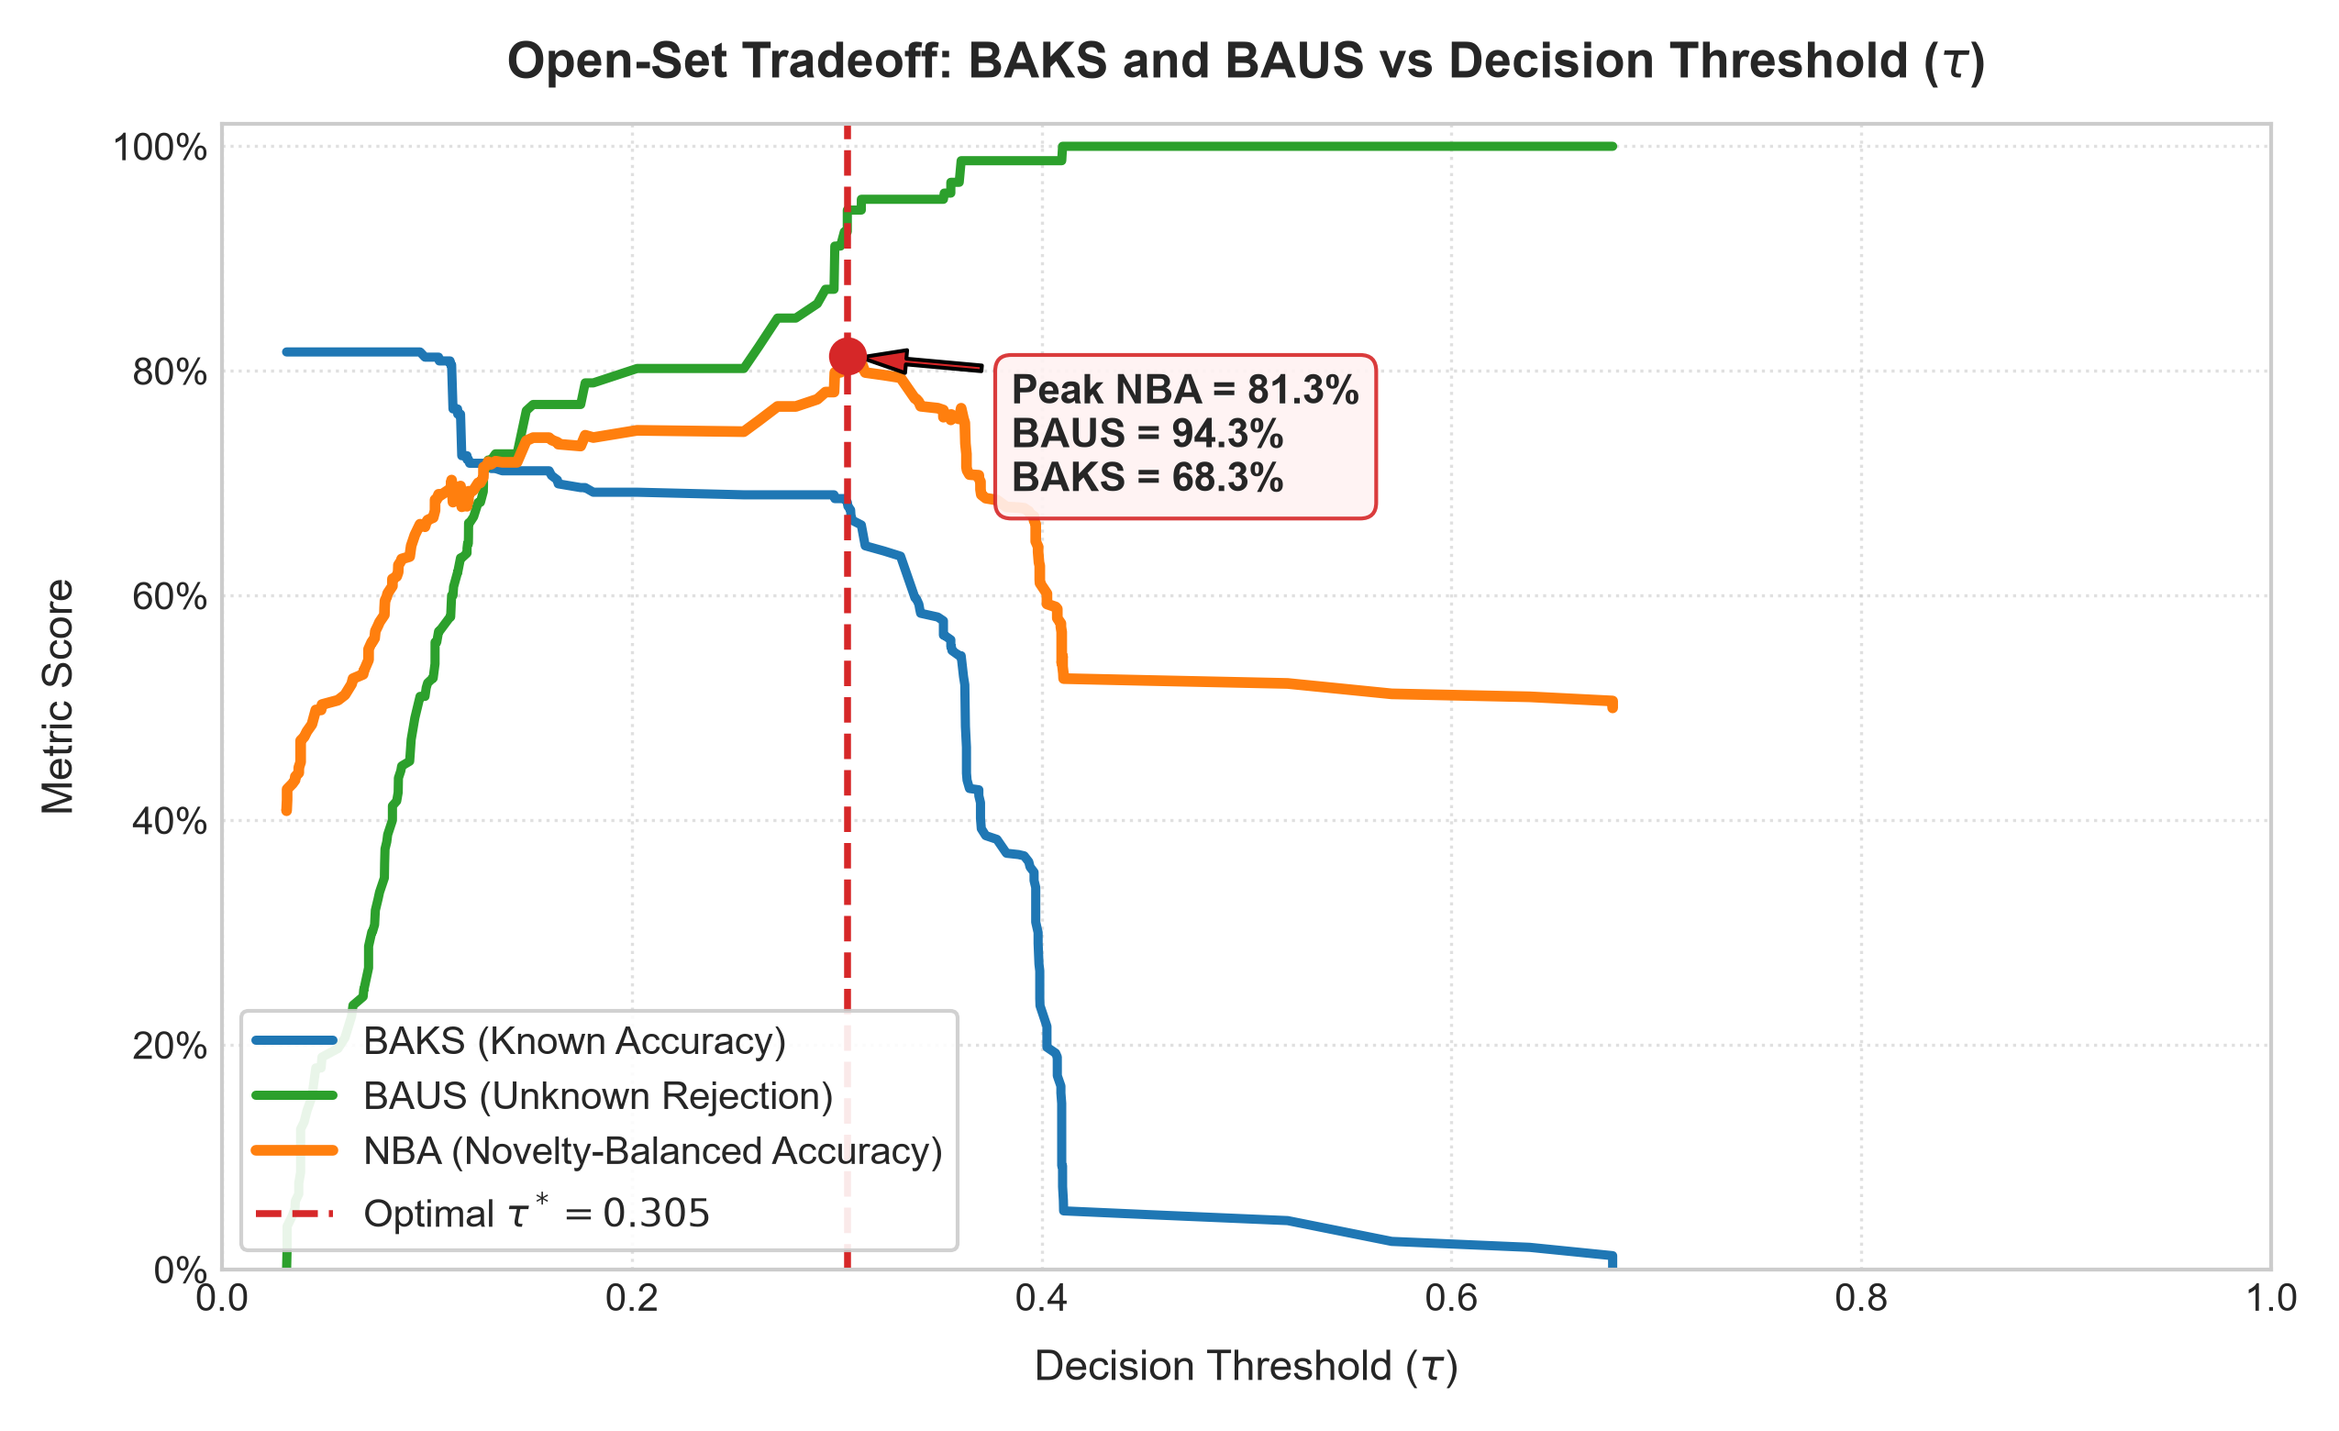
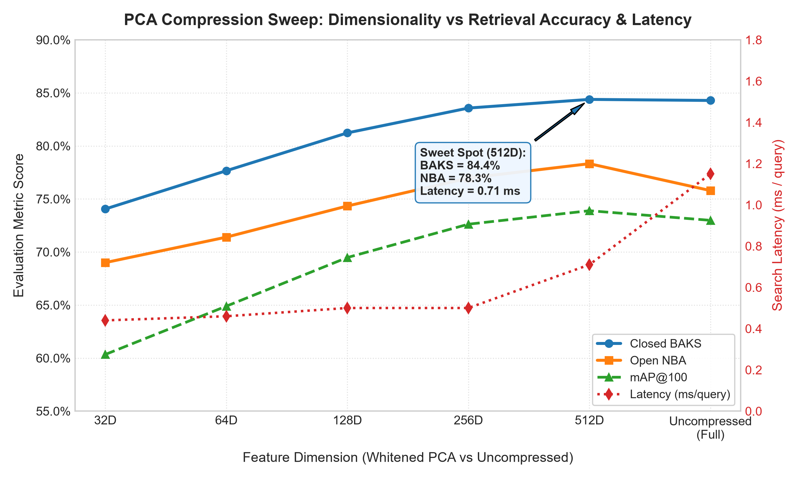
Results
Method | Closed BAKS | Open score | BAUS | mAP@K
DINOv2 baseline | 0.5651 | 0.5186 (0.1897) | 0.8474 | 0.2555
Global | 0.8143 | 0.7874 (0.6636) | 0.9112 | 0.7583
Global + EVA02 | 0.8176 | 0.7898 (0.6683) | 0.9112 | 0.7582
Global + ALIKED | 0.7994 | 0.7978 (0.6524) | 0.9432 | 0.7846
All three, fused | 0.8169 | 0.8131 (0.6830) | 0.9432 | 0.7857
Plot: BAKS and BAUS vs τ
Plot: PCA dimension sweep
32 to 512 dimensions vs uncompressed
Metrics:
BAKS: balanced accuracy on known animals.
BAUS: unknown animals correctly called “new”.
Open score = (BAKS + BAUS) / 2.
* Reduced validation subset (200 queries); other rows are the full test split. Local branch is preliminary.
4 / 5
Notes:
~2.5 min. Tables: first four rows are the full test split; rows marked * use a 200-query validation subset (the only run that includes the local branch), so treat them as preliminary. Talking points: Fine-tuned MegaDescriptor carries the system (closed BAKS 81.1, open score 73.3). EVA02 and DINOv2 alone are near the 50% of rejecting every query. Adding EVA02 changes test scores by under 0.1 points. On the subset, adding ALIKED raised open score 79.0 to 81.3 (BAUS 91.1 to 94.3) with closed BAKS unchanged; 113 known queries so one query is 0.9 pt. PCA: 256-d costs 0.7 BAKS, 512-d matches, 128/64/32 lose 3.1/6.6/10.2. Paste the tau plot, PCA plot and your extra result into the dashed boxes. Tau is chosen on validation and frozen for test.

Slide 5
Conclusion and ablation
Different evidence fails in different ways, so we fuse it.
Configuration | What it tells us
Global alone | Fine-tuned model carries the system: 81.1 BAKS, 73.3 open
EVA02 alone | Weak alone: 42.7 BAKS, 50.4 open (about reject-all)
ALIKED alone | Local branch alone: not run separately
Global + EVA02 | Under 0.1 point change on test
Global + ALIKED | Not run alone; added to G+EVA02: 79.0 to 81.3 open (subset)
All three | Preliminary: 81.3 open, 94.3 BAUS (subset)
Calibration makes unlike scores comparable
Local matching runs only on a shortlist, so it stays affordable
One threshold τ separates known from new animals
5 / 5
Notes:
~2 min, then ~2.5 min live demo (streamlit run src/ui/app.py). Ablation = switch branches off to see what each adds: each alone, each pair, then all three. If full fusion beats every single branch and pair, the evidence is complementary: that is why we fuse. State your finding in one sentence once numbers are in. Limitation: fusion cannot recover an animal the cosine shortlist missed, so shortlist recall bounds it. Demo: pick a test image, show the top identities, move tau and show an image flip to NEW.

