Slide 1

Data Analysis & Forecasting on COVID-19 Cases in Rhineland-Palatinate

Slide 2
Group 2 Mahbubul Alam Tuhin (220201242) Mukund Rameshbhai Vekariya (220200552) Raicy Ann Mammen (221202836)

Slide 3
Research Question
The goal is to predict the hospitalized case of covid-19 next 7days.
So, government can take necessary steps for future.
Can an LSTM model accurately predict the hospitalization incidence based on previous data?
Can we determine in comparison between LSTM and Neural Network Model that which model is showing more robustness for different cases?
Can Random Forest model accurately predict the number of COVID-19 cases and how do the feature importance differ between total covid cases and current covid cases?

Slide 4
Data Pre-processing
Data cleaning
Data Normalization
Data Transformation
Feature selection
Data splitting

Slide 5
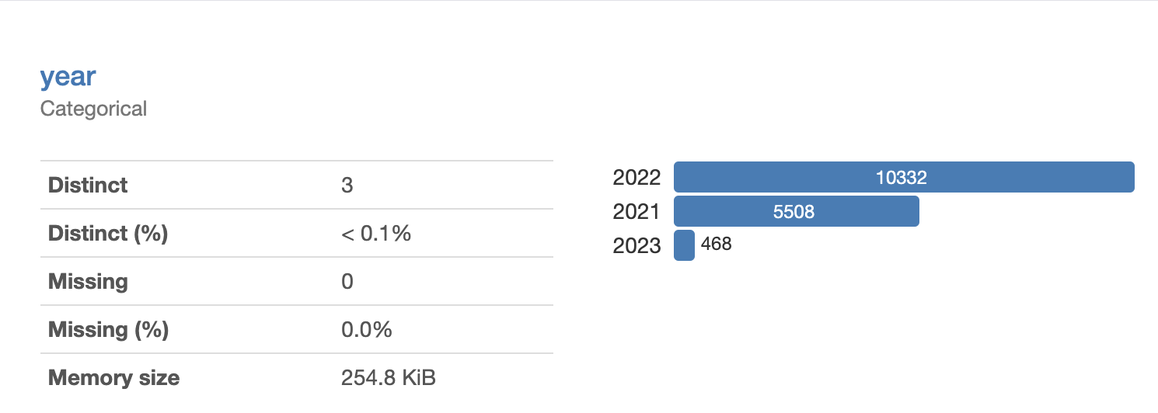
Exploratory Data Analysis
Hereby analysis on the data was performed from which it got concluded that the dataset was unequally distributed.
In the figure shown, it can be noted that the available data is time series one and also the data for each year varied.
Therefore, if we work on time series model with this data, it will cause a problem in analysis.

Slide 6
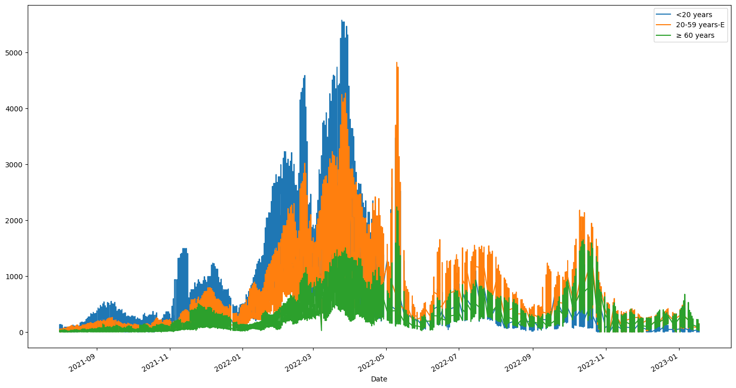

Slide 7
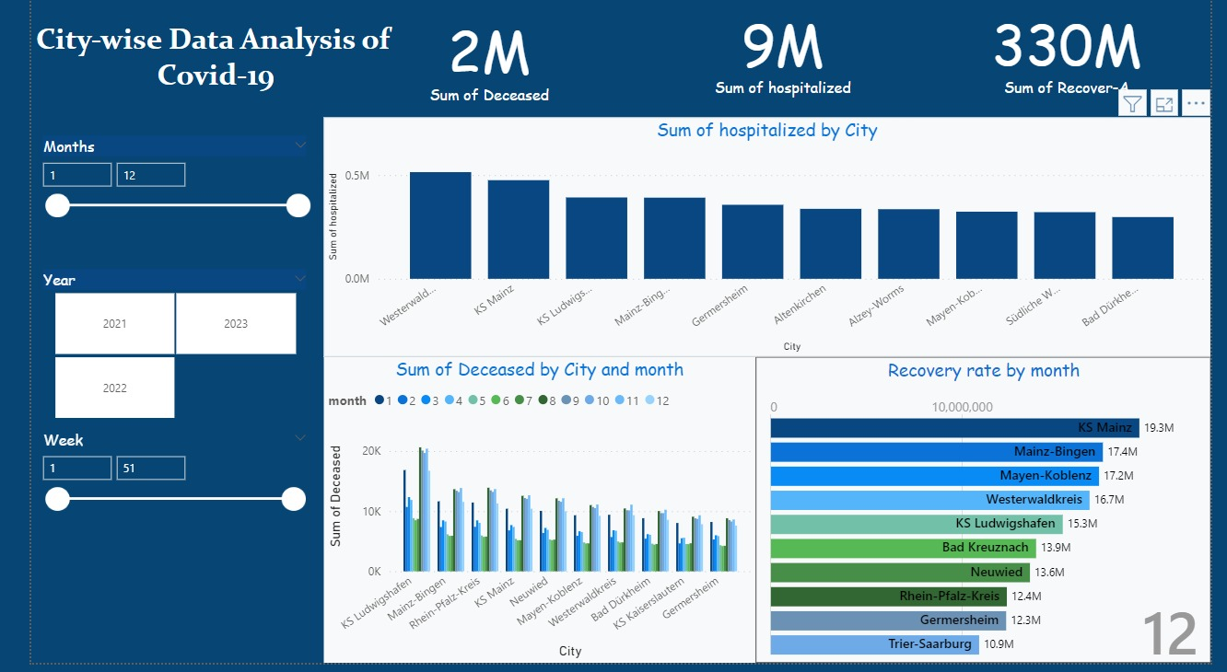
Data Analysis with Power BI

Slide 8
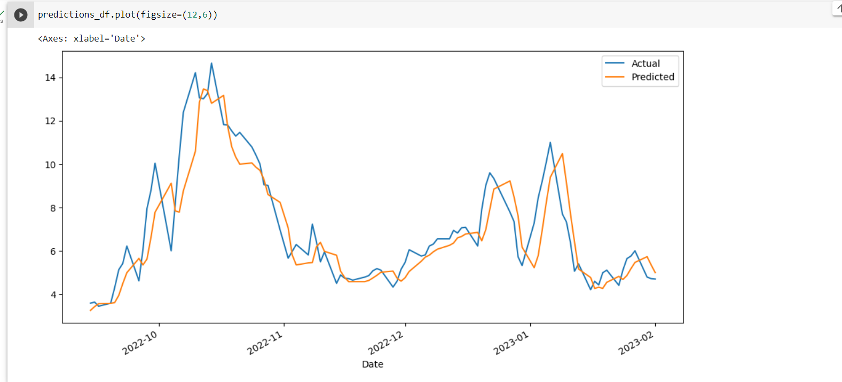
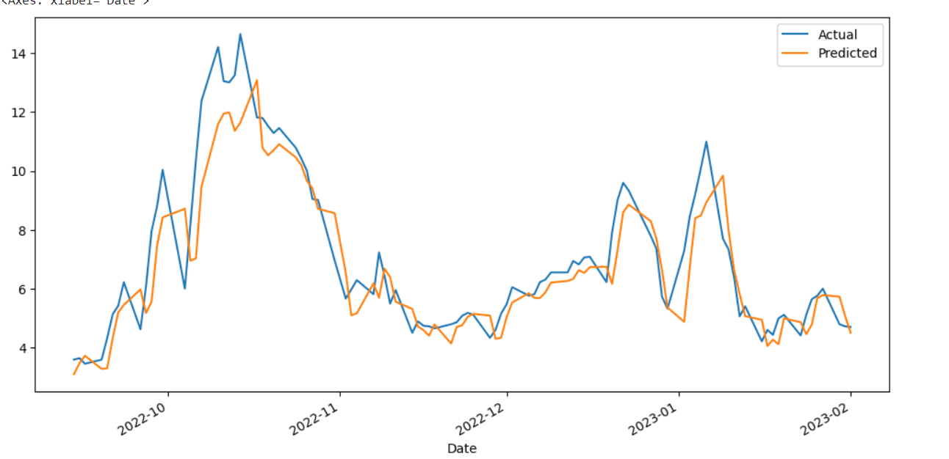
Forecasting (LSTM VS Neural Network)
- Forecasting 7 day Hospitalization Incidence based on 349 data
LSTM visualization
Neural network visualization

Slide 9
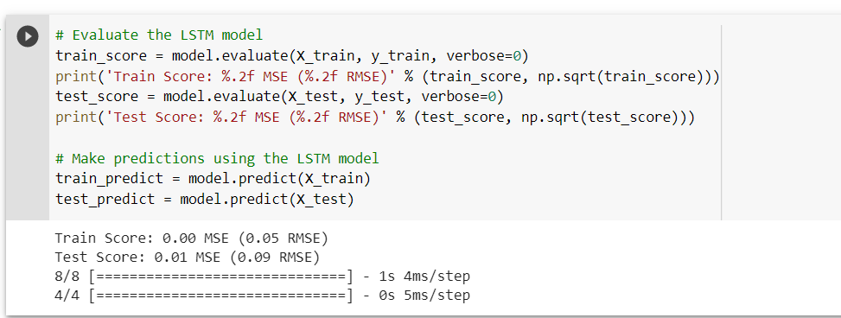
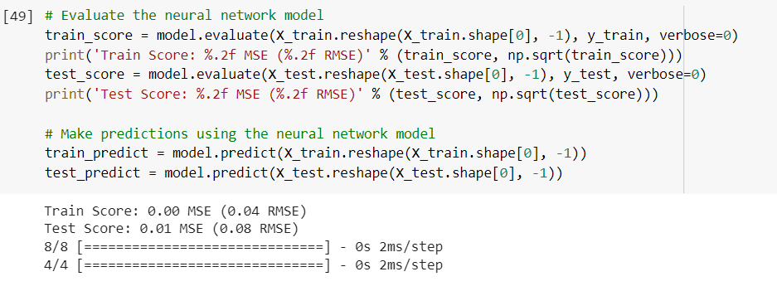


Evaluation Metrics : LSTM VS Neural Network 7 day hospitalization incidence data

Slide 10
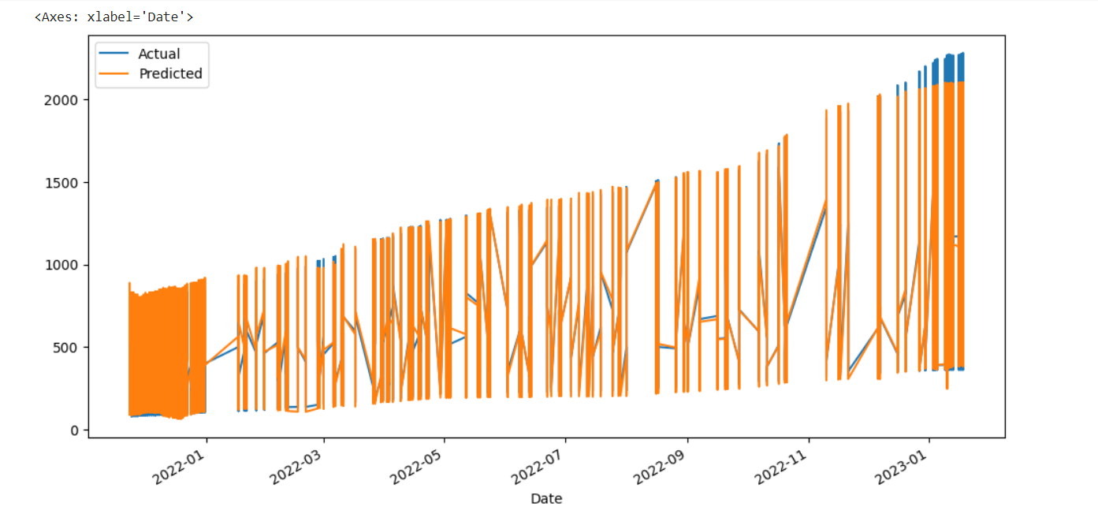
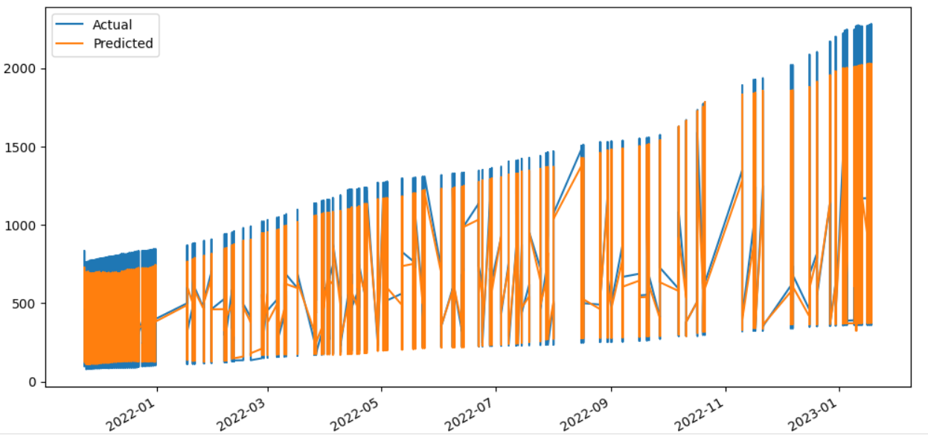
Forecasting (LSTM VS Neural Network)
- Forecasting hospitalization on 16,308 data (2021-10-01 to 2023-01-13)
LSTM visualization for hospitalization cases for actual and predicted value
Neural Network visualization for hospitalization cases for actual and predicted value

Slide 11
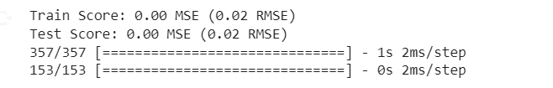
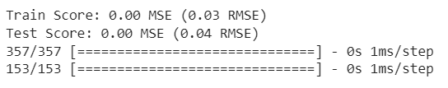
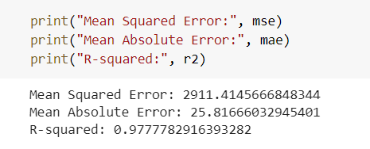

Evaluation Metrics : LSTM VS Neural Network
- Evaluation for hospitalization data
Neural Network Model
LSTM Model

Slide 12
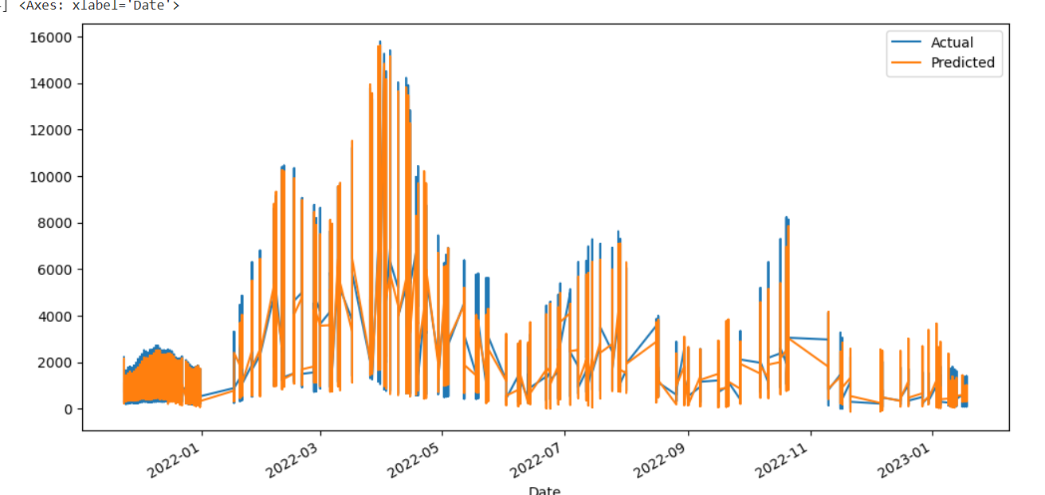
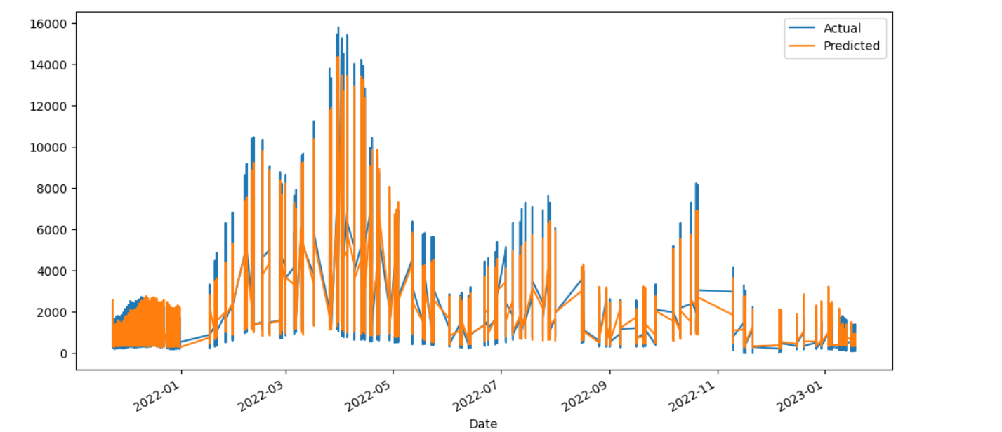
Forecasting (LSTM VS Neural Network)
- Forecasting current covid cases on 16308 data
LSTM visualization for Current covid cases for actual and predicted value
Neural Network visualization for current covid cases for actual and predicted value

Slide 13
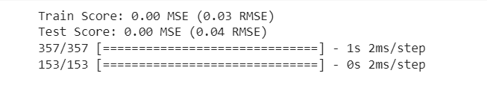
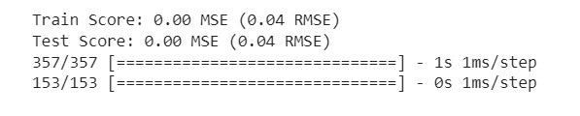


Evaluation Metrics : LSTM VS Neural Network
- Current covid cases evaluation
LSTM Model Evaluation
Neural Network Model Evaluation

Slide 14
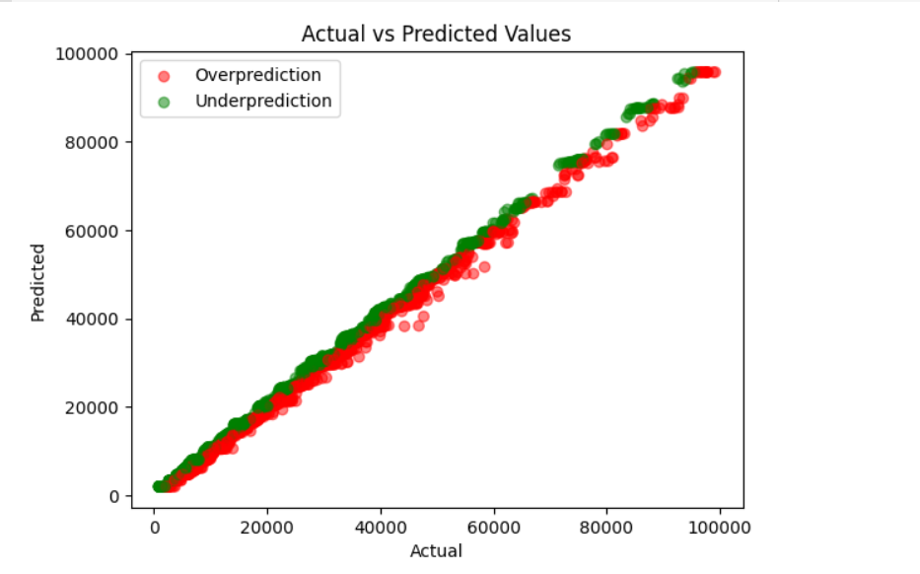
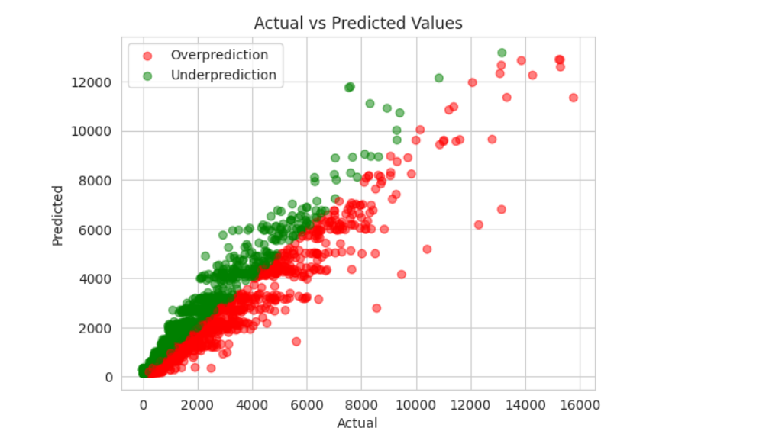
Forecasting (Random Forest Regressor Model)
Data Visualization between actual and predicted value for total reported covid cases
Data Visualization between actual and predicted value for current covid cases

Slide 15
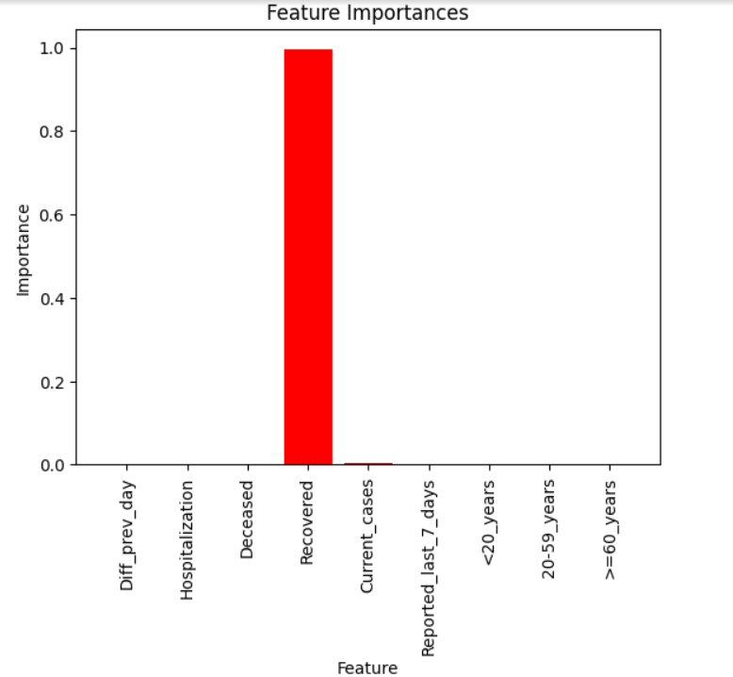
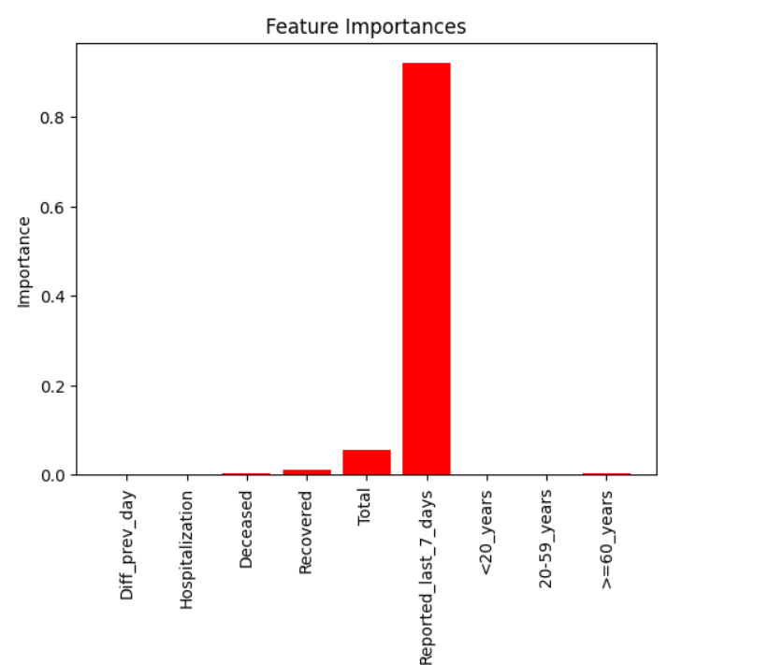
Feature Importance
Important features for predicting Total covid cases
Important features for predicting current covid cases

Slide 16
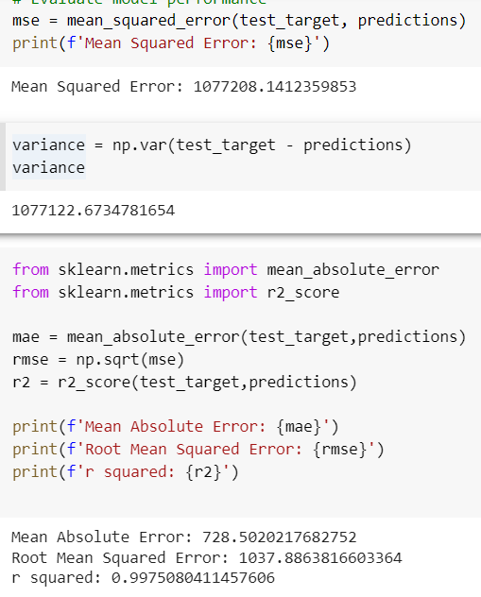
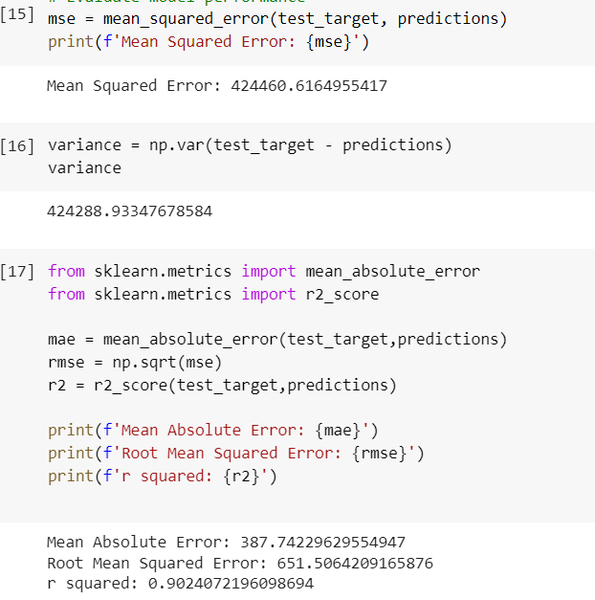
Evaluation Metrics : Random Forest Regressor
Total Covid Cases
Current Covid Cases

Slide 17
Thank You

