Slide 1
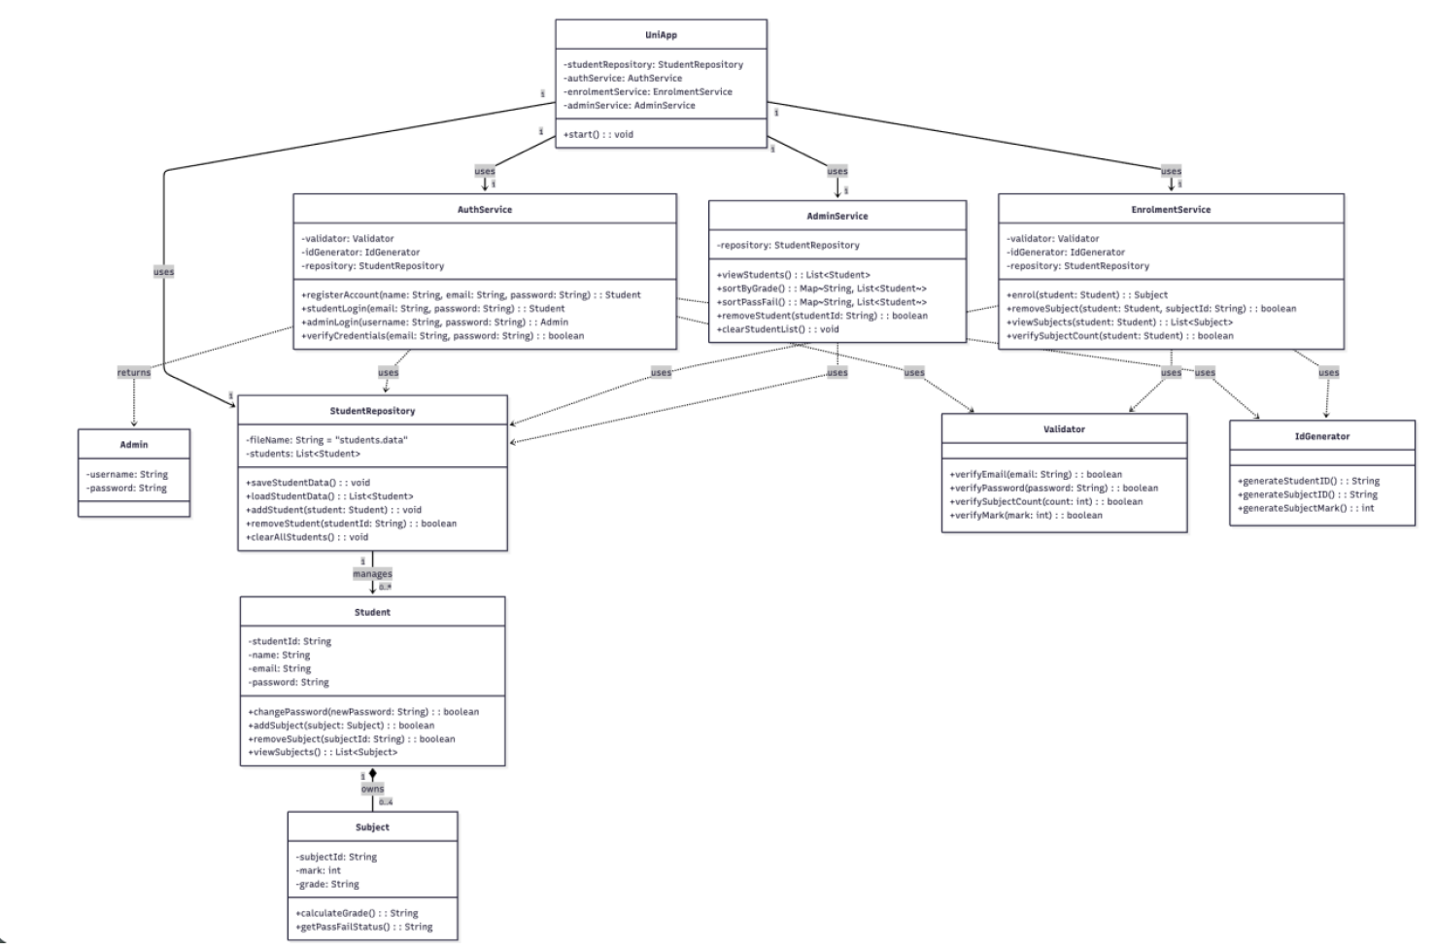

Slide 2
Main Class / GUI
University
System
GUI APP
Varun
Main()
CLI / Controller Classes
Siddhart
University
Controller
Student Controller
Subject
Controller
Admin
Controller
Admin
Student
Exit
Login
Register
Exit
Change
Enroll
Remove
View
Exit
Clear database
Group students
Partition students
Remove students
Show
exit
System Classes
Mathis
Shiva
Student
Repository
Database
(.data file)
Student
Validator
Subject
ID Generator

Slide 3
Responsible:
Varun
Siddhart
Mathis
Shiva
Main / GUI
UniversitySystem
GUI App
CLI / Controllers
created on login
UniversityController
AdminController
StudentController
SubjectController
System
StudentRepository
Database
JSON file
list
Student
Validator
list
Subject
IDGenerator
Core classes
Utils & Persistence
Notes:
1

