Slide 1

PREDICTION MODELS BASED ON MAX-STEMS (or harnessing imbalanced data) Episode Four: Advanced Examinations
Ahmet Furkan EMREHAN
(matahmet@gmail.com)

Slide 2
PREDICTION MODELS BASED ON MAX-STEMS
Episode One: One-Word Based
Episode Two: A Combinatorial Approach
Episode Three: Effect of Hyperparameters
Episode Four: Advanced Examinations

Slide 3
INTRODUCTION
In this chapter, I examine some cases:
A) How do Accuracy Rates of Categories change, if the sample is changed ?
B) Let’s compare all methods for each category
C) Can a Trigonometric Approach contribute to hyperparametic model ?

Slide 4
A) How do Accuracy Rates of Categories change, if the sample is changed ? (Based on Predict Model 1 (On Word))
Accuracy Rates of Cateagories
Sample | DÜNYA | SPOR | SANAT | Teknoloji
1 | 0.791 | 0.167 | 0.029 | 0.013
2 | 0.798 | 0.166 | 0.025 | 0.012
3 | 0.783 | 0.181 | 0.023 | 0.013
4 | 0.794 | 0.169 | 0.024 | 0.013
5 | 0.792 | 0.172 | 0.024 | 0.012
6 | 0.793 | 0.175 | 0.024 | 0.009
7 | 0.797 | 0.172 | 0.022 | 0.010
8 | 0.809 | 0.159 | 0.022 | 0.010
9 | 0.793 | 0.175 | 0.024 | 0.009
10 | 0.797 | 0.172 | 0.022 | 0.010
Result: Stable against samples
Note: Naturally Samples insersect wit each other at %80 level.

Slide 5
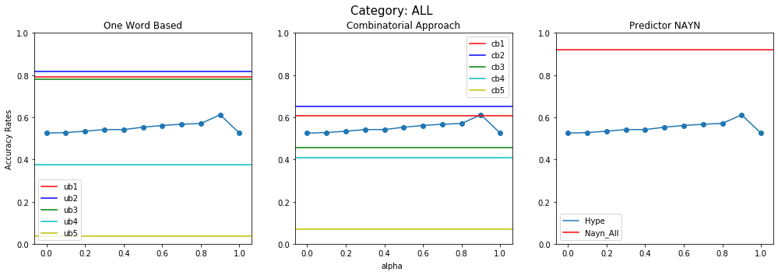
B) Let’s compare all methods for each category

Slide 6
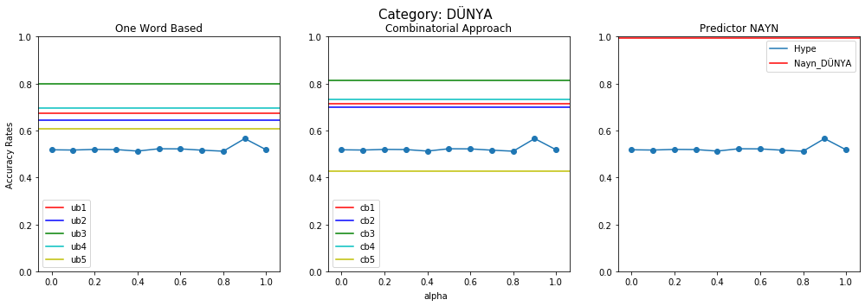
B) Let’s compare all methods for each category

Slide 7
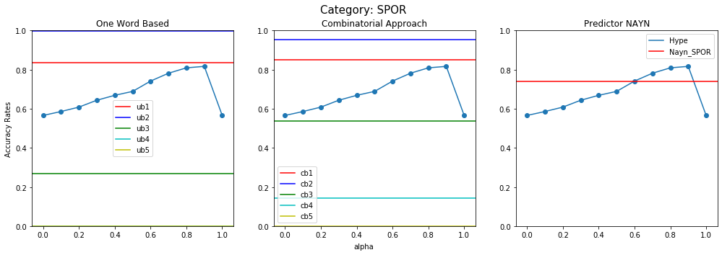
B) Let’s compare all methods for each category

Slide 8
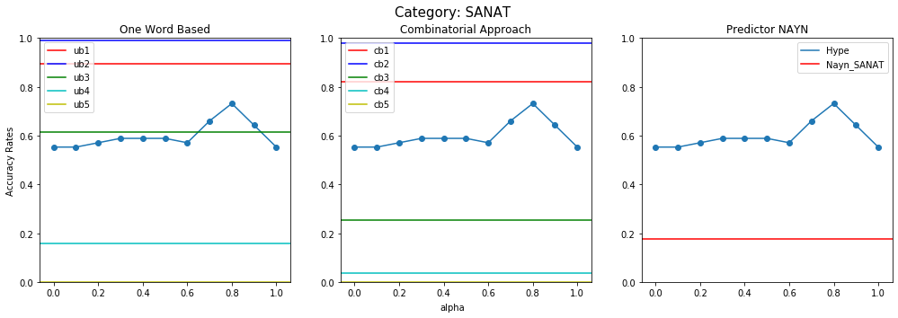
B) Let’s compare all methods for each category

Slide 9
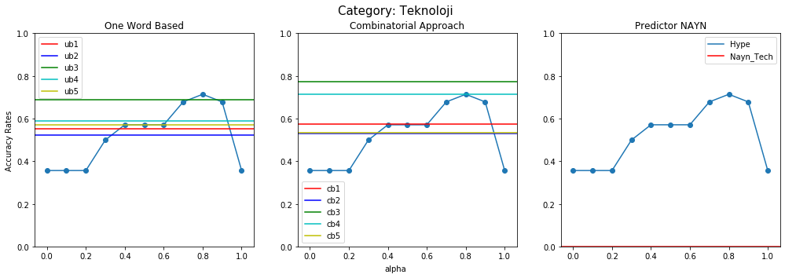
B) Let’s compare all methods for each category

Slide 10
B) Let’s compare all methods for each category
Conclusion:
Whereas NAYN predictor is successful at predicting documents labelled with «DÜNYA», other prediction models (one stems and combinatorial approach) is more successful at predicting documents labelled with other categories.

Slide 11

C) Can a Trigonometric Approach contribute to hyperparametic model ?
In this section we use trigonometric approach to hyperparameters such that
$$α=\sin\left(θ\right)and β=\cos\left(θ\right)where θ∈\left[0,\frac{π}{2}\right]$$

Slide 12


General Scheme for Application of Trigonometric Approach to Prediction Models with hyperparameter
X_test
$${doc}_{i}$$
${doc}_{i}=lower({doc}_{i}$)
${doc}_{i}=clean({doc}_{i}$)
${token}_{i}=clean({doc}_{i}$)
Predictions
$$Σ_{i1}^{p},Π_{i1}^{p},Λ_{i1},λ_{i1}$$
Analyze_doc
$${stem}_{i1}$$
${stems}_{i}=max⁡_stems({token}_{i}$)
$$Σ_{i2}^{p},Π_{i2}^{p},Λ_{i2},λ_{i2}$$
$${stem}_{i2}$$
.
.
.
.
.
.
Turkish Stem List (32001 stems)
(for application)
$$Σ_{im_{i}}^{p},Π_{im_{i}}^{p},Λ_{im_{i}},λ_{im_{i}}$$
$${stem}_{im_{i} }$$
$$α=\sin\left(θ\right),β=cos⁡(θ)$$
X_train, y_train
$$θ$$
Step2_Preprocess_word.ipynb
Step3_Classifier_V10.ipynb
Evaluations (accuracy, confusion etc.)
y_test
Step4_Prediction_Models_ub.ipynb
Step5_Trigonometric_Approach_for_
Models_with_HyperParameters_Create.ipynb

Slide 13
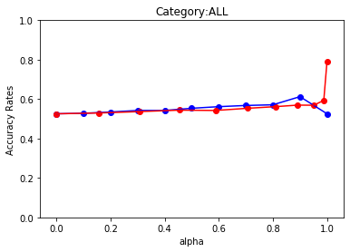
C) Can a Trigonometric Approach contribute to hyperparametic model ?
Results

Slide 14
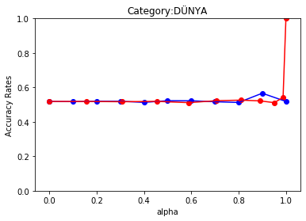
C) Can a Trigonometric Approach contribute to hyperparametic model ?

Slide 15
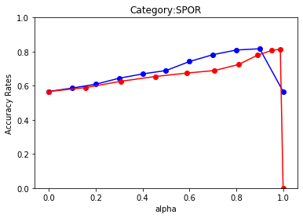
C) Can a Trigonometric Approach contribute to hyperparametic model ?

Slide 16
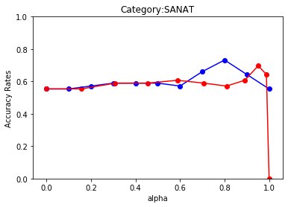
C) Can a Trigonometric Approach contribute to hyperparametic model ?

Slide 17
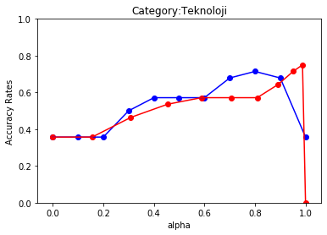
C) Can a Trigonometric Approach contribute to hyperparametic model ?

Slide 18
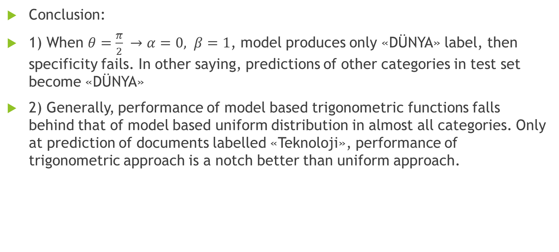
C) Can a Trigonometric Approach contribute to hyperparametic model ?
Conclusion:
1) When $θ=\frac{π}{2} →α=0, β=1$, model produces only «DÜNYA» label, then specificity fails. In other saying, predictions of other categories in test set become «DÜNYA»
2) Generally, performance of model based trigonometric functions falls behind that of model based uniform distribution in almost all categories. Only at prediction of documents labelled «Teknoloji», performance of trigonometric approach is a notch better than uniform approach.

Slide 19
THE END

