Slide 1

PREDICTION MODELS BASED ON MAX-STEMS (or harnessing imbalanced data) Episode Two: A Combinatorial Approach
Ahmet Furkan EMREHAN
(matahmet@gmail.com)

Slide 2
MOTIVATION
This study is an extension of previous study (chapter one) with combinatiorial approach.
In chapter one, I examine five models using distribution of stems separately. Combination of stems with s-elements have a potential to help efficient prediction. Because documents including comination of stems may be semantically closer than one stem based prediction (defined in chapter one).

Slide 3
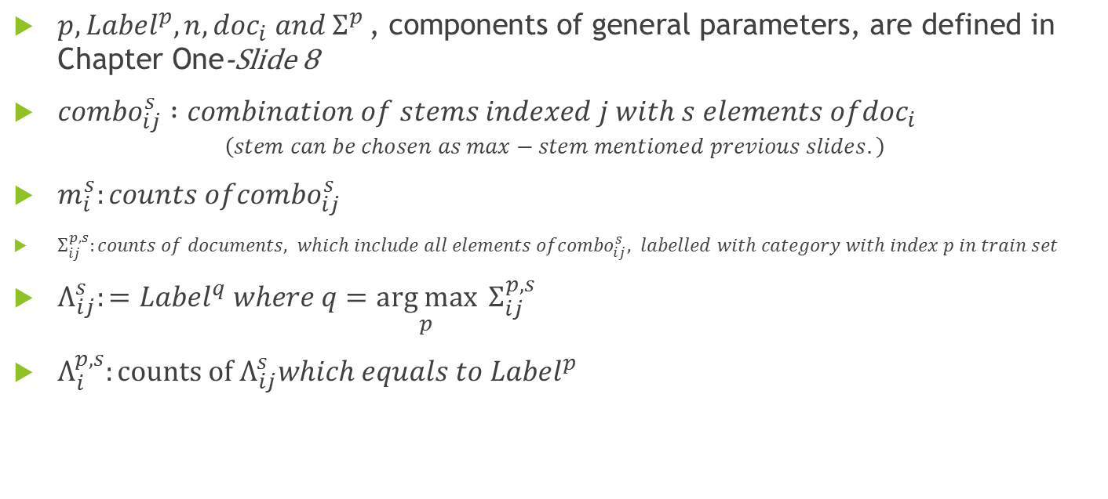
ADAPTATION OF COMPONENTS OF MODELS
$p, {Label}^{p},n, {doc}_{i} and Σ^{p }\text{, }\text{components} \text{of} \text{general} \text{parameters}\text{, }\text{are} \text{defined} \text{in} \text{Chapter} \text{One}\text{−}\text{Slide}\text{ 8}$
${combo}_{ij}^{s} :combination of stems indexed j with s elements of{doc}_{i}$
$$\left(stem can be chosen as max−stem mentioned previous slides.\right)$$
$m_{i}^{s}:counts of{combo}_{ij}^{s}$
$Σ_{ij}^{p,s}:counts of documents, which include all elements of{combo}_{ij}^{s}, labelled with category with index p in train set$
$Λ_{ij}^{s}:={Label}^{q} where q=\underset{p}{arg max}{{ Σ}_{ij}^{p,s}}$
$Λ_{i}^{p,s}:counts of Λ_{ij}^{s}which equals to {Label}^{p}$

Slide 4
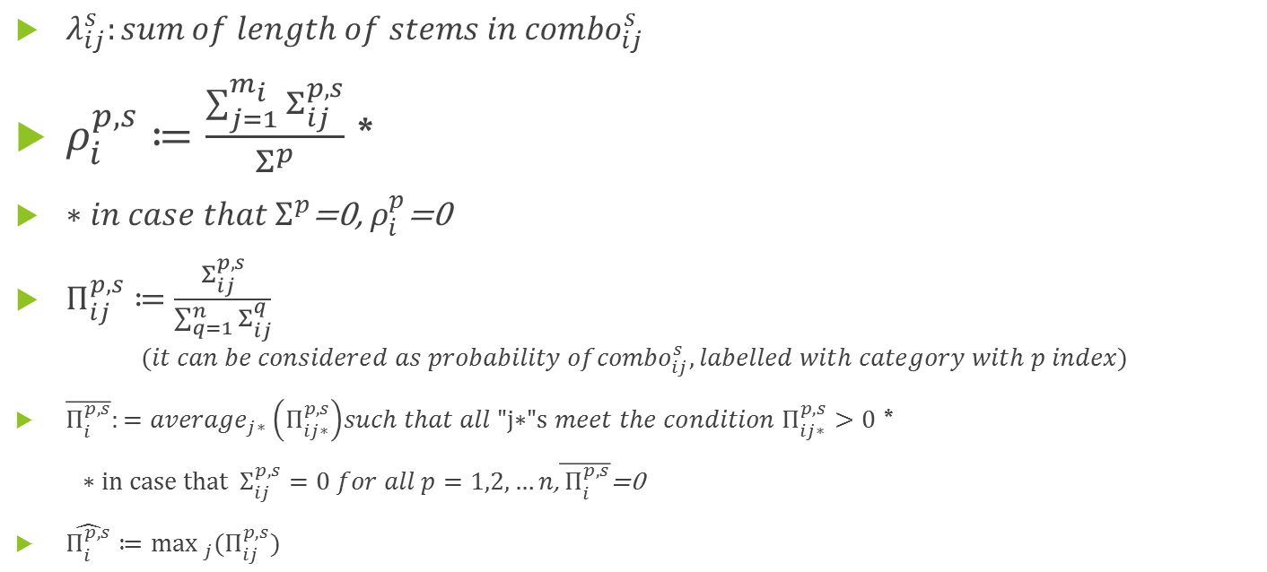
ADAPTATION OF COMPONENTS OF MODELS
$λ_{ij}^{s}:sum of length of stems in{ combo}_{ij}^{s}$
$ρ_{i}^{p,s}≔\frac{\sum_{j=1}^{m_{i}}{Σ_{ij}^{p,s}}}{Σ^{p}}$ *
$∗{in case that Σ}^{p}$=0, $ρ_{i}^{p}$=0
$Π_{ij}^{p,s}≔\frac{Σ_{ij}^{p,s}}{\sum_{q=1}^{n}{Σ_{ij}^{q}}}$
$$(it can be considered as probability of{combo}_{ij}^{s},labelled with category with p index)$$
$\overline{Π_{i}^{p,s}}:={average}_{j∗} \left(Π_{ij∗}^{p,s}\right)such that all \text{"}\text{j}\text{∗"}\text{s} meet the condition Π_{ij∗}^{p,s}>0$ *
$∗in case that{ Σ}_{ij}^{p,s}=0 for all p=1,2,…n$,$\overline{{ Π}_{i}^{p,s}}$=0
$\hat{Π_{i}^{p,s}}≔\max_{j}(Π_{ij}^{p,s})$

Slide 5

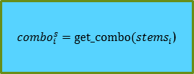
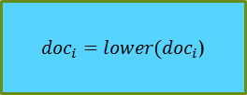



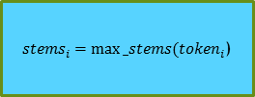

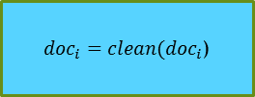

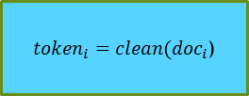

General Scheme for Prediction Models with Combinatorial Approach
X_test
$${doc}_{i}$$
${doc}_{i}=lower({doc}_{i}$)
${doc}_{i}=clean({doc}_{i}$)
${token}_{i}=clean({doc}_{i}$)
Predictions
With
Combinatiorial
Approach
$$Σ_{i1}^{p,s},Π_{i1}^{p,s},Λ_{i1}^{s},λ_{i1}^{s}$$
Analyze_word_s
$${{combo}_{i}}_{i1}$$
${combo}_{i}^{s}=get_combo({stems}_{i}$)
${stems}_{i}=max⁡_stems({token}_{i}$)
$$Σ_{i2}^{p,s},Π_{i2}^{p,s},Λ_{i2}^{s},λ_{i2}^{s}$$
$${{combo}_{i}}_{i2}$$
.
.
.
.
.
.
$$Σ_{im_{i}}^{p,s},Π_{im_{i}}^{p,s},,Λ_{im_{i}^{s}}^{s},λ_{im_{i}^{s}}^{s}$$
$${{combo}_{i}}_{im_{i}^{s}}$$
X_train, y_train
Evaluations (accuracy, confusion etc.)
y_test

Slide 6

Model 1
${predict_cb}_{1}\left({doc}_{i},s\right)=\left\{\begin{aligned}{Label}^{q} if{ Σ}_{ij}^{p,s}=0<{ Σ}_{ij}^{q,s} for all p≠q \\ {Label}^{q} where q=\arg{2nd \max_{p}{ Λ}_{i}^{p,s}otherwise}∗\end{aligned}\right\}$
$$∗in case that q is not uniqe, q is chosen as the minimum index meeting the condition$$

Slide 7

Model 2
${predict_cb}_{2}\left({doc}_{i},s\right)={Label}^{q} where q=\arg{\max_{p}}ρ_{i}^{p,s}$

Slide 8

Model 3
${predict_cb}_{3}\left({doc}_{i},s\right)={Label}^{q} where q=\arg{\max_{p}\overline{Π_{i}^{p,s}}}$

Slide 9

Model 4
${predict_cb}_{4}\left({doc}_{i},s\right)={Label}^{q} where q=\arg{\max_{p}\hat{Π_{i}^{p,s}}}$
$$∗in case that q is not uniqe, q is chosen as the minimum index meeting the condition$$

Slide 10

Model 5
${predict_cb}_{5}\left({doc}_{i},s\right)={Label}^{q} where q=\arg{\max_{p}}(\max_{j}\left(λ_{ij}∗\frac{Σ_{ij}^{p}}{Σ^{p}}\right))$

Slide 11

A Trivial Result
${predict_cb}_{k}\left({doc}_{i},1\right)={predict}_{k}\left({doc}_{i}\right) for k=1,2,…,5$
Moreover all parameters in case $s=1,$ equal to corresponding parameters in chapter one (slides 8-10) For example $m_{i}^{s}=m_{i},Σ_{ij}^{p,1}=Σ_{ij}^{p}$ and $\overline{Π_{i}^{p,1}}=\overline{Π_{i}^{p}}$.

Slide 12
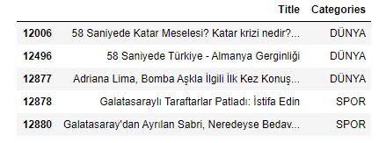
Application (introduction)
We use data of «nayn.co» a news portal in Turkish Language. Data is imported by url «"https://raw.githubusercontent.com/naynco/nayn.data/master/classification_clean.csv"» as done in chapter one.
Head of data is presented below
There are 11622 documents («Title» column) with label («DÜNYA» (World), «SPOR» (Sports), «SANAT»(Art) and «Teknoloji»(Technology)). But data is imbalanced in favor of category «DÜNYA» such that the counts [and percentages] of categories 9226[%79] ,1967 [%17],285 [%2] and 144 [%1] respectively.

Slide 13

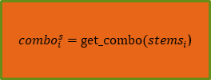
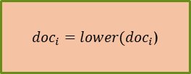



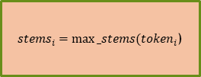

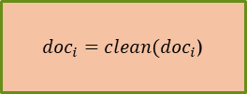

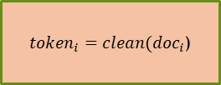

General Scheme for Application of Prediction Models with Combinatorial Approach
X_test
$${doc}_{i}$$
${doc}_{i}=lower({doc}_{i}$)
${doc}_{i}=clean({doc}_{i}$)
${token}_{i}=clean({doc}_{i}$)
Predictions
With
Combinatiorial
Approach
$$Σ_{i1}^{p,s},Π_{i1}^{p,s},Λ_{i1}^{s},λ_{i1}^{s}$$
Analyze_word_s
$${{combo}_{i}}_{i1}$$
${combo}_{i}^{s}=get_combo({stems}_{i}$)
${stems}_{i}=max⁡_stems({token}_{i}$)
$$Σ_{i2}^{p,s},Π_{i2}^{p,s},Λ_{i2}^{s},λ_{i2}^{s}$$
$${{combo}_{i}}_{i2}$$
.
.
.
.
.
.
Turkish Stem List (32001 stems)
(for application)
$$Σ_{im_{i}}^{p,s},Π_{im_{i}}^{p,s},,Λ_{im_{i}^{s}}^{s},λ_{im_{i}^{s}}^{s}$$
$${{combo}_{i}}_{im_{i}^{s}}$$
X_train, y_train
Step2_Preprocess_word.ipynb
Step3_Classifier_V10.ipynb
Evaluations (accuracy, confusion etc.)
y_test
Step4_Prediction_Models_cb.ipynb
Step6_Run_Integrated_Model_cb.ipynb

Slide 14
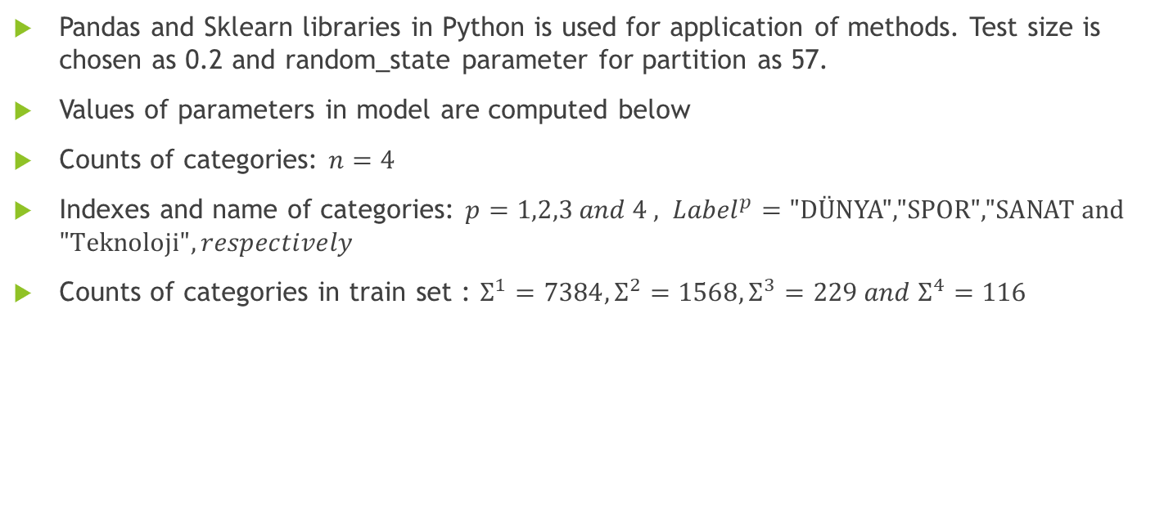
Application (computations)
Pandas and Sklearn libraries in Python is used for application of methods. Test size is chosen as 0.2 and random_state parameter for partition as 57.
Values of parameters in model are computed below
Counts of categories: $n=4$
Indexes and name of categories: $p=1,2,3 and 4 , {Label}^{p}=\text{"}\text{D}\text{Ü}\text{NYA}\text{","}\text{SPOR}\text{","}\text{SANAT} \text{and}\text{ "}\text{Teknoloji}", respectively$
Counts of categories in train set : $Σ^{1}=7384,Σ^{2}=1568,Σ^{3}=229 and{ Σ}^{4}=116$

Slide 15

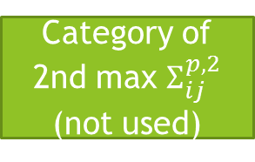


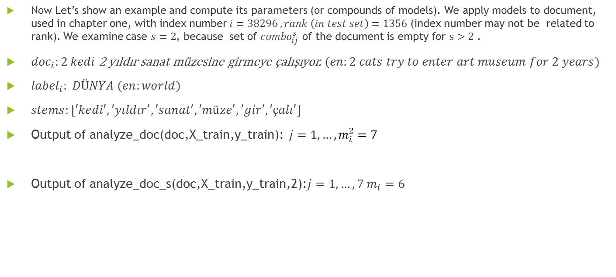



Application (computations)
Now Let’s show an example and compute its parameters (or compounds of models). We apply models to document, used in chapter one, with index number $i=38296 , rank \left(in test set\right)=1356$ (index number may not be related to rank). We examine case $s=2$, because set of ${combo}_{ij}^{s}$ of the document is empty for $s>2$ .
${doc}_{i}:2 kedi$ 2 yıldır sanat müzesine girmeye çalışıyor. $(en:2 cats try to enter art museum for 2 years)$
${label}_{i}: DÜNYA (en:world)$
$stems:[′kedi′, ′yıldır′, ′sanat′, ′müze′, ′gir′, ′çalı′]$
Output of analyze_doc(doc,X_train,y_train): $j=1,…{,m}_{i}^{2}=7$
Output of analyze_doc_s(doc,X_train,y_train,2):$j=1,…,7 m_{i}=6$
$${combo}_{ij}^{2}$$
$$λ_{ij}^{2}$$
$$Σ_{ij}^{p,2}$$
$$Π_{ij}^{p,2}$$
$$Λ_{i}^{p,2}$$
Category of 2nd max $Σ_{ij}^{p,2}$
(not used)

Slide 16
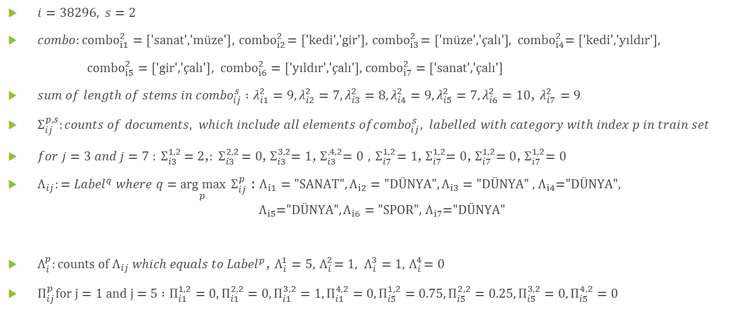
Application (computations)
$i=38296, s=2$
$combo:{combo}_{i1}^{2}=\text{[′}\text{sanat}\text{′,′}\text{m}\text{ü}\text{ze}\text{′]}, { combo}_{i2}^{2}=\text{[′}\text{kedi}\text{′,′}\text{gir}\text{′]}, { combo}_{i3}^{2}=\text{[′}\text{m}\text{ü}\text{ze}\text{′,′ç}\text{al}\text{ı′]}$, ${ combo}_{i4}^{2}=\text{[′}\text{kedi}\text{′,′}\text{y}\text{ı}\text{ld}\text{ı}\text{r}\text{′]}$,
${combo}_{i5}^{2}=\text{[′}\text{gir}\text{′,′ç}\text{al}\text{ı′]}, { combo}_{i6}^{2}=\text{[′}\text{y}\text{ı}\text{ld}\text{ı}\text{r}\text{′,′ç}\text{al}\text{ı′],} { combo}_{i7}^{2}=\text{[′}\text{sanat}\text{′,′ç}\text{al}\text{ı′]}$
$sum of length of stems in{ combo}_{ij}^{s} :λ_{i1}^{2}=9, λ_{i2}^{2}=7,λ_{i3}^{2}=8,λ_{i4}^{2}=9,λ_{i5}^{2}=7,λ_{i6}^{2}=10$, $λ_{i7}^{2}=9$
$Σ_{ij}^{p,s}:counts of documents, which include all elements of{combo}_{ij}^{s}, labelled with category with index p in train set$
$for j=3 and j=7 {: Σ}_{i3}^{1,2}=2$,${: Σ}_{i3}^{2,2}=0$,${ Σ}_{i3}^{3,2}=1$,${ Σ}_{i3}^{,4,2}=0$ $,{ Σ}_{i7}^{1,2}=1$,${ Σ}_{i7}^{1,2}=0$,${ Σ}_{i7}^{1,2}=0$,${ Σ}_{i7}^{1,2}=0$
$Λ_{ij}:={Label}^{q} where q=\underset{p}{arg max}{{ Σ}_{ij}^{p}}$ : $Λ_{i1}=\text{"}\text{SANAT}\text{"},Λ_{i2}=\text{"}\text{D}\text{Ü}\text{NYA}",Λ_{i3}=\text{"}\text{D}\text{Ü}\text{NYA}\text{" ,}{ Λ}_{i4}\text{="}\text{D}\text{Ü}\text{NYA}",$
$${{ Λ}_{i5}\text{="}\text{D}\text{Ü}\text{NYA}",Λ}_{i6}=\text{"}\text{SPOR}\text{",}{ Λ}_{i7}\text{="}DÜNYA"$$
$Λ_{i}^{p}:counts of{ Λ}_{ij} which equals to {Label}^{p}$, $Λ_{i}^{1}=5,{ Λ}_{i}^{2}=1, Λ_{i}^{3}=1,{ Λ}_{i}^{4}=0$
$Π_{ij}^{p}for j=1 and j=5 :Π_{i1}^{1,2}=0,Π_{i1}^{2,2}=0,Π_{i1}^{3,2}=1,Π_{i1}^{4,2}=0,Π_{i5}^{1,2}=0.75,Π_{i5}^{2,2}=0.25,Π_{i5}^{3,2}=0,Π_{i5}^{4,2}=0$

Slide 17

Application (computations)
$ρ_{i}^{p}: ρ_{i}^{1}=\frac{8}{7384}=0.001$, $ρ_{i}^{2}=\frac{3}{1568}=0.002,ρ_{i}^{3}=\frac{3}{229}=0.\text{013}\text{, }ρ_{i}^{4}=\frac{0}{116}=0$
$\overline{Π_{i}^{p}}:$ $\overline{Π_{i}^{1}}=\frac{1+0.67+1+0.75+1}{4}=0.884, \overline{Π_{i}^{2}}=\frac{0.25+1}{2}=0.625, \overline{Π_{i}^{3}}=\frac{1+0.33}{2}=0.665, \overline{ Π_{i}^{4}}=0$
$\hat{Π_{i}^{p}}: \hat{Π_{i}^{1}}=1,$ $\hat{Π_{i}^{2}}=1$, $\hat{Π_{i}^{3}}=1,$ $\hat{Π_{i}^{4}}=0$

Slide 18

Application (Predictions)
$for i=38296$
${predict_cb}_{1}\left({doc}_{i},2\right)=SPOR$
${predict_cb}_{2}\left({doc}_{i},2\right)=SANAT$
${predict_cb}_{3}\left({doc}_{i},2\right)=DÜNYA$
${predict_cb}_{4}\left({doc}_{i},2\right)=DÜNYA$
${predict_cb}_{5}\left({doc}_{i},2\right)=SANAT$

Slide 19
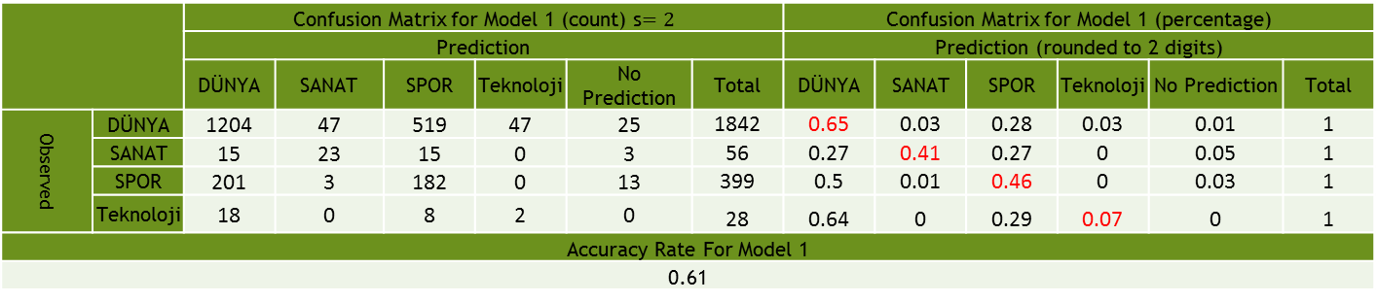
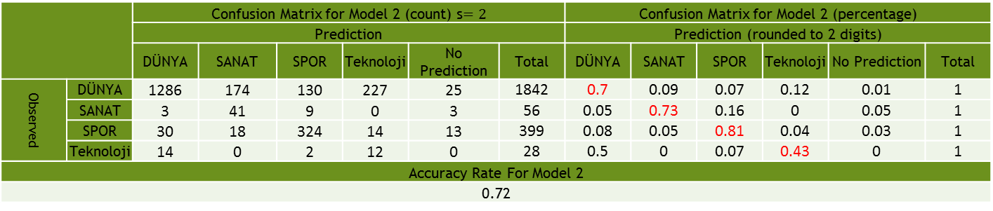
Application (Results)
 |  | Confusion Matrix for Model 1 (count) s$=2$ |  |  |  |  |  | Confusion Matrix for Model 1 (percentage)
 |  | Prediction |  |  |  |  |  | Prediction (rounded to 2 digits)
 |  | DÜNYA | SANAT | SPOR | Teknoloji | No Prediction | Total | DÜNYA | SANAT | SPOR | Teknoloji | No Prediction | Total
Observed | DÜNYA | 1204 | 47 | 519 | 47 | 25 | 1842 | 0.65 | 0.03 | 0.28 | 0.03 | 0.01 | 1
 | SANAT | 15 | 23 | 15 | 0 | 3 | 56 | 0.27 | 0.41 | 0.27 | 0 | 0.05 | 1
 | SPOR | 201 | 3 | 182 | 0 | 13 | 399 | 0.5 | 0.01 | 0.46 | 0 | 0.03 | 1
 | Teknoloji | 18 | 0 | 8 | 2 | 0 | 28 | 0.64 | 0 | 0.29 | 0.07 | 0 | 1
Accuracy Rate For Model 1
0.61
 |  | Confusion Matrix for Model 2 (count) s$=2$ |  |  |  |  |  | Confusion Matrix for Model 2 (percentage)
 |  | Prediction |  |  |  |  |  | Prediction (rounded to 2 digits)
 |  | DÜNYA | SANAT | SPOR | Teknoloji | No Prediction | Total | DÜNYA | SANAT | SPOR | Teknoloji | No Prediction | Total
Observed | DÜNYA | 1286 | 174 | 130 | 227 | 25 | 1842 | 0.7 | 0.09 | 0.07 | 0.12 | 0.01 | 1
 | SANAT | 3 | 41 | 9 | 0 | 3 | 56 | 0.05 | 0.73 | 0.16 | 0 | 0.05 | 1
 | SPOR | 30 | 18 | 324 | 14 | 13 | 399 | 0.08 | 0.05 | 0.81 | 0.04 | 0.03 | 1
 | Teknoloji | 14 | 0 | 2 | 12 | 0 | 28 | 0.5 | 0 | 0.07 | 0.43 | 0 | 1
Accuracy Rate For Model 2
0.72

Slide 20
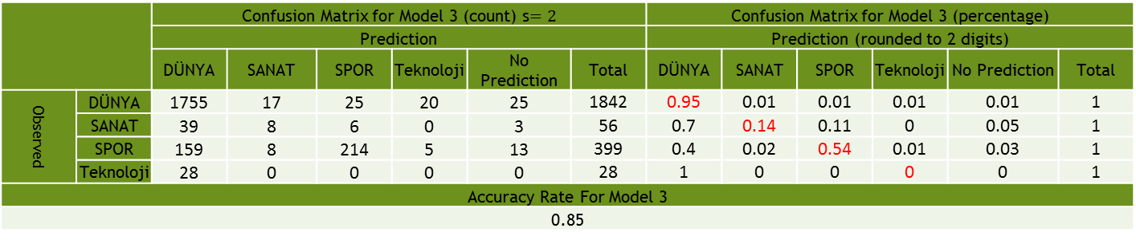

Application (Results)
 |  | Confusion Matrix for Model 3 (count) s$=2$ |  |  |  |  |  | Confusion Matrix for Model 3 (percentage)
 |  | Prediction |  |  |  |  |  | Prediction (rounded to 2 digits)
 |  | DÜNYA | SANAT | SPOR | Teknoloji | No Prediction | Total | DÜNYA | SANAT | SPOR | Teknoloji | No Prediction | Total
Observed | DÜNYA | 1755 | 17 | 25 | 20 | 25 | 1842 | 0.95 | 0.01 | 0.01 | 0.01 | 0.01 | 1
 | SANAT | 39 | 8 | 6 | 0 | 3 | 56 | 0.7 | 0.14 | 0.11 | 0 | 0.05 | 1
 | SPOR | 159 | 8 | 214 | 5 | 13 | 399 | 0.4 | 0.02 | 0.54 | 0.01 | 0.03 | 1
 | Teknoloji | 28 | 0 | 0 | 0 | 0 | 28 | 1 | 0 | 0 | 0 | 0 | 1
Accuracy Rate For Model 3
0.85
 |  | Confusion Matrix for Model 4 (count) s$=2$ |  |  |  |  |  | Confusion Matrix for Model 4 (percentage)
 |  | Prediction |  |  |  |  |  | Prediction (rounded to 2 digits)
 |  | DÜNYA | SANAT | SPOR | Teknoloji | No Prediction | Total | DÜNYA | SANAT | SPOR | Teknoloji | No Prediction | Total
Observed | DÜNYA | 1805 | 3 | 7 | 2 | 25 | 1842 | 0.98 | 0 | 0 | 0 | 0.01 | 1
 | SANAT | 47 | 2 | 4 | 0 | 3 | 56 | 0.84 | 0.04 | 0.07 | 0 | 0.05 | 1
 | SPOR | 284 | 0 | 102 | 0 | 13 | 399 | 0.71 | 0 | 0.26 | 0 | 0.03 | 1
 | Teknoloji | 28 | 0 | 0 | 0 | 0 | 28 | 1 | 0 | 0 | 0 | 0 | 1
Accuracy Rate For Model 4
0.82

Slide 21
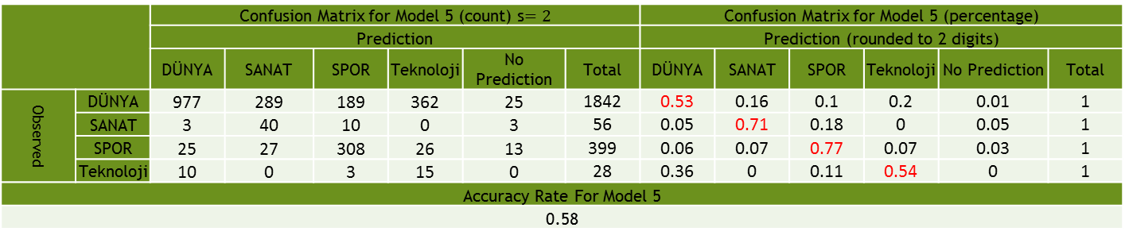
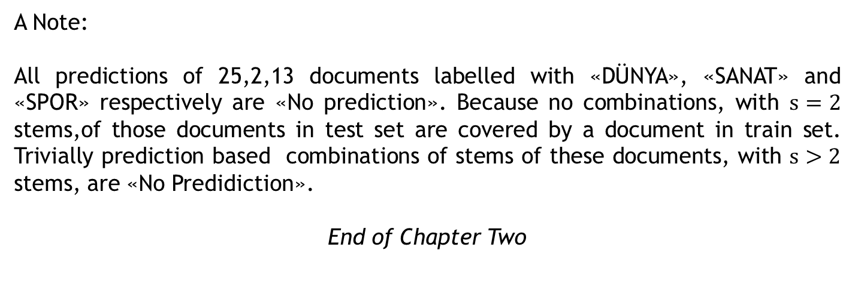
Application (Results)
 |  | Confusion Matrix for Model 5 (count) s$=2$ |  |  |  |  |  | Confusion Matrix for Model 5 (percentage)
 |  | Prediction |  |  |  |  |  | Prediction (rounded to 2 digits)
 |  | DÜNYA | SANAT | SPOR | Teknoloji | No Prediction | Total | DÜNYA | SANAT | SPOR | Teknoloji | No Prediction | Total
Observed | DÜNYA | 977 | 289 | 189 | 362 | 25 | 1842 | 0.53 | 0.16 | 0.1 | 0.2 | 0.01 | 1
 | SANAT | 3 | 40 | 10 | 0 | 3 | 56 | 0.05 | 0.71 | 0.18 | 0 | 0.05 | 1
 | SPOR | 25 | 27 | 308 | 26 | 13 | 399 | 0.06 | 0.07 | 0.77 | 0.07 | 0.03 | 1
 | Teknoloji | 10 | 0 | 3 | 15 | 0 | 28 | 0.36 | 0 | 0.11 | 0.54 | 0 | 1
Accuracy Rate For Model 5
0.58
A Note:
All predictions of 25,2,13 documents labelled with «DÜNYA», «SANAT» and «SPOR» respectively are «No prediction». Because no combinations, with $s=2$ stems,of those documents in test set are covered by a document in train set. Trivially prediction based combinations of stems of these documents, with $s>2$ stems, are «No Predidiction».
End of Chapter Two

