Slide 1

PREDICTION MODELS BASED ON MAX-STEMS (or harnessing imbalanced data) Episode Three: Effect of Hyperparameters
Ahmet Furkan EMREHAN
(matahmet@gmail.com)

Slide 2
PREDICTION MODELS BASED ON MAX-STEMS
Episode One: One-Word Based
Episode Two: A Combinatorial Approach
Episode Three: Effect of Hyperparameters
Episode Four: Advanced Examinations

Slide 3
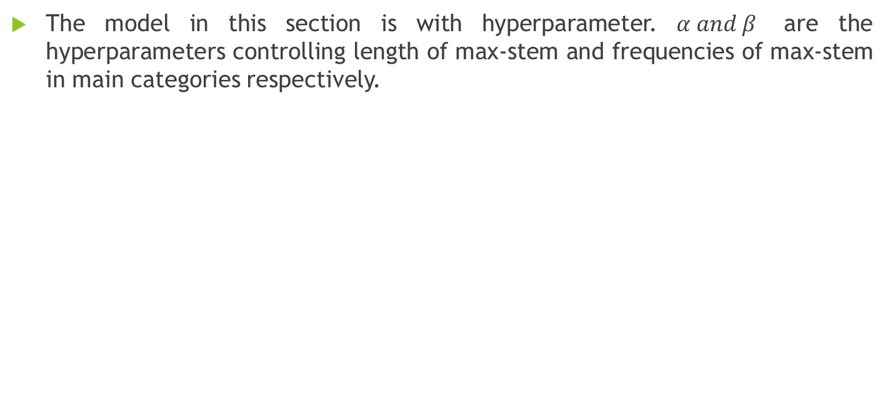
INTRODUCTION
The model in this section is with hyperparameter. $α and β$ are the hyperparameters controlling length of max-stem and frequencies of max-stem in main categories respectively.

Slide 4
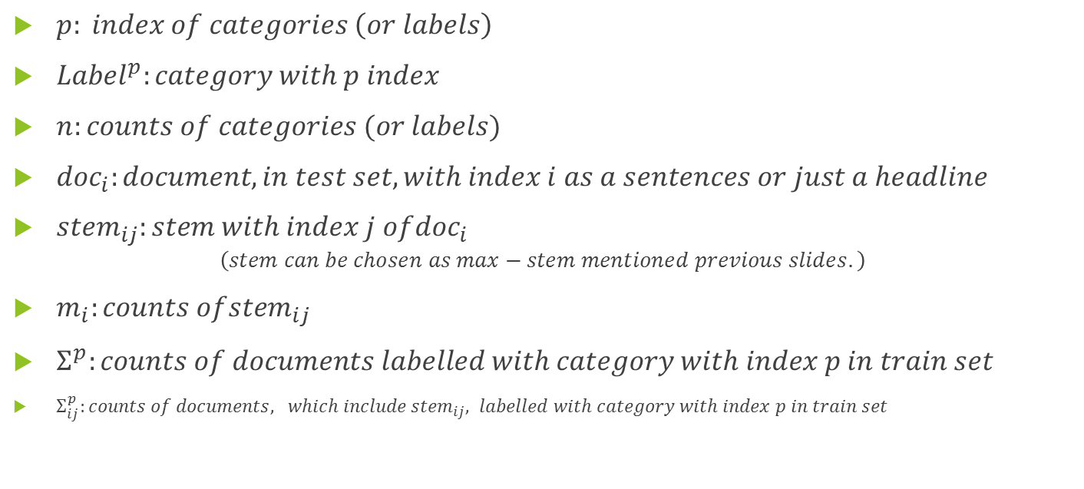
COMPONENTS OF MODELS
$p: index of categories \left(or labels\right)$
${Label}^{p}:category with p index$
$n:counts of categories (or labels)$
${doc}_{i}:document, in test set, with index i as a sentences or just a headline$
${stem}_{ij}:stem with index j of{doc}_{i}$
$$\left(stem can be chosen as max−stem mentioned previous slides.\right)$$
$m_{i}:counts of{stem}_{ij}$
$Σ^{p}:counts of documents labelled with category with index p in train set$
$Σ_{ij}^{p}:counts of documents, which include{ stem}_{ij}, labelled with category with index p in train set$

Slide 5
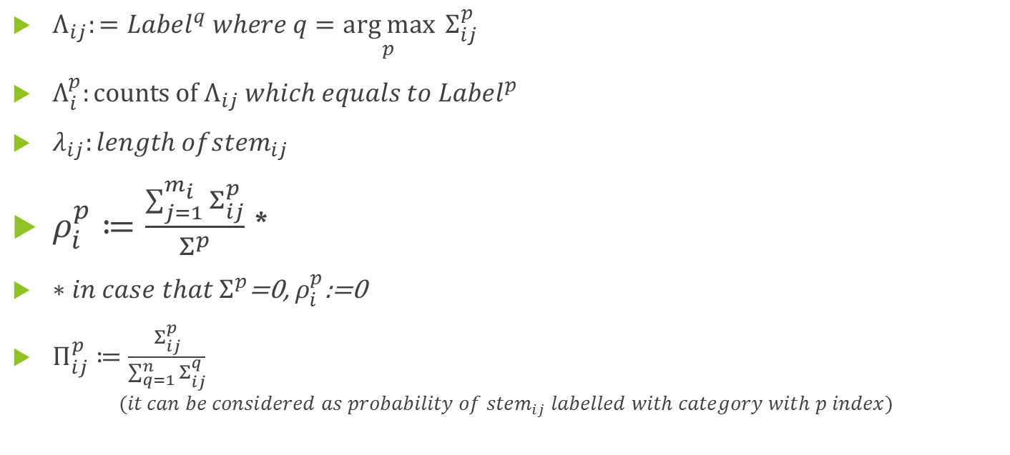
COMPONENTS OF MODELS
$Λ_{ij}:={Label}^{q} where q=\underset{p}{arg max}{{ Σ}_{ij}^{p}}$
$Λ_{i}^{p}:counts of{ Λ}_{ij} which equals to {Label}^{p}$
$λ_{ij}:length of{stem}_{ij}$
$ρ_{i}^{p}≔\frac{\sum_{j=1}^{m_{i}}{Σ_{ij}^{p}}}{Σ^{p}}$ *
$∗{in case that Σ}^{p}$=0, $ρ_{i}^{p}$:=0
$Π_{ij}^{p}≔\frac{Σ_{ij}^{p}}{\sum_{q=1}^{n}{Σ_{ij}^{q}}}$
$$(it can be considered as probability of {stem}_{ij} labelled with category with p index)$$

Slide 6

COMPONENTS OF MODELS
$\overline{Π_{i}^{p}}:={average}_{j∗} \left(Π_{ij∗}^{p}\right)such that all \text{"}\text{j}\text{∗"}\text{s} meet the condition Π_{ij∗}^{p}>0$
$∗in case that{ Σ}_{ij}^{p}=0 for all p=1,2,…n$,$\overline{{ Π}_{i}^{p}}$=0
$\hat{Π_{i}^{p}}≔\max_{j}(Π_{ij}^{p})$

Slide 7


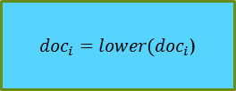



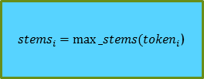

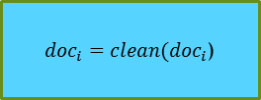

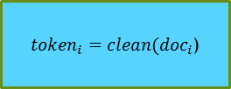

General Scheme for Prediction Models with hyperparameters
X_test
$${doc}_{i}$$
${doc}_{i}=lower({doc}_{i}$)
${doc}_{i}=clean({doc}_{i}$)
${token}_{i}=clean({doc}_{i}$)
Predictions
$$Σ_{i1}^{p},Π_{i1}^{p},Λ_{i1},λ_{i1}$$
Analyze_word
$${stem}_{i1}$$
${stems}_{i}=max⁡_stems({token}_{i}$)
$$Σ_{i2}^{p},Π_{i2}^{p},Λ_{i2},λ_{i2}$$
$${stem}_{i2}$$
.
.
.
.
.
.
$$Σ_{im_{i}}^{p},Π_{im_{i}}^{p},Λ_{im_{i}},λ_{im_{i}}$$
$${stem}_{im_{i} }$$
$$α,β$$
X_train, y_train
Evaluations (accuracy, confusion etc.)
y_test

Slide 8

Model with hyperparameter
${predict}_{hype}\left({doc}_{i},α,β\right)={Label}^{q} where q=\arg{\max_{p}}(\max_{j}\left[{\left(λ_{ij}\right)}^{α}\text{∗}{\left(Π_{ij}^{p}\right)}^{β}\right])$

Slide 9


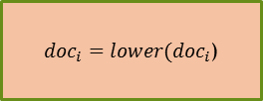



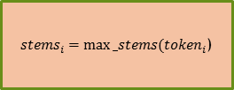

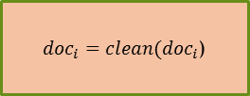

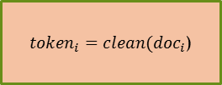

General Scheme for Application of Prediction Models with hyperparameter
X_test
$${doc}_{i}$$
${doc}_{i}=lower({doc}_{i}$)
${doc}_{i}=clean({doc}_{i}$)
${token}_{i}=clean({doc}_{i}$)
Predictions
$$Σ_{i1}^{p},Π_{i1}^{p},Λ_{i1},λ_{i1}$$
Analyze_doc
$${stem}_{i1}$$
${stems}_{i}=max⁡_stems({token}_{i}$)
$$Σ_{i2}^{p},Π_{i2}^{p},Λ_{i2},λ_{i2}$$
$${stem}_{i2}$$
.
.
.
.
.
.
Turkish Stem List (32001 stems)
(for application)
$$Σ_{im_{i}}^{p},Π_{im_{i}}^{p},Λ_{im_{i}},λ_{im_{i}}$$
$${stem}_{im_{i} }$$
$$α,β$$
X_train, y_train
Step2_Preprocess_word.ipynb
Step3_Classifier_V10.ipynb
Evaluations (accuracy, confusion etc.)
y_test
Step4_Prediction_Models_hype.ipynb
Step6_Run_Integrated_Model_hype.ipynb

Slide 10
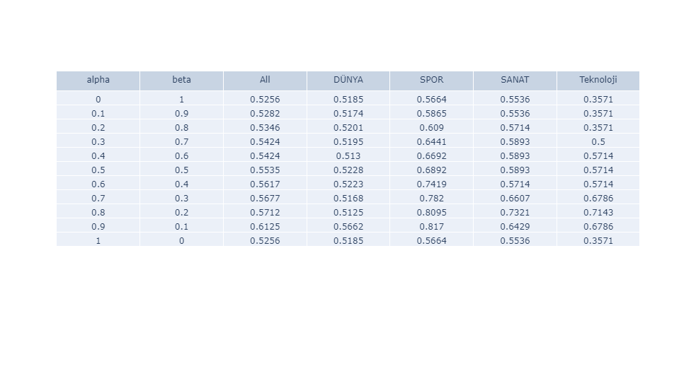
Results
Accuracy Rates for All Categories and sub-categories over $α and β \left(or 1−α\right) in \left[0,1\right]x\left[0,1\right]$

Slide 11
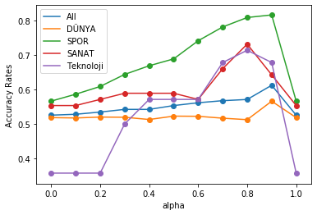
Results

