Slide 1
MERN STACK PROJECT
LOCAL MARKETPLACE PLATFORM
A MERN Stack Web Application
Connecting local sellers with nearby customers
Presented by: MATAM AKSHITHA -25MVCSMR0417
T.EUNICE DIVYA – 25MVCSMR0446
SAIGARI TEJASHWINI – 25MVCSMRO435
E.VASANTHA- 25MVCSMR0391
01 / 12

Slide 2

INTRODUCTION
A local marketplace connects neighborhood sellers and customers through one online platform.
Sellers can list products with prices, quantities, and locations.
Customers can browse available products and discover nearby sellers.
The platform makes local product discovery more convenient.
LOCAL MARKETPLACE PLATFORM • MERN STACK
02 / 12

Slide 3
PROBLEM STATEMENT
Many small local sellers do not have an easy way to showcase products online.
Customers may struggle to find nearby sellers and compare product details.
Stock, price, and location information can be difficult to keep updated.
Solution: create a centralized web platform for listing and managing local products.
LOCAL MARKETPLACE PLATFORM • MERN STACK
03 / 12

Slide 4

PROJECT OBJECTIVES
Demonstrate full-stack development using the MERN stack.
Implement Create, Read, Update, and Delete (CRUD) operations.
Build REST APIs with Node.js and Express.js.
Create an interactive frontend using React.js.
Add authentication and role-based access
where required.
Present seller and product information clearly.
LOCAL MARKETPLACE PLATFORM • MERN STACK
04 / 12

Slide 5
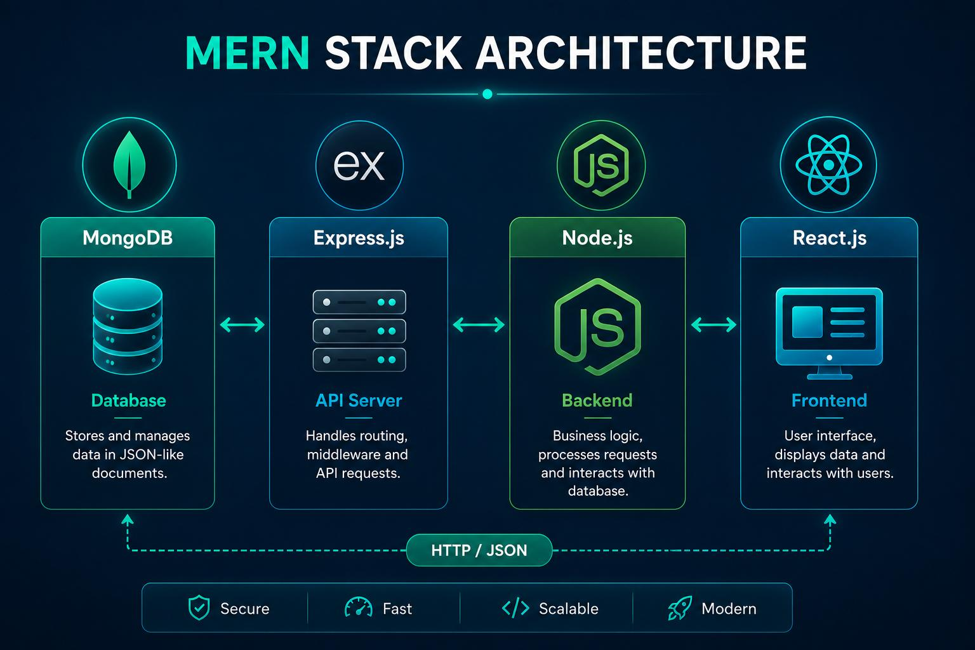
TECHNOLOGIES USED
MongoDB — stores users, sellers, and product records.
Express.js — defines API routes and handles HTTP requests.
React.js — creates the frontend pages and reusable components.
Node.js — runs the backend application.
JWT and bcrypt — optional tools for login sessions
and password hashing.
CSS / Bootstrap — supports responsive styling.
LOCAL MARKETPLACE PLATFORM • MERN STACK
05 / 12

Slide 6
SYSTEM ARCHITECTURE
FRONTEND
BACKEND
DATABASE
→
→
React.js
Pages & Components
Node.js + Express.js
REST APIs
MongoDB
Users & Products
Request → Processing → Database result → Response
Frontend: React pages for customers and sellers.
Backend: Node.js + Express.js REST API.
Database: MongoDB collections for users and products.
Request flow: React UI → REST API → MongoDB → API response → React UI.
Role checks help restrict seller actions to authorized users.
LOCAL MARKETPLACE PLATFORM • MERN STACK
06 / 12

Slide 7
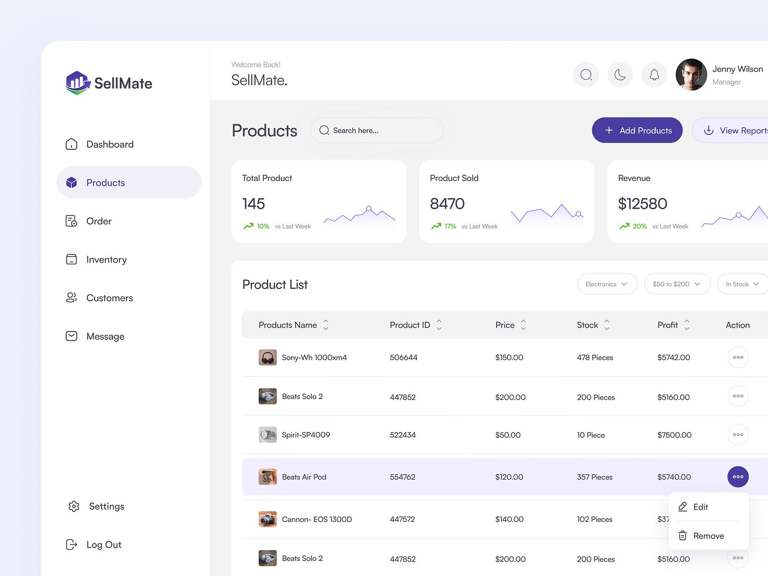
MAIN MODULES
Customer Module: browse products
and view price, stock, and seller location.
Seller Module: register or log in and
manage product listings.
Product Module: add, view, edit, and
remove product details.
Search & Filter Module: find products
by name, category, or location.
Authentication Module: manage user
identity and permissions.
Admin Module (optional): review users
or moderate listings.
LOCAL MARKETPLACE PLATFORM • MERN STACK
07 / 12

Slide 8
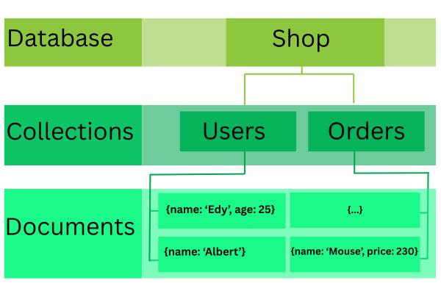
DATABASE DESIGN
USERS
PRODUCTS
name • email • passwordHash
role
name • category • price • quantity
location • sellerId
Each product references its seller through sellerId.
Users collection: name, email, passwordHash, role.
Products collection: name, description, category, price, quantity, location, sellerId.
sellerId links each product to the seller who owns it.
Use validation for required fields, positive prices, and non-negative quantity.
Store passwords as secure hashes, never as plain text.
LOCAL MARKETPLACE PLATFORM • MERN STACK
08 / 12

Slide 9
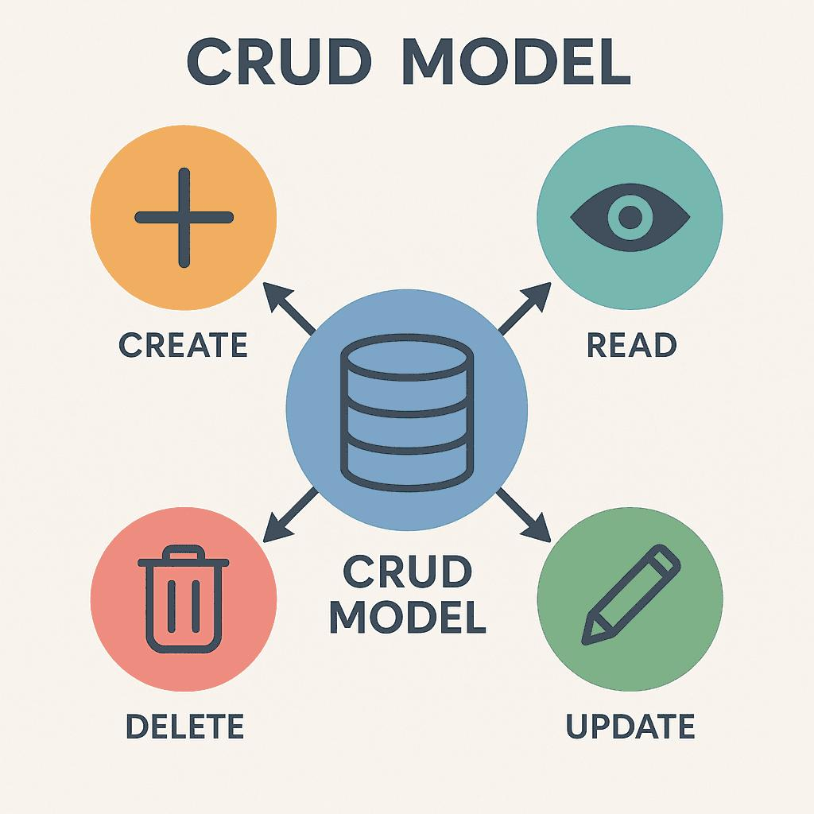
CRUD OPERATIONS
CREATE
READ
UPDATE
DELETE
Add a product
View listings
Edit details
Remove listing
Validate input and verify seller ownership before update or delete.
Create: seller adds a new product listing.
Read: customer or seller views product details.
Update: seller changes price, quantity, description, or location.
Delete: seller removes a listing they own.
The backend validates requests and checks authorization before changing records.
LOCAL MARKETPLACE PLATFORM • MERN STACK
09 / 12

Slide 10
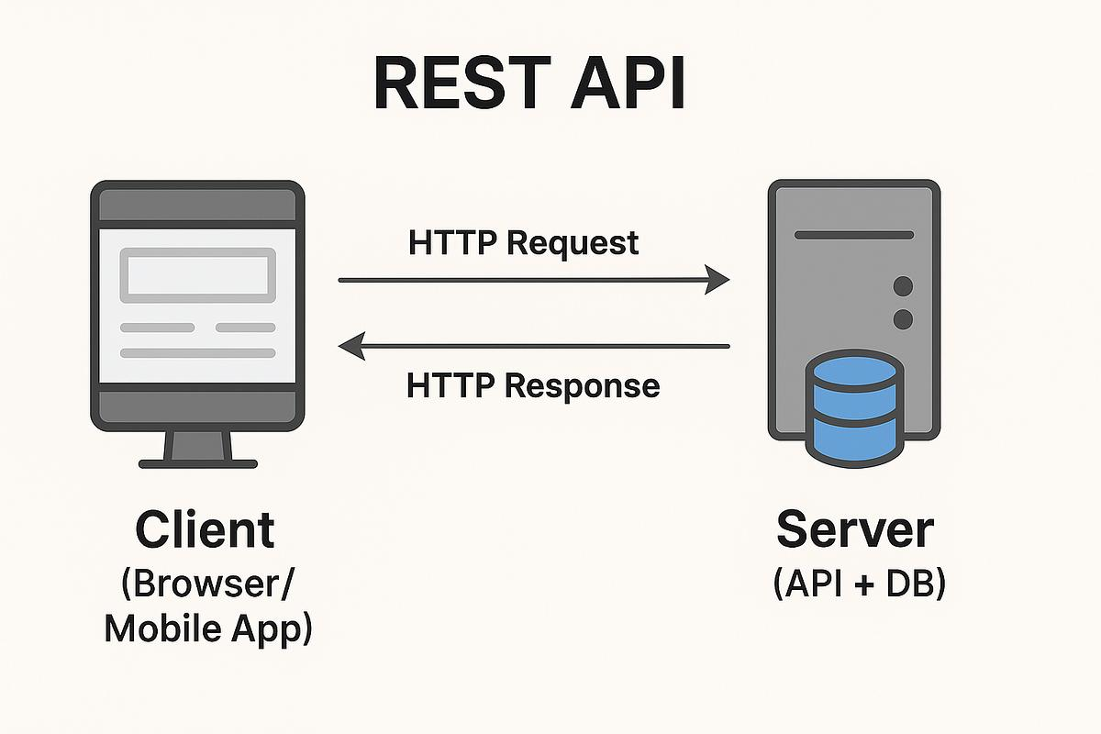
REST API DESIGN
GET /api/products — retrieve product listings.
GET /api/products/:id — retrieve one product.
POST /api/products — create a listing (authenticated seller).
PUT /api/products/:id — update a listing (owner only).
DELETE /api/products/:id — delete a listing (owner only).
POST /api/auth/register and POST /api/auth/login — account access.
LOCAL MARKETPLACE PLATFORM • MERN STACK
10 / 12

Slide 11

EXPECTED RESULTS & BENEFITS
Local sellers can publish and maintain product listings.
Customers can discover nearby products and compare basic details.
Product quantity and price information can be updated quickly.
CRUD APIs demonstrate database operations and backend integration.
Responsive pages make the platform accessible on desktop and mobile.
LOCAL MARKETPLACE PLATFORM • MERN STACK
11 / 12

Slide 12

CONCLUSION & FUTURE SCOPE
The project demonstrates a complete MERN-based marketplace workflow.
It combines a React interface, Express APIs, Node.js, and MongoDB.
Future scope: product images, maps, reviews, favorites, and order tracking.
Further improvements: online payments, notifications, analytics, and delivery integration.
THANK YOU
LOCAL MARKETPLACE PLATFORM • MERN STACK
12 / 12

