Slide 1





Complete Selenium Automation Engineer Bootcamp: Go from Zero to Hero

Slide 2
TestNG
TestNG is a testing framework designed to simplify a broad range of testing needs, from unit testing (testing a class in isolation of the others) to integration testing (testing entire systems made of several classes, several packages and even several external frameworks, such as application servers).
TestNG was created/built due to lot of limitations of JUnit.
TestNG comprises all the features of Junit and adds more features of its own for testing.
While JUnit is primarily used for Unit Test, TestNG is primarily used for Functional/Integration test.
You can invoke TestNG suite in several different ways:
With a TestNG.xml file.
With ant (Apache Ant is a Java library and command-line tool whose mission is to drive processes described in build files).
From the command line.
Writing a test is typically a three-step process:
Write the business logic of your test and insert TestNG annotations in your code.
Add the information about your test (e.g. the class name, the groups you wish to run, etc...) in a TestNG.xml file or in build.xml.
Run TestNG.

Slide 3
TestNG
TestNG has many features that makes it number one framework for functional and integration testing.
Annotations.
Run your tests in arbitrarily big thread pools with various policies available (all methods in their own thread, one thread per test class, etc...).
Test that your code is multithread safe & Flexible test configuration.
Support for data-driven testing (with @DataProvider) and parameterization.
Supported by a variety of tools and plug-ins (Eclipse, IDEA, Maven, etc...).
TestNG can be installed using Maven installing the dependency.
<dependency>
<groupId>org.testng</groupId>
<artifactId>testng</artifactId>
<version>6.13.1</version>
<scope>test</scope>
</dependency>

Slide 4
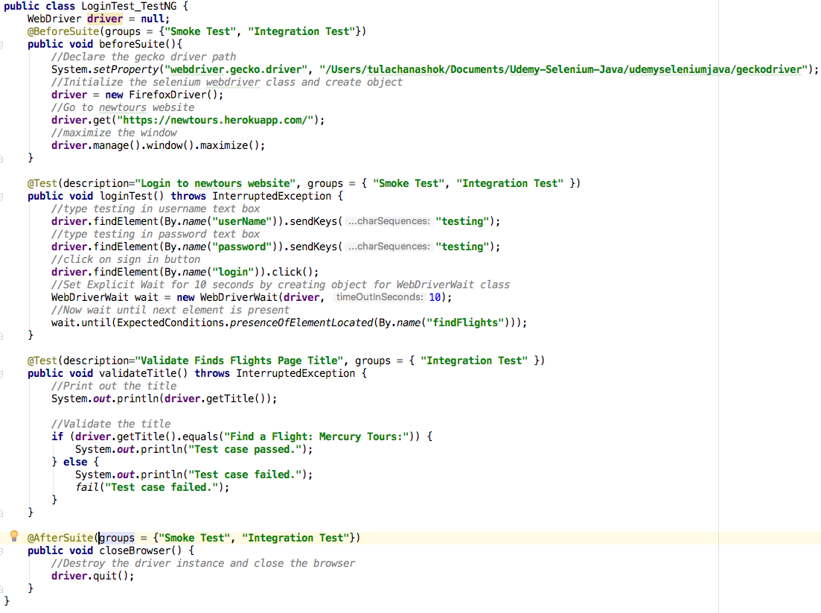
TestNG Example

Slide 5
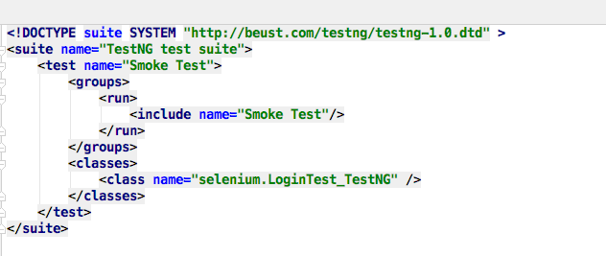
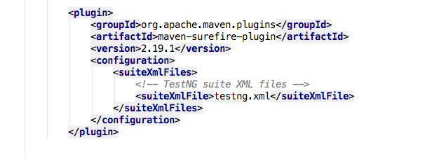
TestNG Suite Example

Slide 6
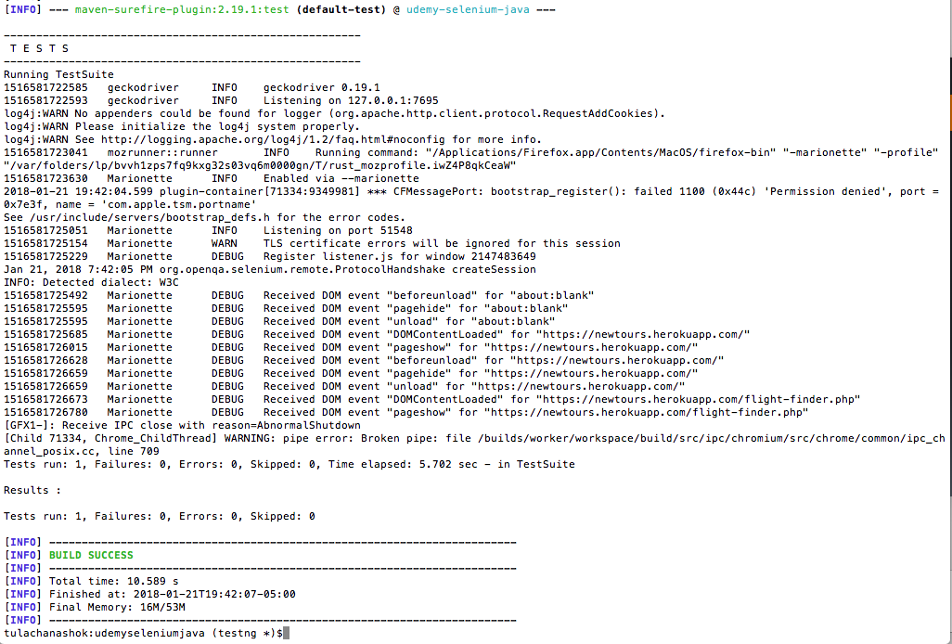
TestNG Suite Example

Slide 7
Complete Selenium Automation Engineer Bootcamp: Go from Zero to Hero

Slide 8
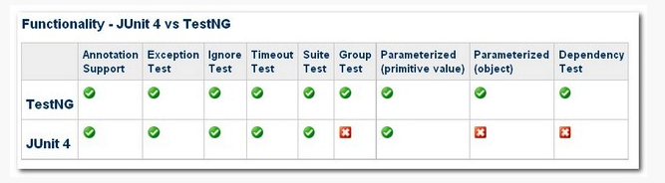
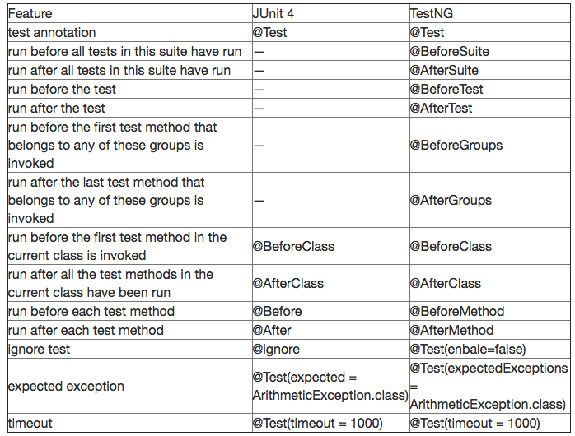
TestNG Vs JUnit

Slide 9
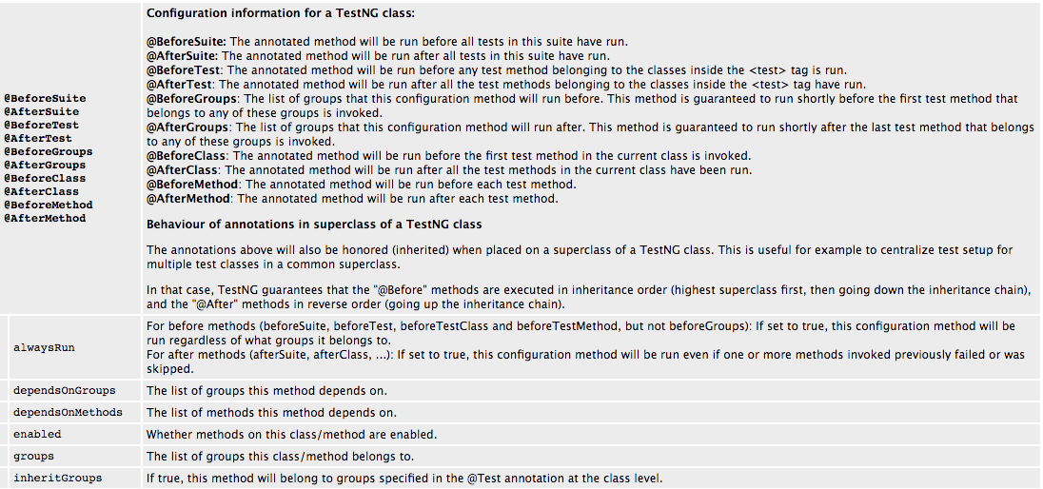
TestNG Annotations

Slide 10
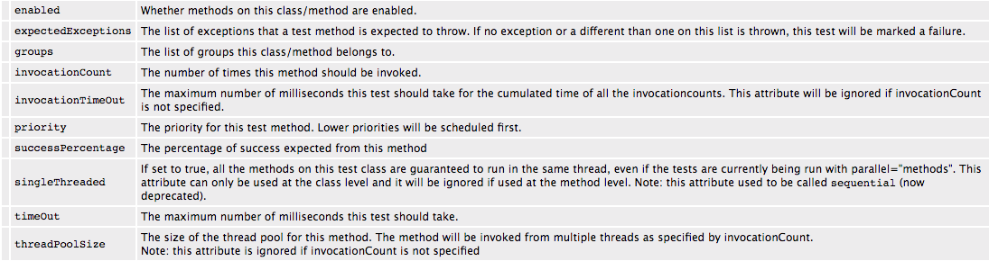
TestNG Annotations

Slide 11
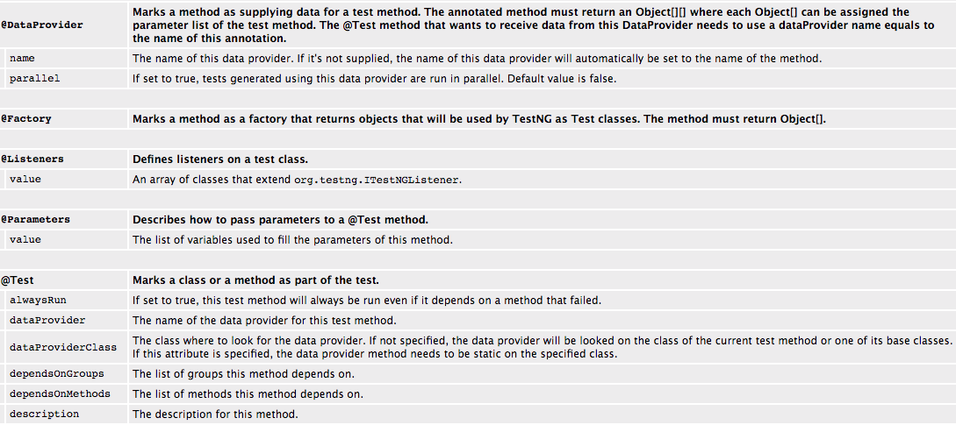
TestNG Annotations

Slide 12
Complete Selenium Automation Engineer Bootcamp: Go from Zero to Hero

Slide 13
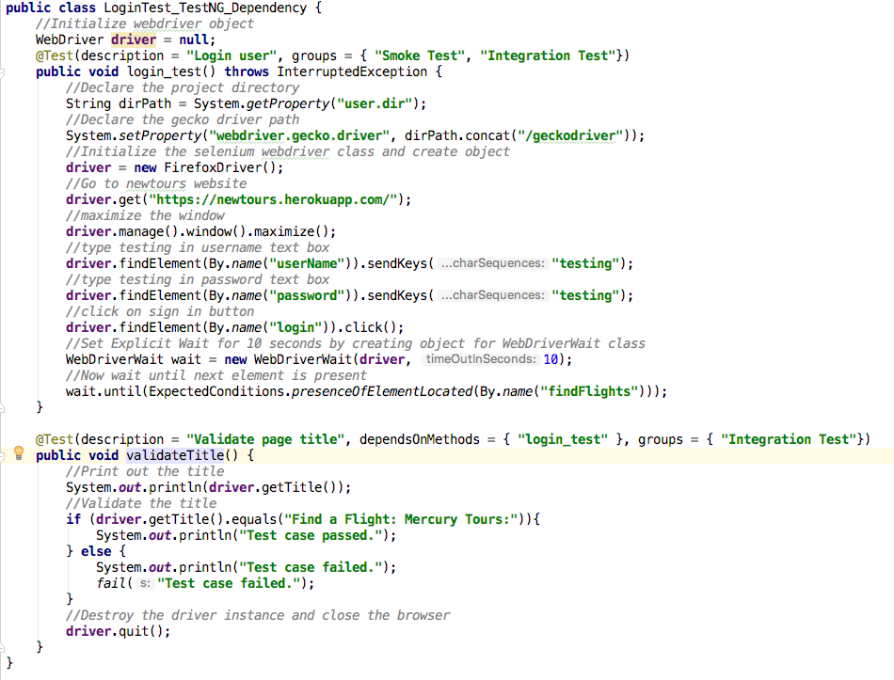
TestNG Dependency Test

Slide 14
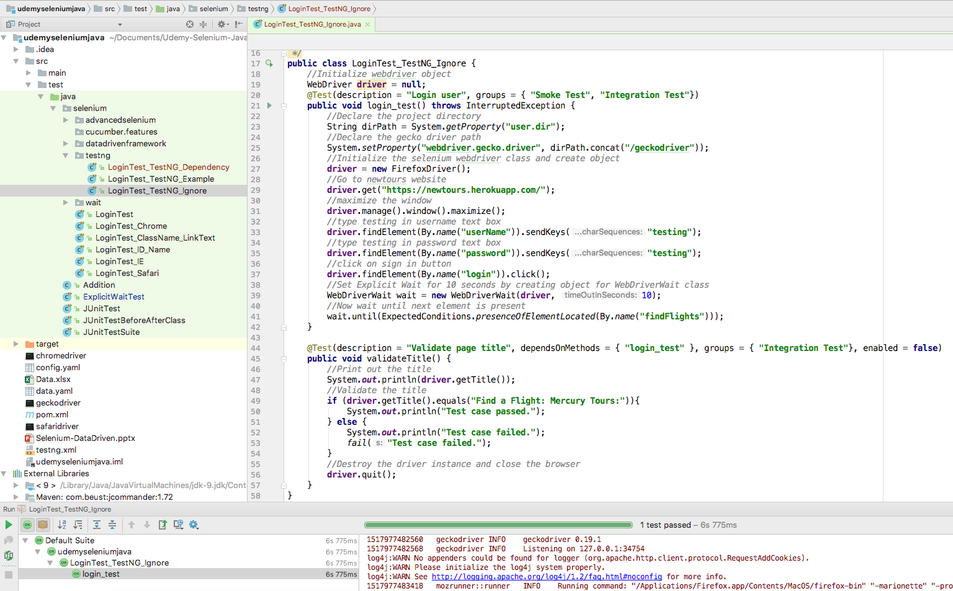
TestNG Disabled Test

Slide 15
Complete Selenium Automation Engineer Bootcamp: Go from Zero to Hero

Slide 16
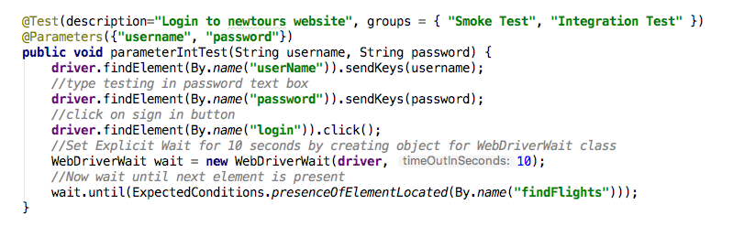
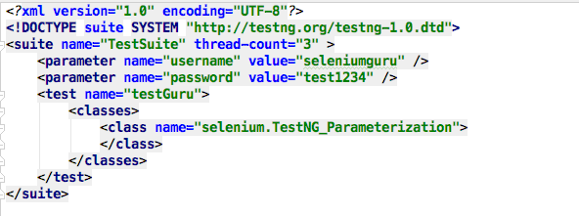
TestNG Parameterized Test : XML

Slide 17
Complete Selenium Automation Engineer Bootcamp: Go from Zero to Hero

Slide 18
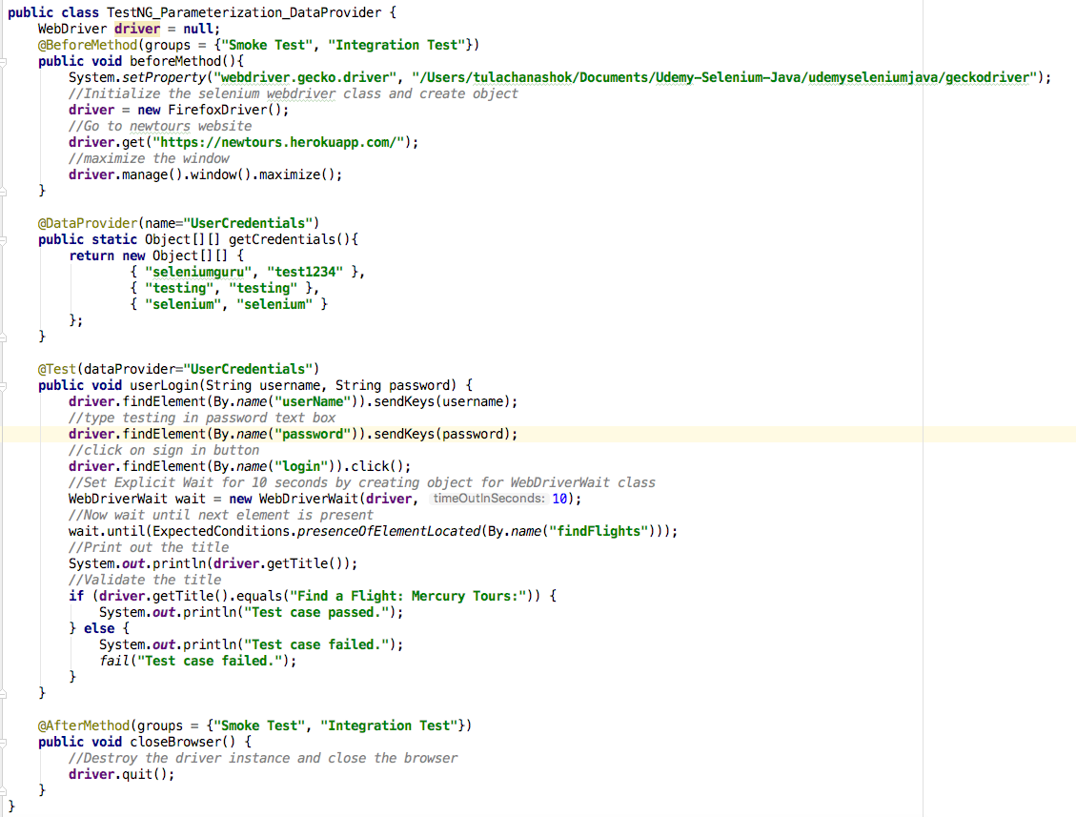
TestNG Parameterized Test : DataProvider

Slide 19
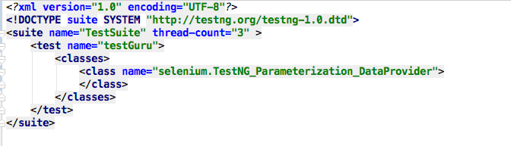
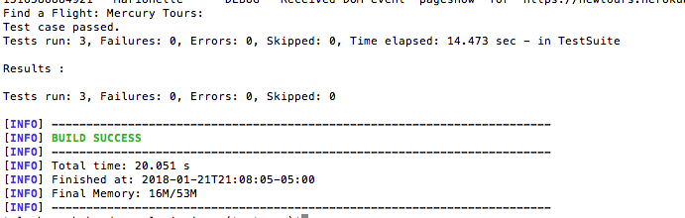
TestNG Parameterized Test : Data Provider

