Slide 1
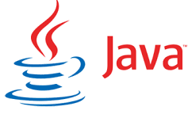

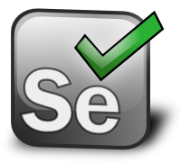


Complete Selenium Automation Engineer Bootcamp: Go from Zero to Hero

Slide 2
DBMS
A database management system (DBMS) is a collection of programs that enables you to store, modify, and extract information from a database. There are many different types of database management systems, ranging from small systems that run on personal computers to huge systems that run on mainframes.
Requests for information from a database are made in the form of a query. The set of rules for constructing queries are called query language. Different database uses different types of query language but most common is “SQL” i.e. Structured Query Language.
DBMS can be different types
Relational – DBMS that stores data in form of related tables. Ex: Oracle, Postgres,
Flat – DBMS that stores data in a single table. Ex: text file
Hierarchical – DBMS in which data is organized into a tree like structure. Ex: Mainframe
Network - Modeled where each object types are nodes and relation types are arcs and is not restricted by hierarchy. Ex: integrated Data store
Example of DBMS
Computerized library system
Automated teller machines
Flight Reservation System
Computerized Parts Inventory system

Slide 3
RDBMS
Database management system (DBMS) that stores data in the form of related tables.
Relational databases are powerful because they require few assumptions about how data is related or how it will be extracted from the database. As a result, the same database can be viewed in many different ways.
An important feature of relational systems is that a single database can be spread across several tables. This differs from flat-file databases, in which each database is self-contained in a single table.
RDBMS data is stored in database objects which are called as tables. This table is basically a collection of related data entries and it consists of numerous columns and rows.
A table is the most common and simplest form of data storage in a relational database
Example of DBMS
Oracle
MySQL
SQL Server
SQLite
Postgres

Slide 4
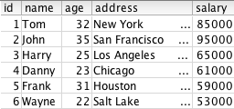
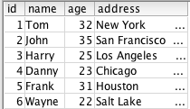
RDBMS
RDBMS also uses SQL or structured query language to extract information from the table.
Ex:
SELECT * FROM EMPLOYEE;
SELECT ID,NAME,AGE,ADDRESS FROM EMPLOYEE;

Slide 5
Complete Selenium Automation Engineer Bootcamp: Go from Zero to Hero

Slide 6
Postgres
PostgreSQL is an object-relational database management system (ORDBMS) based on POSTGRES, Version 4.2, developed at the University of California at Berkeley Computer Science Department.
POSTGRES pioneered many concepts that only became available in some commercial database systems much later.
PostgreSQL is an open-source descendant of this original Berkeley code. It supports a large part of the SQL standard and offers many modern features
PostgreSQL can be used, modified, and distributed by anyone free of charge for any purpose, be it private, commercial, or academic.
Source
https://www.postgresql.org/
Installation
https://www.openscg.com/bigsql/postgresql/installers.jsp/

Slide 7
Complete Selenium Automation Engineer Bootcamp: Go from Zero to Hero

Slide 8


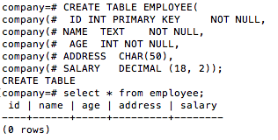
SQL
Create database
create database company;
Access/Connect to database
\c company;
Create Table:
CREATE TABLE EMPLOYEE(
ID INT PRIMARY KEY NOT NULL,
NAME TEXT NOT NULL,
AGE INT NOT NULL,
ADDRESS CHAR(50),
SALARY DECIMAL (18, 2));

Slide 9
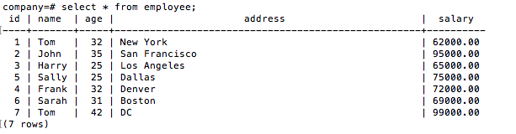
SQL
Insert data into table:
INSERT INTO EMPLOYEE (ID,NAME,AGE,ADDRESS,SALARY) VALUES (1, 'Tom', 32, 'New York', 92000.00);
INSERT INTO EMPLOYEE (ID,NAME,AGE,ADDRESS,SALARY) VALUES (2, 'John', 35, 'San Francisco', 95000.00);
INSERT INTO EMPLOYEE (ID,NAME,AGE,ADDRESS,SALARY) VALUES (3, 'Harry', 25, 'Los Angeles', 85000.00);
INSERT INTO EMPLOYEE (ID,NAME,AGE,ADDRESS,SALARY) VALUES (4, ’Frank', 32, Denver', 72000.00);
INSERT INTO EMPLOYEE (ID,NAME,AGE,ADDRESS,SALARY) VALUES (5, ‘Sally’, 25, ’Dallas', 75000.00);
INSERT INTO EMPLOYEE (ID,NAME,AGE,ADDRESS,SALARY) VALUES (6, ’Sarah', 31, ‘Boston', 69000.00);
INSERT INTO EMPLOYEE (ID,NAME,AGE,ADDRESS,SALARY) VALUES (7, 'Tom', 42, ‘DC’, 99000.00);

Slide 10
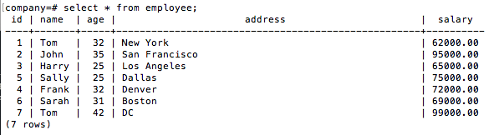
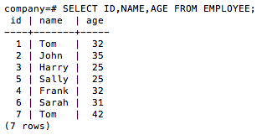
SQL
Retrieve data from table: SELECT statement is used to fetch the data from a database table, which returns data in the form of result table.
SELECT * FROM EMPLOYEE;
SELECT ID,NAME,AGE FROM EMPLOYEE;

Slide 11


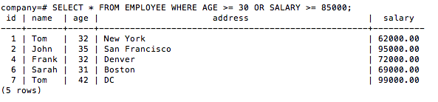
SQL
Retrieve data from table with where clause.
SELECT * FROM EMPLOYEE WHERE SALARY = 95000;
SELECT * FROM EMPLOYEE WHERE AGE >= 25 AND SALARY >= 85000;
SELECT * FROM EMPLOYEE WHERE AGE >= 30 OR SALARY >= 85000;

Slide 12

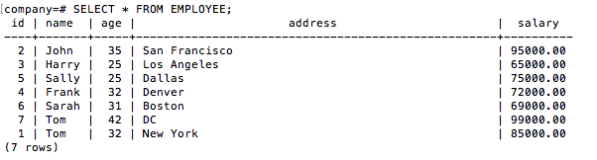
SQL
Retrieve data from table using like clause
SELECT * FROM COMPANY WHERE AGE::text LIKE '2%';
Update data in the table
UPDATE EMPLOYEE SET SALARY = 85000 WHERE ID = 1;

Slide 13
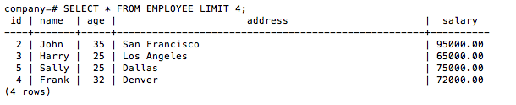
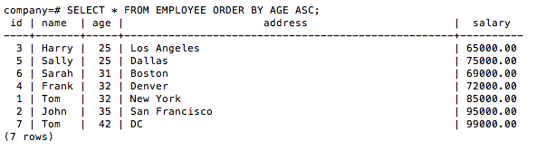
SQL
Limit output data from table.
SELECT * FROM EMPLOYEE LIMIT 4;
Order output data from table by ascending/descending order.
SELECT * FROM EMPLOYEE ORDER BY AGE ASC;

Slide 14
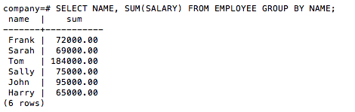
SQL
SQL GROUP BY clause is used in collaboration with the SELECT statement to arrange identical data into groups.
SELECT NAME, SUM(SALARY) FROM EMPLOYEE GROUP BY NAME;

Slide 15
Complete Selenium Automation Engineer Bootcamp: Go from Zero to Hero

Slide 16
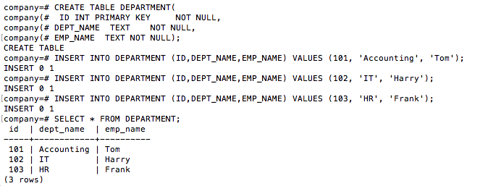
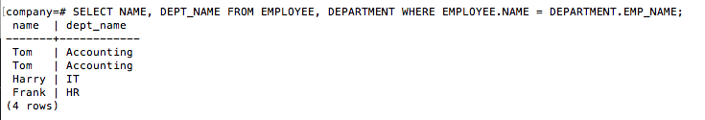
SQL - Joins
SQL Joins clause is used to combine records from two or more tables in a database.
SELECT * FROM DEPARTMENT;
SELECT NAME, DEPT_NAME FROM EMPLOYEE, DEPARTMENT WHERE EMPLOYEE.NAME = DEPARTMENT.EMP_NAME;

Slide 17
SQL - JOINS
There are different types of joins available in SQL.
INNER JOIN − returns rows when there is a match in both tables.
LEFT JOIN − returns all rows from the left table, even if there are no matches in the right table.
RIGHT JOIN − returns all rows from the right table, even if there are no matches in the left table.
FULL JOIN − returns rows when there is a match in one of the tables.
SELF JOIN − is used to join a table to itself as if the table were two tables, temporarily renaming at least one table in the SQL statement.
CARTESIAN JOIN − returns the Cartesian product of the sets of records from the two or more joined tables.

Slide 18
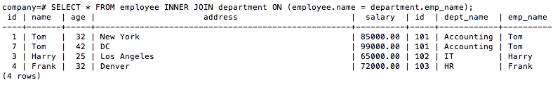
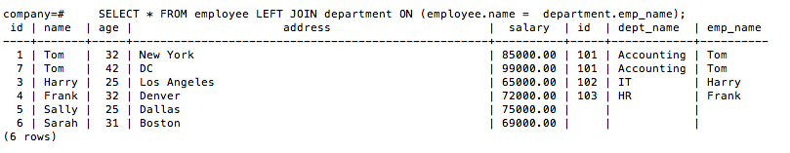
SQL
INNER JOIN EXAMPLE
SELECT * FROM employee INNER JOIN department ON (employee.name = department.emp_name);
LEFT JOIN EXAMPLE
SELECT * FROM employee LEFT JOIN department ON (employee.name = department.emp_name);

Slide 19
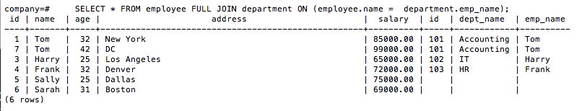
SQL
RIGHT JOIN EXAMPLE
SELECT * FROM employee RIGHT JOIN department ON (employee.name = department.emp_name);
FULL JOIN EXAMPLE
SELECT * FROM employee FULL JOIN department ON (employee.name = department.emp_name);

Slide 20
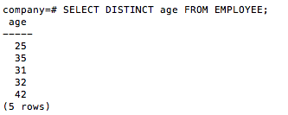

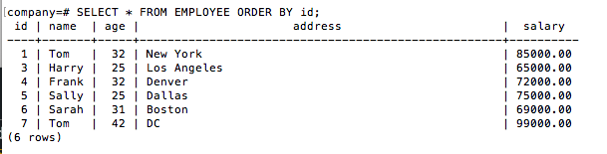
SQL
Retrieve unique data(age) from table.
SELECT DISTINCT age FROM EMPLOYEE;
Select particular rows where the function's result meets some condition.
SELECT NAME FROM EMPLOYEE GROUP BY name HAVING count(name) > 1;
Delete row from table
DELETE FROM EMPLOYEE WHERE ID = 2;
SELECT * FROM EMPLOYEE;

Slide 21



SQL
Delete all rows from table.
DELETE FROM EMPLOYEE;
Delete the entire table.
DROP TABLE EMPLOYEE;
Delete the entire database.
DROP DATABASE COMPANY;

Slide 22
Complete Selenium Automation Engineer Bootcamp: Go from Zero to Hero

Slide 23
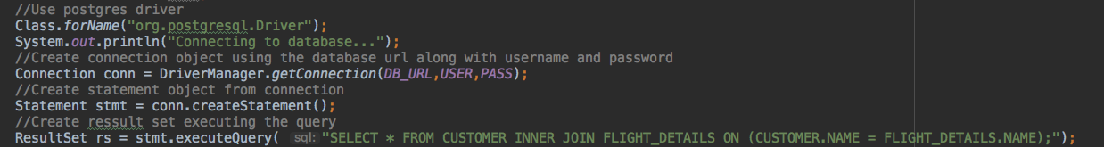
Data Driven Framework using Postgres
Download postgressql jdbc artifact using Maven.
<dependency> <groupId>postgresql</groupId> <artifactId>postgresql</artifactId> <version>9.1-901-1.jdbc4</version> </dependency>

Slide 24
Complete Selenium Automation Engineer Bootcamp: Go from Zero to Hero

Slide 25
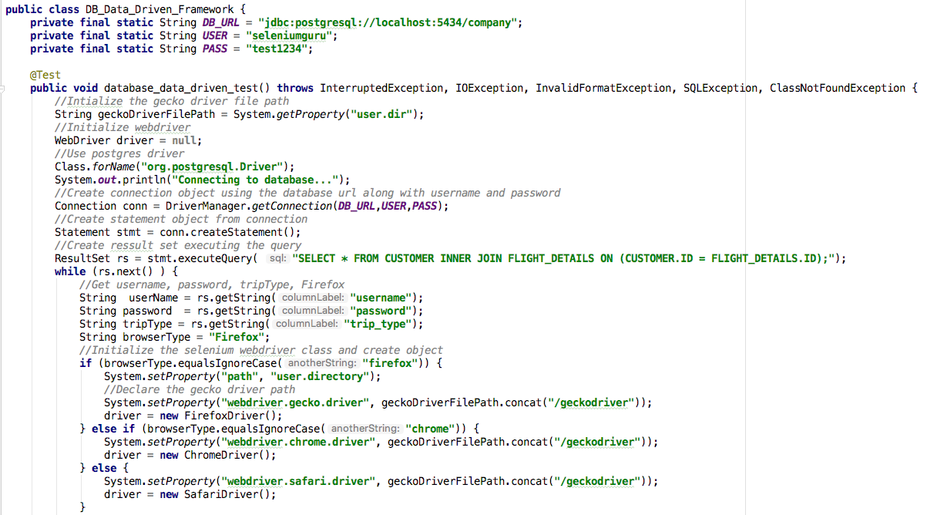
Data Driven Framework: Postgres DB

Slide 26
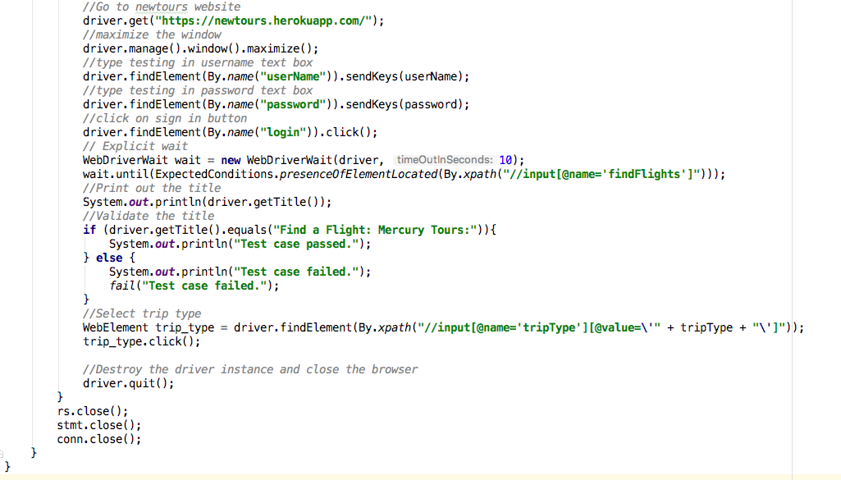
Data Driven Framework: Postgres DB

