Slide 1
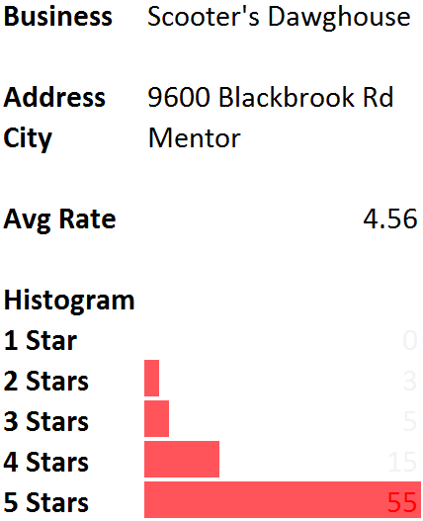
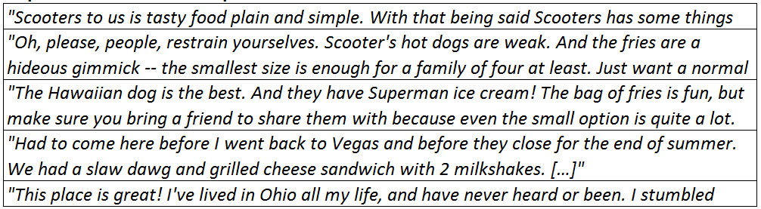

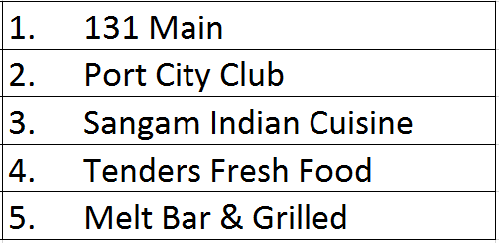
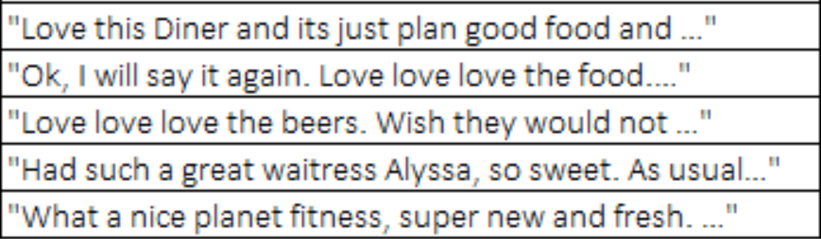
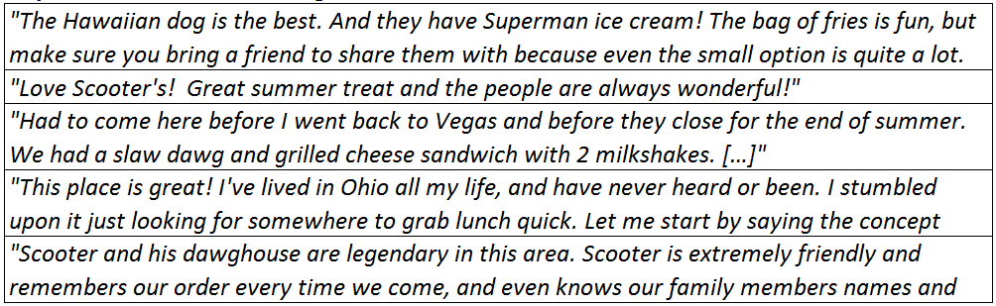
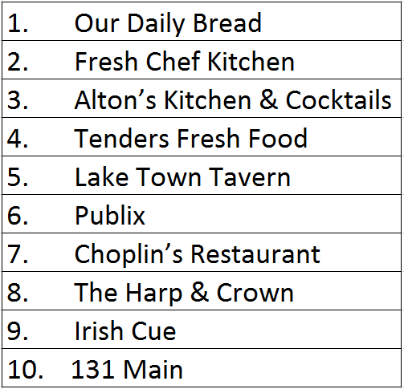
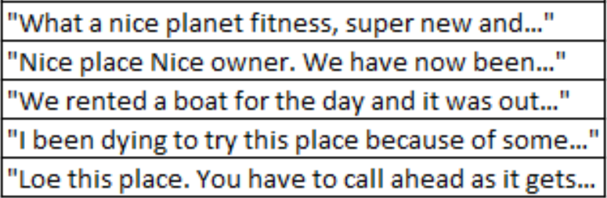
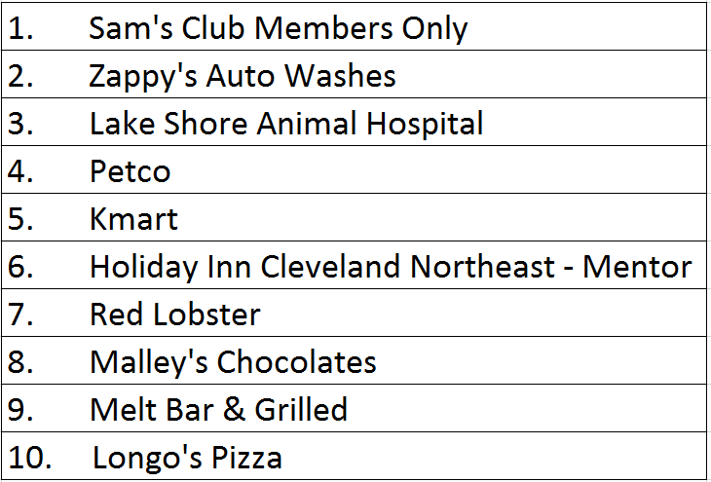
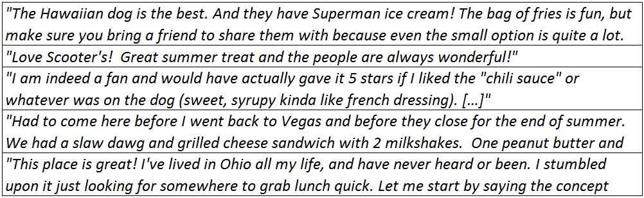

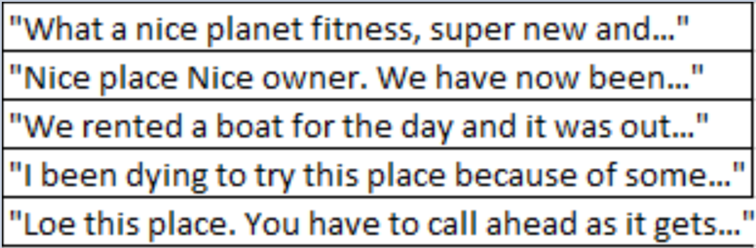
Yelp New Web-Page Design Driven By Analytics Metrics
User View
Business View
Your Reviewer Rank: # 1 (80 reviews)
Business Recommendations:
Your Business Rating:
Top 5 Most Helpful Reviews:
Avg Reviewer Rating: 3.68/5 Stars
Top 5 Most Reviewed Businesses in Your Area:
Top 5 Most Recent Reviews:
Top 5 Businesses by Rating:
Based on your reviews:
Top 5 Most Helpful Reviews:
Your Reviewers Have Also Reviewed:
Top 5 Most Recent Reviews:
Top 5 Businesses by Rating:
Team Members: Rodrigo Cancino, Hamid Tellez, Birane Seck, Pablo Alvarez, Matan Becker

