Slide 1
Matan Becker
Data Science Intern/ PCC Classification / Thursday 14 December 2017
Notes:
Example divider page – Replace text content etc
Top Tip: Choose other dividers (Choose from four color dividers in the master pages, Home menu, select ‘Layout’ and choose the appropriate divider)
No source or slide numbers

Slide 2
PCC Classification
Description:
Use MIDT booking data with a variety of machine learning models in order to learn the nature of and classify PCCs
Business Context:
‘PCC’ has come to take on a new meaning over the years and we’ve lost track of what it really means
Objective:
To understand the nature of the field ‘PCC’ more thoroughly and derive insights from it’s relationship with other ‘flight features’
Technologies Used: 1) Spark 2) Hive 3) Excel

Slide 3
Initial Analysis of PCCs
Data: PCC table (from capacity planning) and one day’s worth of search data
Fields: PCC, m_cust_nm_aat, m_cust_nm_cidb, country, region, GDS, volume
Analysis:
Created the following ‘Top 25’ pivot tables with accompanying charts/graphs:
PCCs by Region, PCC’s by Country, PCC’s by Company
PCCs by Volume, Company Name by Volume, GDS by Volume
Broad Observations:
91 companies (’m_cust_nm_cidb’) have > 100 PCC’s and 6,881 companies have > 1 PCC
All files available on SharePoint
Notes:
Use this slide for your content slides, replace content etc. All text: Calibri, blue headers, grey text, blue bullets etc.
Transitions are all ‘Fade’. Animations to be used as appropriate.
Top tip: Reapplying the master
If you’re adding slides to this template, please reapply new slides to the master:
Select the new inserted slides (either CTRL+A or individually by selecting CTRL only)
In the Home menu, select Layout and choose the appropriate slide from the master set
You may need to reformat individual slides, reapplying sizes, fonts and colours
Top tip: To change all the ‘Confidential’ footer notes in one go: (select ‘Insert’ then ‘Header & Footer’ and change footer note, select ‘Apply to all’) All slides have slide numbers, bottom right

Slide 4
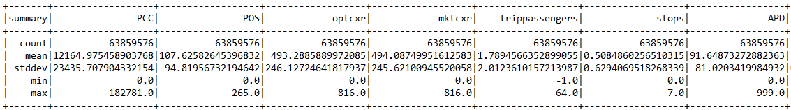
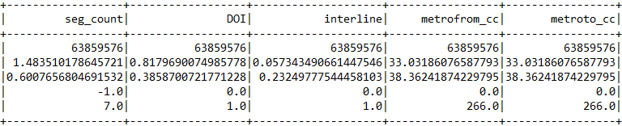
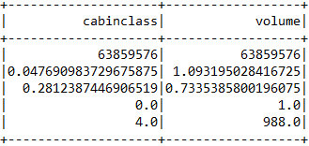
Data Preparation
Much of my time was spent on data prep:
Query data in Hive → export dataset to csv
Load csv in .py script → convert dataset to numeric values
Convert to float() → transform to features vector
Create pipelines → execute models in Spark
Data Source | HDFS - Hive
Tables | midt_avro_v2, cos2cabin_txt, midt_cities
# Rows | 63,859,576
# Files | 201
Feature Stats
Notes:
Example pie chart using palette colours, double click on chart to replace content / data
All text data should be dark grey R74 G74 B74, please use chart colors from the palette provided
Use/delete footer as appropriate. All slides have slide numbers, bottom right

Slide 5
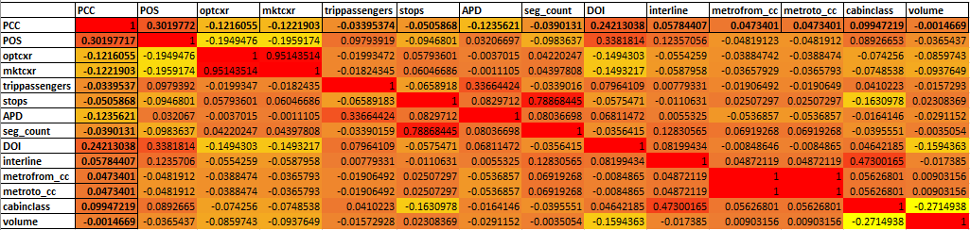
Correlation Matrix
Significant correlations between PCC and:
POS
DOI
Moderate correlations between PCC and:
optcxr
mktcxr
cabinclass
Notes:
Example bar chart using palette colours, double click on chart to replace content / data
All text data should be dark grey R74 G74 B74, please use chart colors from the palette provided
Use/delete footer/source as appropriate. All slides have slide numbers, bottom right

Slide 6
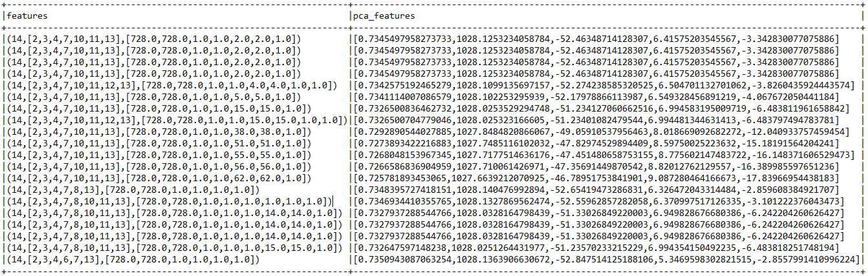
Principal Component Analysis
From given inputs → PCA helps reduce the number of features by using the ‘principal components’ that explain the most variation
Find optimal ‘K’ features through PCA decomposition – components with highest eigenvalues (measure of variance accounted for by each factor)
Notes:
Example pie chart using palette colours, double click on chart to replace content / data
All text data should be dark grey R74 G74 B74, please use chart colors from the palette provided
Use/delete footer as appropriate. All slides have slide numbers, bottom right

Slide 7
Next Steps
KNN-means clustering
Use semi-supervised learning and supervised learning to predict booking data into a defined ‘class’ of PCC’s
Other Tasks I worked on:
Defining Data Details for DF Source Reports roadmap
Available on SharePoint

Slide 8
Questions?

