Slide 1

Maccabi Health Services
Data Science Home Assignment
Predicting Hypertensive Disorders in Pregnancy
Candidate: Matan Boaz

Slide 2
Project Overview
The task is to predict hypertensive disorders by week 15.
Goal: Refer only the highest-risk patients for costly blood testing, maximizing case detection under budget.
Data used: Structured (labs, vitals, diagnoses, demographics) + Unstructured (physician notes).

Slide 3
Methodology
1. Data Exploration: Visualized distributions, missingness, correlations.
2. Feature Engineering: Created lab ratios, flags, diagnosis history, and extracted TF-IDF from clinical notes.
3. Modeling: Logistic Regression, Random Forest, XGBoost, LightGBM evaluated using ROC AUC, PR AUC, Recall@Top X%

Slide 4
Model Results
Best model: LightGBM
- ROC AUC: 0.976
- PR AUC: 0.884
Recall @ Top 10%:
- LR: 0.20
- RF: 0.83
- XGB: 0.93
- LGBM: 0.94

Slide 5
Recommendations
Use LightGBM at gestational week 15.
Refer top 10% (captures ~94% of cases).
Future:
- Add calibration (e.g., Platt scaling)
- Bootstrap confidence intervals
- Explore deep models for text
Business Insight:
Maximize early detection under budget.

Slide 6
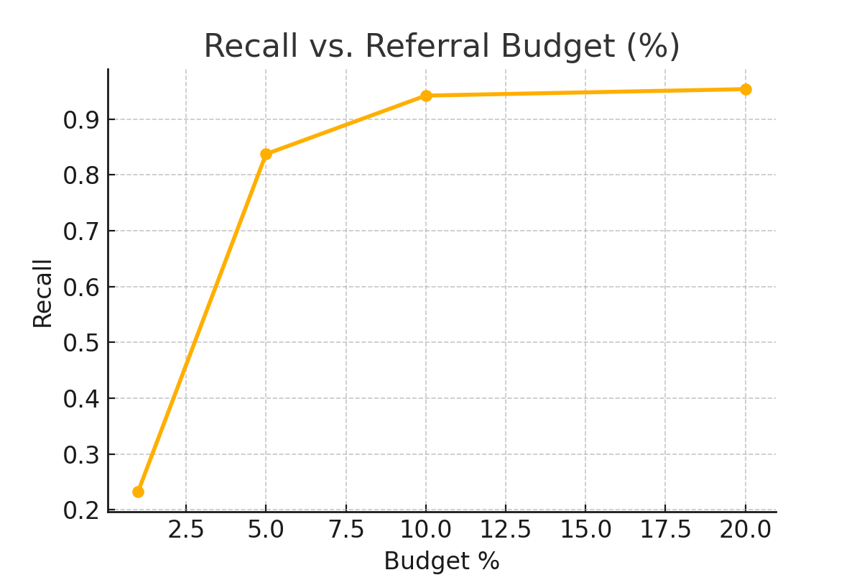
Recall vs. Referral Budget

Slide 7
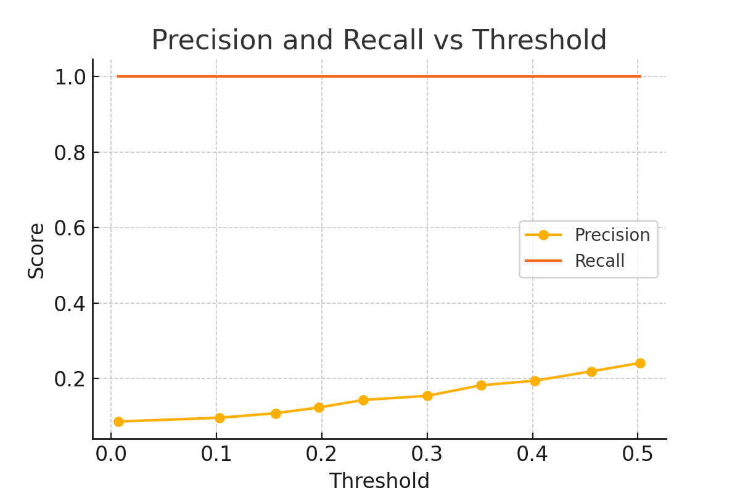
Precision and Recall vs Threshold

Slide 8
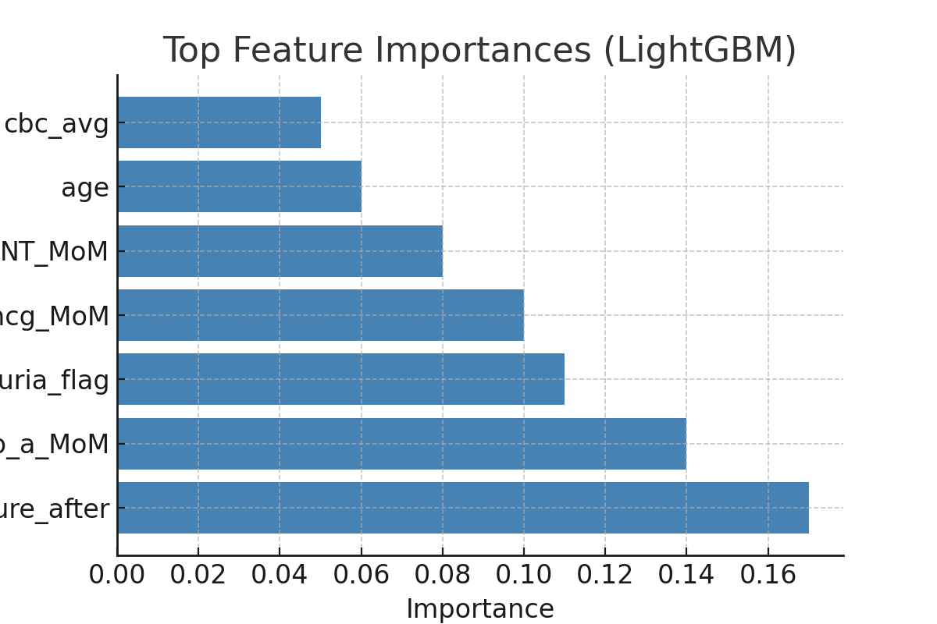
Top Feature Importances (LightGBM)

Slide 9
Summary of Approach
✔ Exploratory Data Analysis (EDA):
Inspected distributions, missing values, and variable types by feature group.
Identified non-informative columns and imputed missing values where needed.
✔ Feature Engineering:
Created clinically meaningful ratios from CBC and biochemical data.
Flagged key diagnostic conditions (e.g., proteinuria, past diagnoses).
Converted unstructured Hebrew text to TF-IDF features; selected via chi-squared.
✔ Modeling Strategy:
Chose models that handle tabular data well: LightGBM, XGBoost, etc.
Used ROC AUC and PR AUC for performance due to class imbalance.
Budget-aware evaluation: recall@top-k% used to simulate referral thresholds.
✔ Final Recommendations:
LightGBM selected for best performance and interpretability.
Recommend top 10% threshold (~94% recall) for referral to costly testing.

