Slide 1
REVIEW CLASS
Reid Offringa, PhD
Data Scientist, Glooko

Slide 2
REVIEW
Today we’ll slow things down
We’ll go over topics like:
Evaluating Datasets
Training/Testing/Cross validation
Regularization
Sklearn
Dummy variables
Then we’ll build a big Ridge Reg model in sklearn!

Slide 3
EVALUTATING MODEL FIT
Reid Offringa, PhD
Data Scientist, Glooko

Slide 4
EVALUATING DATA SETS
Build Model
EVALUATE model
USE the model
FULL
DATA
New data you’ve never seen before
MODEL

Slide 5
EVALUATIONS
PROBLEMS WITH THIS APPROACH:
Purpose of a model is to use it again!
On a different dataset!
But how do we know those data will be comparable?
What if there is some bias in our available data?

Slide 6
WHY NOT TEST THE MODEL FIRST?
Build Model
EVALUATE model
Training Set DATA
Training Set DATA
MODEL
TESTING DATA
New data you’ve never seen before

Slide 7
TRAINING VS TESTING SET
+ So we’ve got this great method
+ What are the drawbacks?
+ What if the Training vs Test split has some bias to it?
- Decrease accuracy in the new data!
- But how can we reduce this sort of bias?

Slide 8
K-fold CROSS VALIDATION (Fold == 1)
Training Set DATA
TESTING DATA
Build Model
EVALUATE model
MODEL 1

Slide 9
K-fold CROSS VALIDATION (Fold == 2)
TESTING DATA
Training Set DATA
Build Model
EVALUATE model
MODEL 2

Slide 10
K-fold CROSS VALIDATION (Fold == 3)
Training Set DATA
TESTING DATA
EVALUATE model
Build Model
MODEL 3

Slide 11
K-fold CROSS VALIDATION (Fold == 4)
Training Set DATA
TESTING DATA
Build Model
EVALUATE model
MODEL 4

Slide 12
YOU GET THE IDEA

Slide 13
Let’s Fit a Ridge Regression on a huge dataset
Open up your jupyter notebook!
Regularization, Regression and Big Datasets_Student.ipynb

Slide 14
REVIEW
GRADIENT DESCENT

Slide 15
GRADIENT DESCENT
Gradient Descent can also help us minimize error.
How Gradient Descent works:
A random linear solution is provided as a starting point
The solver attempts to find a next “step”: take a step in any direction and measure the performance.
If the solver finds a better solution (i.e. lower MSE), this is the new starting point.
Repeat these steps until the performance is optimized and no “next steps” perform better. The size of steps will shrink over time.

Slide 16
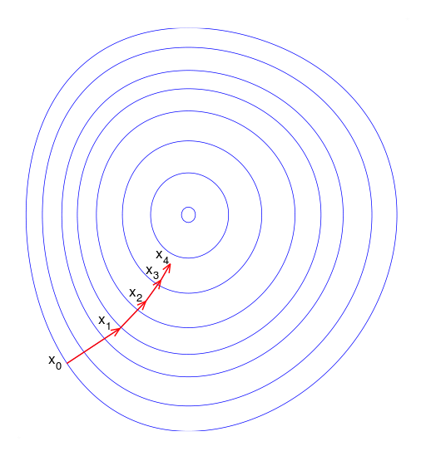
GRADIENT DESCENT

Slide 17
A PSEUDOCODE EXAMPLE OF GRADIENT DESCENT
Step 1: Choose the metric you want to optimize
Is it MSE for a model?
Is it the raw residual between y and y hat?
Is it the difference between iterative coefficient estimations?
All are possible!
Step 2: Define your starting variables for optimization
Beta_0_hat = 0
Beta_1_hat = 1
Y= outcome
X = Starting variables
Step 3: Define your formula
beta_0_hat + beta_1_hat * x
Step 4: set your criteria
For loop or “while” loop until you’ve optimized!

Slide 18
A CODE EXAMPLE OF GRADIENT DESCENT
num_to_approach, start, steps, optimized = 6.2, 0., [-1, 1], False while not optimized: current_distance = num_to_approach - start got_better = False next_steps = [start + i for i in steps] for n in next_steps: distance = np.abs(num_to_approach - n) if distance < current_distance: got_better = True print distance, 'is better than', current_distance current_distance = distance start = n

Slide 19
A CODE EXAMPLE OF GRADIENT DESCENT
if got_better: print 'found better solution! using', current_distance a += 1 else: optimized = True print start, 'is closest to', num_to_approach
What is the code doing? What could go wrong?

Slide 20
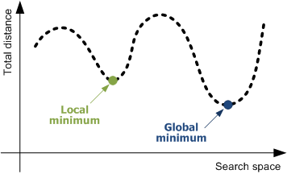
GLOBAL VS LOCAL MINIMUMS
Gradient Descent could solve for a local minimum instead of a global minimum.
A local minimum is confined to a very specific subset of solutions. The global minimum considers all solutions. These could be equal, but that’s not always true.

Slide 21
Let’s Code our own Gradient Descent!
Open up your jupyter notebook!
codealong Gradient Descent.ipynb

Slide 22
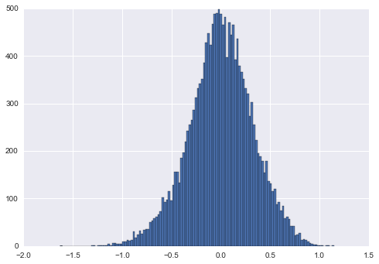
RECALL: WHAT’S RESIDUAL ERROR?
In linear models, residual error must be normal with a median close to zero.
Individual residuals are useful to see the error of specific points, but it doesn’t provide an overall picture for optimization.
We need a metric to summarize the error in our model into one value.
Mean square error: the mean residual error in our model

Slide 23
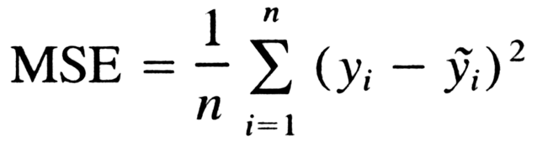
MEAN SQUARED ERROR (MSE)
To calculate MSE:
Calculate the difference between each target y and the model’s predicted value y-hat (i.e. the residual)
Square each residual.
Take the mean of the squared residual errors.

Slide 24
MEAN SQUARED ERROR (MSE)
sklearn’s metrics module includes a mean_squared_error function.
from sklearn import metrics
y = bike_data['registered']
x = bike_data[['temp', 'hum']]
lm = linear_model.LinearRegression().fit(x, y)
metrics.mean_squared_error(y, lm.predict(x))

Slide 25
DEMO
CROSS VALIDATION

Slide 26
CROSS VALIDATION
Cross validation can help account for bias.
The general idea is to
Generate several models on different cross sections of the data
Measure the performance of each
Take the mean performance
This technique swaps bias error for generalized error, describing previous trends accurately enough to extend to future trends.

Slide 27
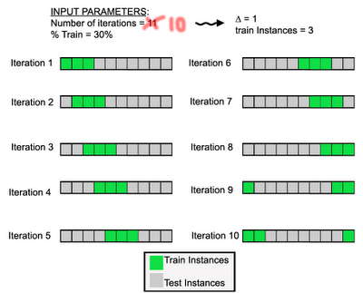
CROSS VALIDATION:
For 10 iterations
Train on 30%

Slide 28
K-FOLD CROSS VALIDATION
k-fold cross validation
Split the data into k groups
Train the model on all segments except one
Test model performance on the remaining set
If k = 5, split the data into five segments and generate five models.

Slide 29
USING K-FOLD CROSS VALIDATION WITH MSE
Import the appropriate packages and load data.
from sklearn import cross_validation wd = '../../datasets/' bikeshare = pd.read_csv(wd + 'bikeshare/bikeshare.csv') weather = pd.get_dummies(bikeshare.weathersit, prefix='weather') modeldata = bikeshare[['temp', 'hum']].join(weather[['weather_1', 'weather_2', 'weather_3']]) y = bikeshare.casual

Slide 30
USING K-FOLD CROSS VALIDATION WITH MSE
Build models on subsets of the data and calculate the average score.
kf = cross_validation.KFold(len(modeldata), n_folds=5, shuffle=True) scores = [] for train_index, test_index in kf: lm = linear_model.LinearRegression().fit(modeldata.iloc[train_index], y.iloc[train_index]) scores.append(metrics.mean_squared_error(y.iloc[test_index], lm.predict(modeldata.iloc[test_index])))
print np.mean(scores)

Slide 31
USING K-FOLD CROSS VALIDATION WITH MSE
This can be compared to the model built on all of the data.
- This score will be lower, but we're trading off bias error for generalized error: lm = linear_model.LinearRegression().fit(modeldata, y) print metrics.mean_squared_error(y, lm.predict(modeldata))
Which approach would predict new data more accurately?

Slide 32
GUIDED PRACTICE
CROSS VALIDATION WITH LINEAR REGRESSION

Slide 33

ACTIVITY: CROSS VALIDATION WITH LINEAR REGRESSION
DIRECTIONS (20 minutes)
EXERCISE
If we were to continue increasing the number of folds in cross validation, would error increase or decrease?
Using the previous code example, perform k-fold cross validation for all even numbers between 2 and 50.
Answer the following questions:
What does shuffle=True do?
At what point does cross validation no longer seem to help the model?
Hint: range(2, 51, 2) produces a list of even numbers from 2 to 50
DELIVERABLE
Answers to questions

Slide 34
INTRODUCTION
REGULARIZATION AND CROSS VALIDATION

Slide 35
WHAT IS REGULARIZATION? AND WHY DO WE USE IT?
Regularization is an additive approach to protect models against overfitting (being potentially biased and overconfident, not generalizing well).
Regularization becomes an additional weight to coefficients, shrinking them closer to zero.
L1 (Lasso Regression) adds the extra weight to coefficients.
L2 (Ridge Regression) adds the square of the extra weight to coefficients.
Use Lasso when we have more features than observations (k > n) and Ridge otherwise.

Slide 36
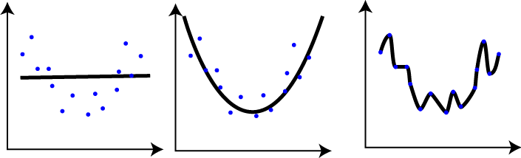
WHAT IS OVERFITTING?
The first model poorly explains the data.
The second model explains the general curve of the data.
The third model drastically overfits the model, bending to every point.
Regularization helps prevent the third model.

Slide 37
WHERE REGULARIZATION MAKES SENSE
What happens to MSE if use Lasso or Ridge Regression directly?
lm = linear_model.LinearRegression().fit(modeldata, y) print metrics.mean_squared_error(y, lm.predict(modeldata)) lm = linear_model.Lasso().fit(modeldata, y) print metrics.mean_squared_error(y, lm.predict(modeldata)) lm = linear_model.Ridge().fit(modeldata, y) print metrics.mean_squared_error(y, lm.predict(modeldata))
1672.58110765 # OLS 1725.41581608 # L1 1672.60490113 # L2

Slide 38
WHERE REGULARIZATION MAKES SENSE
It doesn’t seem to help. Why is that?
We need to optimize the regularization weight parameter (called alpha) through cross validation.

Slide 39
ACTIVITY: KNOWLEDGE CHECK
ANSWER THE FOLLOWING QUESTIONS (5 minutes)
EXERCISE
Why is regularization important?
What does it protect against and how?
DELIVERABLE
Answers to the above questions

Slide 40
DEMO
UNDERSTANDING REGULARIZATION EFFECTS

Slide 41
QUICK CHECK
We are working with the bikeshare data to predict riders over hours/days with a few features.
Does it make sense to use a ridge regression or a lasso regression?
Why?

Slide 42
UNDERSTANDING REGULARIZATION EFFECTS
Let’s test a variety of alpha weights for Ridge Regression on the bikeshare data.
alphas = np.logspace(-10, 10, 21) for a in alphas: print 'Alpha:', a lm = linear_model.Ridge(alpha=a) lm.fit(modeldata, y) print lm.coef_ print metrics.mean_squared_error(y, lm.predict(modeldata))
What happens to the weights of the coefficients as alpha increases? What happens to the error as alpha increases?

Slide 43
WE CAN MAKE THIS EASIER WITH GRID SEARCH!
Grid search exhaustively searches through all given options to find the best solution. Grid search will try all combos given in param_grid.
param_ grid = { 'intercept': [True, False], 'alpha': [1, 2, 3], }

Slide 44
WE CAN MAKE THIS EASIER WITH GRID SEARCH!
This param grid has six different options:
intercept True, alpha 1
intercept True, alpha 2
intercept True, alpha 3
intercept False, alpha 1
intercept False, alpha 2
intercept False, alpha 3
param_ grid = { 'intercept': [True, False], 'alpha': [1, 2, 3], }

Slide 45
WE CAN MAKE THIS EASIER WITH GRID SEARCH!
This is an incredibly powerful, automated machine learning tool!
from sklearn import grid_search alphas = np.logspace(-10, 10, 21) gs = grid_search.GridSearchCV( estimator=linear_model.Ridge(), param_grid={'alpha': alphas}, scoring='mean_squared_error')

Slide 46
WE CAN MAKE THIS EASIER WITH GRID SEARCH!
gs.fit(modeldata, y) print -gs.best_score_ # mean squared error here comes in negative, so let's make it positive. print gs.best_estimator_ # explains which grid_search setup worked best print gs.grid_scores_ # shows all the grid pairings and their performances.

Slide 47
GUIDED PRACTICE
GRID SEARCH CV, SOLVING FOR ALPHA

Slide 48
ACTIVITY: GRID SEARCH CV, SOLVING FOR ALPHA
DIRECTIONS (25 minutes)
EXERCISE
Modify the previous code to do the following:
Introduce cross validation into the grid search. This is accessible from the cv argument.
Add fit_intercept = True and False to the param_grid dictionary.
Re-investigate the best score, best estimator, and grid score attributes as a result of the grid search.
DELIVERABLE
New code and output that meets above requirements

Slide 49
INTRODUCTION
MINIMIZING LOSS THROUGH GRADIENT DESCENT

Slide 50
GRADIENT DESCENT
Gradient Descent can also help us minimize error.
How Gradient Descent works:
A random linear solution is provided as a starting point
The solver attempts to find a next “step”: take a step in any direction and measure the performance.
If the solver finds a better solution (i.e. lower MSE), this is the new starting point.
Repeat these steps until the performance is optimized and no “next steps” perform better. The size of steps will shrink over time.

Slide 51
GRADIENT DESCENT

Slide 52
A CODE EXAMPLE OF GRADIENT DESCENT
num_to_approach, start, steps, optimized = 6.2, 0., [-1, 1], False while not optimized: current_distance = num_to_approach - start got_better = False next_steps = [start + i for i in steps] for n in next_steps: distance = np.abs(num_to_approach - n) if distance < current_distance: got_better = True print distance, 'is better than', current_distance current_distance = distance start = n

Slide 53
A CODE EXAMPLE OF GRADIENT DESCENT
if got_better: print 'found better solution! using', current_distance a += 1 else: optimized = True print start, 'is closest to', num_to_approach
What is the code doing? What could go wrong?

Slide 54
GLOBAL VS LOCAL MINIMUMS
Gradient Descent could solve for a local minimum instead of a global minimum.
A local minimum is confined to a very specific subset of solutions. The global minimum considers all solutions. These could be equal, but that’s not always true.

Slide 55
DEMO
APPLICATION OF GRADIENT DESCENT

Slide 56
APPLICATION OF GRADIENT DESCENT
Gradient Descent works best when:
We are working with a large dataset. Smaller datasets are more prone to error.
Data is cleaned up and normalized.
Gradient Descent is significantly faster than OLS. This becomes important as data gets bigger.

Slide 57
APPLICATION OF GRADIENT DESCENT
We can easily run a Gradient Descent regression.
Note: The verbose argument can be set to 1 to see the optimization steps.
lm = linear_model.SGDRegressor() lm.fit(modeldata, y) print lm.score(modeldata, y) print metrics.mean_squared_error(y, lm.predict(modeldata))
Untuned, how well did gradient descent perform compared to OLS?

Slide 58
APPLICATION OF GRADIENT DESCENT
Gradient Descent can be tuned with
the learning rate: how aggressively we solve the problem
epsilon: at what point do we say the error margin is acceptable
iterations: when should be we stop no matter what

Slide 59
INDEPENDENT PRACTICE
ON YOUR OWN

Slide 60
ACTIVITY: ON YOUR OWN
DIRECTIONS (30 minutes)
EXERCISE
There are tons of ways to approach a regression problem.
Implement the Gradient Descent approach to our bikeshare modeling problem.
Show how Gradient Descent solves and optimizes the solution.
Demonstrate the grid_search module.
Use a model you evaluated last class or the simpler one from today. Implement param_grid in grid search to answer the following questions:
With a set of values between 10^-10 and 10^-1, how does MSE change?
Our data suggests we use L1 regularization. Using a grid search with l1_ratios between 0 and 1, increasing every 0.05, does this statement hold true? If not, did gradient descent have enough iterations to work properly?
How do these results change when you alter the learning rate?
DELIVERABLE
Gradient Descent approach and answered questions

Slide 61
ACTIVITY: ON YOUR OWN
Starter Code
params = {} # put your gradient descent parameters here gs = grid_search.GridSearchCV( estimator=linear_model.SGDRegressor(), cv=cross_validation.KFold(len(modeldata), n_folds=5, shuffle=True), param_grid=params, scoring='mean_squared_error', ) gs.fit(modeldata, y) print 'BEST ESTIMATOR' print -gs.best_score_ print gs.best_estimator_ print 'ALL ESTIMATORS' print gs.grid_scores_
EXERCISE

Slide 62
CONCLUSION
TOPIC REVIEW

Slide 63
LESSON REVIEW
What's the (typical) range of r-squared?
What's the range of mean squared error?
How would changing the scale or interpretation of y (your target variable) effect mean squared error?
What's cross validation, and why do we use it in machine learning?
What is error due to bias? What is error due to variance? Which is better for a model to have, if it had to have one?
How does gradient descent try a different approach to minimizing error?

Slide 64
COURSE
BEFORE NEXT CLASS

Slide 65
DUE DATE
BEFORE NEXT CLASS
Homework: Lesson 6

Slide 66
LESSON
EXIT TICKET
DON’T FORGET TO FILL OUT YOUR EXIT TICKET

