Slide 1
INTRO TO CLASSIFICATION
Reid Offringa, PhD
Data Scientist, Glooko

Slide 2
LEARNING OBJECTIVES
INTRO TO CLASSIFICATION
Define class labels
Understand a classification problem
Build a K-Nearest Neighbors using the scikit learn library
Learn metrics for classification accuracy and error

Slide 3
OPENING
INTRO TO CLASSIFICATION

Slide 4
INTRO TO CLASSIFICATION
So far, we’ve worked primarily with regression problems. We’ve focused on predicting a continuous set of values.
That means we’ve been able to use distance to measure how accurate our prediction is.
However, for other problems, we need to predict binary responses.
E.g.: A loan will default or it won’t.
An email is spam or isn’t spam.

Slide 5

ACTIVITY: KNOWLEDGE CHECK
ANSWER THE FOLLOWING QUESTIONS
EXERCISE
What if we want to build a model to predict a set of values, like a photo color or the gender of a baby?
Can we use regression for binary values?
Do the same principles apply?
DELIVERABLE
Answers to the above questions

Slide 6
INTRODUCTION
WHAT IS CLASSIFICATION?

Slide 7
WHAT IS CLASSIFICATION?
Classification is a machine learning problem for :
Predicting a categorical outcome
Many classification problems are trying to predict binary values.
For example, we may be using patient data (medical history)
to predict whether the patient is a smoker or not.

Slide 8

WHAT IS CLASSIFICATION?
Some problems don’t appear to be binary at first glance.
But you can it boil down to a boolean (true/false) value.
What if you are predicting whether an image pixel will be red or blue?
We don’t need to predict that a pixel is blue, just that it is not red.
This is similar to the concept of dummy variables.

Slide 9
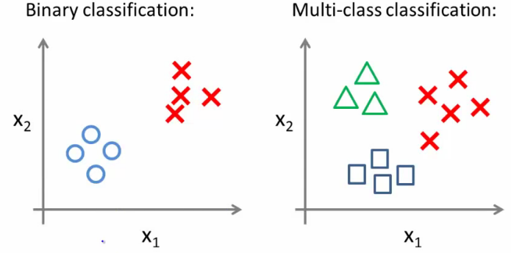
WHAT IS CLASSIFICATION?
Binary classification is the simplest form of classification.
However, classification problems can have multiple class labels.
Instead of predicting whether the pixel is red or blue, you could predict whether the pixel is red, blue, or green.

Slide 10
WHAT IS A CLASS LABEL?
A class label is a representation of what we are trying to predict: our target.
Examples of class labels from before are:
Data Problem | Class Labels
Patient data problem | is smoker, is not smoker
pixel color | red, blue, green

Slide 11
GUIDED PRACTICE
REGRESSION OR CLASSIFICATION?

Slide 12
DETERMINING REGRESSION OR CLASSIFICATION
One of the easiest ways to determine if a problem is regression or classification is to determine if our target variable can be ordered mathematically.
For example, if predicting company revenue, $100MM is greater than $90MM. This is a regression problem because the target can be ordered.
However, if predicting pixel color, red is not inherently greater than blue. Therefore, this is a classification problem.

Slide 13
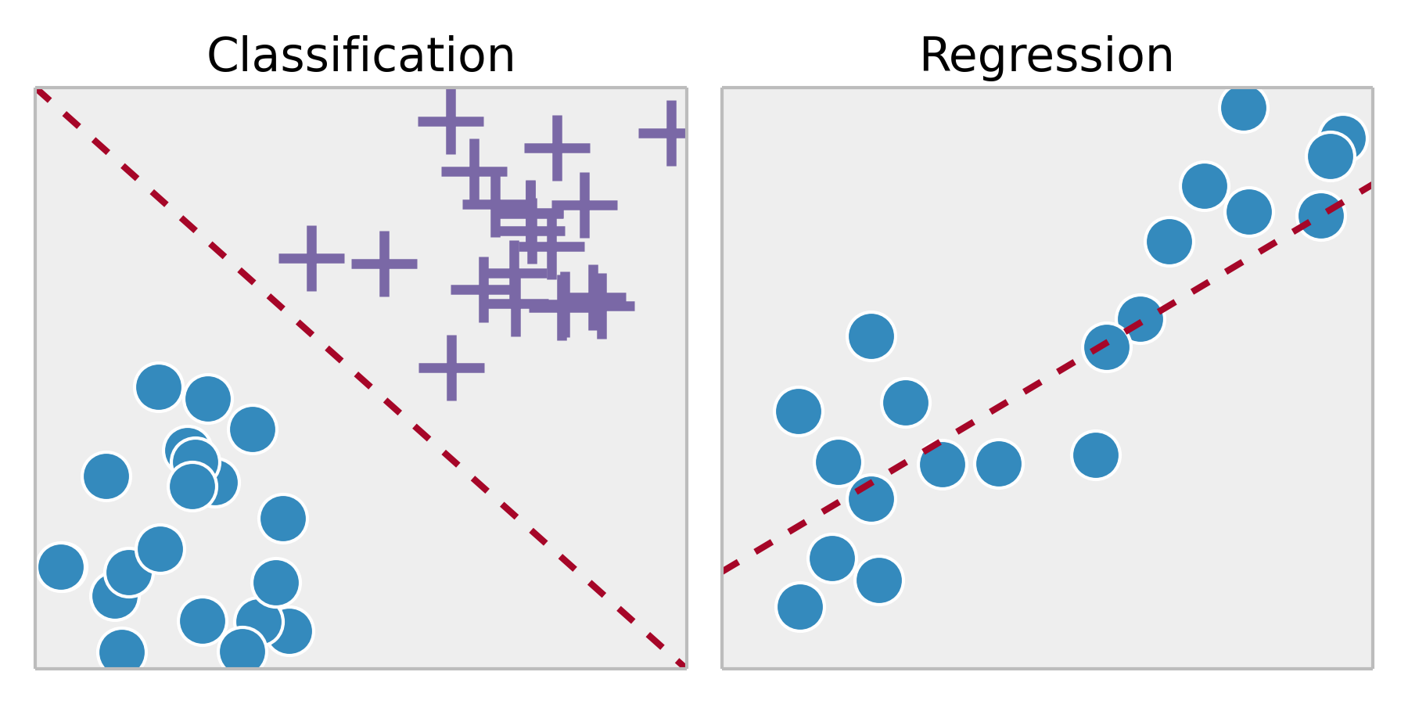
DETERMINING REGRESSION OR CLASSIFICATION
Classification and regression differ in what you are trying to predict.

Slide 14
ACTIVITY: REGRESSION OR CLASSIFICATION?
DIRECTIONS
EXERCISE
Review the following situations and decide if each one is a regression problem, classification problem, or neither:
Using the total number of explosions in a movie, predict if the movie is by JJ Abrams or Michael Bay.
Determine how many tickets will be sold to a concert given who is performing, where, and the date and time.
Given the temperature over the last year by day, predict tomorrow's temperature outside.
Using data from four cell phone microphones, reduce the noisy sounds so the voice is crystal clear to the receiving phone.
With customer data, determine if a user will return or not in the next 7 days to an e-commerce website.
DELIVERABLE
Answers to the above questions

Slide 15
INDEPENDENT PRACTICE
BUILD A CLASSIFIER!

Slide 16
ACTIVITY: BUILD A CLASSIFIER!
DIRECTIONS (20 minutes)
EXERCISE
Re-explore the iris dataset and build a program that classifies each data point. Use if-else statements and some Pandas functions.
Measure the accuracy of your classifier using the math of “total correct” over “total samples”.
Your classifier should be able to:
Get one class label 100% correct (one type of iris is easily distinguishable from the other two).
Accurately predict the majority of the other two classes with some error (hint: make sure you generalize).
DELIVERABLE
Classification program for the iris dataset

Slide 17
ACTIVITY: BUILD A CLASSIFIER!
STARTER CODE
EXERCISE
from sklearn import datasets, neighbors, metrics import pandas as pd
iris = datasets.load_iris() irisdf = pd.DataFrame(iris.data, columns=iris.feature_names) irisdf['target'] = iris.target cmap = {'0': 'r', '1': 'g', '2': 'b' } irisdf['ctarget'] = irisdf.target.apply(lambda x: cmap[str(x)])

Slide 18
ACTIVITY: BUILD A CLASSIFIER!
STARTER CODE
EXERCISE
irisdf.plot('petal length (cm)', 'petal width (cm)', kind='scatter', c=irisdf.ctarget) print irisdf.plot('petal length (cm)', 'petal width (cm)', kind='scatter', c=irisdf.ctarget) print irisdf.describe()

Slide 19
ACTIVITY: BUILD A CLASSIFIER!
STARTER CODE
EXERCISE
# starter code def my_classifier(row): if row['petal length (cm)'] < 2: return 0 else: return 1 predictions = irisdf.apply(my_classifier, axis=1)

Slide 20
ACTIVITY: BUILD A CLASSIFIER!
DIRECTIONS
EXERCISE
Answer the following questions.
How simple could the if-else classifier be while remaining relatively accurate?
How complicated could our if-else classifier be and remain completely accurate? How many if-else statements would you need, or nested if-else statements, in order to get the classifier 100% accurate? (The above uses a count of 2).
Which if-else classifier would work better against iris data that it hasn't seen? Why is that the case?
DELIVERABLE
Answers to the above questions

Slide 21
INTRODUCTION
WHAT IS K NEAREST NEIGHBORS?

Slide 22
WHAT IS K NEAREST NEIGHBORS?
K Nearest Neighbors (KNN) is a classification algorithm that makes a prediction based upon the closest data points.
The KNN algorithm:
For a given point, calculate the distance to all other points.
Given those distances, pick the k closest points.
Calculate the probability of each class label given those points.
The original point is classified as the class label with the largest probability (“votes”).

Slide 23
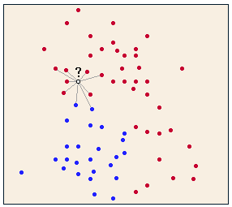
WHAT IS K NEAREST NEIGHBORS?
KNN uses distance to predict a class label. This application of distance is used as a measure of similarity between classifications.
We’re using shared traits to identify the most likely class label.

Slide 24
WHAT IS K NEAREST NEIGHBORS?
Suppose we want to determine your favorite type of music. How might we determine this without directly asking you?
Generally, friends share similar traits and interests (e.g. music, sports teams, hobbies, etc). We could ask your five closest friends what their favorite type of music is and take the majority vote.
This is the idea behind KNN: we look for things similar to (or close to) our new observation and identify shared traits. We can use this information to make an educated guess about a trait of our new observation.

Slide 25
ACTIVITY: KNOWLEDGE CHECK
ANSWER THE FOLLOWING QUESTIONS
EXERCISE
In what other tasks do we use a heuristic similar to K Nearest Neighbors?
DELIVERABLE
Answers to the above questions

Slide 26
DEMO
KNN IN ACTION

Slide 27
WHAT HAPPENS IN TIES?
What happens if two classes get the same number of votes?
This could happen in binary classification if we use an even number for k. This could also happen if there are multiple class labels.
In sklearn, it will choose the class that it first saw in the training set.

Slide 28
WHAT HAPPENS IN TIES?
We could implement a weight, taking into account the distance between the point and its neighbors.
This can be done in sklearn by changing the weights parameter to ”distance”.
Try changing the weights parameter. How does this affect accuracy?

Slide 29
WHAT HAPPENS IN HIGH DIMENSIONALITY?
Since KNN works with distance, higher dimensionality of data (i.e. more features) requires significantly more samples in order to have the same predictive power.
Consider this: with more dimensions, all points slowly start averaging out to be equally distant. This causes significant issues for KNN.
Keep the feature space limited and KNN will do well. Exclude extraneous features when using KNN.

Slide 30
WHAT HAPPENS IN HIGH DIMENSIONALITY?
Consider two different examples:
classifying users of a newspaper and users of a particular toothpaste.
The features of the newspapers are very broad and there are many: sections, topics, types of stories, writers, online vs print, etc.
However, the features of a toothpaste are more narrow: has fluoride, controls tartar, etc.
For which problem would KNN work better?

Slide 31
Let’s open the starter code
AND BUILD A KNN MODEL!

Slide 32
INTRODUCTION
CLASSIFICATION METRICS

Slide 33
INTRODUCTION TO CLASSIFICATION METRICS
Metrics for regression do not apply to classification.
We could measure the distance between the probability of a given class and an item being in that class. Guessing 0.6 for a 1 is a 0.5 error.
But this overcomplicates our goal: understanding binary classification, whether something is black or white, right or wrong.
To do this, we’ll measure “correctness” or “incorrectness”.

Slide 34
INTRODUCTION TO CLASSIFICATION METRICS
We’ll use two primary metrics: accuracy and misclassification rate.
Accuracy is the number of correct predictions out of all predictions in the sample. This is a value we want to maximize.
Misclassification rate is the number of incorrect predictions out of all predictions in the sample. This is a value we want to minimize.
These two metrics are directly opposite of each other.
1 - misclassification rate = accuracy

Slide 35
CONFUSION MATRIX
Prediction
Positive Predictions
Negative Predictions
Positive Observations
True Positive
False Negative
(Type II Error)
Reality
Negative Observations
False Positive
(Type I Error)
True Negative

Slide 36
CONFUSION MATRIX: ACCURACY
+
True Positive
True Positive
False Negative
(Type II Error)
False Positive
(Type I Error)
True Negative
True Negative

Slide 37
CONFUSION MATRIX: Precision
True Positive
True Positive
False Negative
(Type II Error)
False Positive
(Type I Error)
True Negative
Positive Predictions

Slide 38
CONFUSION MATRIX: Recall
True Positive
True Positive
False Negative
(Type II Error)
False Positive
(Type I Error)
True Negative
Positive Observations

Slide 39
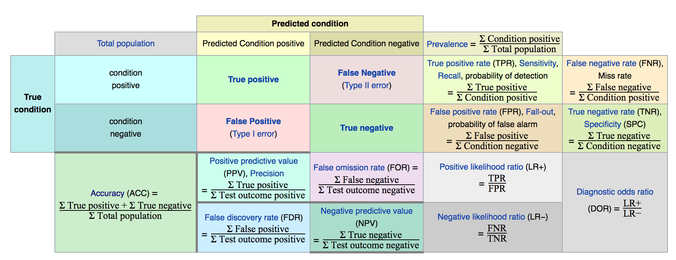
CONFUSION MATRIX – with all evaluation metrics!

Slide 40
INDEPENDENT PRACTICE
SOLVING FOR K

Slide 41
ACTIVITY: SOLVING FOR K
DIRECTIONS (35 minutes)
EXERCISE
One of the primary challenges of KNN is solving for k - how many neighbors do we use?
The smallest k we can use is 1. However, using only one neighbor will probably perform poorly.
The largest k we can use is n-1 (every other point in the data set). However, this would result in always choosing the largest class in the sample. This would also perform poorly.
Use the lesson 8 starter code and the iris data set to answer the following questions:
What is the accuracy for k=1?
What is the accuracy for k=n-1?
Using cross validation, what value of k optimizes model accuracy. Create a plot with k as the x-axis and accuracy as the y-axis (called a “fit chart”) to help find the answer.
DELIVERABLE
Answers to the above questions

Slide 42
ACTIVITY: SOLVING FOR K
STARTER CODE
EXERCISE
from sklearn import grid_search params = {'n_neighbors': } gs = grid_search.GridSearchCV( estimator=, param_grid=, cv=, ) gs.fit(iris.data, iris.target) gs.grid_scores_

Slide 43
ACTIVITY: SOLVING FOR K
DIRECTIONS
EXERCISE
Bonus Questions:
By default, the KNN classifier in sklearn uses the Minkowski metric for distance.
What type of data does this metric work best for?
What type of data does this distance metric not work for?
You can read about distance metrics in the sklearn documentation.
It is possible to use KNN as a regression estimator. Determine the following:
Steps that KNN Regression would follow
How it predicts a regression value
DELIVERABLE
Answers to the above questions

Slide 44
CONCLUSION
TOPIC REVIEW

Slide 45
REVIEW
What are class labels? What does it mean to classify?
How is a classification problem different from a regression problem? How are they similar?
How does the KNN algorithm work?
What primary parameters are available for tuning a KNN estimator?
How do you define: accuracy, misclassification?

Slide 46
DUE DATE
BEFORE NEXT CLASS
Project: Final Project, Deliverable 1

Slide 47
LESSON
Q & A

Slide 48
LESSON
EXIT TICKET
DON’T FORGET TO FILL OUT YOUR EXIT TICKET

