Slide 1
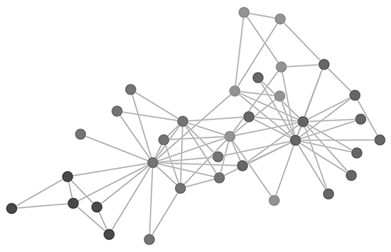
TCP Server - Client Project : Graph Theory Algorithms
By Daniel Shmayovich, Gari Zeldich and Matan Faragian

Slide 2
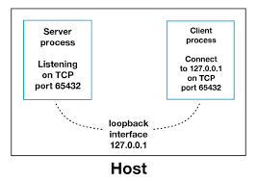
Main Idea:
Building a Server-Client Model, based on Multi-Threading methodology, so the server will serve multiple clients in parallel.
The server will be able to solve advanced algorithmic problems related to Graph Theory field.

Slide 3
The Missions:
Mission 1 – finding connected components in a graph
Mission 2 – finding all the shortest paths between a given source node in the graph and a target.
Mission 3 – finding all the legal submarines in a given matrix.
Mission 4 – finding all the paths (not just the shortests) between 2 nodes.

Slide 4
Classes
Graph – Includes all the complex algorithms that solve the missions.
TCP Server & Client
Matrix Handler – Manages the requests that come from the clients, and activates the appropriate functions.
Matrix & Index – Represents objects of 2D array, and an index in the matrix.

Slide 5
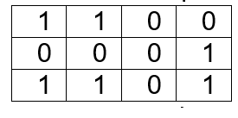
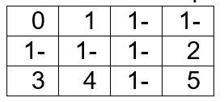
Work flow
- Each mission handled in a separate function (with identical name – “mission1/2/3/4”).
We changed the matrix to be valued instead of binary matrix (in the function “UpdateMatrix”).
We changed the value of 1 to be 0,1,2,3…etc, and the value of 0 to be -1.
Each node in the graph will be represented as a number.

Slide 6
Work Flow
We kept for each value the appropriate index in the array “fromValueToIndex”.
Then there is the Instance of the class Graph that is have been creatd.
Run the function “getAllEdges”:
for each node – find his neigbors by running the function “getReachebls”.
Runing the function “addEdge” in the class Graph – it will initialize the adjListArray that shows for each node the edges he have.

Slide 7
Mission1
Runing the function “connectedComponents” in the Graph class.
Using DFS algorithm to find al the connected components in the graph.
In the end, returned an List of HashSets, and each HashSet represents a component.

Slide 8
Mission3
Using Mission1.
Taking the List of the components, and for each node chedock:
Looping over all the nodes in the component:
If the number of nodes in the components is 2 or above
And each one of the nodes is not a part of a diagonal (using the function “findingDiagonals”)
So, this component is legal submarine.
In the end, returns the number of the legal submarines in the matrix.

Slide 9
Mission4 & MISSION2
Running the function “findAllPaths” in the class graph, with a given source node and a target node. A recursive function, similar to BFS algorithm.
It will return a list of list with all the optional paths from the source to the targrt.
In mission 2, we taking the list we saved at mission 4, we finds what is the shortest in the list, and we return a list of all the shortest paths we found on that list.

