Slide 1
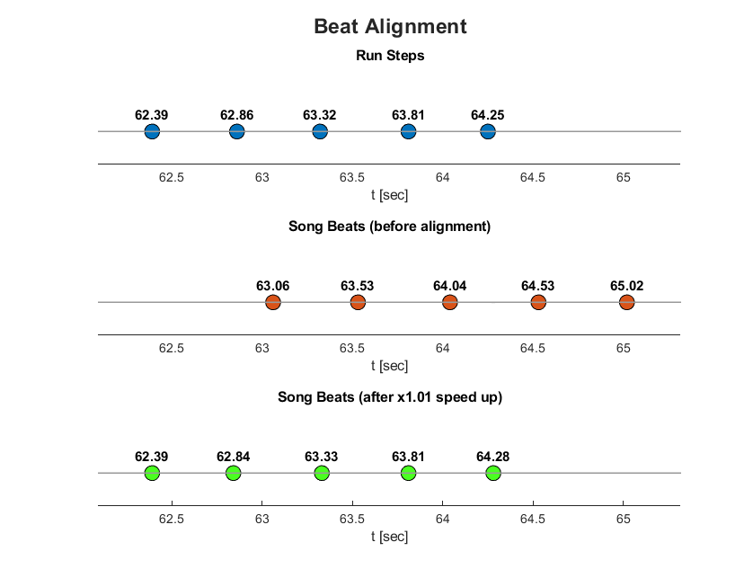
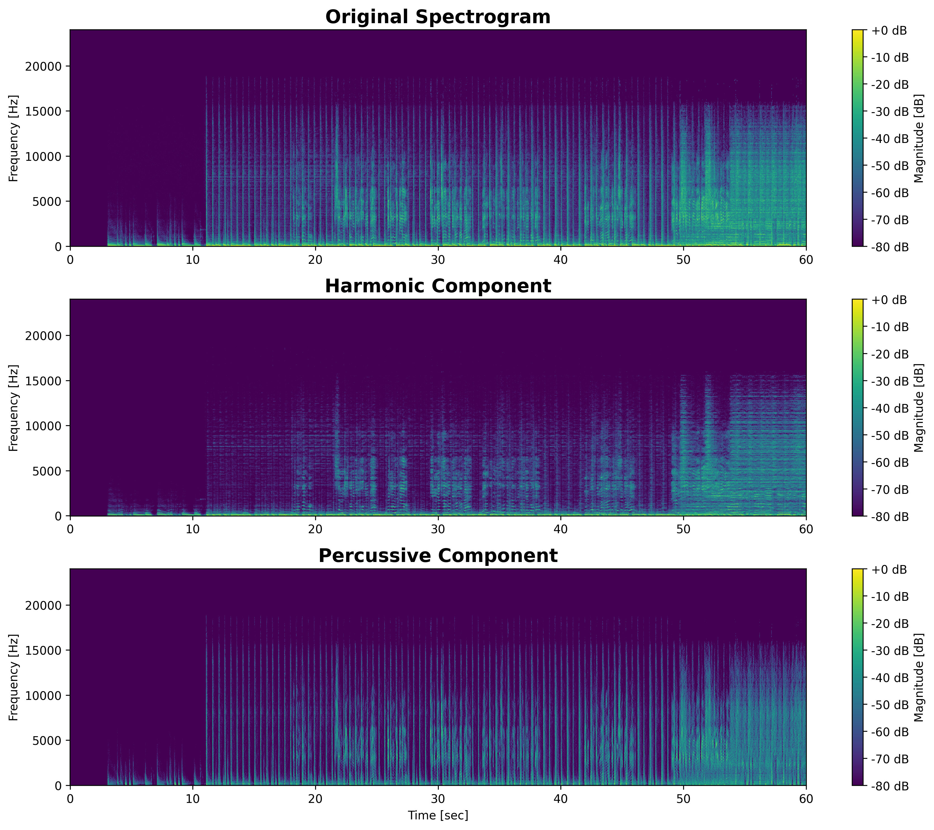
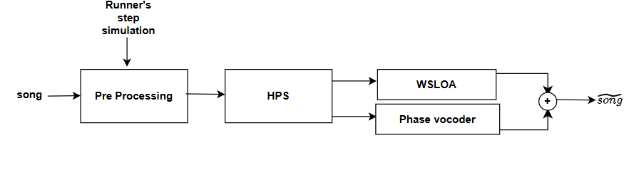
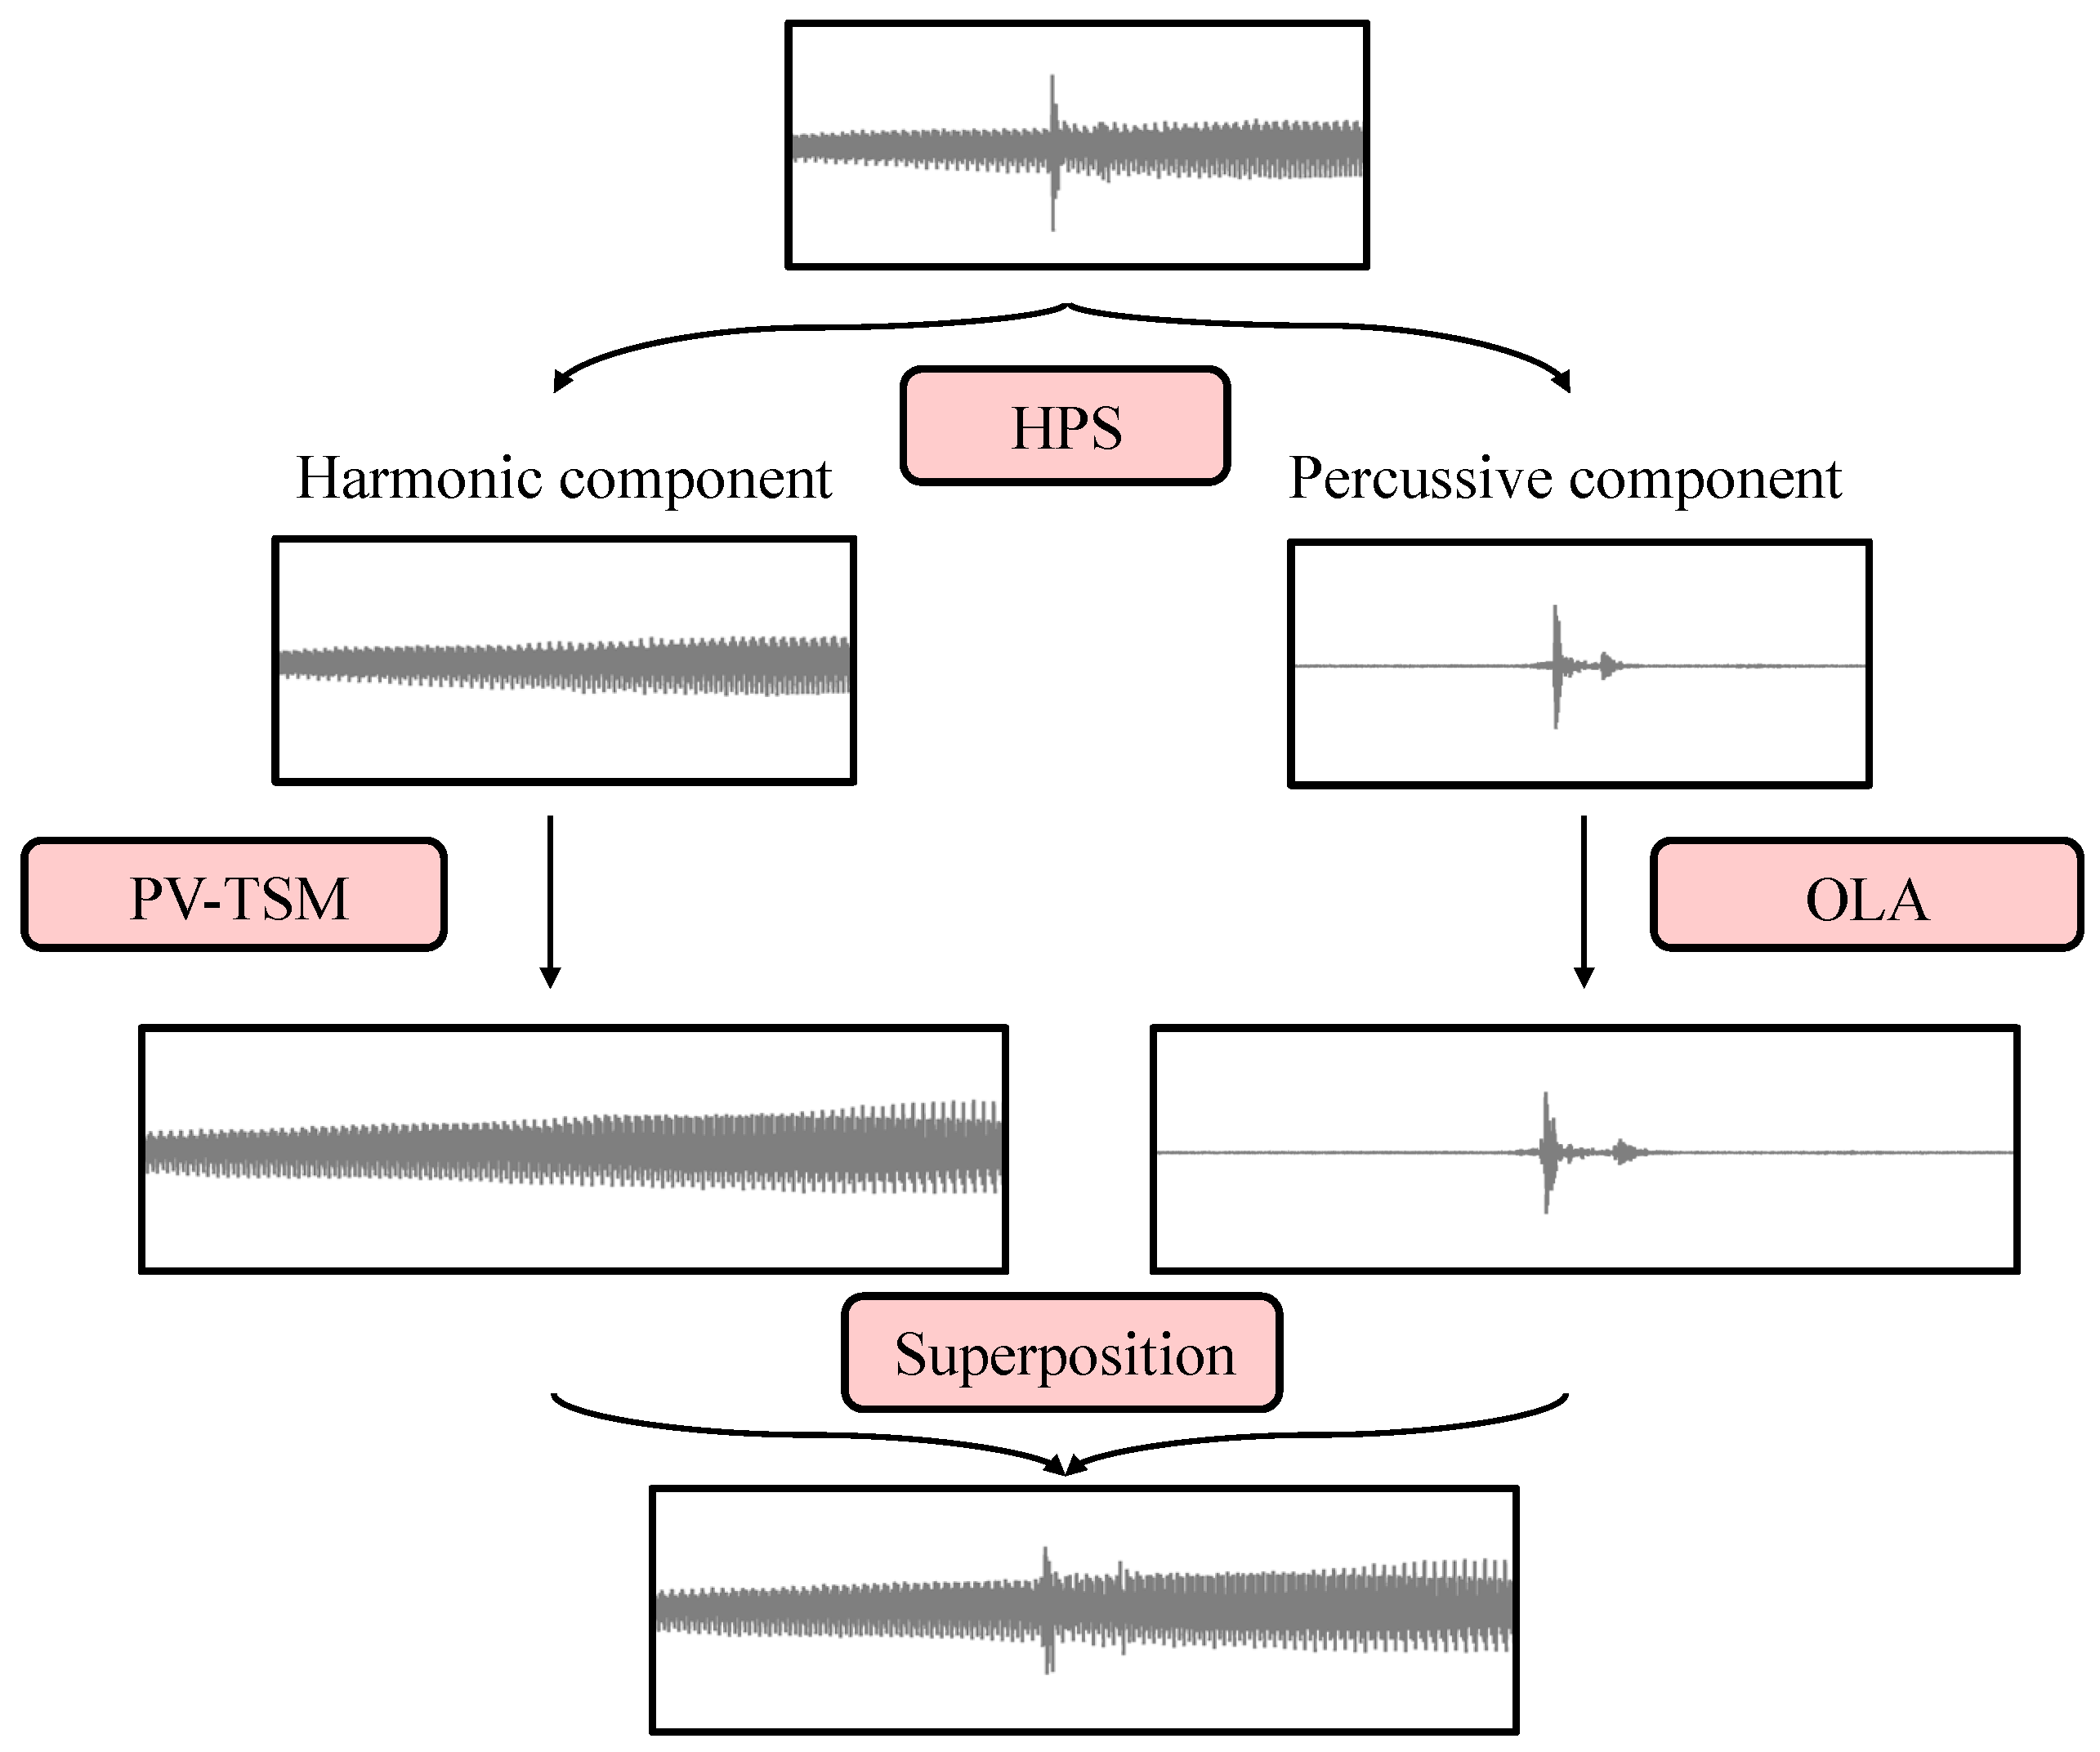


SyncRun – Align Music to Run
Matan Granot, Yogev Grinblatt
Advisor: Dr. Lior Arbel
Project Number: 25-1-1-3408
Introduction
In our project, we want to adjust a simple rhythmic song – like “Seven Nation Army” to match the simulated steps of a runner, during his various workouts.
This is done by using DSP algorithms, to find the optimal speed-up/speed-down rate, and to stretch the audio by the best value, while keeping the pitch of the original song. These algorithms are implemented in python.
Motivation
We want to give the runner smoother running experience. Because in reality, most of the songs are slower than the average runner pace.
Implementation
Pre-processing:
First, we make 2 time-stamped vectors – One song beats time stamps (using beat track), Second is run steps time stamps.
Then we do beat alignment - divide those vectors in segments of 2.5 seconds, and find the best speed-up ratio for each segment, in terms of L1 distance.
$${r_{opt}=argmin}_{r}\{\left\|\vec{beats}−r_{speed−up}∗\vec{steps}\right\|\}$$
HPS (Harmonic-Precussive Separation):
we apply STFT (Short Time Fourier Transform) :
$$X\left[m, k\right]=\sum_{n=0}^{N−1}{x\left[n+mH\right]⋅w\left[n\right]⋅e^{−j\frac{2π}{N}kn } }$$
And use median filters to separate the harmonic and percussive content.
WSOLA - Changes audio duration without altering pitch by overlapping similar time-domain waveforms.
Phase vocoder (PV-TSM) - Independently controls time and pitch using the STFT to adjust frequency phases.
Results
Harmonic – Percussive Separation:
Our algorithm successfully splits the original audio into its sustained, pitched sounds (horizontal lines in the Harmonic plot) and sharp, transient drum hits (vertical lines in the Percussive plot).
Performance:
References
[1] Jonathan Driedger and Meinard Müller, “A Review of Time-Scale Modification of
Music Signals”, Applied Sciences (2016), volume 6, article 57.
Block Diagram
Criteria | Result
Average Beat Alignment Error | 15.67 ms
Average Segment Latency | 475 ms
Elapsed Time | 38.47 sec
WS

