Slide 1
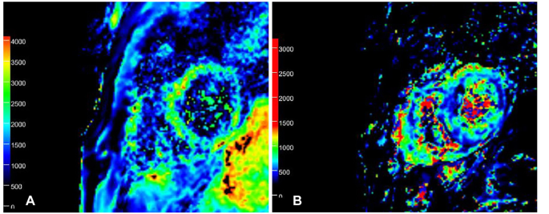
Intravoxel incoherent motion (IVIM)

Slide 2
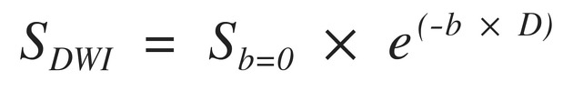

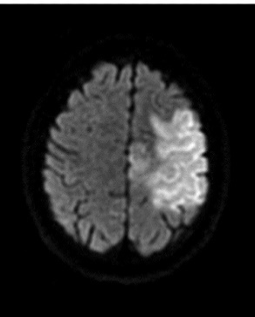
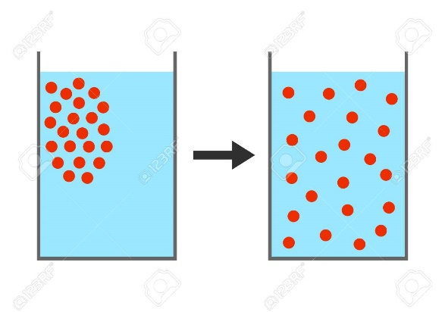
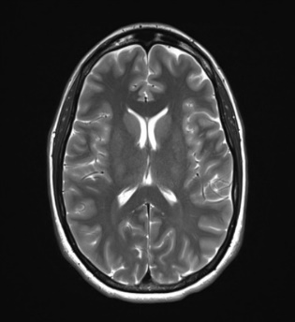
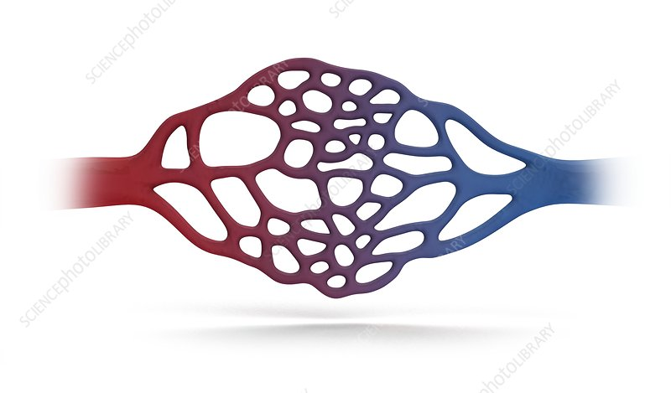



Intravoxel incoherent motion (IVIM)
DWI
Diffusion
T2
perfusion
$\hat{D_{t}}$
$\hat{D_{p}}$
$\hat{F_{p}}$
Notes:
תזכורת

Slide 3
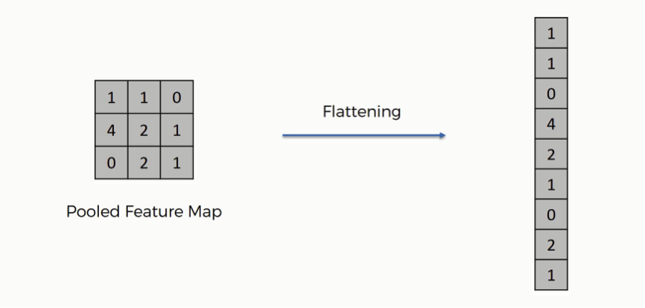
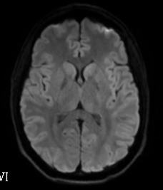
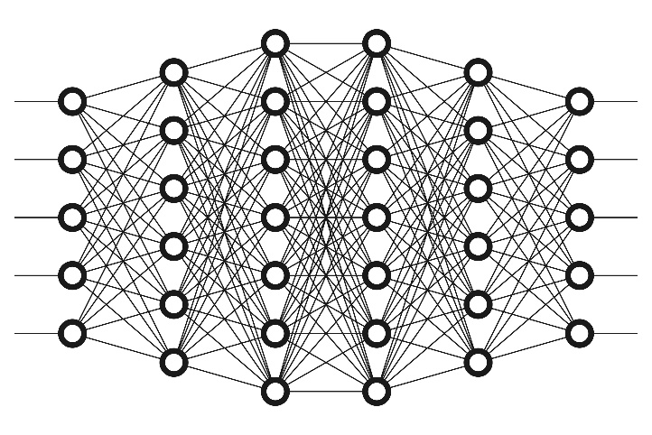


Deep Learning How to Fit an Intravoxel Incoherent Motion Model to Diffusion-Weighted MRI
split
train
flatten
crop
Trained net
Predict
$\hat{D}$
$\hat{D_{p}}$
$\hat{F_{p}}$
Notes:
איך הרשת עובדת – לא היה ברור בהצגה הקודמת
ואז נדלג למה עשינו, לא?
תגידי שהמטרה שלנו הייתה לקחת את הרשת הזאת ולעשות כל מיני שינויים בדומה למאמר
כדי לשפר את התוצאות וללמוד

Slide 4
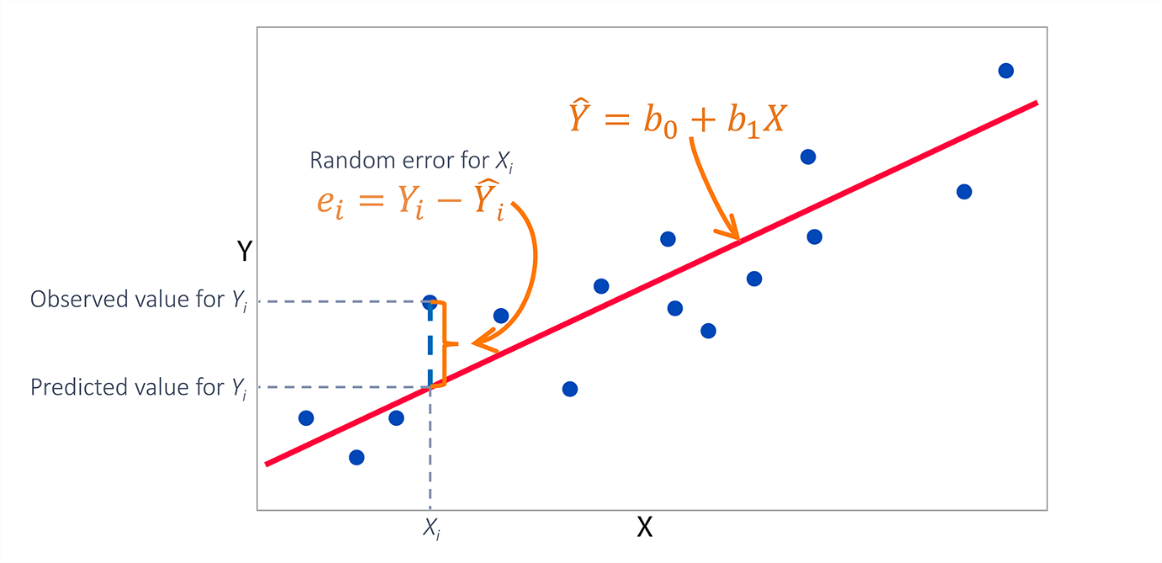
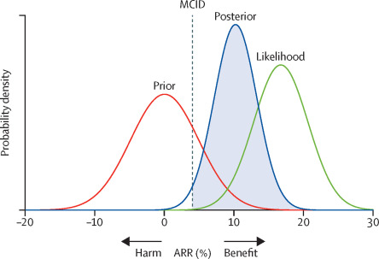
Current approach
Least-squares
Bayesian-probability approach
Notes:
Bayesian more accurate
Bayesian approaches are substantially slower (9 × 10−2 s/vox (11)) than the already slow LS approach (8 × 10−3 s/vox (11)).
Furthermore, Bayesian approaches may lead to biased perfusion estimates of the IVIM model.

Slide 5
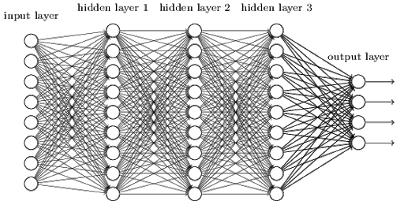





Deep Learning How to Fit an Intravoxel Incoherent Motion Model to Diffusion-Weighted MRI
$\hat{F_{p}}$
DWI
T2
/
$\hat{D_{p}}$
$\hat{D_{t}}$
The number of neurons equal to the number of b-values
3 neurons in the output layer
Notes:
אפשר להזכיר שבהצגה הקודמת הזכרנו שני רשתות – רשת מ
קורית, שזה מה שמופיע כאן עם RELU וכל הדברים
ורשת שנייה עם כל מיני שיפורים שכותבי המאמר הוסיפו
כמו:

Slide 6
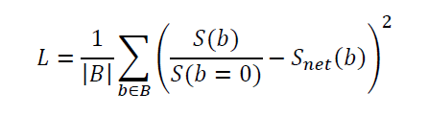
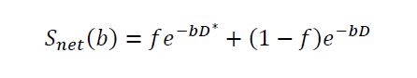
Loss
$\hat{F_{p}}$
DWI
T2
/
$\hat{D_{p}}$
$\hat{D_{t}}$

Slide 7
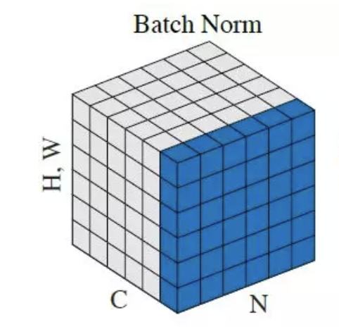
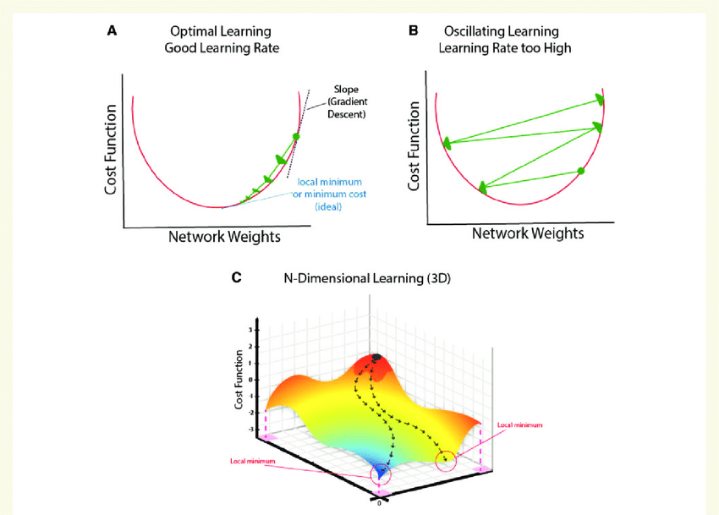
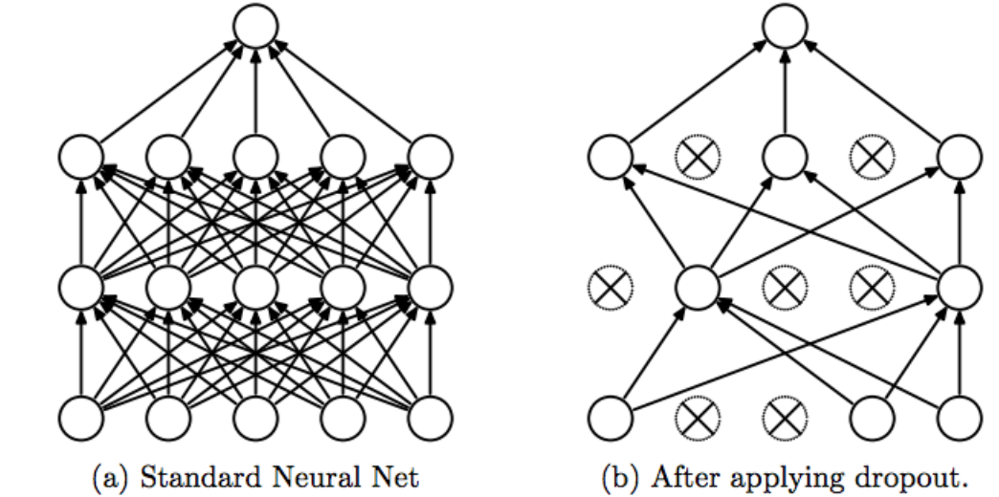
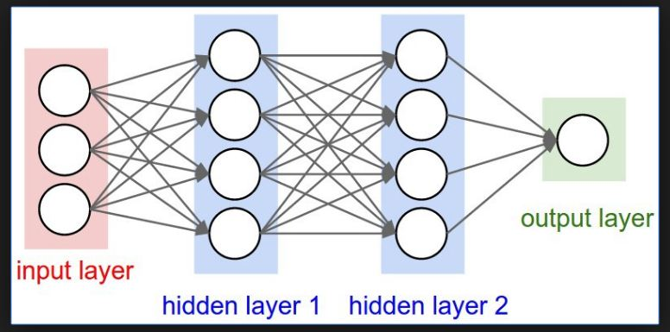
IVIM-NET optim
Number of hidden layer
Dropout
Notes:
לדלג מהר על השקפים האלה
ואז להגיד שהמטרה שלנו היה לעשות כל מיני שינויים דומים ולראות מה קורה
סבבה?

Slide 8

IVIM-NET optim
$\hat{F_{p}}$
$\hat{D_{p}}$
$\hat{D_{t}}$
$\hat{S_{0}}$

Slide 9
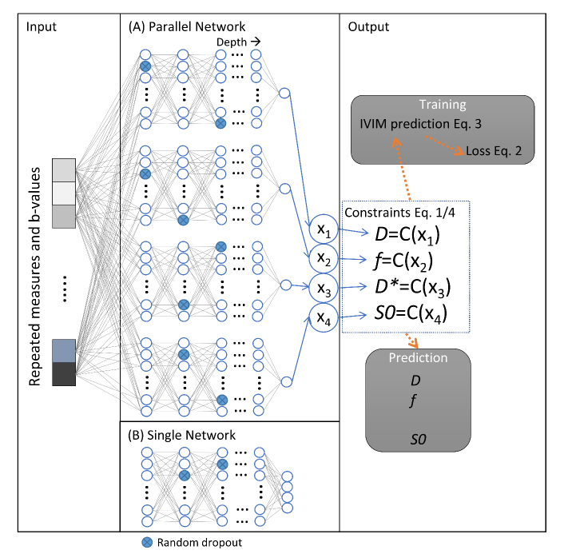
IVIM-NET optim

Slide 10
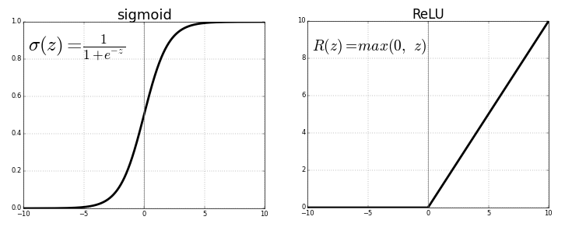

IVIM-NET optim
Sigmoid or Relu

Slide 11
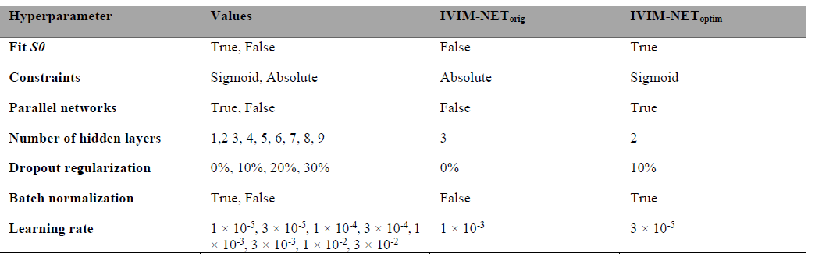
IVIM-NET optim - Result

Slide 12
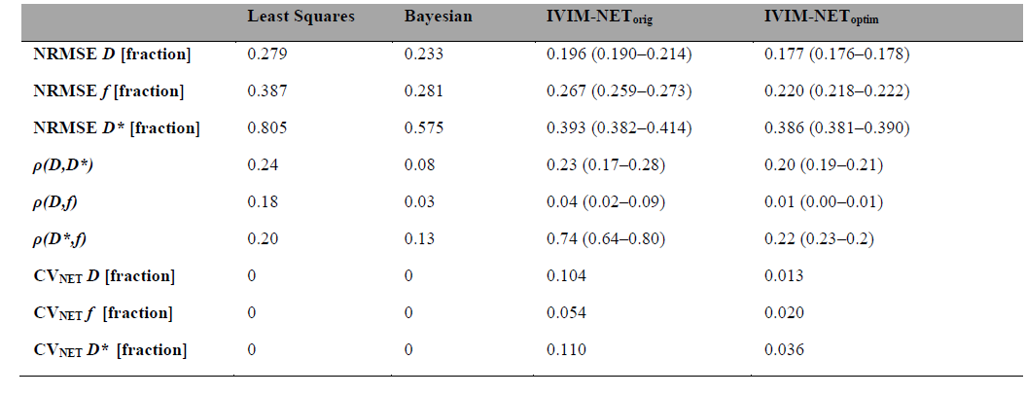
IVIM-NET optim - Result

Slide 13





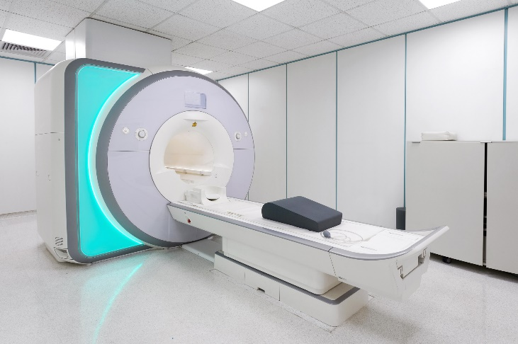
Database
16 healthy controls
9 SCA2 patients
T1
T2
15 DWI
Bval = 1000
X 2
Notes:
Nine SCA2 patients and 16 age-matched healthy controls, were examined twice on the same 1.5T MRI scanner.

Slide 14
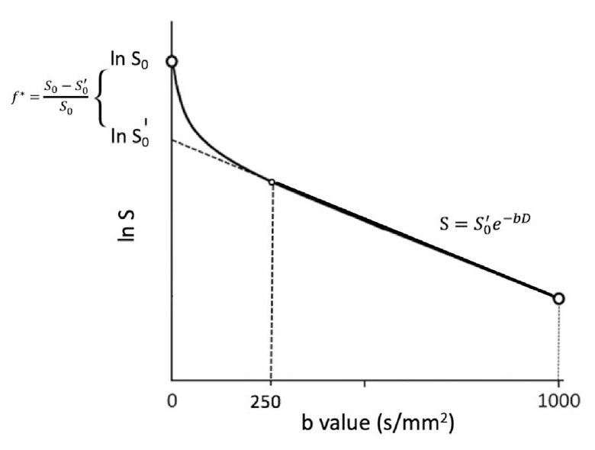
Database

Slide 15
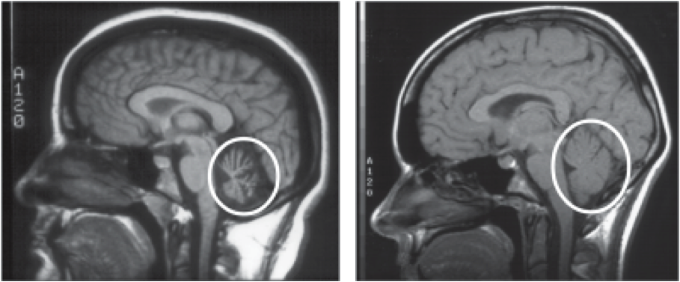
Spinocerebellar Ataxia Type 2 (SCA2)
Notes:
SCA2 -a progressive disorder that causes symptoms including uncoordinated movement (ataxia), speech and swallowing difficulties, muscle wasting, slow eye movement, and sometimes dementia

Slide 16
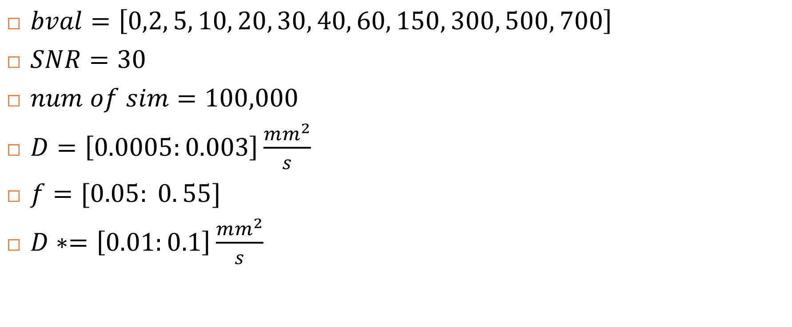
Simulation parameters
$bval=\left[0,2, 5, 10, 20, 30, 40, 60, 150, 300, 500, 700\right]$
$SNR=30$
$num of sim=100,000$
$D=\left[0.0005:0.003\right]\frac{mm^{2}}{s}$
$f=[0.05: 0. 55]$
$D∗=\left[0.01:0.1\right]\frac{mm^{2}}{s}$

Slide 17
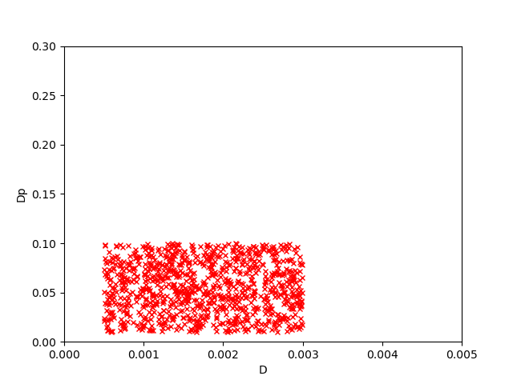
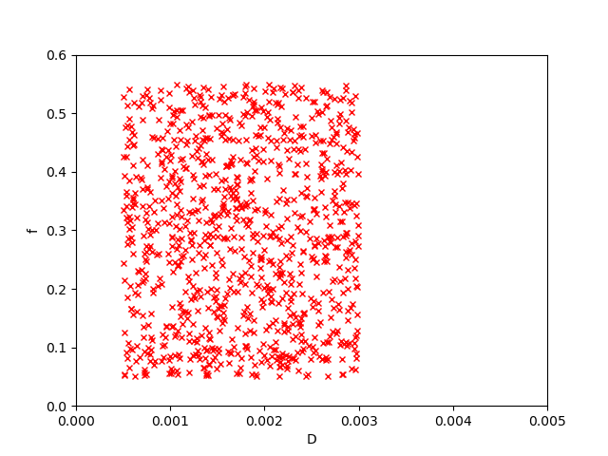
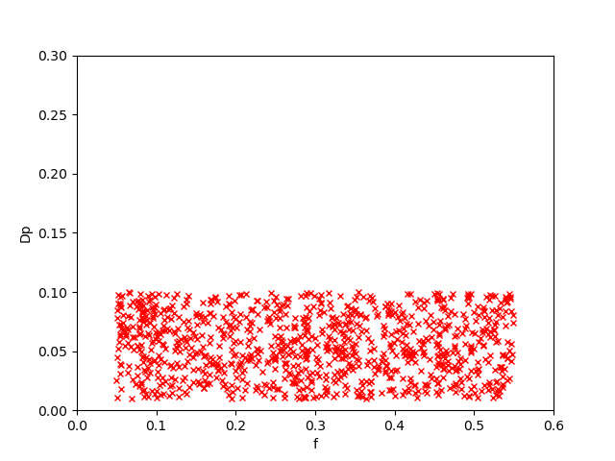
Simulation
D vs Dp
D vs f
f vs Dp

Slide 18
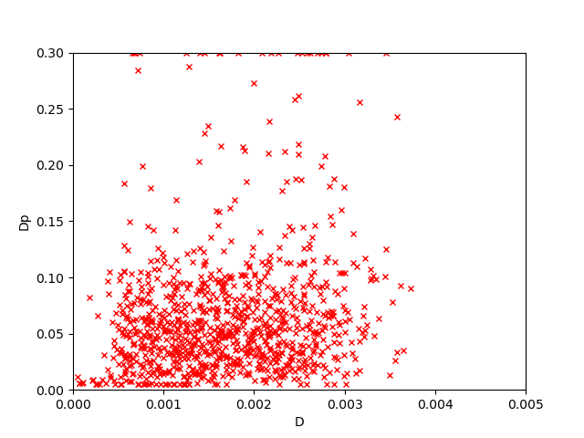
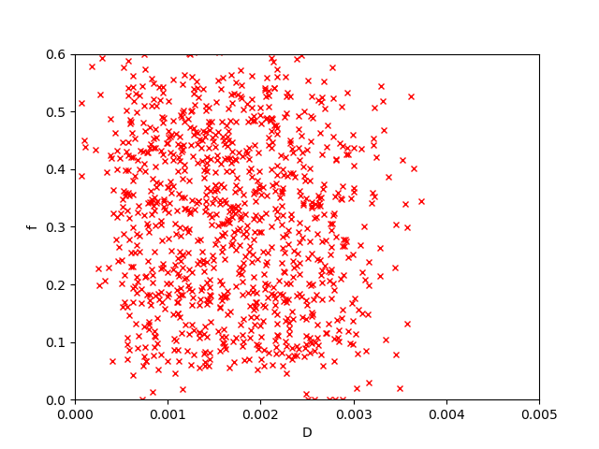
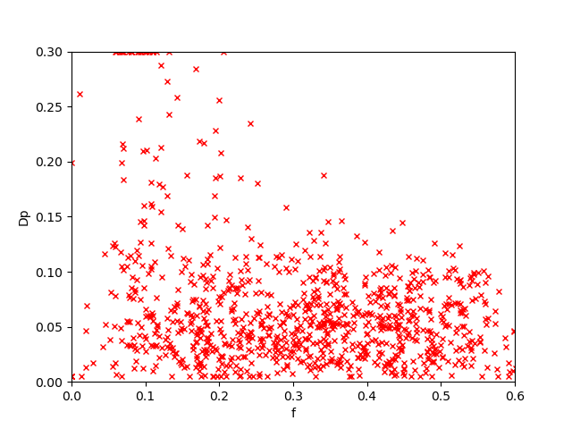
Result - LS
D vs Dp
D vs f
f vs Dp

Slide 19
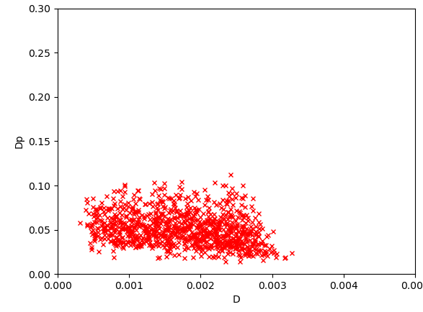
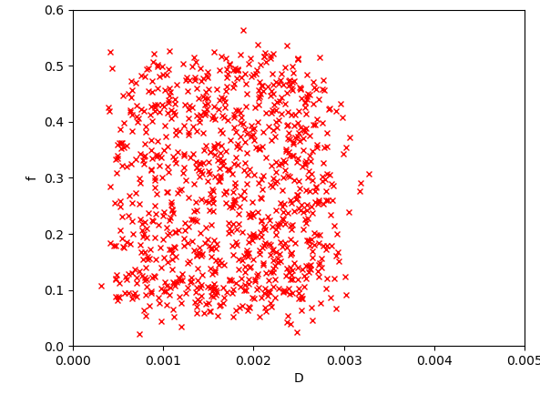
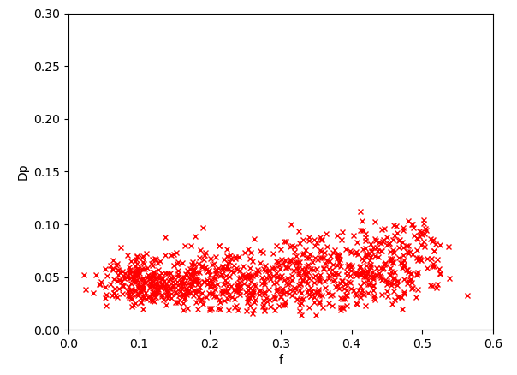
Result - Net
D vs Dp
D vs f
f vs Dp

Slide 20
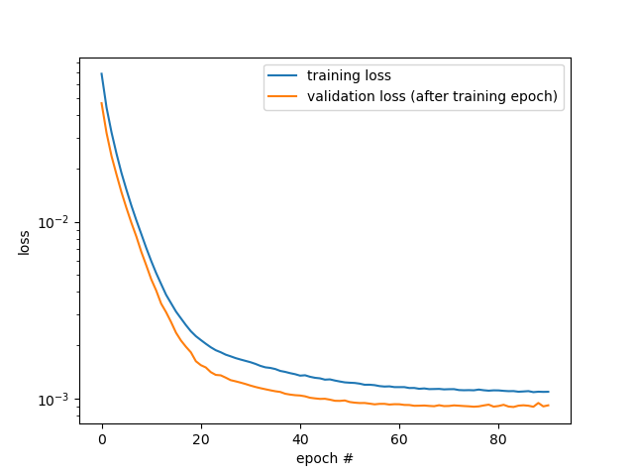
Result - Net

Slide 21
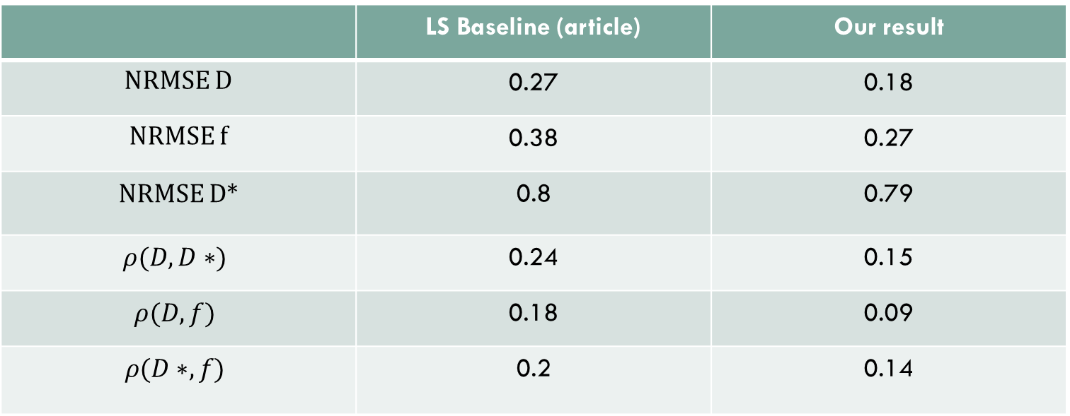
Result - LS
Our result | LS Baseline (article)
0.18 | 0.27 | NRMSE D
0.27 | 0.38 | NRMSE f
0.79 | 0.8 | NRMSE D*
0.15 | 0.24 | $$ρ(D,D∗)$$
0.09 | 0.18 | $$ρ(D,f)$$
0.14 | 0.2 | $$ρ(D∗,f)$$
Notes:
With SNR=30

Slide 22
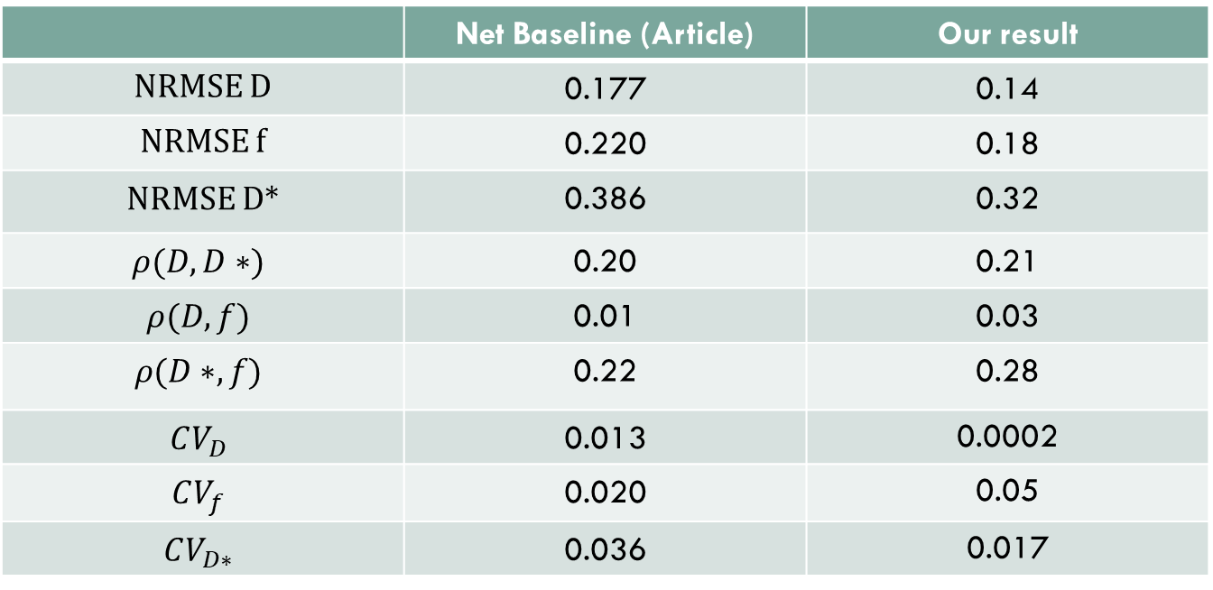
Result - Net
Our result | Net Baseline (Article)
0.14 | 0.177 | NRMSE D
0.18 | 0.220 | NRMSE f
0.32 | 0.386 | NRMSE D*
0.21 | 0.20 | $$ρ(D,D∗)$$
0.03 | 0.01 | $$ρ(D,f)$$
0.28 | 0.22 | $$ρ(D∗,f)$$
0.0002 | 0.013 | $$CV_{D}$$
0.05 | 0.020 | $$CV_{f}$$
0.017 | 0.036 | $$CV_{D∗}$$
Notes:
With SNR=30

Slide 23
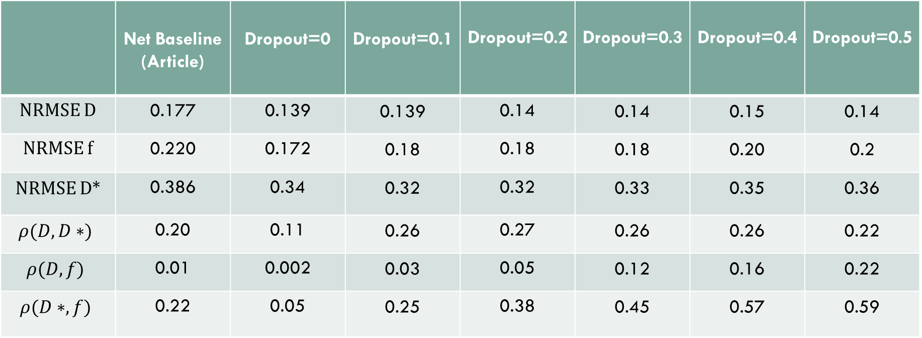
Dropout optimization
Dropout=0.5 | Dropout=0.4 | Dropout=0.3 | Dropout=0.2 | Dropout=0.1 | Dropout=0 | Net Baseline (Article)
0.14 | 0.15 | 0.14 | 0.14 | 0.139 | 0.139 | 0.177 | NRMSE D
0.2 | 0.20 | 0.18 | 0.18 | 0.18 | 0.172 | 0.220 | NRMSE f
0.36 | 0.35 | 0.33 | 0.32 | 0.32 | 0.34 | 0.386 | NRMSE D*
0.22 | 0.26 | 0.26 | 0.27 | 0.26 | 0.11 | 0.20 | $$ρ(D,D∗)$$
0.22 | 0.16 | 0.12 | 0.05 | 0.03 | 0.002 | 0.01 | $$ρ(D,f)$$
0.59 | 0.57 | 0.45 | 0.38 | 0.25 | 0.05 | 0.22 | $$ρ(D∗,f)$$

Slide 24
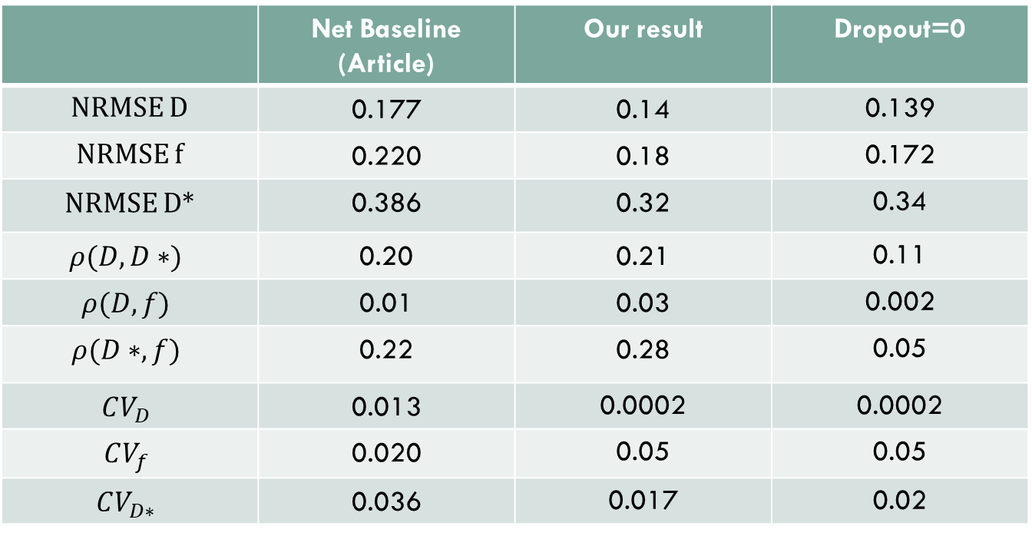
Dropout optimization
Dropout=0 | Our result | Net Baseline (Article)
0.139 | 0.14 | 0.177 | NRMSE D
0.172 | 0.18 | 0.220 | NRMSE f
0.34 | 0.32 | 0.386 | NRMSE D*
0.11 | 0.21 | 0.20 | $$ρ(D,D∗)$$
0.002 | 0.03 | 0.01 | $$ρ(D,f)$$
0.05 | 0.28 | 0.22 | $$ρ(D∗,f)$$
0.0002 | 0.0002 | 0.013 | $$CV_{D}$$
0.05 | 0.05 | 0.020 | $$CV_{f}$$
0.02 | 0.017 | 0.036 | $$CV_{D∗}$$

Slide 25
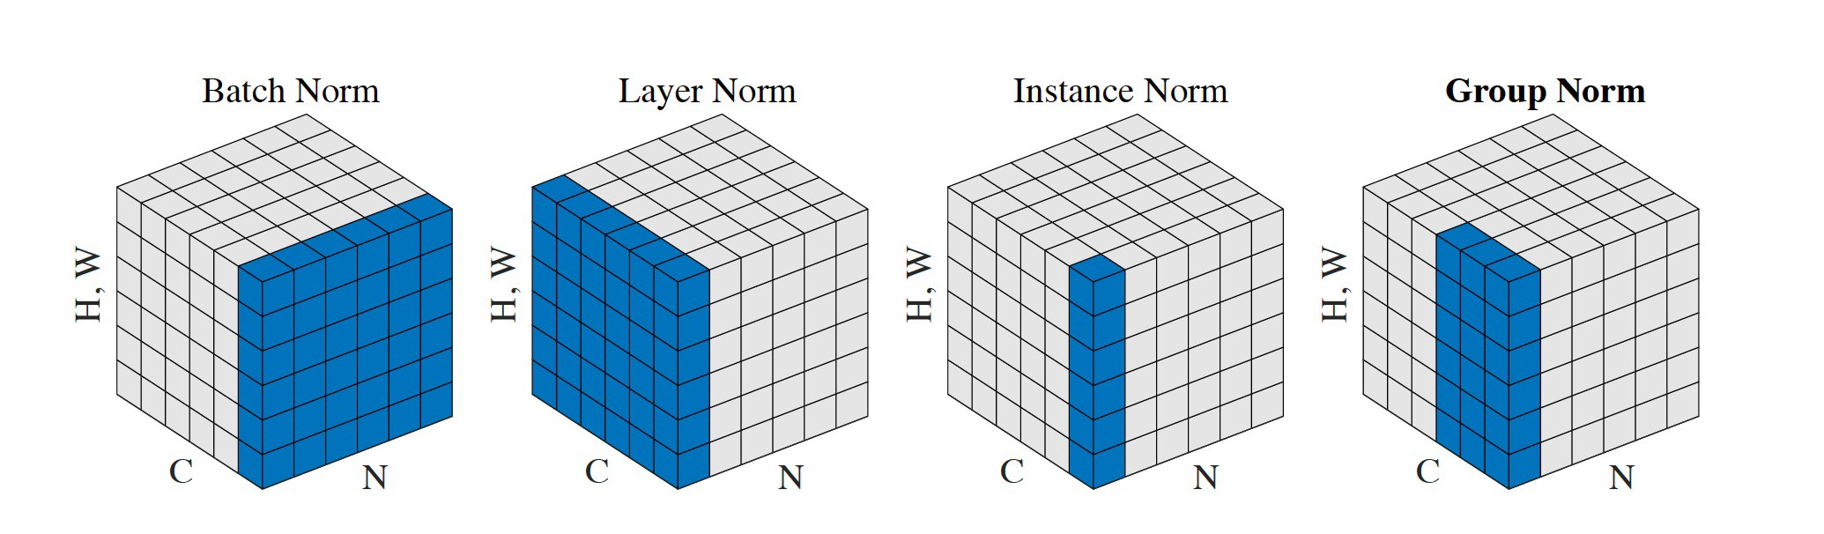
Normalization optimization

Slide 26
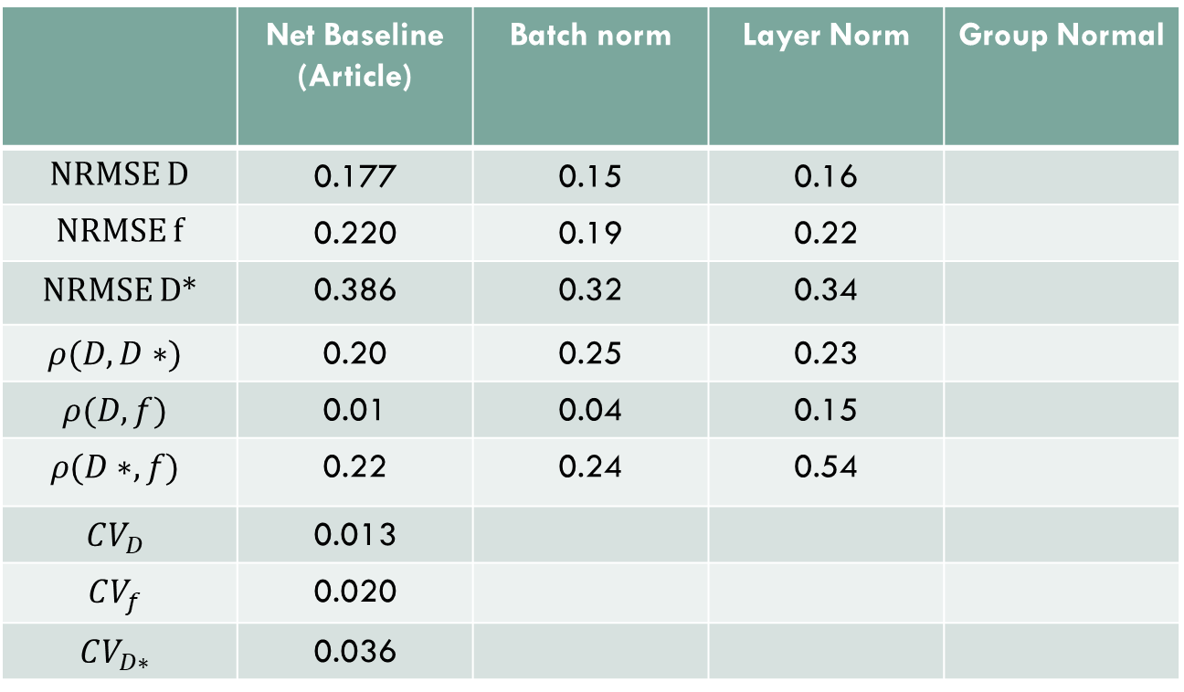
Normalization optimization
Group Normal | Layer Norm | Batch norm | Net Baseline (Article)
 | 0.16 | 0.15 | 0.177 | NRMSE D
 | 0.22 | 0.19 | 0.220 | NRMSE f
 | 0.34 | 0.32 | 0.386 | NRMSE D*
 | 0.23 | 0.25 | 0.20 | $$ρ(D,D∗)$$
 | 0.15 | 0.04 | 0.01 | $$ρ(D,f)$$
 | 0.54 | 0.24 | 0.22 | $$ρ(D∗,f)$$
 |  |  | 0.013 | $$CV_{D}$$
 |  |  | 0.020 | $$CV_{f}$$
 |  |  | 0.036 | $$CV_{D∗}$$

Slide 27
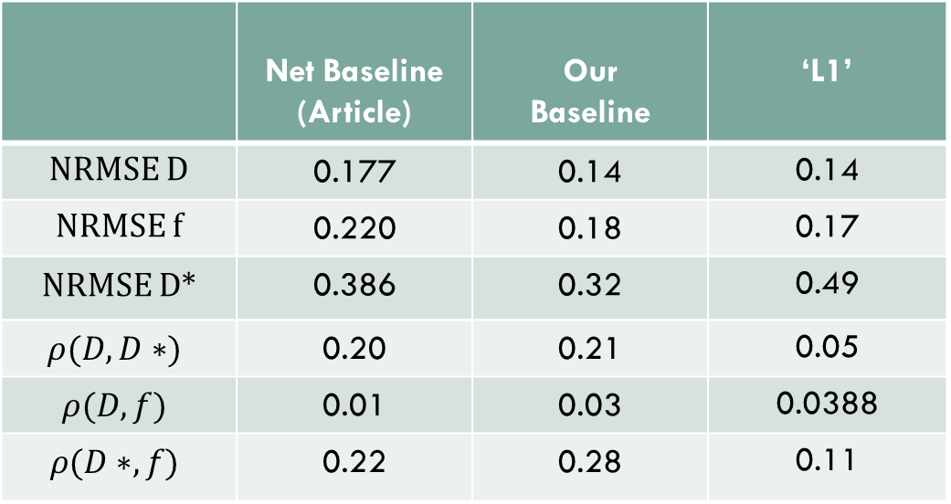
Loss
‘L1’ | Our Baseline | Net Baseline (Article)
0.14 | 0.14 | 0.177 | NRMSE D
0.17 | 0.18 | 0.220 | NRMSE f
0.49 | 0.32 | 0.386 | NRMSE D*
0.05 | 0.21 | 0.20 | $$ρ(D,D∗)$$
0.0388 | 0.03 | 0.01 | $$ρ(D,f)$$
0.11 | 0.28 | 0.22 | $$ρ(D∗,f)$$

Slide 28
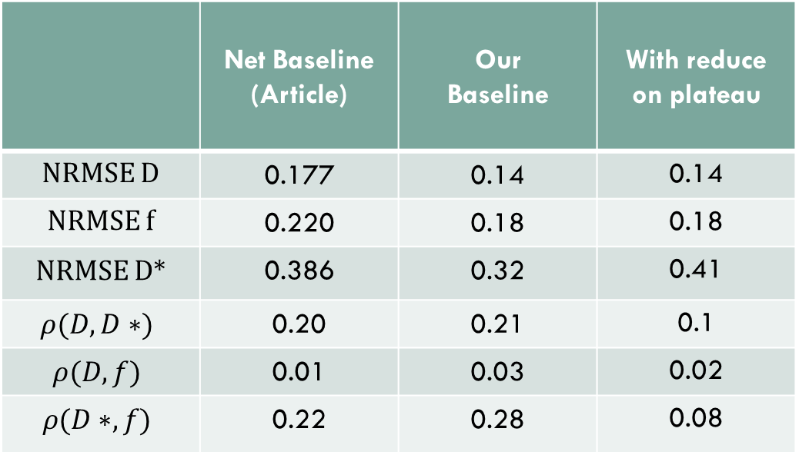
Scheduler
With reduce on plateau | Our Baseline | Net Baseline (Article)
0.14 | 0.14 | 0.177 | NRMSE D
0.18 | 0.18 | 0.220 | NRMSE f
0.41 | 0.32 | 0.386 | NRMSE D*
0.1 | 0.21 | 0.20 | $$ρ(D,D∗)$$
0.02 | 0.03 | 0.01 | $$ρ(D,f)$$
0.08 | 0.28 | 0.22 | $$ρ(D∗,f)$$

Slide 29
Summary
Dropout regularization may be unnecessary
Extensive sampling of the q-space is important for working with real data
Using simulations in unsupervised model can be helpful

Slide 30

Question

