Slide 1
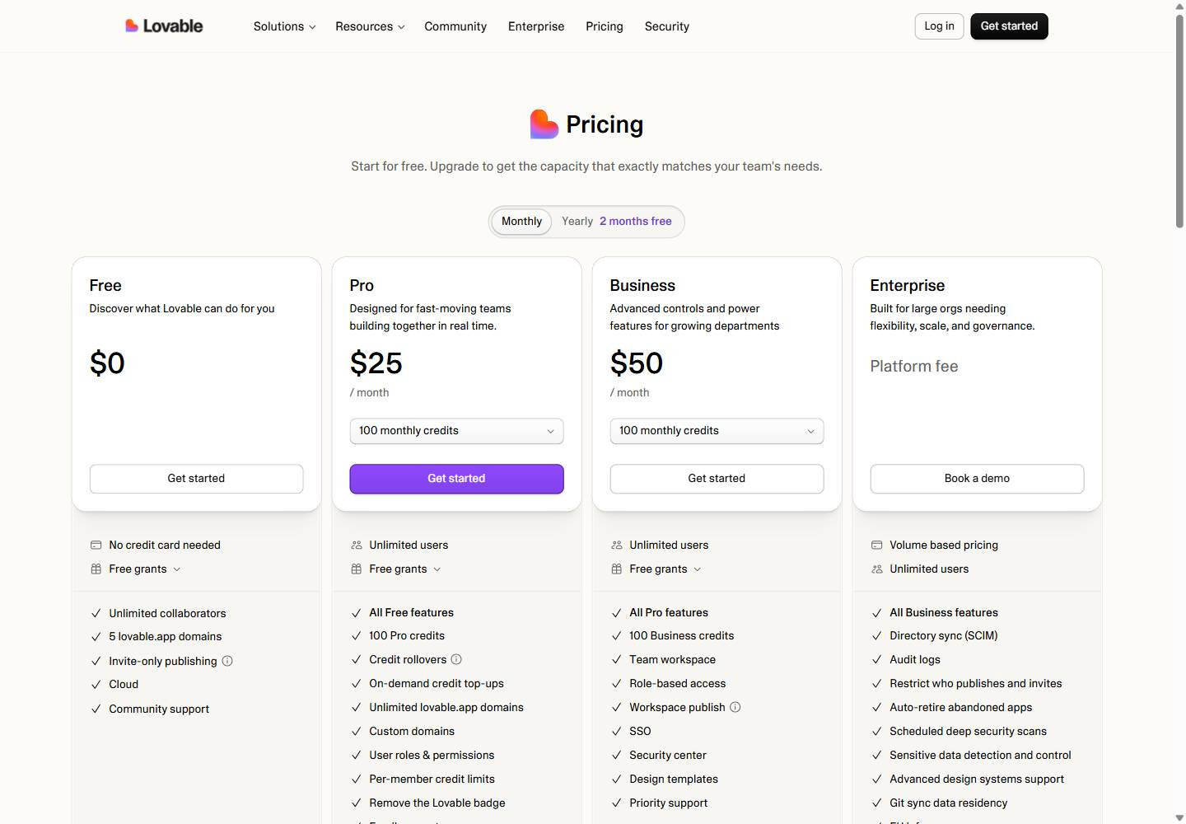
Lovable pricing
No change this week
Week of Oct 19 · lovable.dev/pricing · screenshot Oct 23 Competitor watch

Slide 2

Lovable homepage
No change this week
Week of Oct 19 · lovable.dev · screenshot Oct 23 Competitor watch

Slide 3
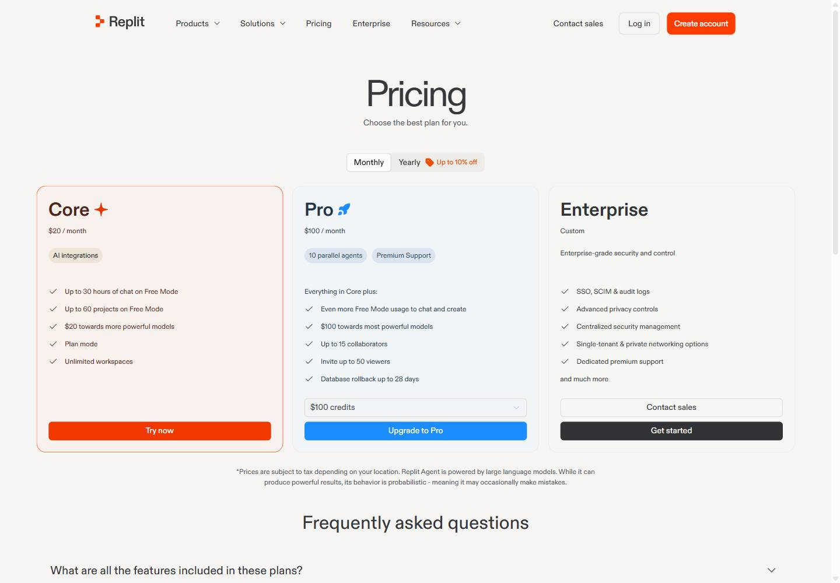
Replit pricing
No change this week
Week of Oct 19 · replit.com/pricing · screenshot Oct 23 Competitor watch

Slide 4
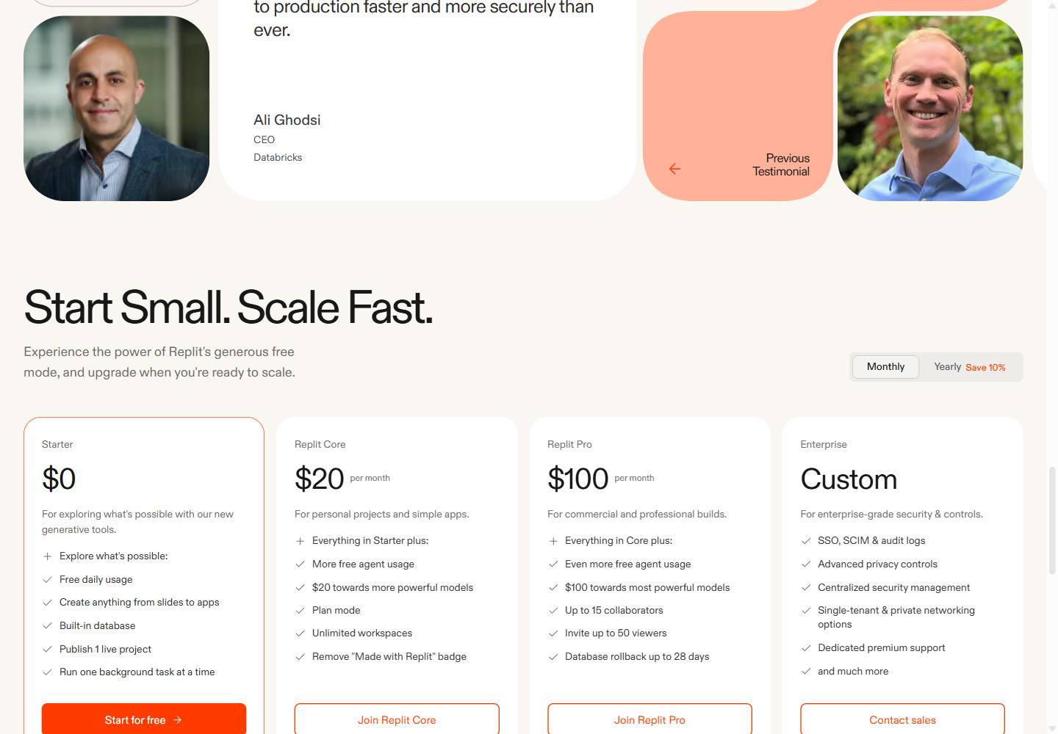
Replit homepage
No change this week
Week of Oct 19 · replit.com · screenshot Oct 23 Competitor watch

Slide 5
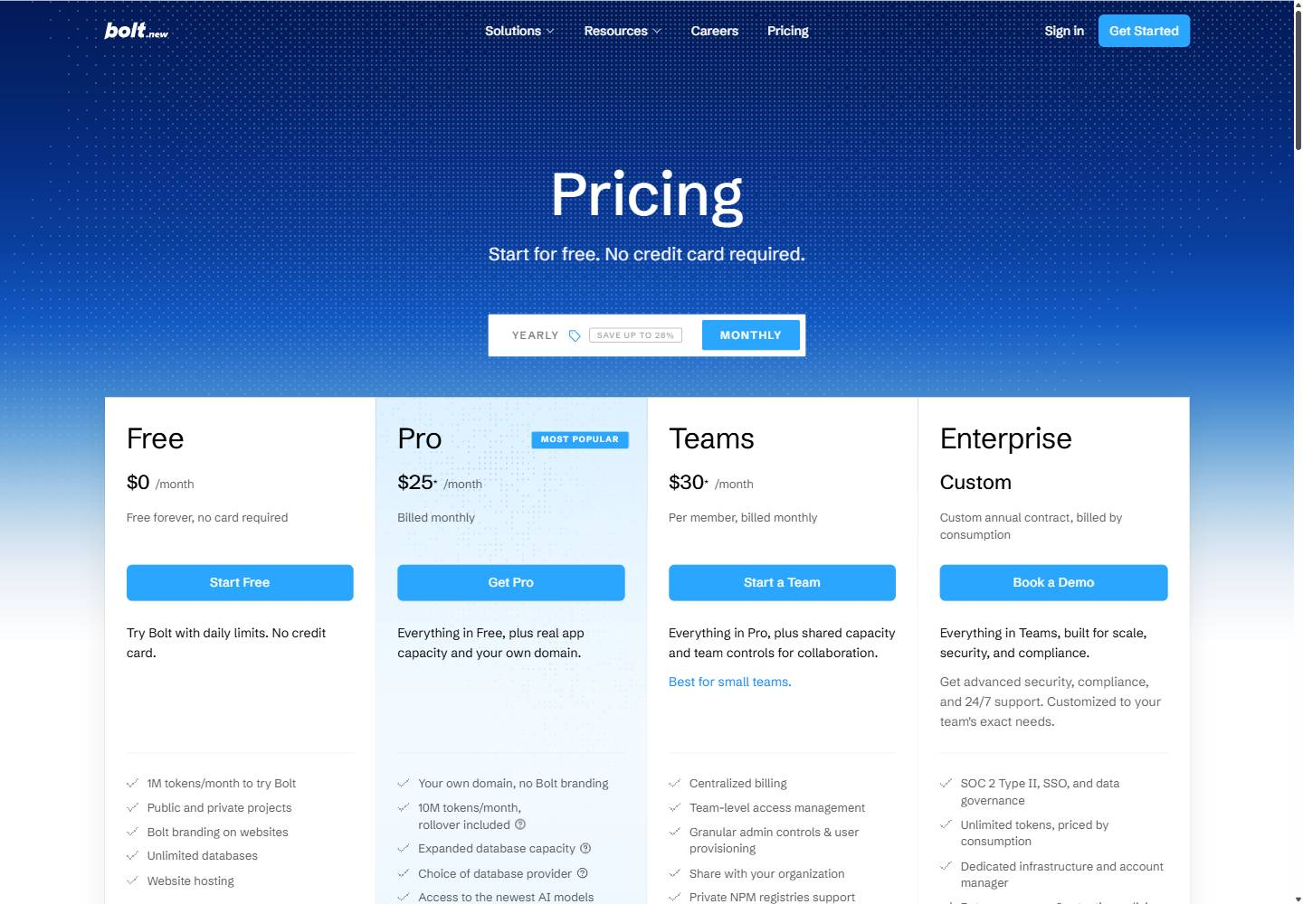
Bolt pricing
Changed this week
Oct 20 Update the Bolt pricing slide: "1M tokens per month" → "1M tokens/month to try Bolt".
Oct 20 Update the Bolt pricing slide: new on the page: "10M tokens/month, rollover included".
Oct 20 Update the Bolt pricing slide: no longer on the page: "300K tokens daily limit".
Oct 20 Update the Bolt pricing slide: no longer on the page: "Start at 10M tokens per month".
Week of Oct 19 · bolt.new/pricing · screenshot Oct 23 Competitor watch

Slide 6
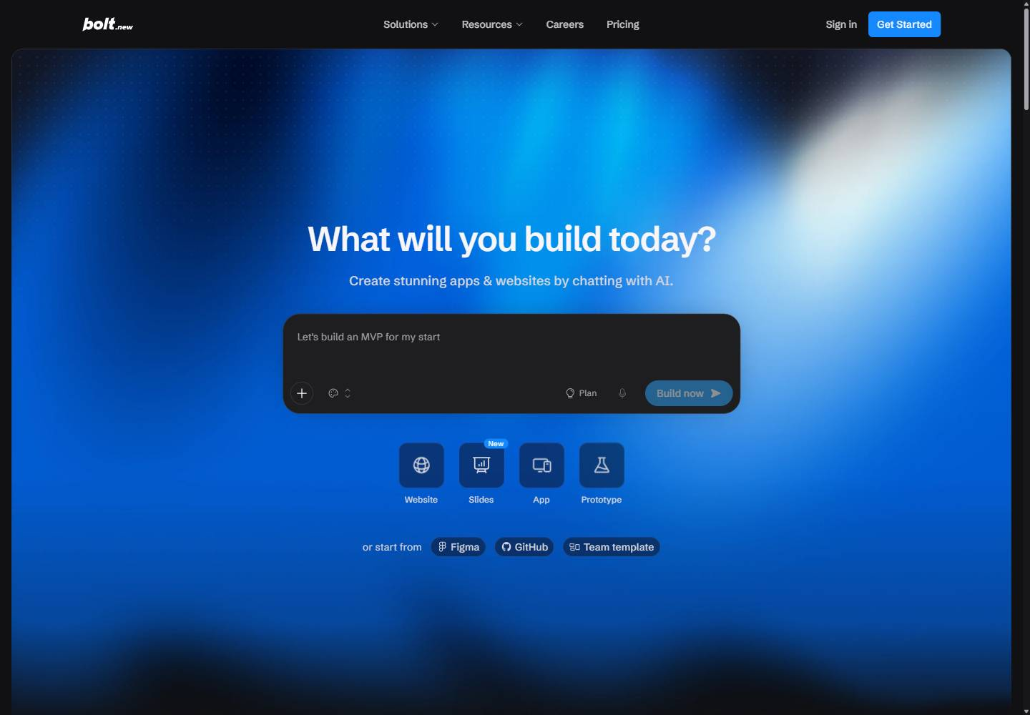
Bolt homepage
No change this week
Week of Oct 19 · bolt.new · screenshot Oct 23 Competitor watch

