Slide 1
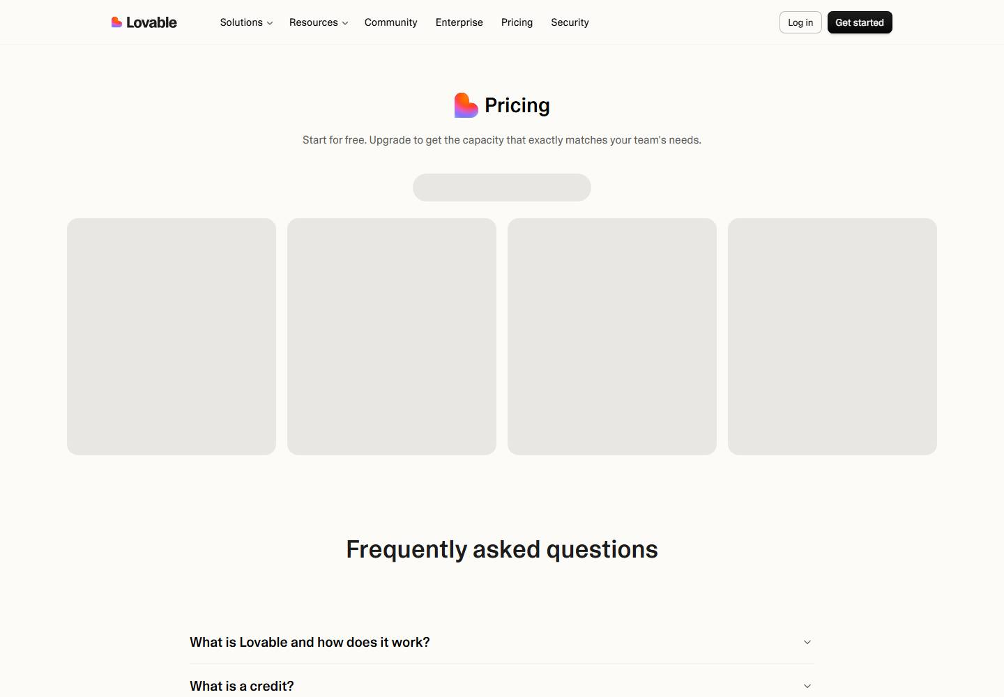
Lovable pricing
No change this week
Week of Oct 12 · lovable.dev/pricing · screenshot Oct 15 (archived copy) Competitor watch

Slide 2

Lovable homepage
No change this week
Week of Oct 12 · lovable.dev · screenshot Oct 14 (archived copy) Competitor watch

Slide 3
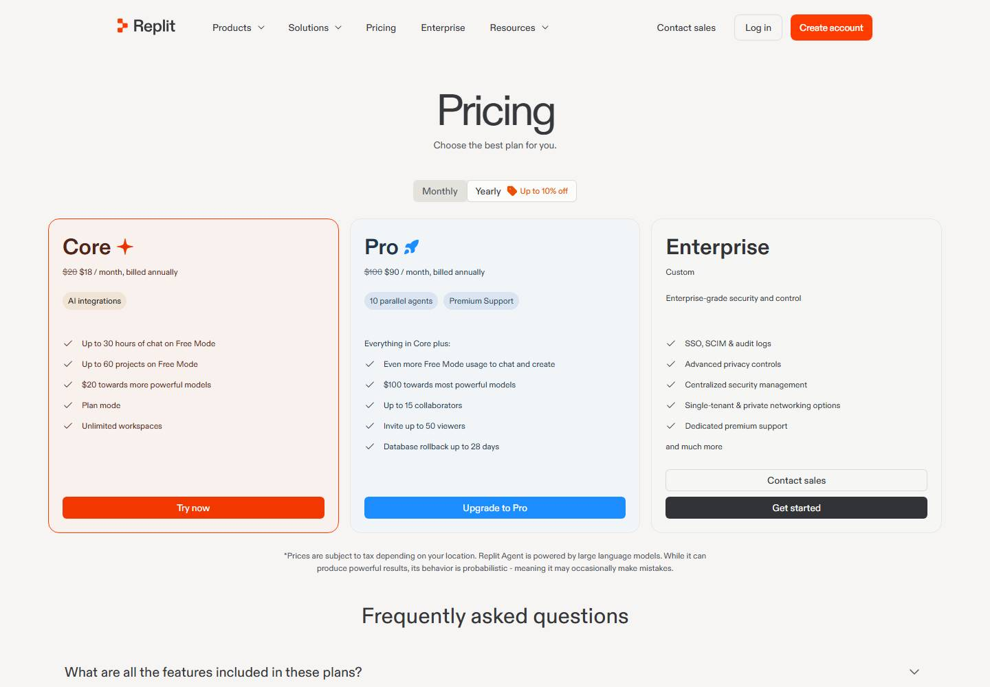
Replit pricing
No change this week
Week of Oct 12 · replit.com/pricing · screenshot Oct 18 (archived copy) Competitor watch

Slide 4

Replit homepage
No change this week
Week of Oct 12 · replit.com · screenshot Oct 16 (archived copy) Competitor watch

Slide 5
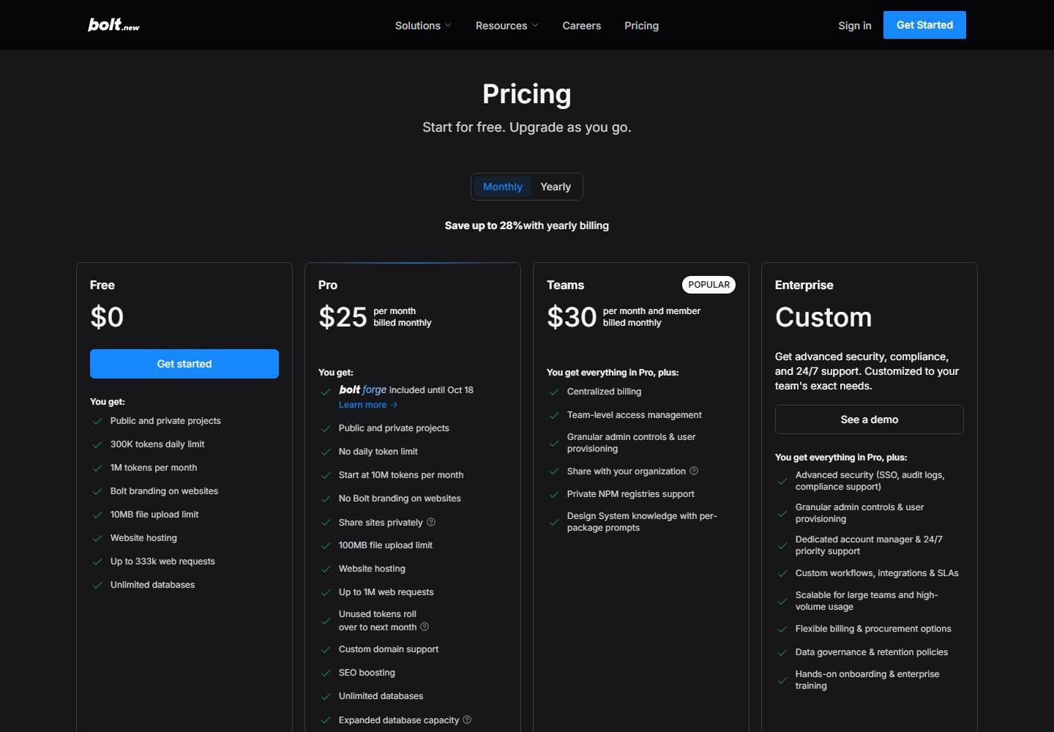
Bolt pricing
No change this week
Week of Oct 12 · bolt.new/pricing · screenshot Oct 16 (archived copy) Competitor watch

Slide 6

Bolt homepage
No change this week
Week of Oct 12 · bolt.new · screenshot Oct 14 (archived copy) Competitor watch

