Slide 1
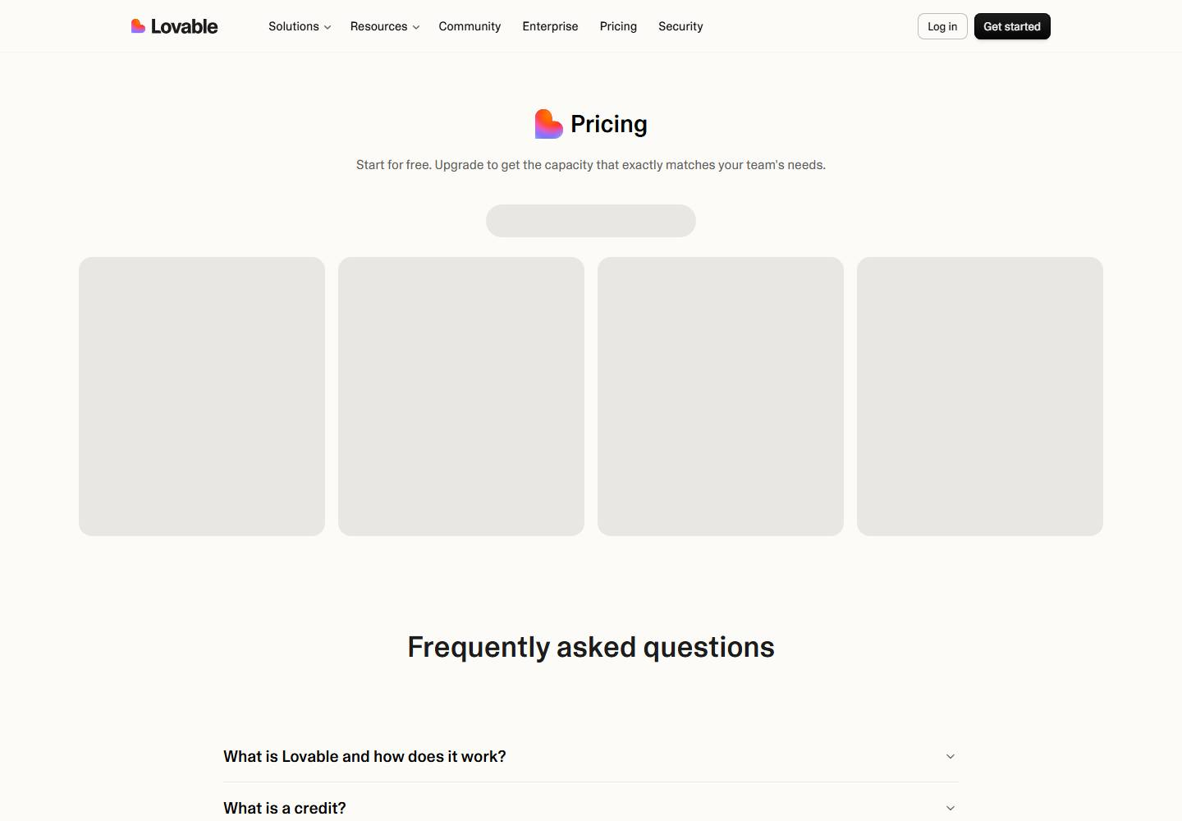
Lovable pricing
No change this week
Week of Sep 28 · lovable.dev/pricing · screenshot Oct 4 (archived copy) Competitor watch

Slide 2
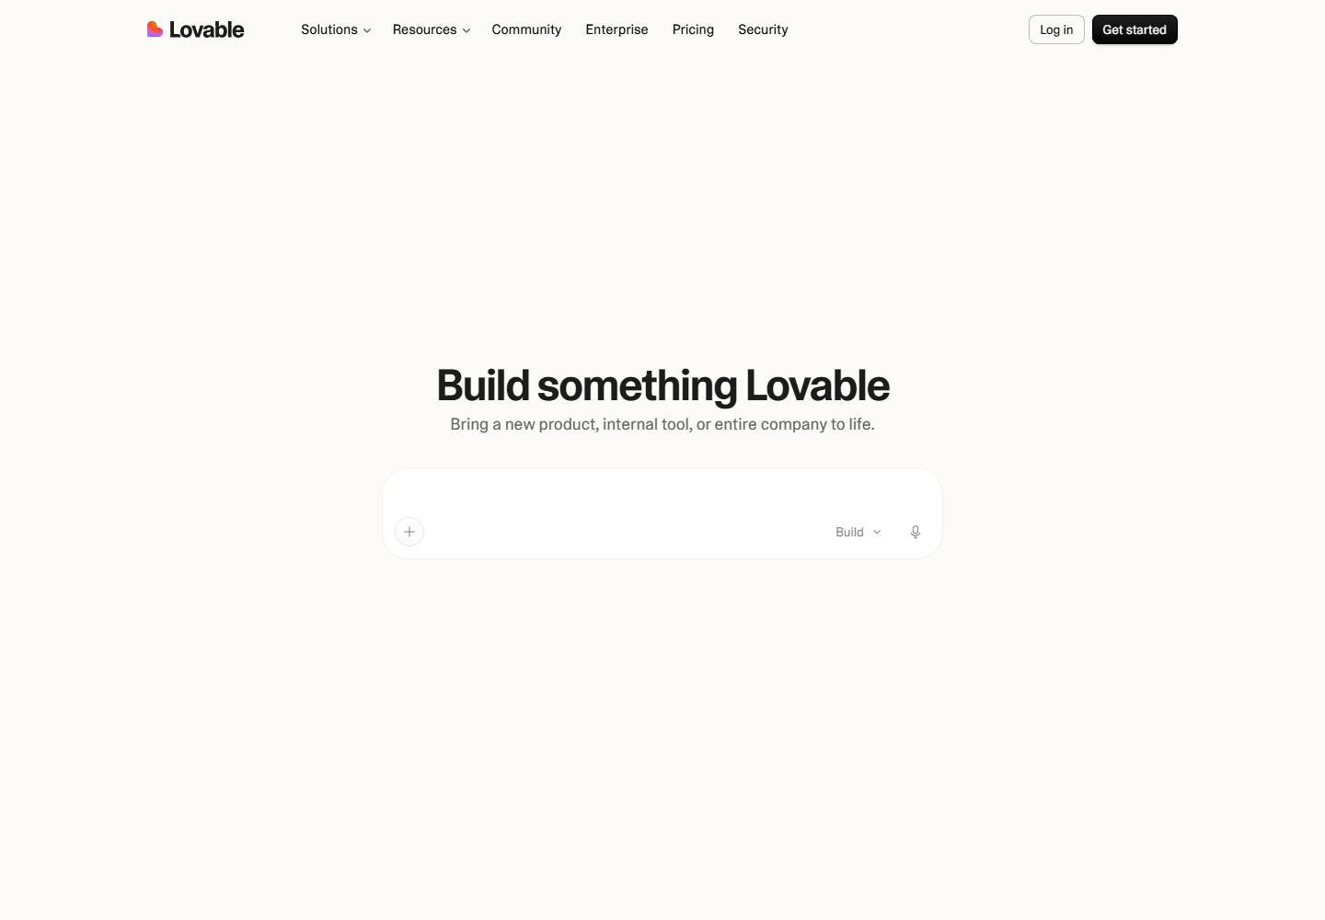
Lovable homepage
No change this week
Week of Sep 28 · lovable.dev · screenshot Oct 3 (archived copy) Competitor watch

Slide 3
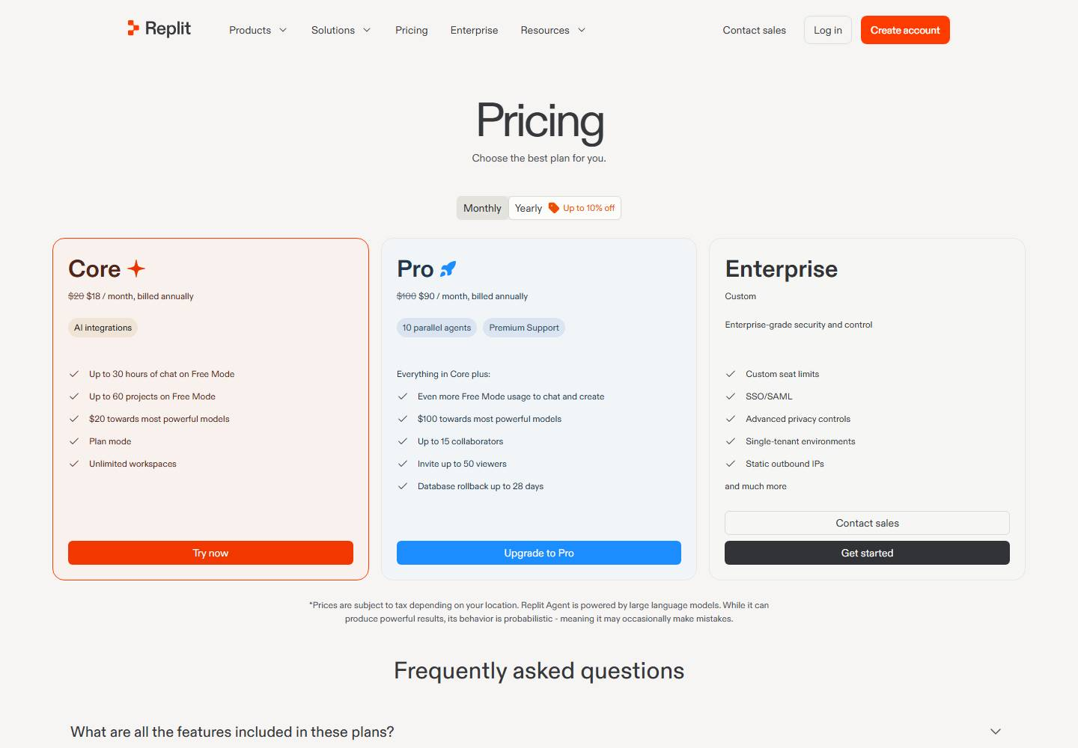
Replit pricing
No change this week
Week of Sep 28 · replit.com/pricing · screenshot Oct 2 (archived copy) Competitor watch

Slide 4
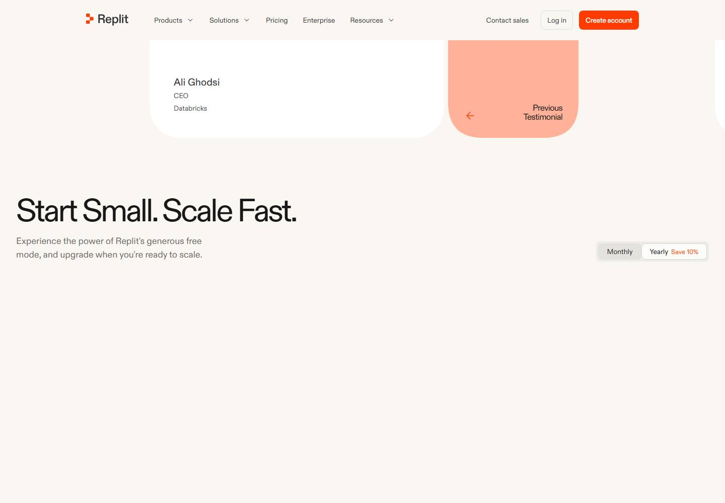
Replit homepage
No change this week
Week of Sep 28 · replit.com · screenshot Oct 3 (archived copy) Competitor watch

Slide 5
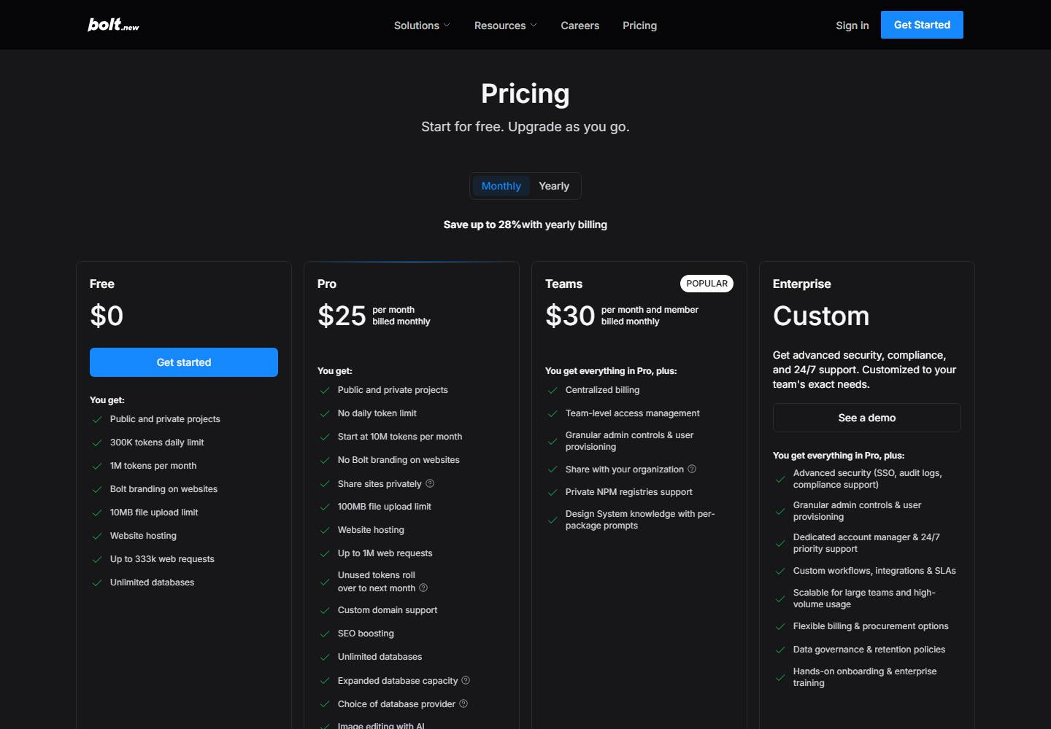
Bolt pricing
Changed this week
Sep 30 Update the Bolt pricing slide: new on the page: "Bolt Lite ($9/month, invite only during the research preview) is powered by Bolt Forge and is the only AI mode on that plan.".
Oct 1 Update the Bolt pricing slide: no longer on the page: "Bolt Lite ($9/month, invite only during the research preview) is powered by Bolt Forge and is the only AI mode on that plan.".
Week of Sep 28 · bolt.new/pricing · screenshot Oct 4 (archived copy) Competitor watch

Slide 6
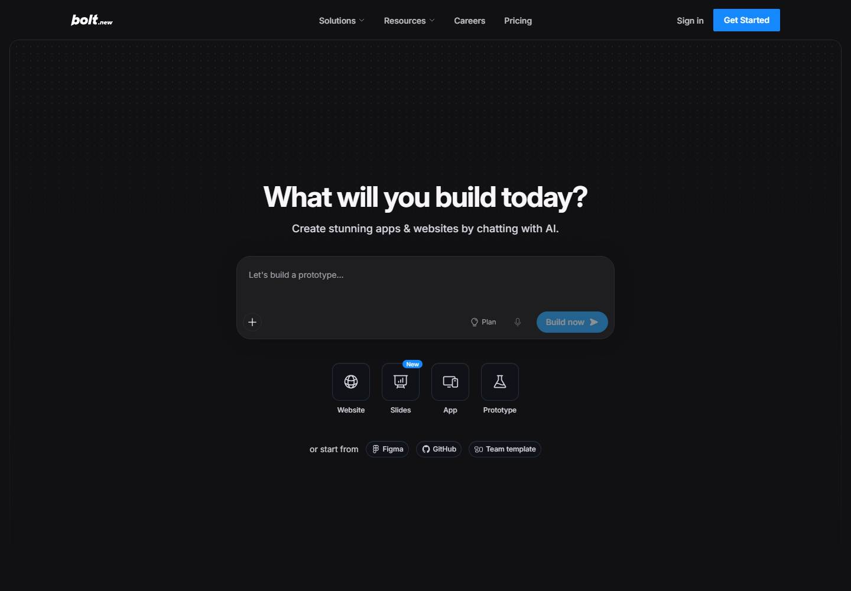
Bolt homepage
No change this week
Week of Sep 28 · bolt.new · screenshot Oct 4 (archived copy) Competitor watch

