Slide 1

Lovable pricing
No change this week
Week of Oct 5 · lovable.dev/pricing · screenshot Oct 10 (archived copy) Competitor watch

Slide 2

Lovable homepage
No change this week
Week of Oct 5 · lovable.dev · screenshot Oct 8 (archived copy) Competitor watch

Slide 3
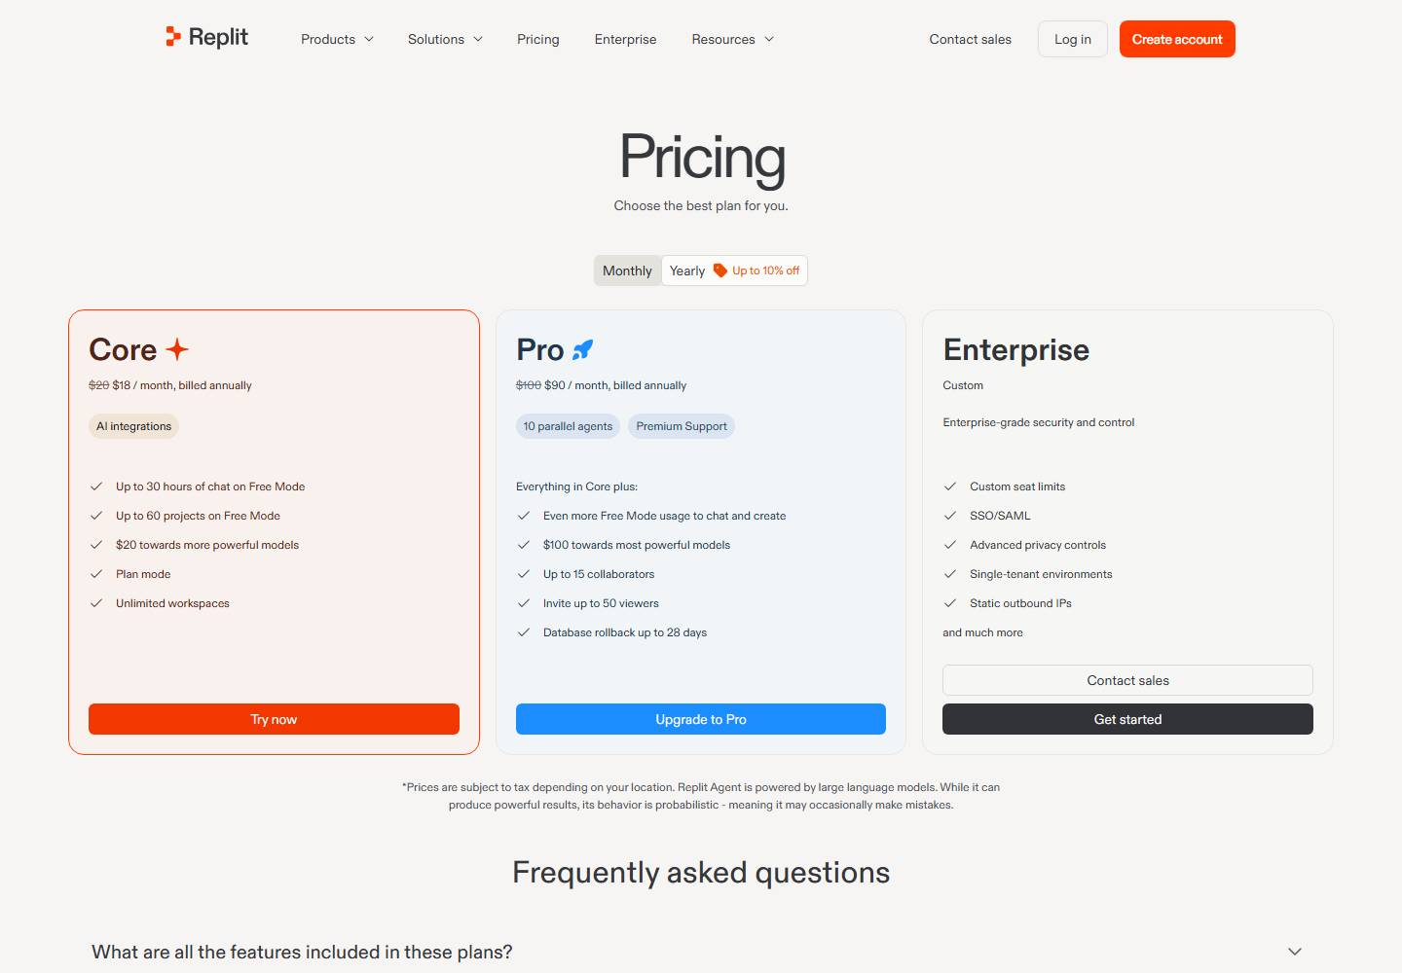
Replit pricing
Changed this week
Oct 7 "$20 towards most powerful models" → "$20 towards more powerful models"
Week of Oct 5 · replit.com/pricing · screenshot Oct 11 (archived copy) Competitor watch

Slide 4

Replit homepage
Changed this week
Oct 7 "$20 towards most powerful models" → "$20 towards more powerful models"
Week of Oct 5 · replit.com · screenshot Oct 11 (archived copy) Competitor watch

Slide 5
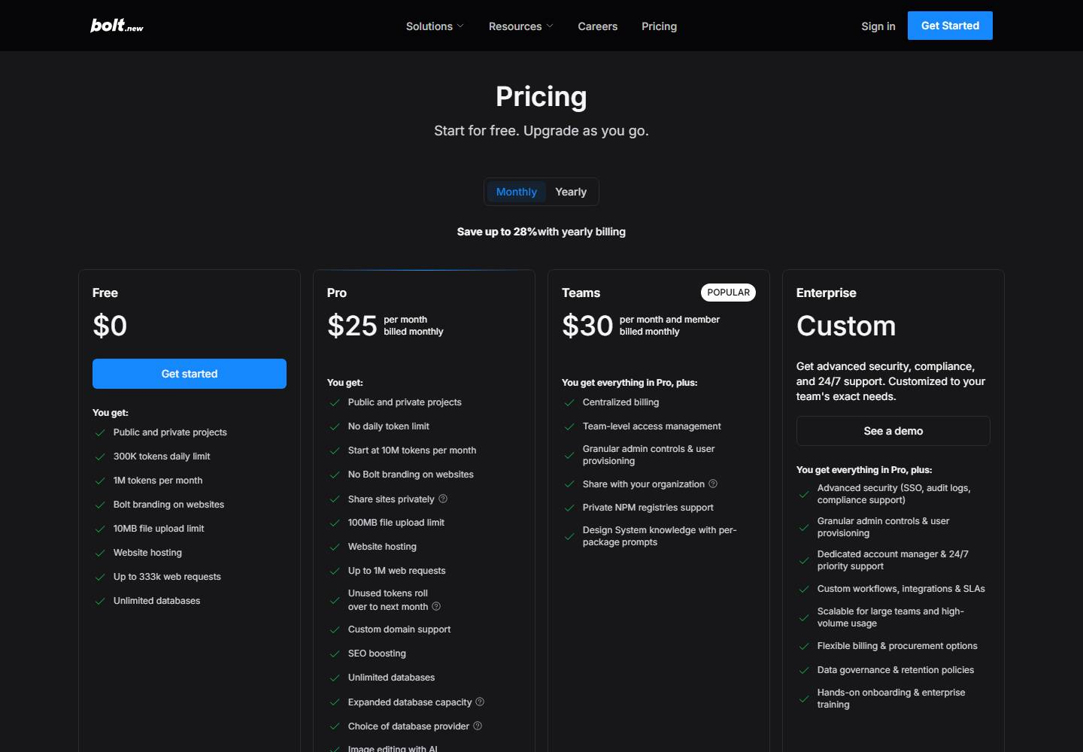
Bolt pricing
No change this week
Week of Oct 5 · bolt.new/pricing · screenshot Oct 10 (archived copy) Competitor watch

Slide 6

Bolt homepage
No change this week
Week of Oct 5 · bolt.new · screenshot Oct 11 (archived copy) Competitor watch

