Slide 1
Competitor pages · Oct 19–25
1 of 6 pages changed
Lovable, Replit and Bolt · pricing pages and homepages
● Bolt pricing Free: "300K tokens daily limit" is no longer on the page Oct 20
Plus 2 wording edits
● No change Lovable pricing · Lovable homepage · Replit pricing · Replit homepage · Bolt homepage
Deck for Mon, Oct 26 · 6 pages · screenshots Oct 25 (live)
Competitor watch

Slide 2
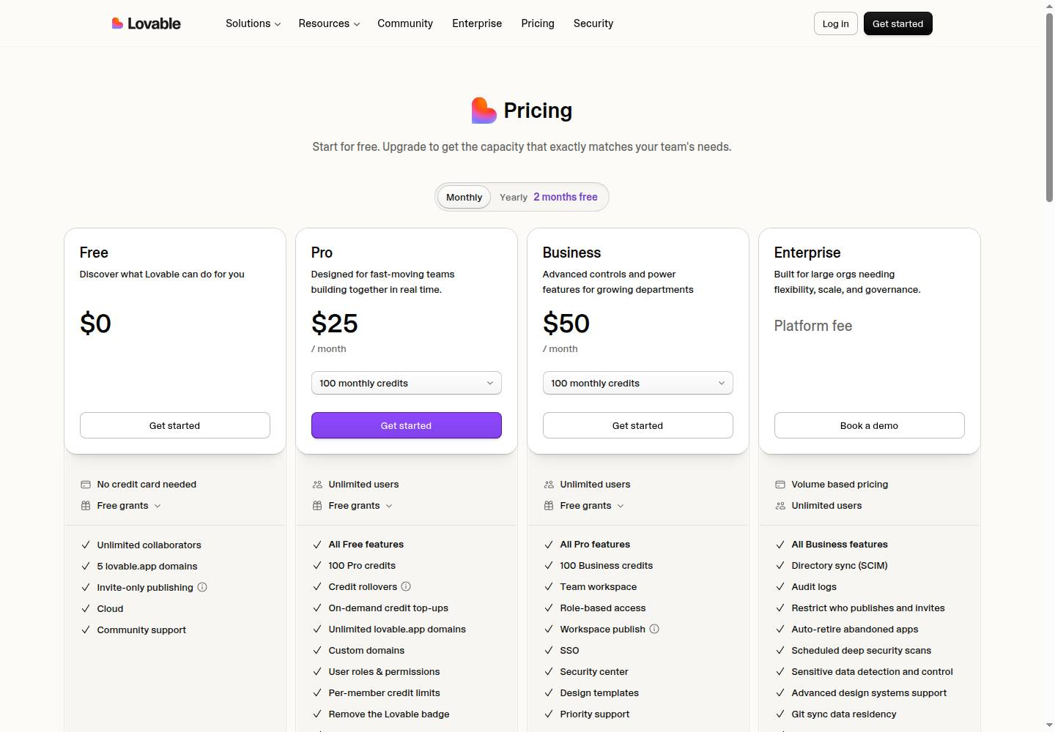
Lovable · Pricing page
Lovable pricing
● No change this week
lovable.dev/pricing
Deck for Mon, Oct 26 · Source: lovable.dev/pricing · Screenshot Oct 25
Competitor watch

Slide 3
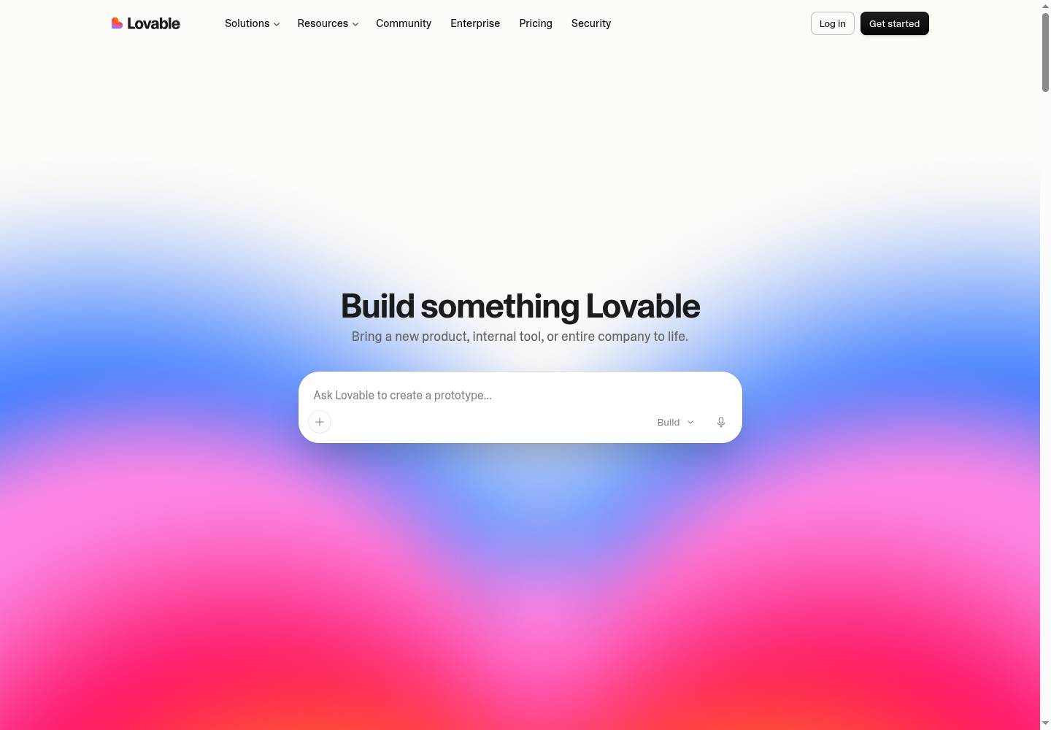
Lovable · Homepage
Lovable homepage
● No change this week
lovable.dev
Deck for Mon, Oct 26 · Source: lovable.dev · Screenshot Oct 25
Competitor watch

Slide 4
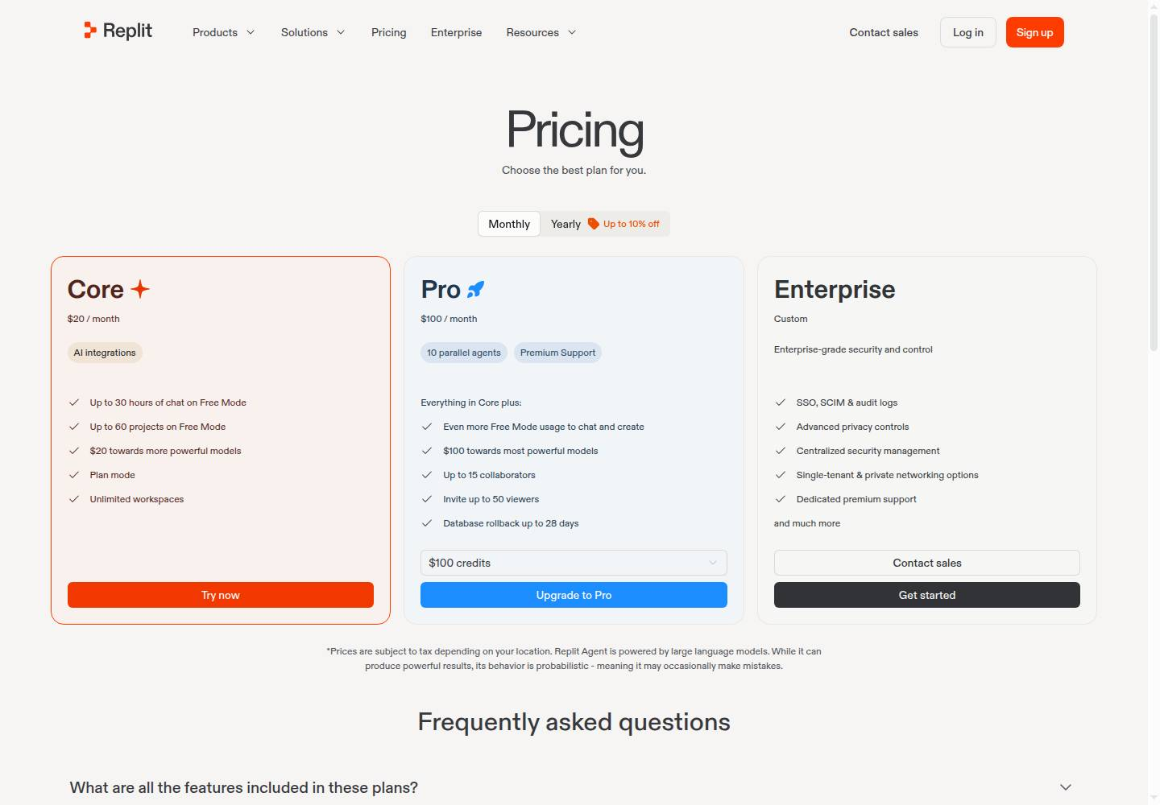
Replit · Pricing page
Replit pricing
● No change this week
replit.com/pricing
Deck for Mon, Oct 26 · Source: replit.com/pricing · Screenshot Oct 25
Competitor watch

Slide 5
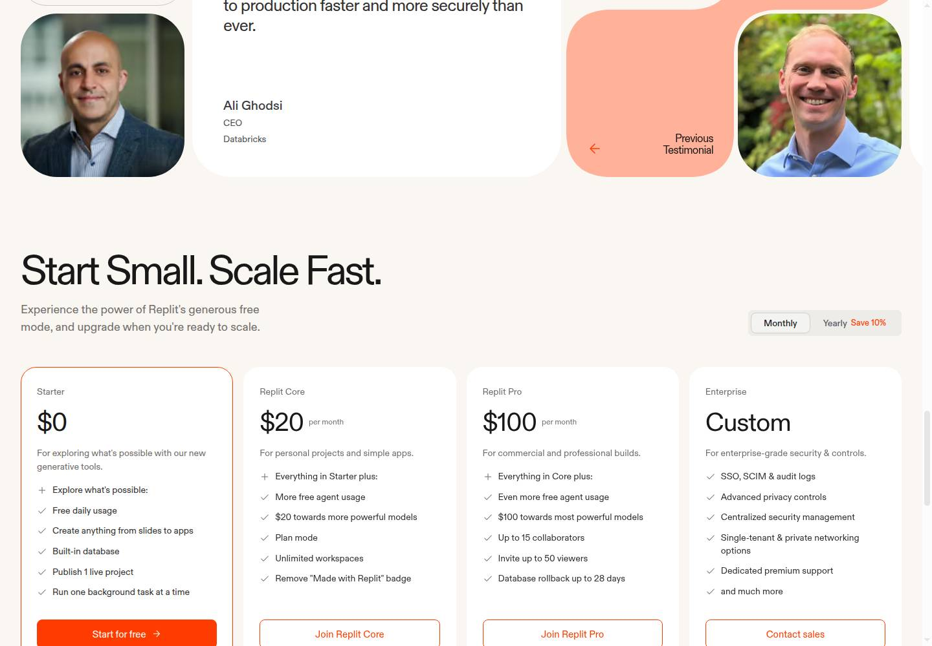
Replit · Homepage
Replit homepage
● No change this week
replit.com
Deck for Mon, Oct 26 · Source: replit.com · Screenshot Oct 25
Competitor watch

Slide 6
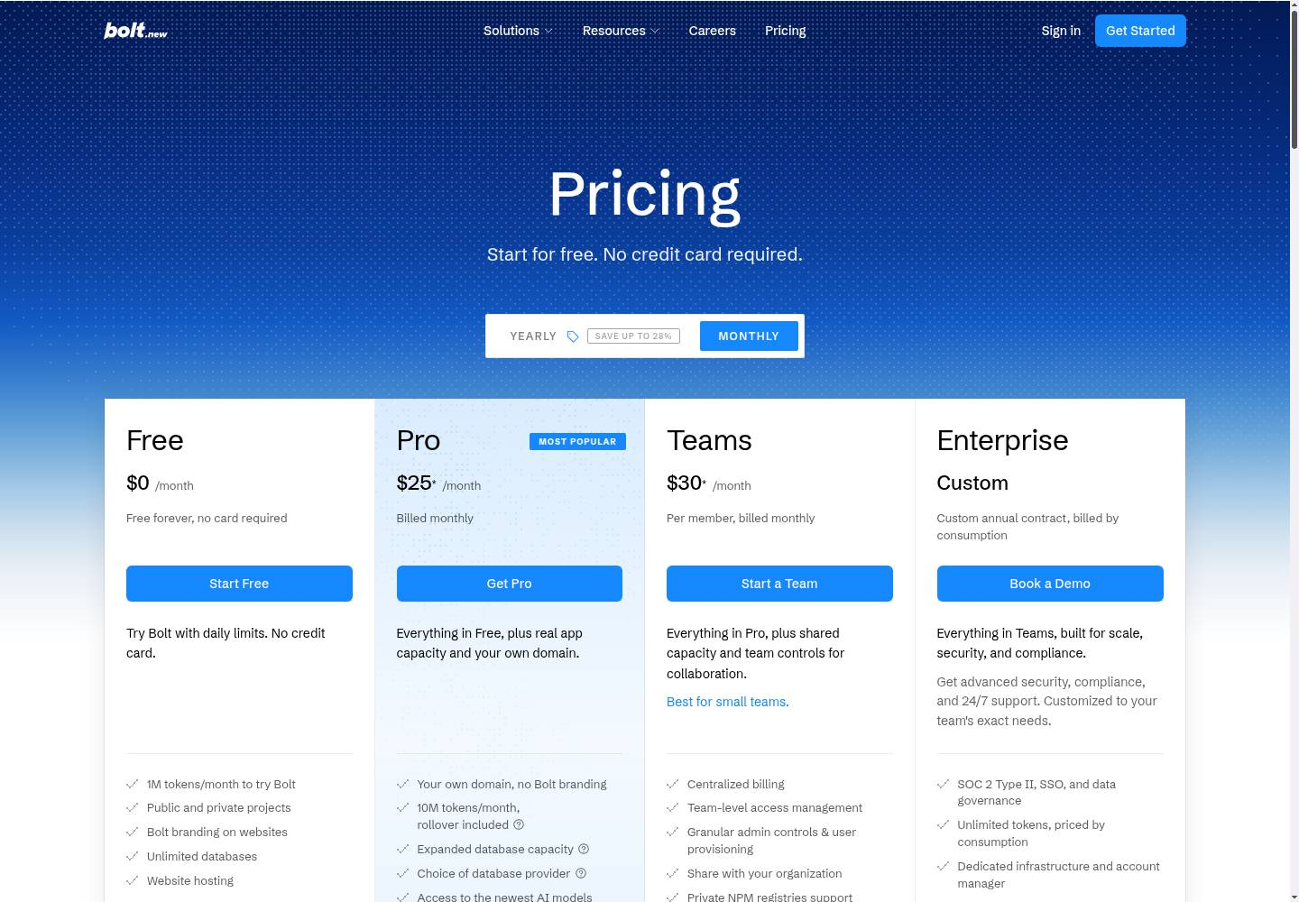
Bolt · Pricing page
Bolt pricing
● Changed this week · 1 change, 2 wording edits
Free Removed 300K tokens daily limit
Free Wording 1M tokens per month → 1M tokens/month to try Bolt
Pro Wording Start at 10M tokens per month → 10M tokens/month, rollover included
bolt.new/pricing
Deck for Mon, Oct 26 · Source: bolt.new/pricing · Screenshot Oct 25
Competitor watch

Slide 7
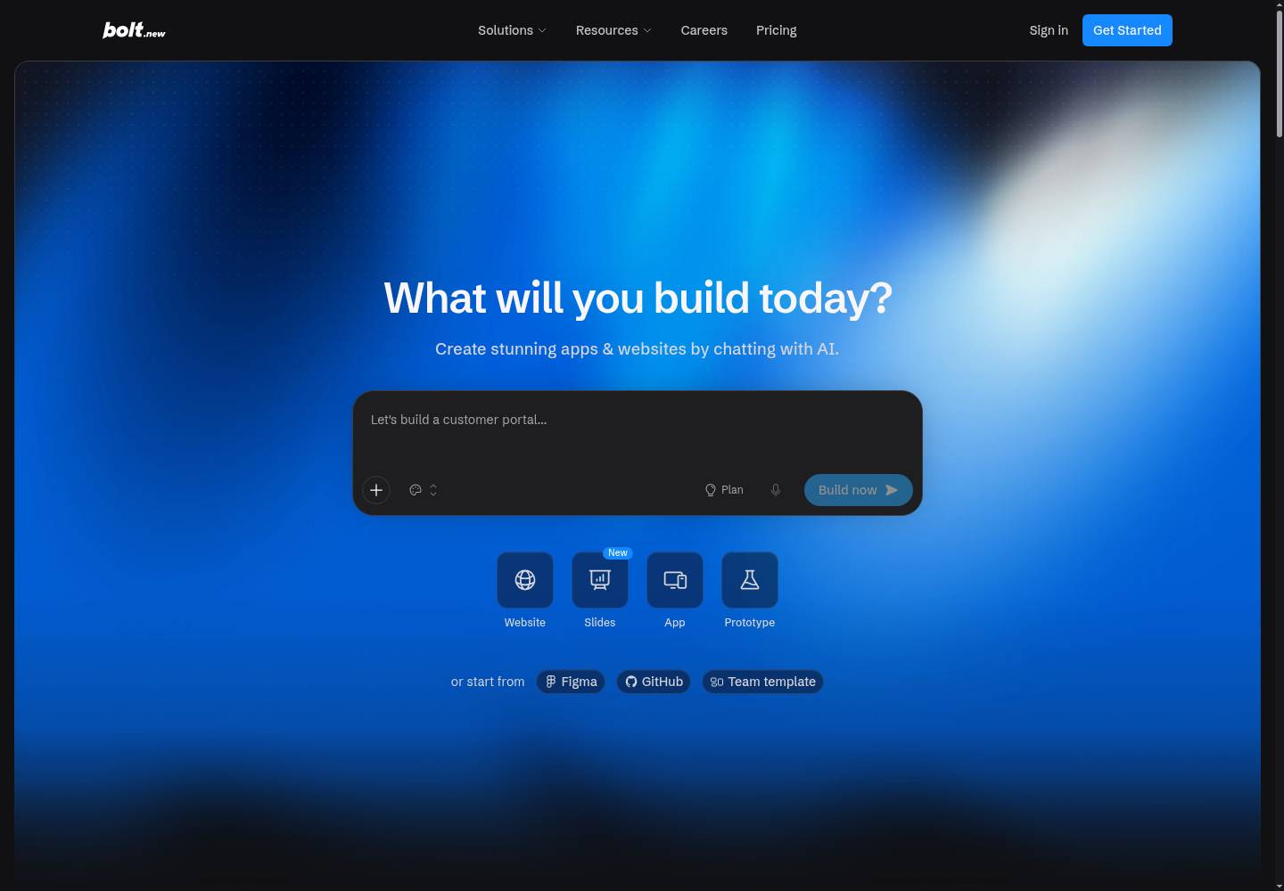
Bolt · Homepage
Bolt homepage
● No change this week
bolt.new
Deck for Mon, Oct 26 · Source: bolt.new · Screenshot Oct 25
Competitor watch

