Slide 1
Competitor pages · Oct 26–Nov 1
2 of 6 pages changed
Lovable, Replit and Bolt · pricing pages and homepages
● Lovable pricing New plan: Free at $0 Oct 28
● Replit homepage Free: new on the page: "Up to 30 hours of chat on Free Mode" Oct 29
Plus 1 more change
● No change Lovable homepage · Replit pricing · Bolt pricing · Bolt homepage
Deck for Mon, Nov 2 · 6 pages · screenshots Nov 1 (live)
Competitor watch

Slide 2
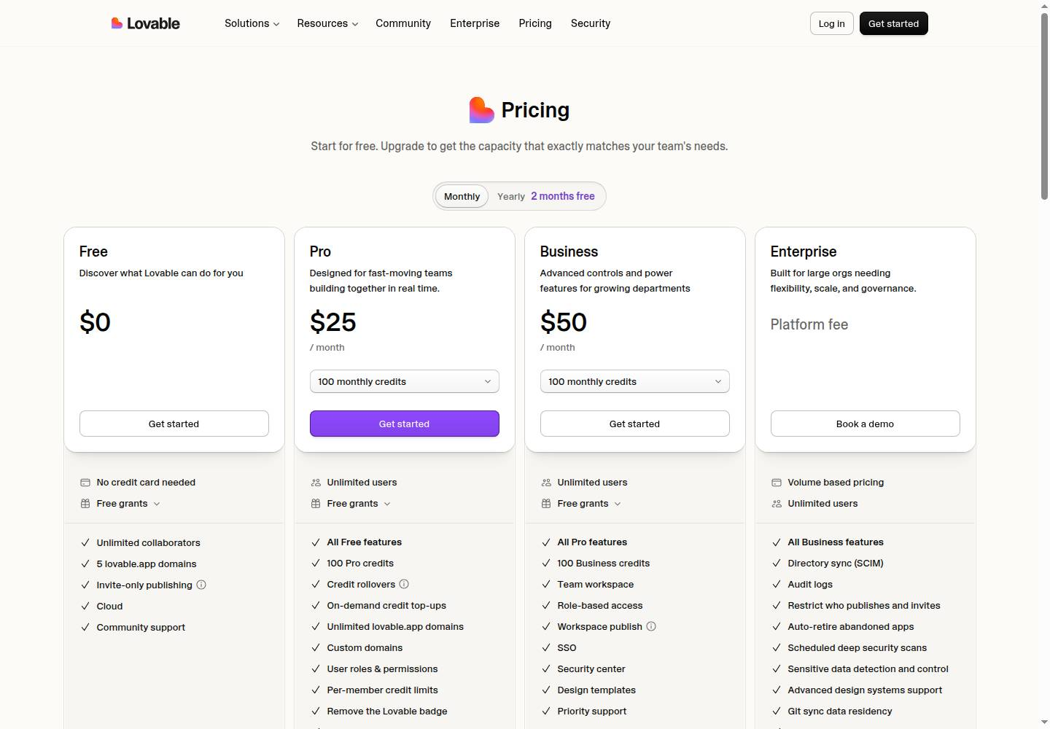
Lovable · Pricing page
Lovable pricing
● Changed this week · 1 change
Free New plan $0
lovable.dev/pricing
Deck for Mon, Nov 2 · Source: lovable.dev/pricing · Screenshot Nov 1
Competitor watch

Slide 3
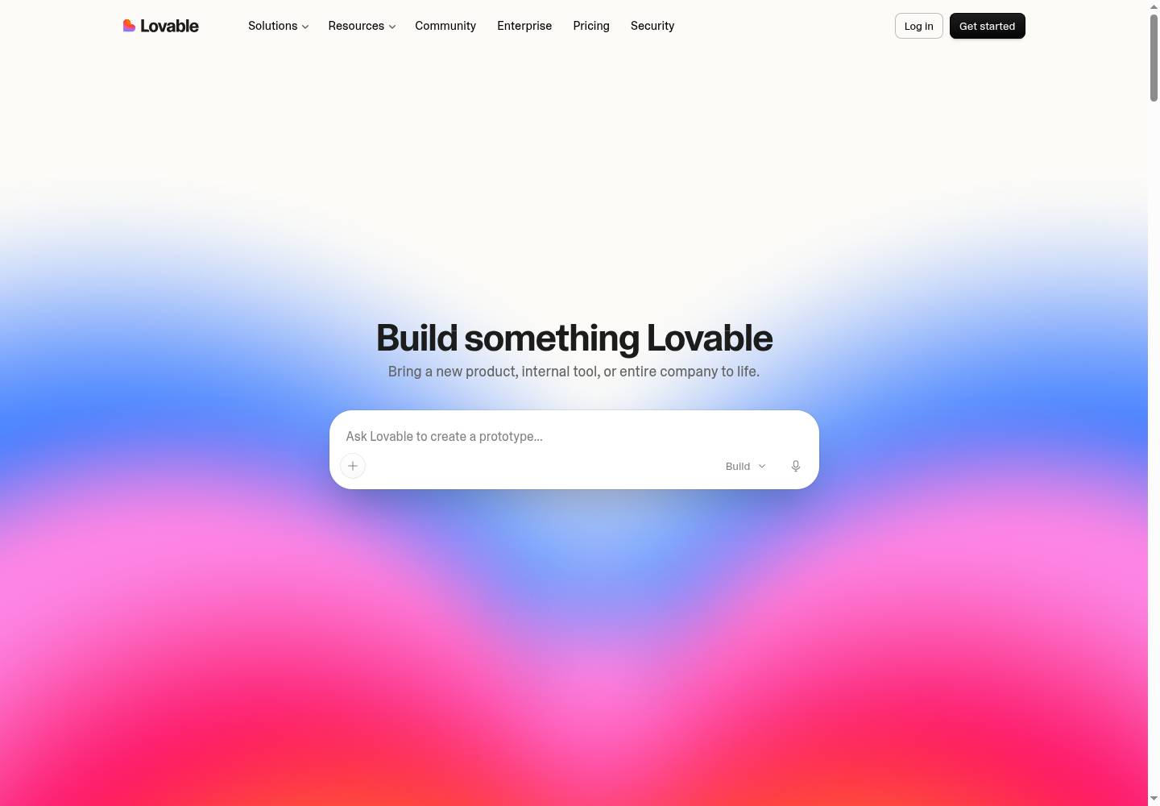
Lovable · Homepage
Lovable homepage
● No change this week
lovable.dev
Deck for Mon, Nov 2 · Source: lovable.dev · Screenshot Nov 1
Competitor watch

Slide 4
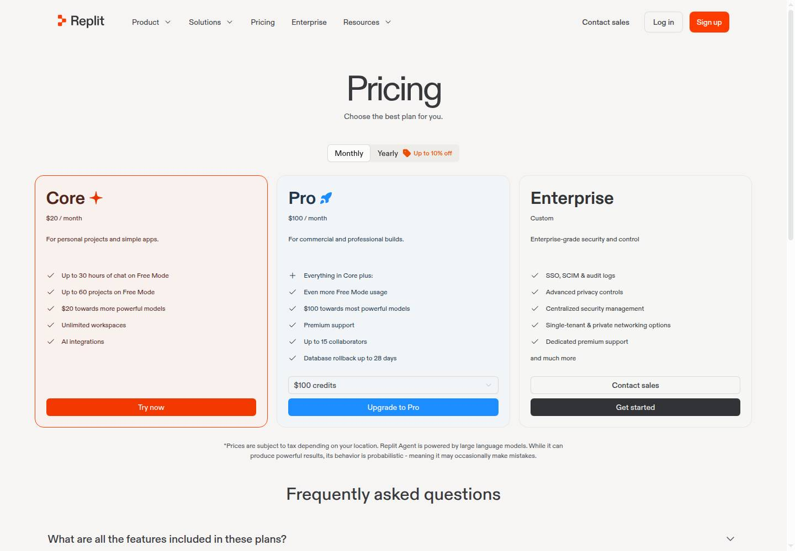
Replit · Pricing page
Replit pricing
● No change this week
replit.com/pricing
Deck for Mon, Nov 2 · Source: replit.com/pricing · Screenshot Nov 1
Competitor watch

Slide 5
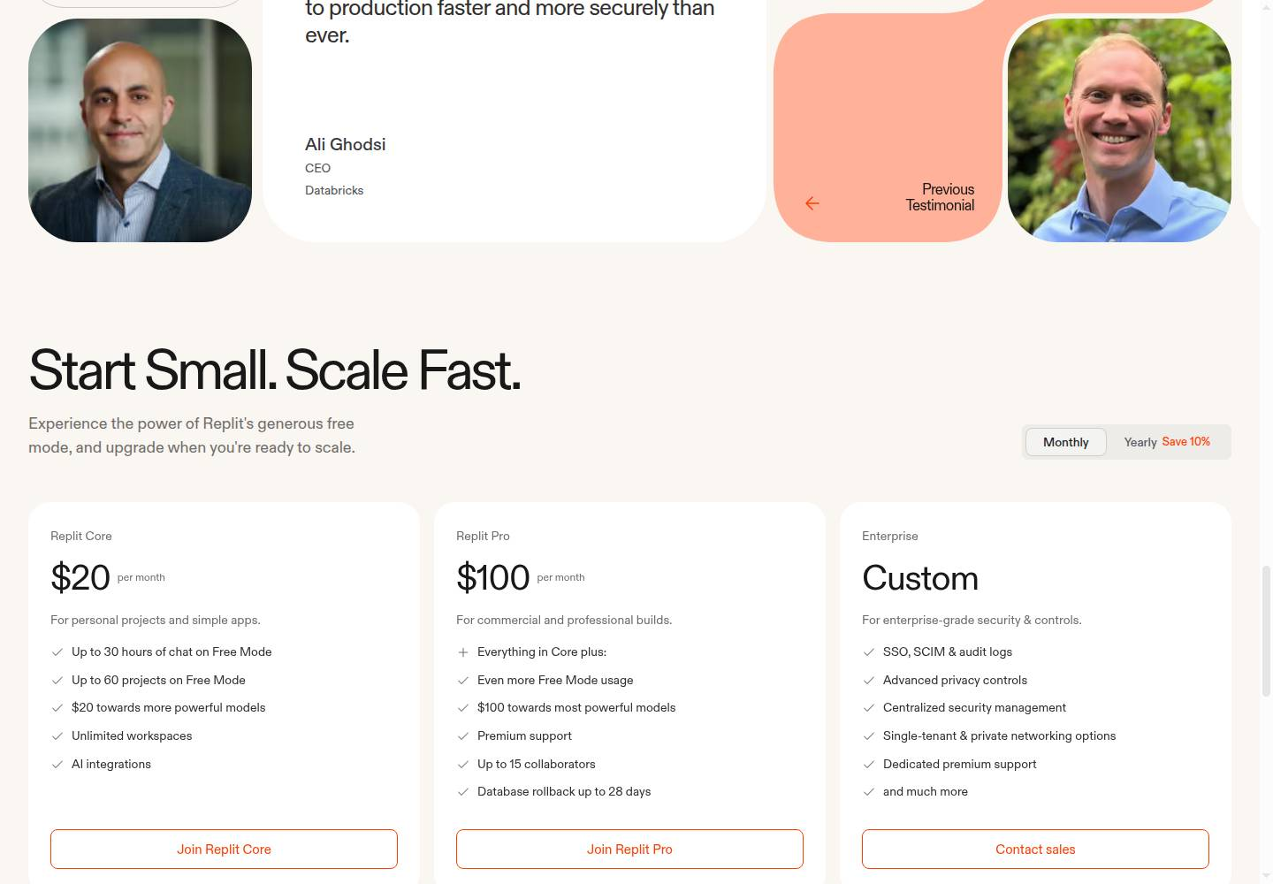
Replit · Homepage
Replit homepage
● Changed this week · 2 changes
Free Added Up to 30 hours of chat on Free Mode
Free Added Up to 60 projects on Free Mode
replit.com
Deck for Mon, Nov 2 · Source: replit.com · Screenshot Nov 1
Competitor watch

Slide 6
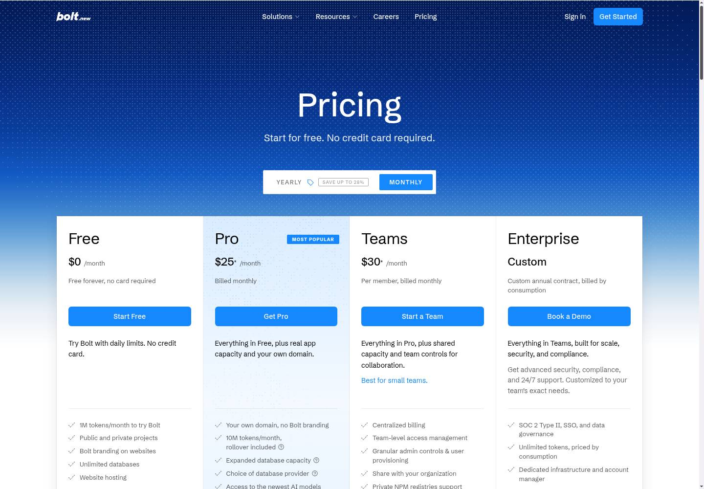
Bolt · Pricing page
Bolt pricing
● No change this week
bolt.new/pricing
Deck for Mon, Nov 2 · Source: bolt.new/pricing · Screenshot Nov 1
Competitor watch

Slide 7
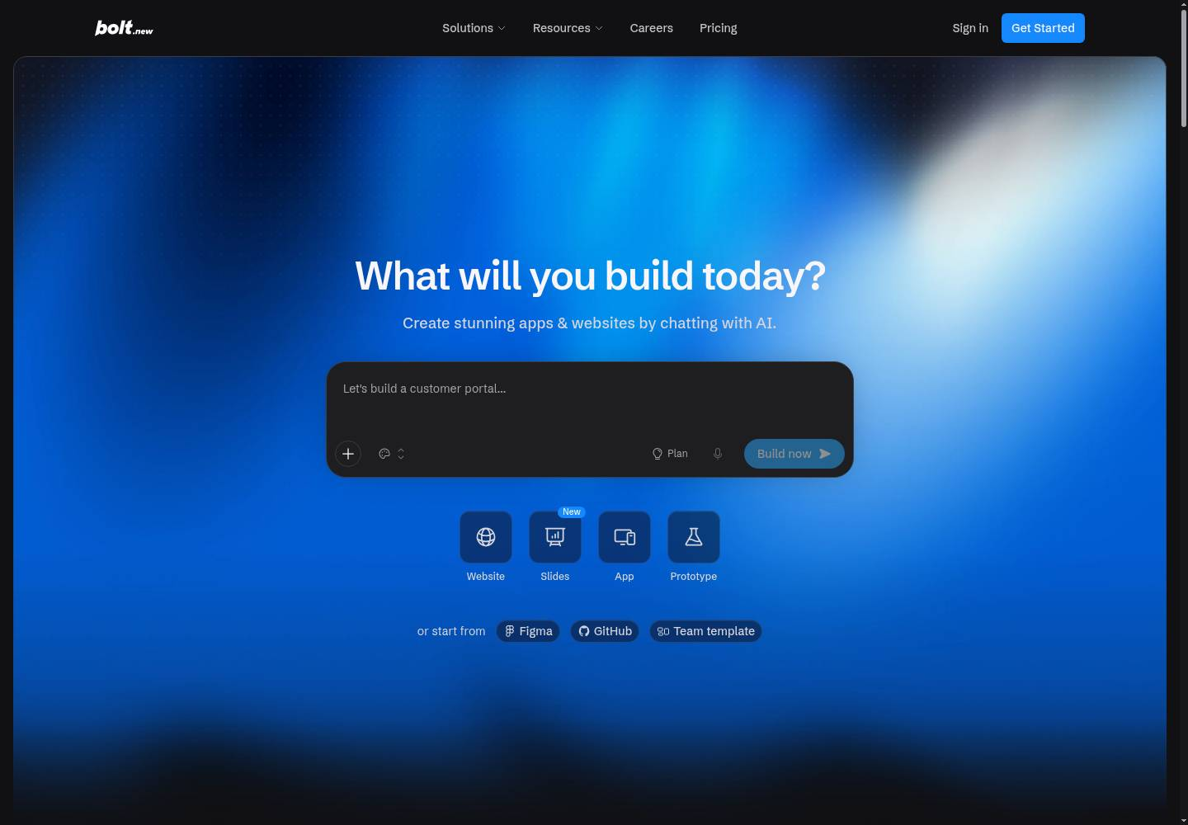
Bolt · Homepage
Bolt homepage
● No change this week
bolt.new
Deck for Mon, Nov 2 · Source: bolt.new · Screenshot Nov 1
Competitor watch

