Slide 1
Competitor pages · Oct 12–18
No changes this week
Lovable, Replit and Bolt · pricing pages and homepages
● No change Lovable pricing · Lovable homepage · Replit pricing · Replit homepage · Bolt pricing · Bolt homepage
■ Check by hand All 6 screenshots come from the Wayback Machine (Oct 14–18), so some may be a few days old.
■ Check by hand The Replit pricing screenshot shows yearly prices (the archived copy can't switch to Monthly).
Deck for Mon, Oct 19 · 6 pages · screenshots Oct 14–18 (6 archived copies)
Competitor watch

Slide 2
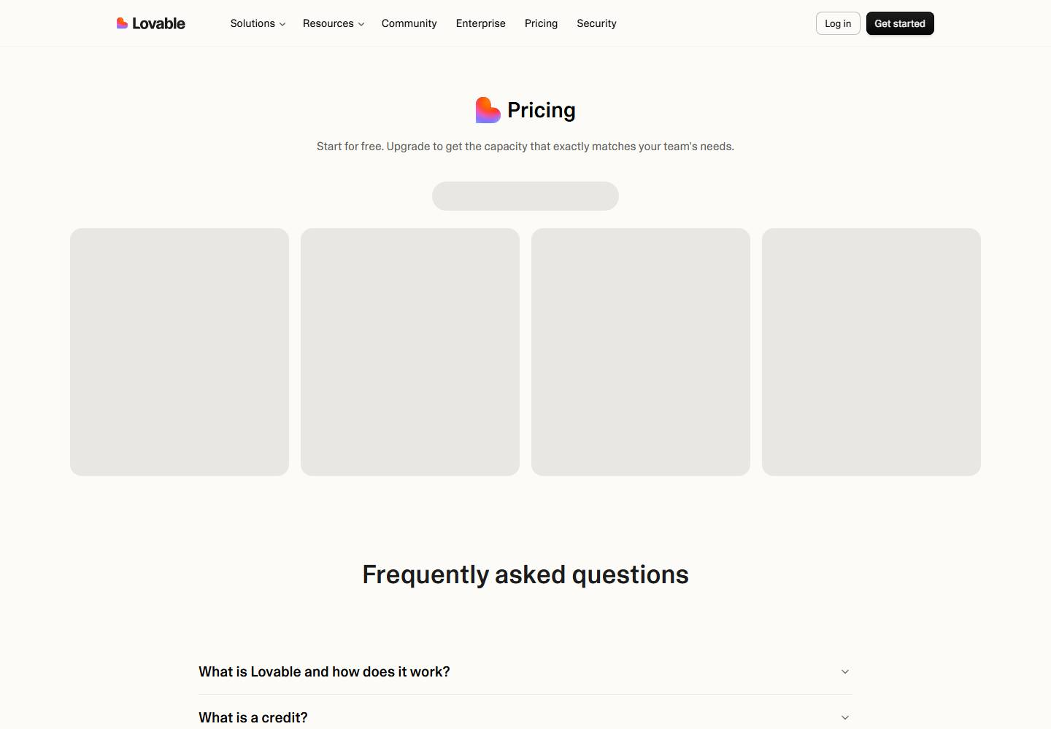
Lovable · Pricing page
Lovable pricing
● No change this week
lovable.dev/pricing
Deck for Mon, Oct 19 · Source: lovable.dev/pricing · Screenshot Oct 15 · archived copy
Competitor watch

Slide 3

Lovable · Homepage
Lovable homepage
● No change this week
lovable.dev
Deck for Mon, Oct 19 · Source: lovable.dev · Screenshot Oct 14 · archived copy
Competitor watch

Slide 4
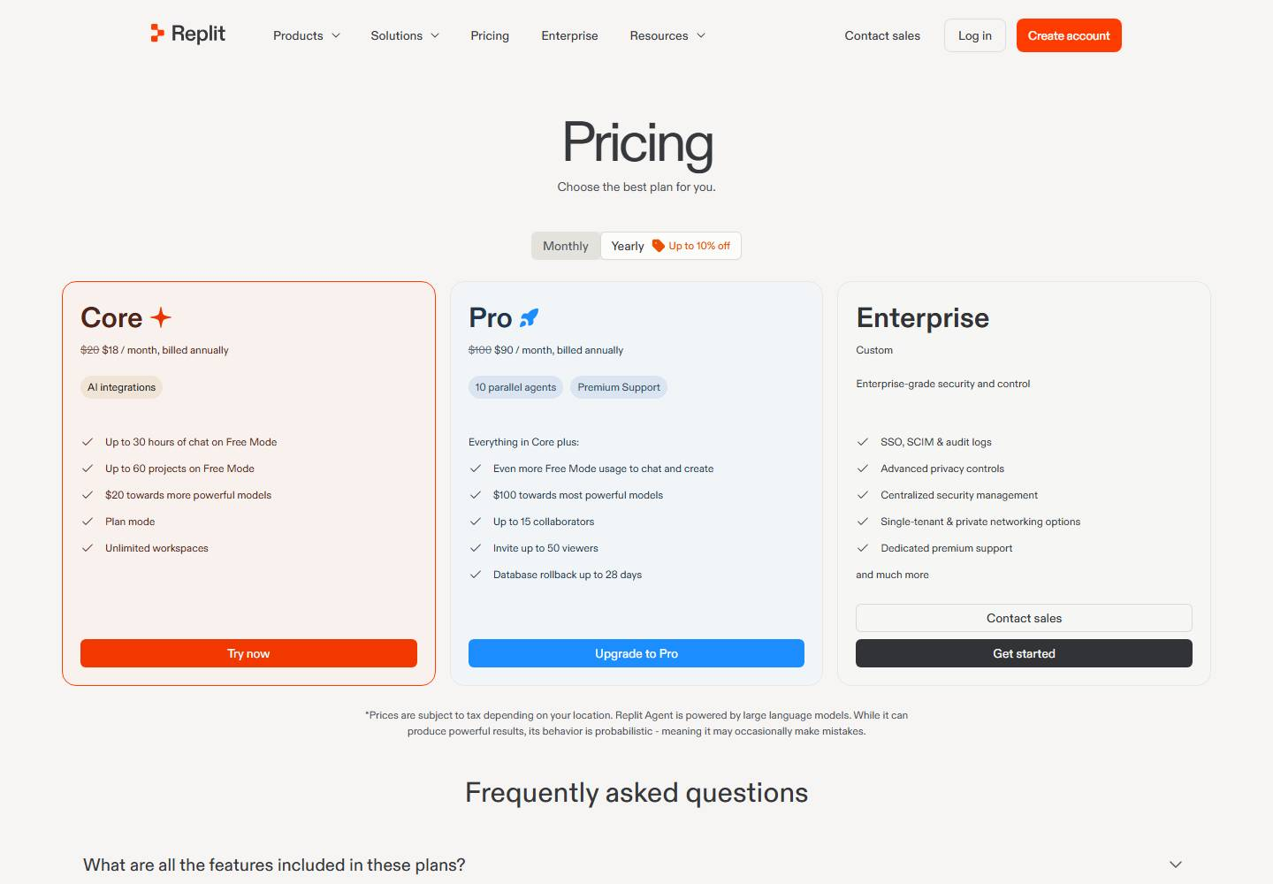
Replit · Pricing page
Replit pricing
● No change this week
replit.com/pricing
Deck for Mon, Oct 19 · Source: replit.com/pricing · Screenshot Oct 18 · archived copy · yearly prices shown
Competitor watch

Slide 5

Replit · Homepage
Replit homepage
● No change this week
replit.com
Deck for Mon, Oct 19 · Source: replit.com · Screenshot Oct 16 · archived copy
Competitor watch

Slide 6
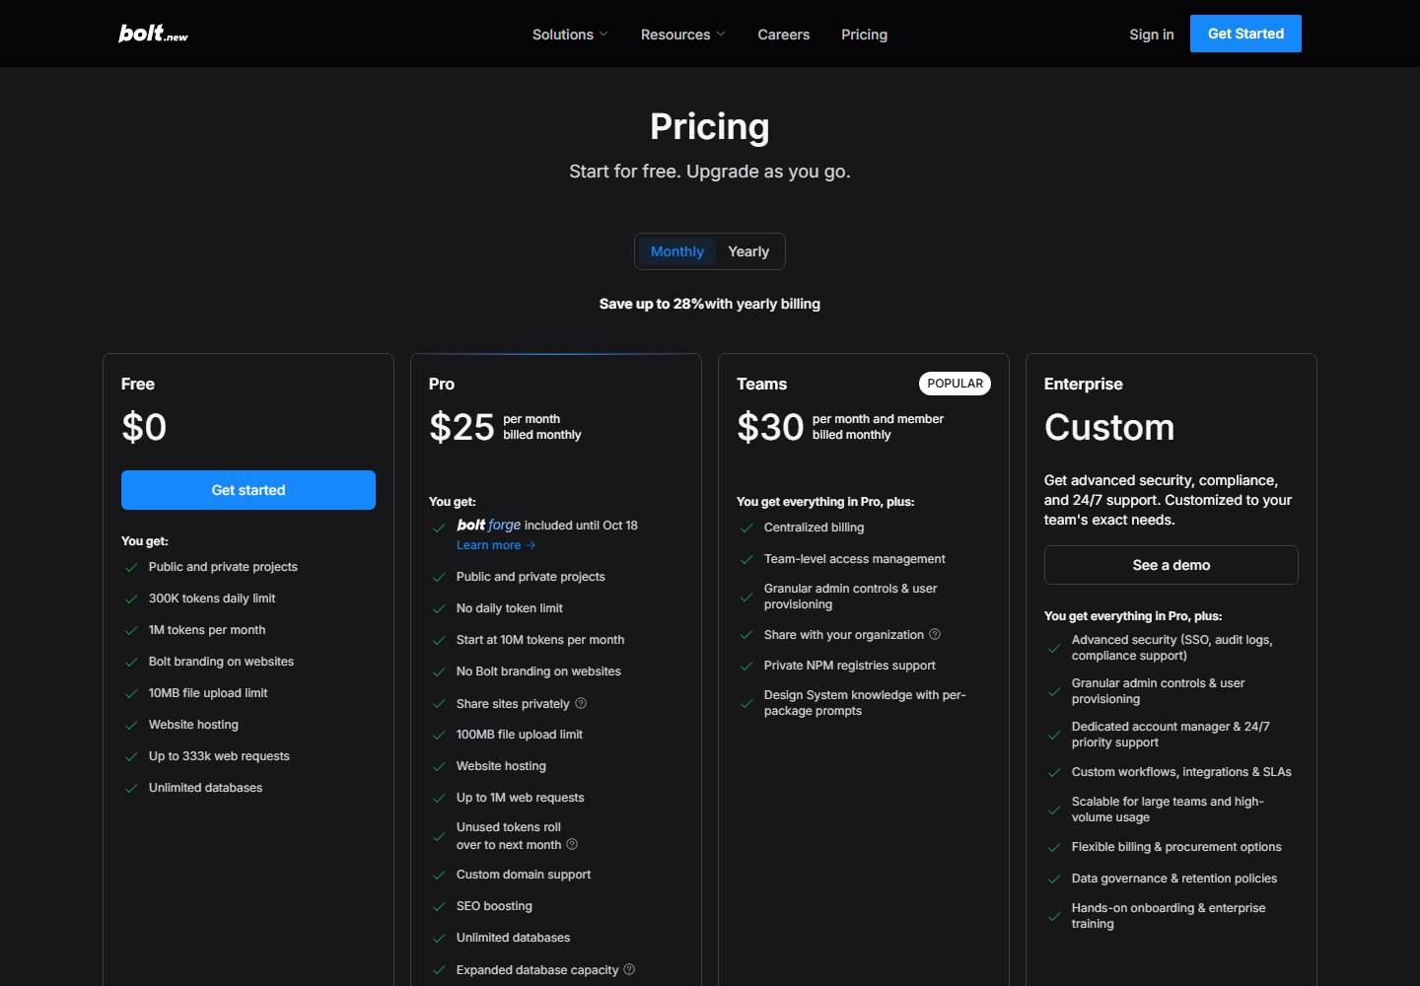
Bolt · Pricing page
Bolt pricing
● No change this week
bolt.new/pricing
Deck for Mon, Oct 19 · Source: bolt.new/pricing · Screenshot Oct 16 · archived copy
Competitor watch

Slide 7

Bolt · Homepage
Bolt homepage
● No change this week
bolt.new
Deck for Mon, Oct 19 · Source: bolt.new · Screenshot Oct 14 · archived copy
Competitor watch

