Slide 1
Competitor pages · Nov 2–8
1 of 6 pages changed
Lovable, Replit and Bolt · pricing pages and homepages
● Bolt pricing Subheadline: "Start for free. No credit card required." → "Start for free. Upgrade as you go." Nov 4
Plus 3 more changes · Plus 2 wording edits
● No change Lovable pricing · Lovable homepage · Replit pricing · Replit homepage · Bolt homepage
Deck for Mon, Nov 9 · 6 pages · screenshots Nov 8 (live)
Competitor watch

Slide 2
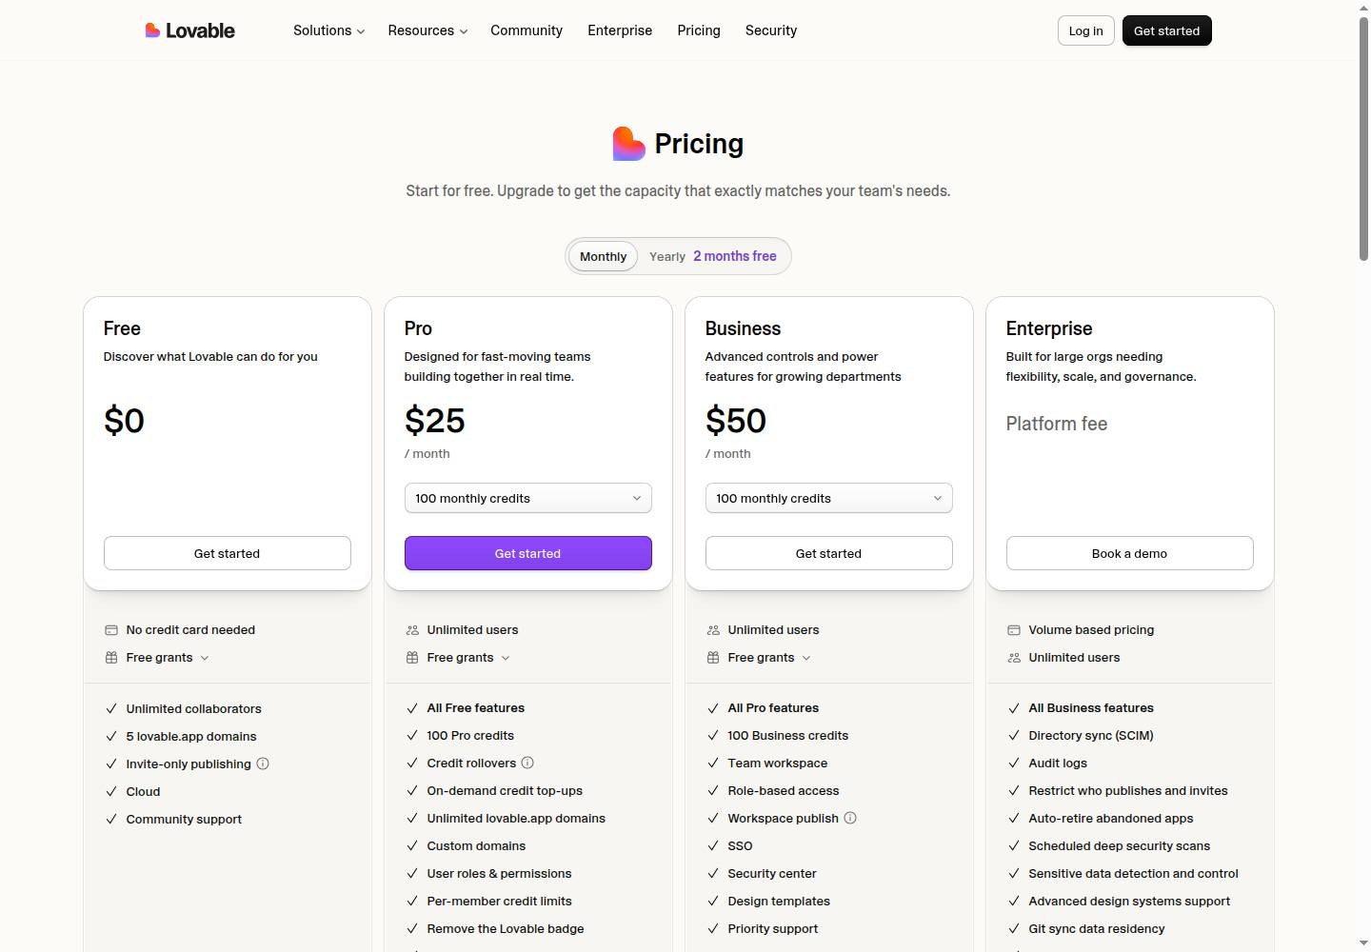
Lovable · Pricing page
Lovable pricing
● No change this week
lovable.dev/pricing
Deck for Mon, Nov 9 · Source: lovable.dev/pricing · Screenshot Nov 8
Competitor watch

Slide 3
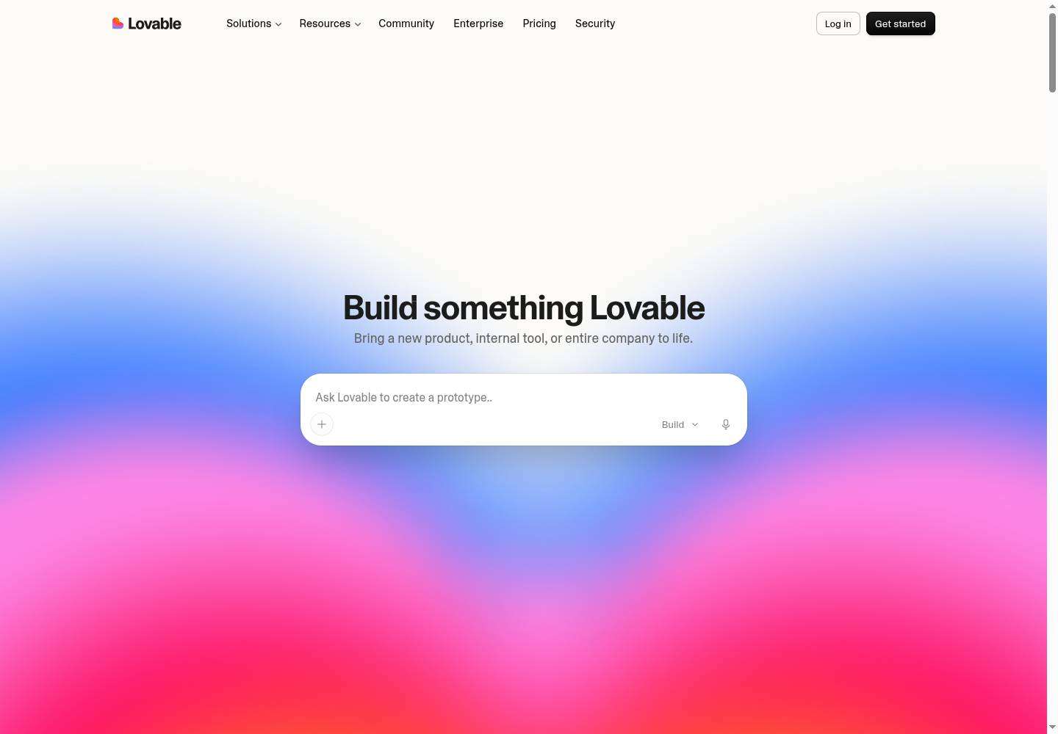
Lovable · Homepage
Lovable homepage
● No change this week
lovable.dev
Deck for Mon, Nov 9 · Source: lovable.dev · Screenshot Nov 8
Competitor watch

Slide 4
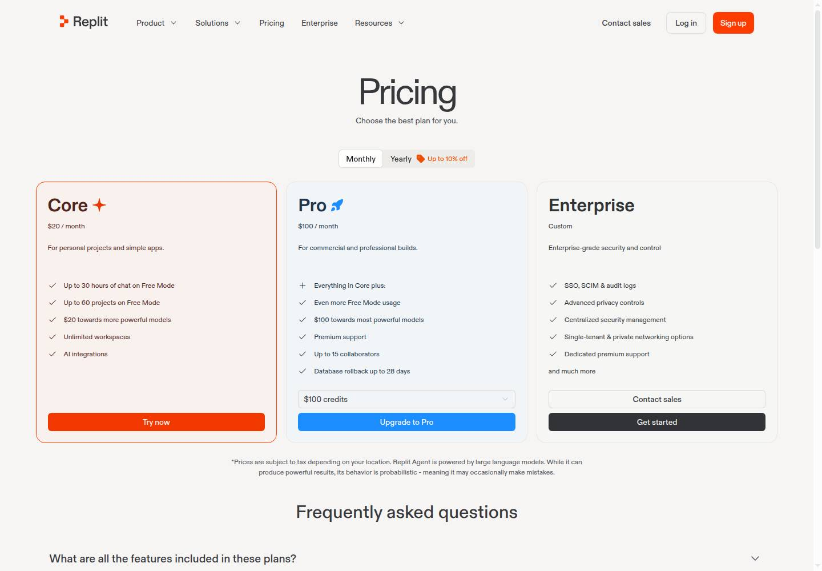
Replit · Pricing page
Replit pricing
● No change this week
replit.com/pricing
Deck for Mon, Nov 9 · Source: replit.com/pricing · Screenshot Nov 8
Competitor watch

Slide 5
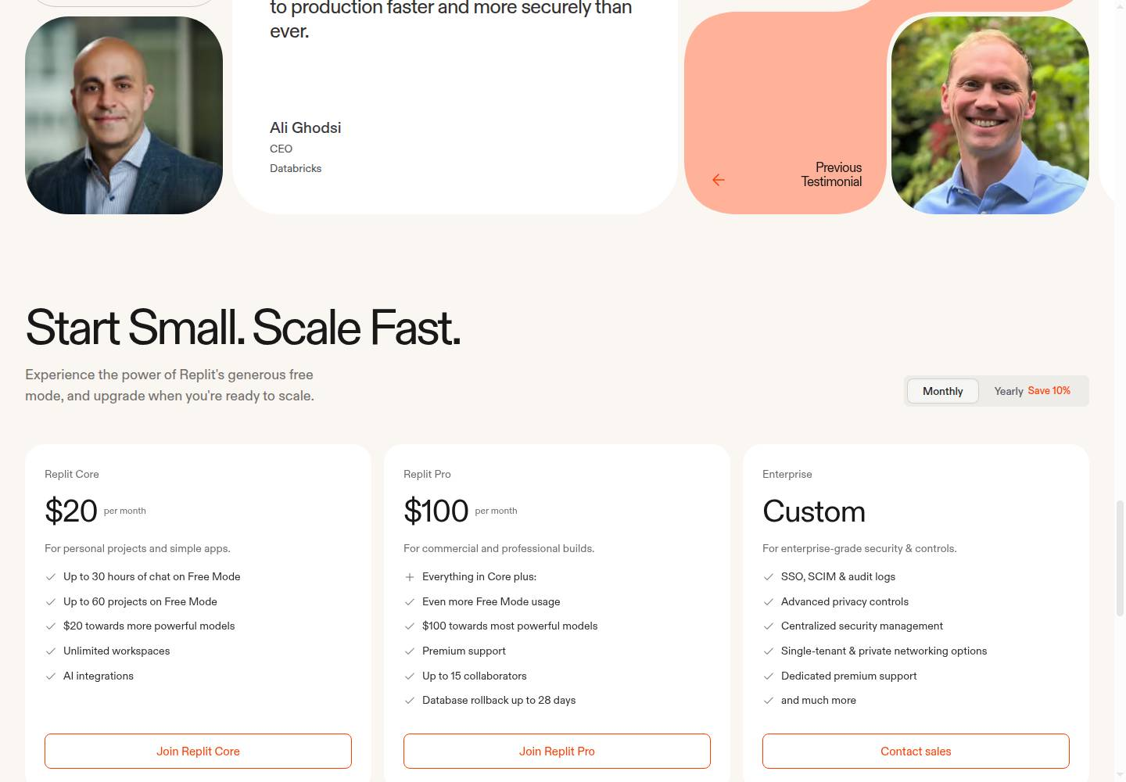
Replit · Homepage
Replit homepage
● No change this week
replit.com
Deck for Mon, Nov 9 · Source: replit.com · Screenshot Nov 8
Competitor watch

Slide 6
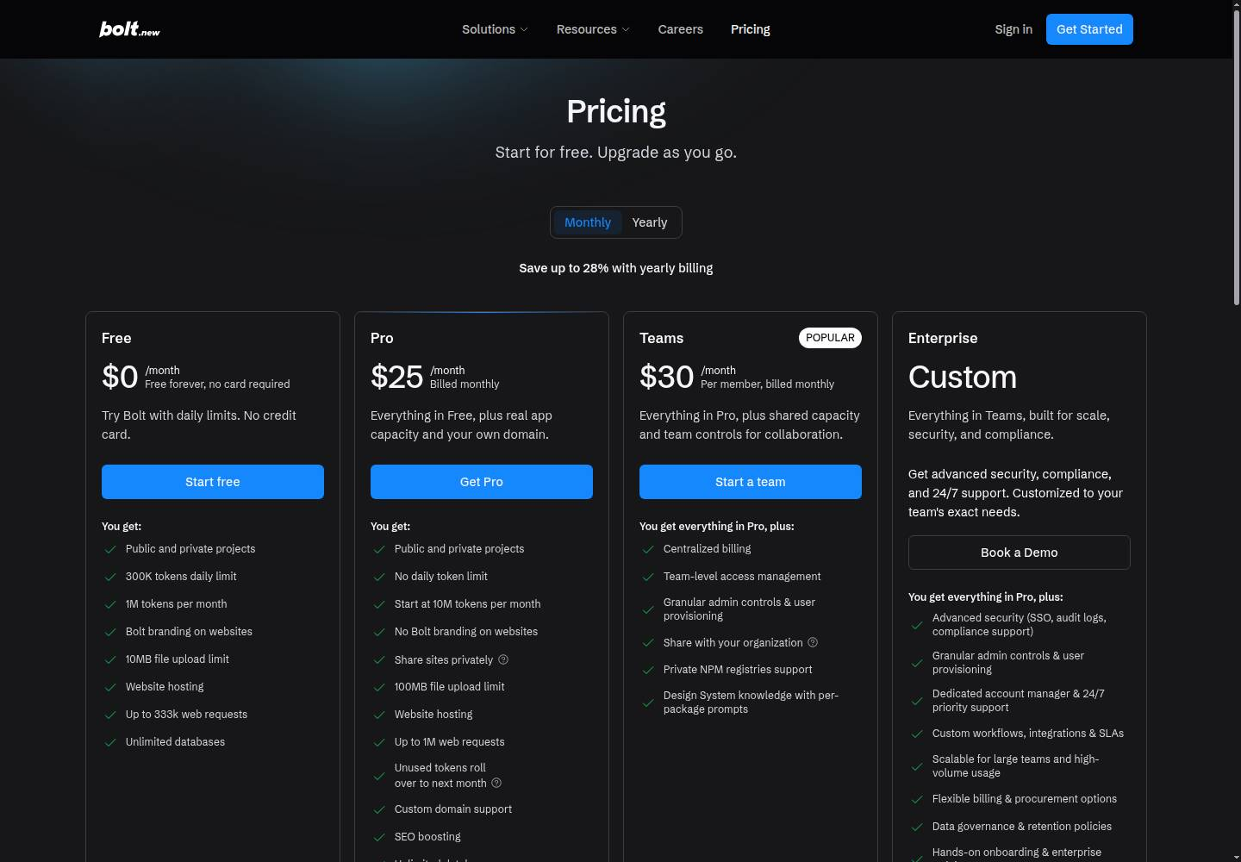
Bolt · Pricing page
Bolt pricing
● Changed this week · 4 changes, 2 wording edits
— Changed Start for free. No credit card required. → Start for free. Upgrade as you go.
— Changed now "Monthly"; now "Yearly"; now "Start free"; now "Start a team"; no longer "YEARLY SAVE UP TO 28%"; no longer "MONTHLY"; no longer "Start Free"; no longer "Start a Team"; no longer "Book a Demo"
Free Added 300K tokens daily limit
— Removed Save up to 28%
Free Wording 1M tokens/month to try Bolt → 1M tokens per month
Pro Wording 10M tokens/month, rollover included → Start at 10M tokens per month
bolt.new/pricing
Deck for Mon, Nov 9 · Source: bolt.new/pricing · Screenshot Nov 8
Competitor watch

Slide 7
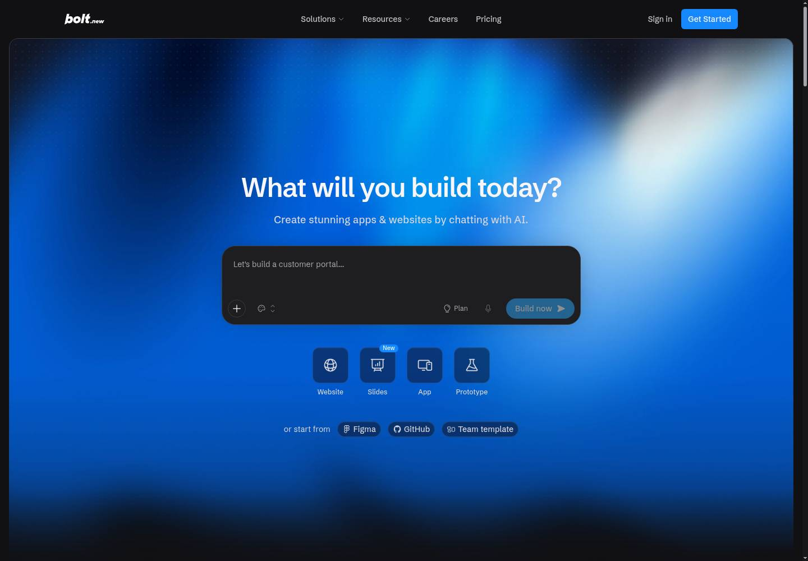
Bolt · Homepage
Bolt homepage
● No change this week
bolt.new
Deck for Mon, Nov 9 · Source: bolt.new · Screenshot Nov 8
Competitor watch

