Slide 1
Deep Learning and NLP Introduction
Amos Azaria

Slide 2
Personal Details
Amos Azaria
Class hours:
Sunday 17:00-20:00
Monday 9:00-12:00
Email: amos.azaria@ariel.ac.il .
Reception hours: TBD (probably Sunday 16:00)
Office: 11.2.11

Slide 3
About the Course
This course is very application oriented. Learned material should be highly applicable and used in the industry.
Nothing should be too difficult to comprehend, but this course is very intense and requires a fair amount of effort.
Prerequisites: Linear algebra 2, probability 1, calculus 2, OOP, databases, automatons.
Notes:
זה קורס עמוס, זה קורס שתכתבו בקורות חיים שלכם
ותדברו עליו ועל הפרוייקט בראיונות העבודה שלכם

Slide 4
Grading Policy
~3 question review quiz at the beginning of every lesson (0.5pt., 5 min.) starting next week! Please come on time to the lessons! Every quiz can give you up to ½ point bonus (maximum 4 points).
You must pass the exam to obtain these points.
60%: exam
40%: project:
5% Proposal (including data description)
10% MLP
25% Presentation + report (CNN / RNN / Reinforcement).

Slide 5
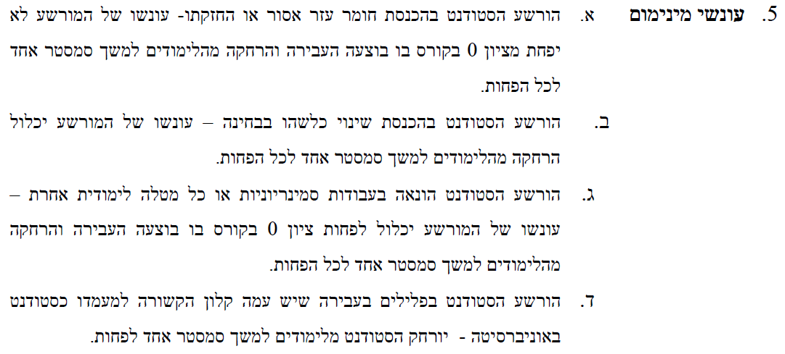
Don't copy…

Slide 6
Mini-Project
The project must include a working component in TensorFlow + a project report (at least 4-full pages) in English.
I will provide a list of topics (but you can choose any other topic that satisfies certain conditions).
The project can be done in groups of 2-3 students.
All following are possible, but require full disclosure:
You may extend your project to be your פרוייקט גמר / thesis (either with me or with someone else).
You may also add Deep Learning to your פרוייקט גמר / thesis as long as you have a working prototype by the end of this semester.

Slide 7
Mini-Project Deliverables
You are expected to start working on the project right away.
The project should evolve over time during the semester. Every-time we learn new material, you should use it to improve your project.
Project structure:
1) 5% Proposal: 1/11/21
A paragraph about your project, and the students working on it. Description of the dataset.
2) 10% MLP 29/11/21
1 page (in English) describing what you did, along with different performance measurements. (+ a working component).
3) 25% Presentation + report (CNN / RNN / Reinforcement etc.). 2-3/1/22
Presentation in class. Final report: at least 4-full pages. (+ a working component).

Slide 8
Submission of deep learning project to a top-tier conference
If you improve your deep learning project work and submit it to any of the following conferences: NIPS, AAAI, ICML, ACL, EMNLP, IJCAI or AAMAS (must be submitted by March'19), and receive at least one positive review (or at least a neutral one) you will receive a final bonus of 10 points. You must receive at least 70 on the exam to obtain this bonus.

Slide 9
Pilot Test (on Prerequisites)
1) Given: p(X=1) = 0.2, p(Y=1)=0.4, p(X=1|Y=1)=0.1
a) What is the probability of p(X=1, Y=1)?
b) Are X and Y independent variables?
2) What is the rank of the following matrix:
[1, 2, 3
4, 5, 6
5, 7, 9]
Notes:
1a) 0.04
1b) no (0.04 != 0.2*0.8)
2) 2

Slide 10


לשון רבים-יחידה
Don’t worry, this is the only slide in Hebrew.
אם משהו לא ברור למישהו מכם, שישאל, כי כנראה יש עוד סטודנטים שלא מבינים (אבל אין להם את האומץ שלו לשאול).
אם משהו לא ברור למישהו או מישהי מכם או מכן, שישאל או שתשאל, כי כנראה יש עוד סטודנטים או סטודנטיות שלא מבינים או מבינות (אבל אין להם או להן את האומץ שלו או שלה לשאול).
אם משהו לא ברור למישהי מכם, שתשאל, כי כנראה יש עוד סטודנטים שלא מבינים (אבל אין להם את האומץ שלה לשאול).
מַפְלֶה!
מַלְאֶה!
בדר"כ לשון יחידה מחביאה בתוכה לשון יחיד. אמרה כותב/ת וכד'
משווה!

Slide 11
Deep Learning and NLP in a Venn Diagram
Artificial Intelligence
Machine Learning
NLP
Deep Learning

Slide 12
Deep Learning Introduction
Amos Azaria

Slide 13
Topics
NumPy and Tensorflow
Linear regression + gradient decent + regularization
Logistic regression + Stochastic-GD and Mini-batch-GD + cross validation
Multi-layer perceptron, forward-prop and back-propagation (+activation layers)
Convolutional networks: CV layers, pooling, dropout
Word embedding (Word2vec)
Recurrent networks: LSTM, GRU. MT, POS tagging, creating new text
Attention (+ transformers)
Autoencoders and variational autoencoders (VAE)
Deep reinforcement learning
Generative adversarial network (GAN)
If time permits:
Neural Turing machine
One-shot learning, Siamese network

Slide 14
Additional Material
Deep Learning Book: https://books.google.co.il/books/about/Deep_Learning.html?id=Np9SDQAAQBAJ (Read it online at: http://www.deeplearningbook.org/, or download a pdf from: https://github.com/HFTrader/DeepLearningBook/blob/master/DeepLearningBook.pdf)
TensorFlow: https://www.tensorflow.org/tutorials
Deep learning in Hebrew: https://github.com/AvrahamRaviv/Deep-Learning-in-Hebrew

Slide 15
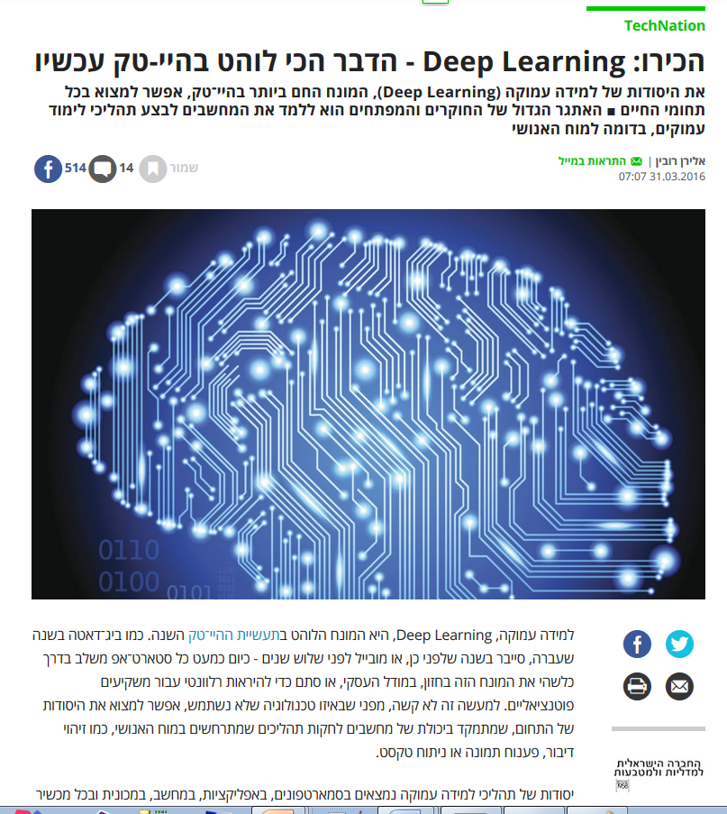

Slide 16
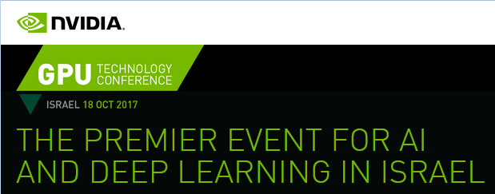

NVIDIA Deep learning Conference
I have attended the NVIDIA deep learning conference on 18/10/17.
About 30 companies were (desperately) recruiting people with background in deep-learning.
I handed out emails of two of my students from last year's class, and they were both contacted by several companies the next day!

Slide 17
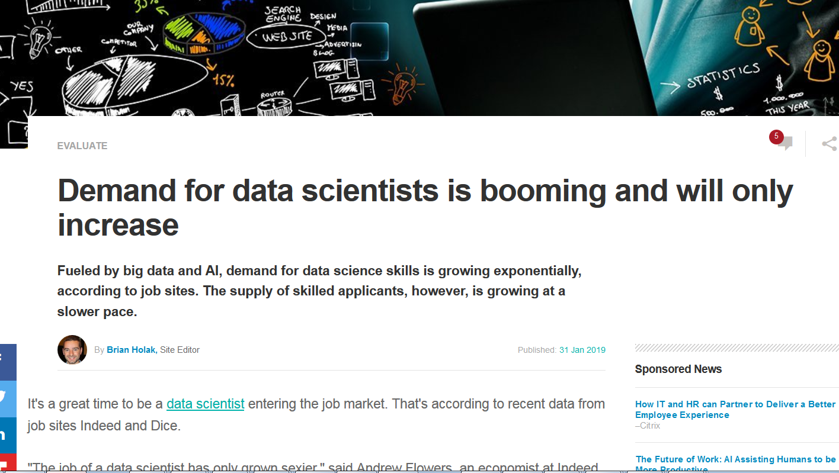
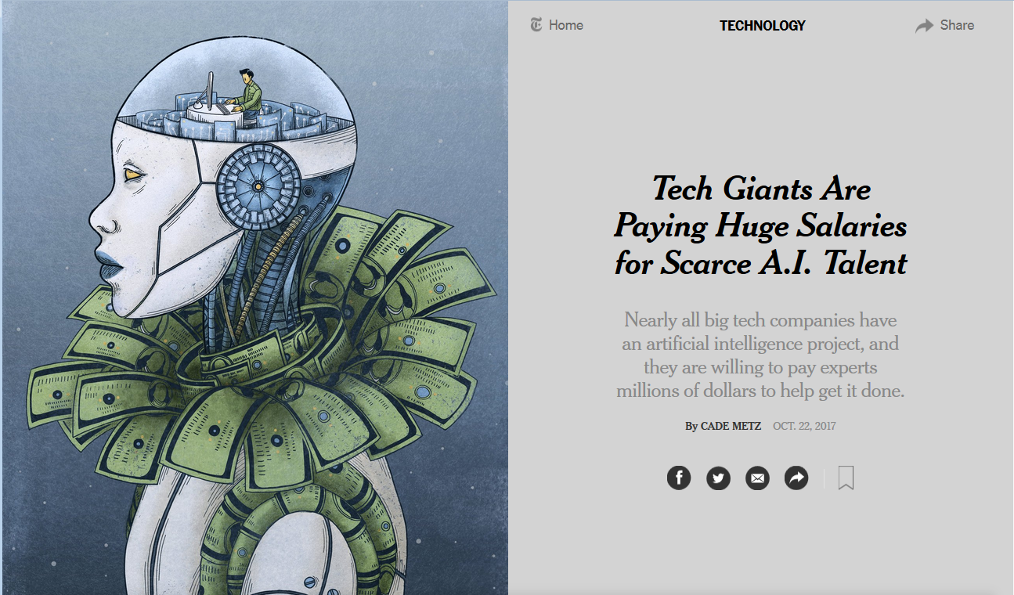
New York Times
Notes:
There has been a slight decrease in pay for entry level data scientists (due to an large increase in applicant numbers).

Slide 18
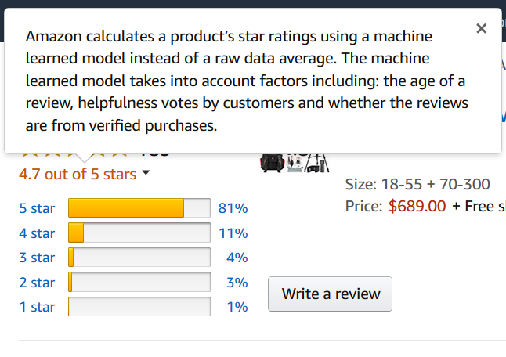
Deep Learning
Everywhere:
Search Queries
Text prediction (Gmail)
Automatic Speech Recognition (ASR)
Image Classification
Face recognition
What song is this? (Google)
Requirements:
A lot of data
Hardware (GPUs) + time
A Model
Must be present in the data!

Slide 19
Deep Learning applications
https://www.youtube.com/watch?v=Bui3DWs02h4
https://www.youtube.com/watch?v=V1eYniJ0Rnk (Atari)
https://www.youtube.com/watch?v=RoGHVI-w9bE (Deep-fake detector)
Notes:
https://www.youtube.com/watch?v=V1eYniJ0Rnk(atari)
https://www.youtube.com/watch?v=hPKJBXkyTKM
https://www.youtube.com/watch?v=aKSILzbAqJs
https://www.youtube.com/watch?v=iqXKQf2BOSE

Slide 20
NLP Introduction
Amos Azaria
Notes:
We will start with NLP, and later move on to Deep Learning (using what we have learned on NLP)

Slide 21
Topics
(Python) + nltk
POS tagging (+Viterbi) + Chunking + NER
Creating new text (using n-grams)
Constituency parsing – CFG and PCFG (CYK algorithm)

Slide 22
Additional Material
Speech and Language Processing, By Daniel Jurafsky and James H. Martin.
(First Chapter: http://www.cs.colorado.edu/~martin/SLP/slp-ch1.pdf )
NLTK book: http://www.nltk.org/book

Slide 23
Can Computers Understand Natural Language
What is “understanding”?

Slide 24
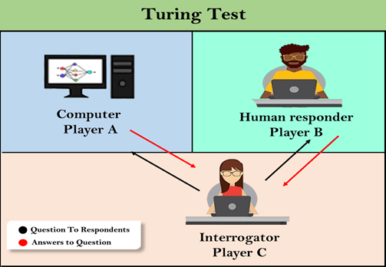
Can Computers Think?
Computing Machinery and Intelligence (Alan Turing 1950)
The Turing Test (AI complete):
https://www.javatpoint.com/turing-test-in-ai
Notes:
If anyone criticizes AI, say that Turing first did Turing machine and then AI

Slide 25
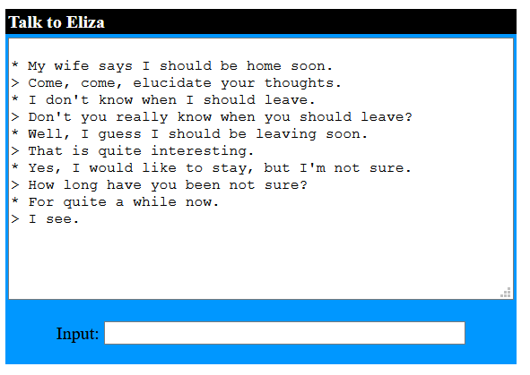
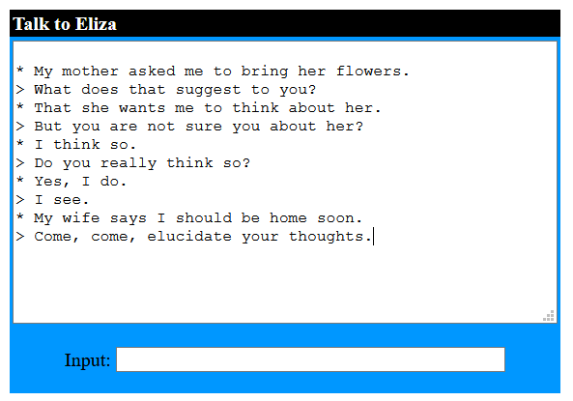
ELIZA (Joseph Weizenbaum 1966)
Linguistic tricks (keywords + regular expressions).
http://psych.fullerton.edu/mbirnbaum/psych101/Eliza.htm

Slide 26
Eugene Goostman (2014)
Eugene Goostman simulates a 13-year-old Ukrainian boy.
English was its “second” language.
It usually merely tried to avoid the questions or answer humorously.
It tricked one of the judges.

Slide 27
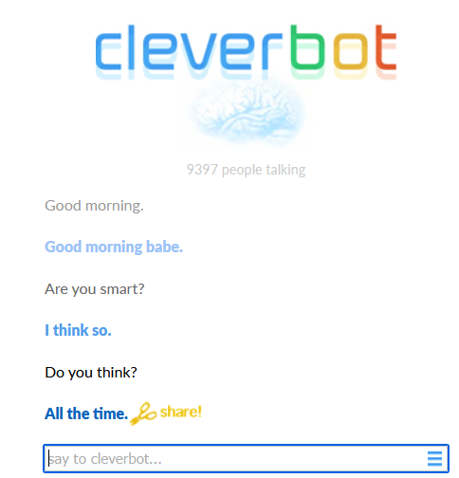
Let’s Get RomanTECH
File://D:/tempVideos/MindField/romanTechAll.mp4
For full episode, see: https://www.youtube.com/watch?v=qZXpgf8N6hs
https://www.cleverbot.com/

Slide 28
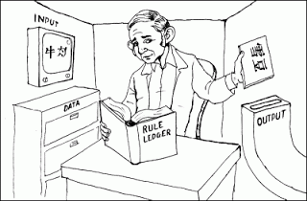
The Chinese Room Argument (John Searle - 1980)
https://absurdbeingblog.wordpress.com/2020/03/10/blindsight-4-the-chinese-room-argument/

Slide 29
But no Such Rule-Book Could Exist
The rule book must consider the previous queries.
Therefore, it must include more pages than the number of atoms in the universe (~10⁸⁰).
So, providing a machine that would replace the book is likely to require great understanding of Chinese (common-knowledge and more).

Slide 30
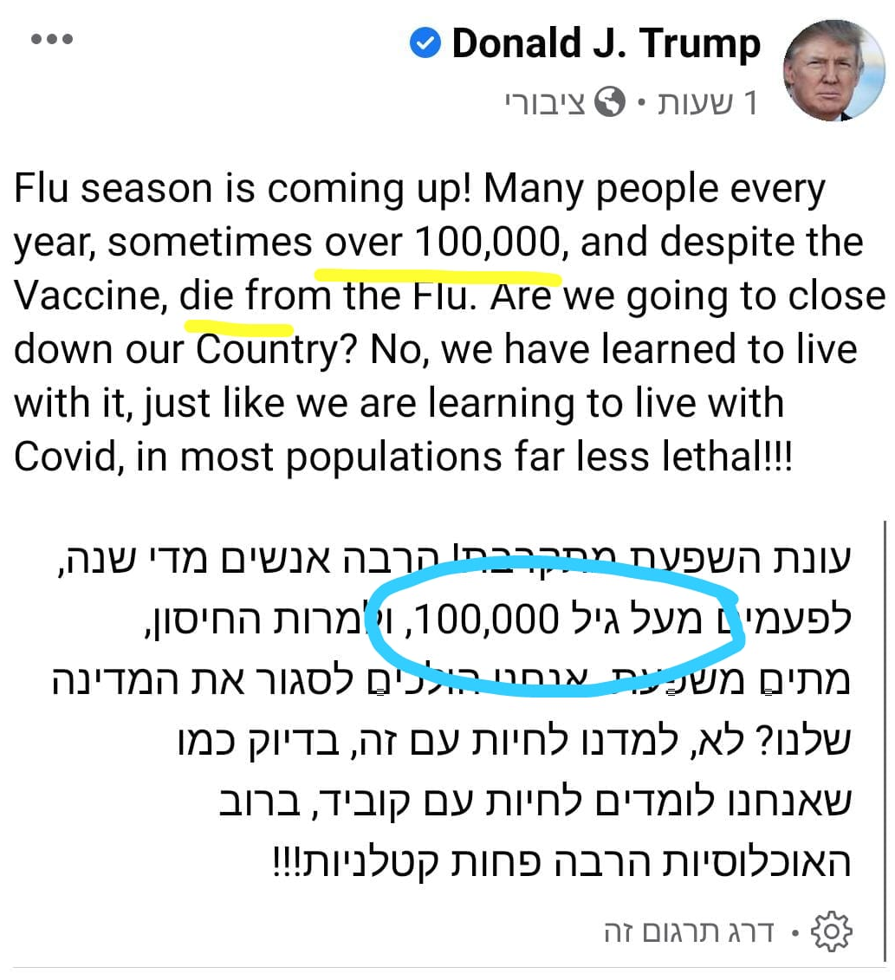
So What is Understanding?
It usually boils down to:
A task or a set of tasks
given a dataset.
How many drops are in the ocean?
https://youtu.be/4ITzgO9CBzU
How much is 100! ?
https://youtu.be/Y7_ecFYhzHg
The translations is quite accurate, but its horrible mistake demonstrates that it has “no-clue” of what the words really mean.

Slide 31
Ambiguity
Natural language is sometimes ambiguous, e.g.:
“I saw Alice with my telescope.”
But for computers things are much worse!
“The trophy would not fit in the brown suitcase because it was too big”
They ate spaghetti with meatballs
They ate spaghetti with forks
They ate spaghetti with pajamas
They ate spaghetti with friends
The main challenge we try solving in NLP is disambiguation.
Notes:
When we think about ambiguous sentences we generally think about…

