Slide 1
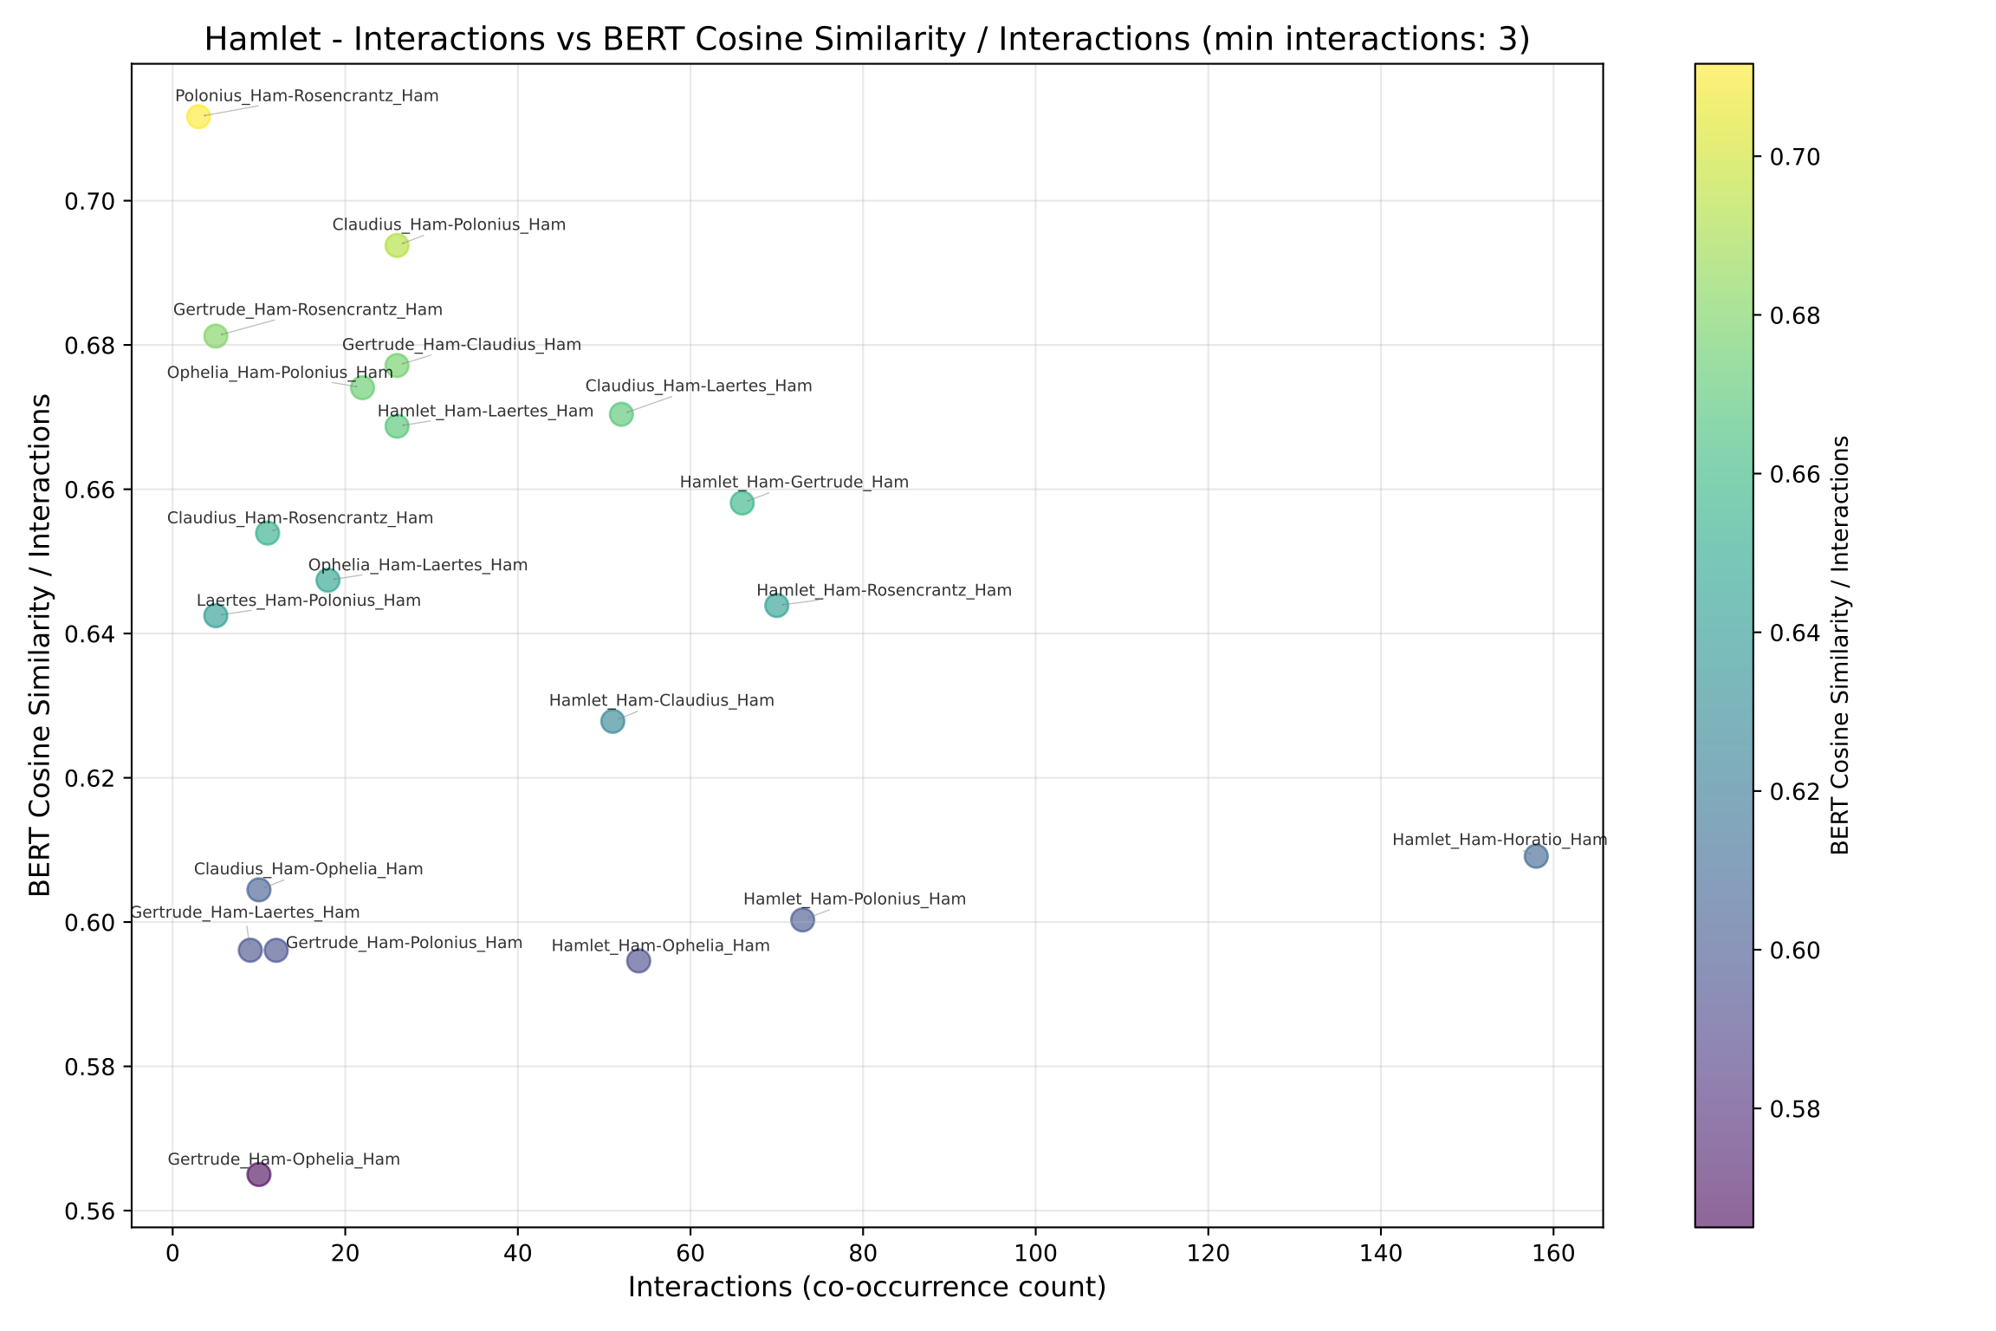
Hamlet bert interactions scatter normalized

Slide 2
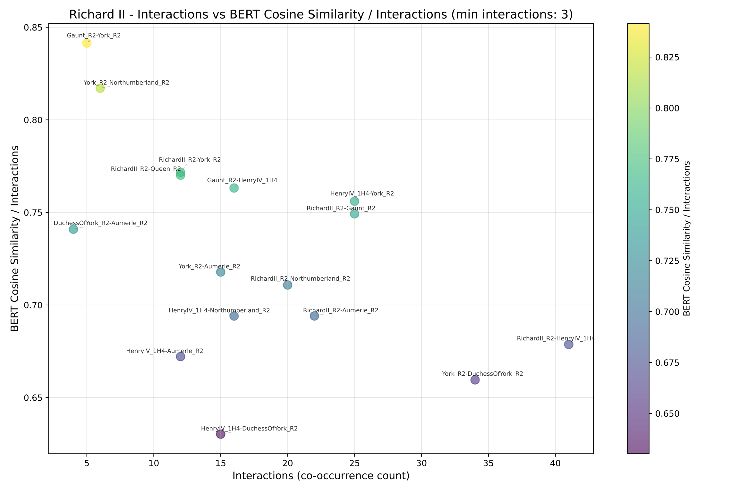
Richard II bert interactions scatter normalized

Slide 3
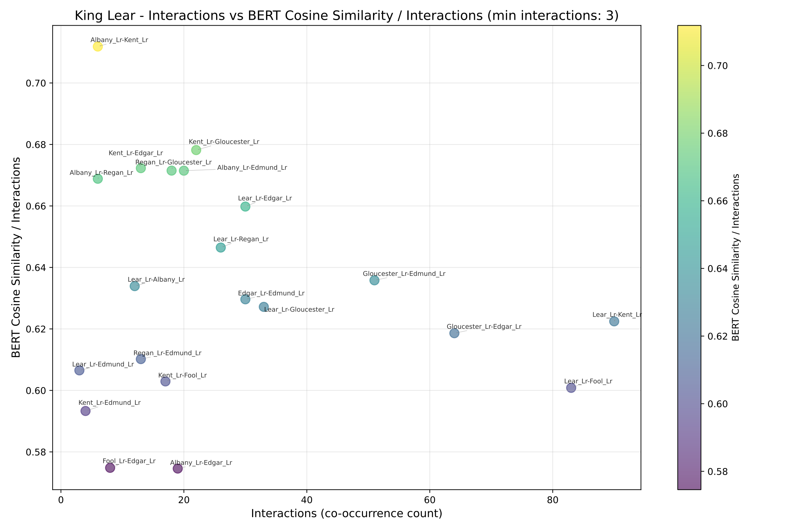
King Lear bert interactions scatter normalized

Slide 4
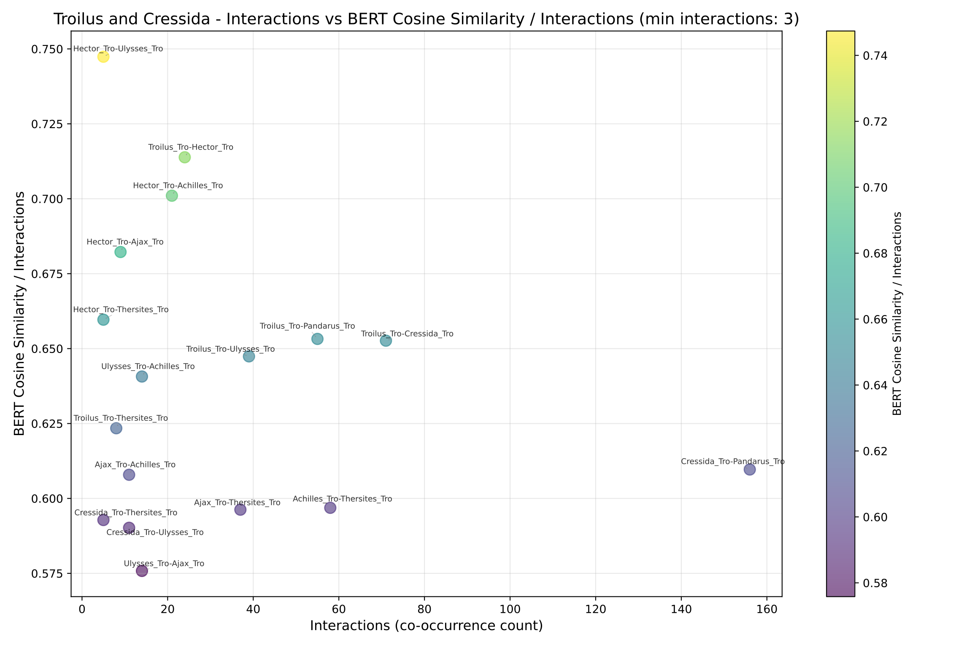
Troilus and Cressida bert interactions scatter normalized

Slide 5
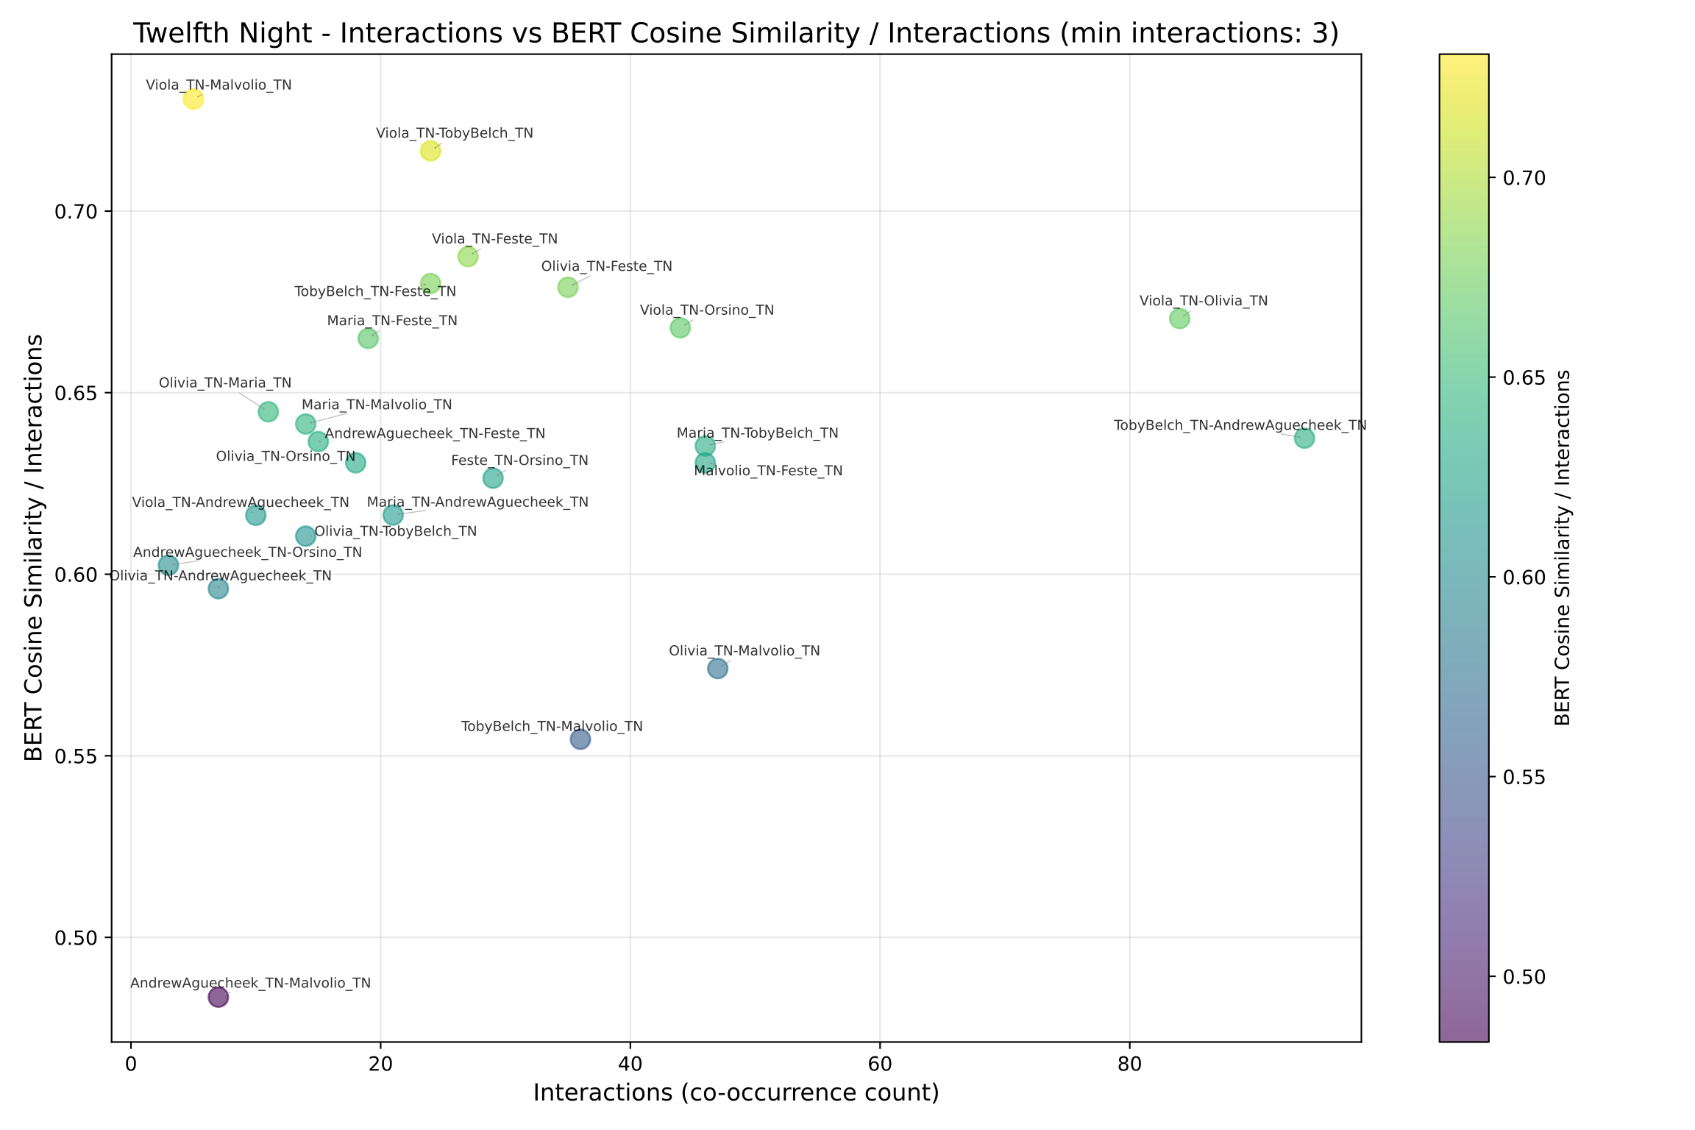
Twelfth Night bert interactions scatter normalized

Slide 6
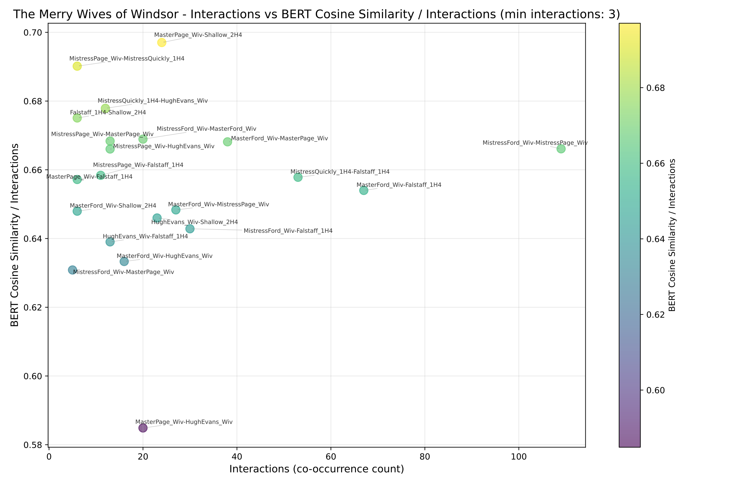
The Merry Wives of Windsor bert interactions scatter normalized

Slide 7
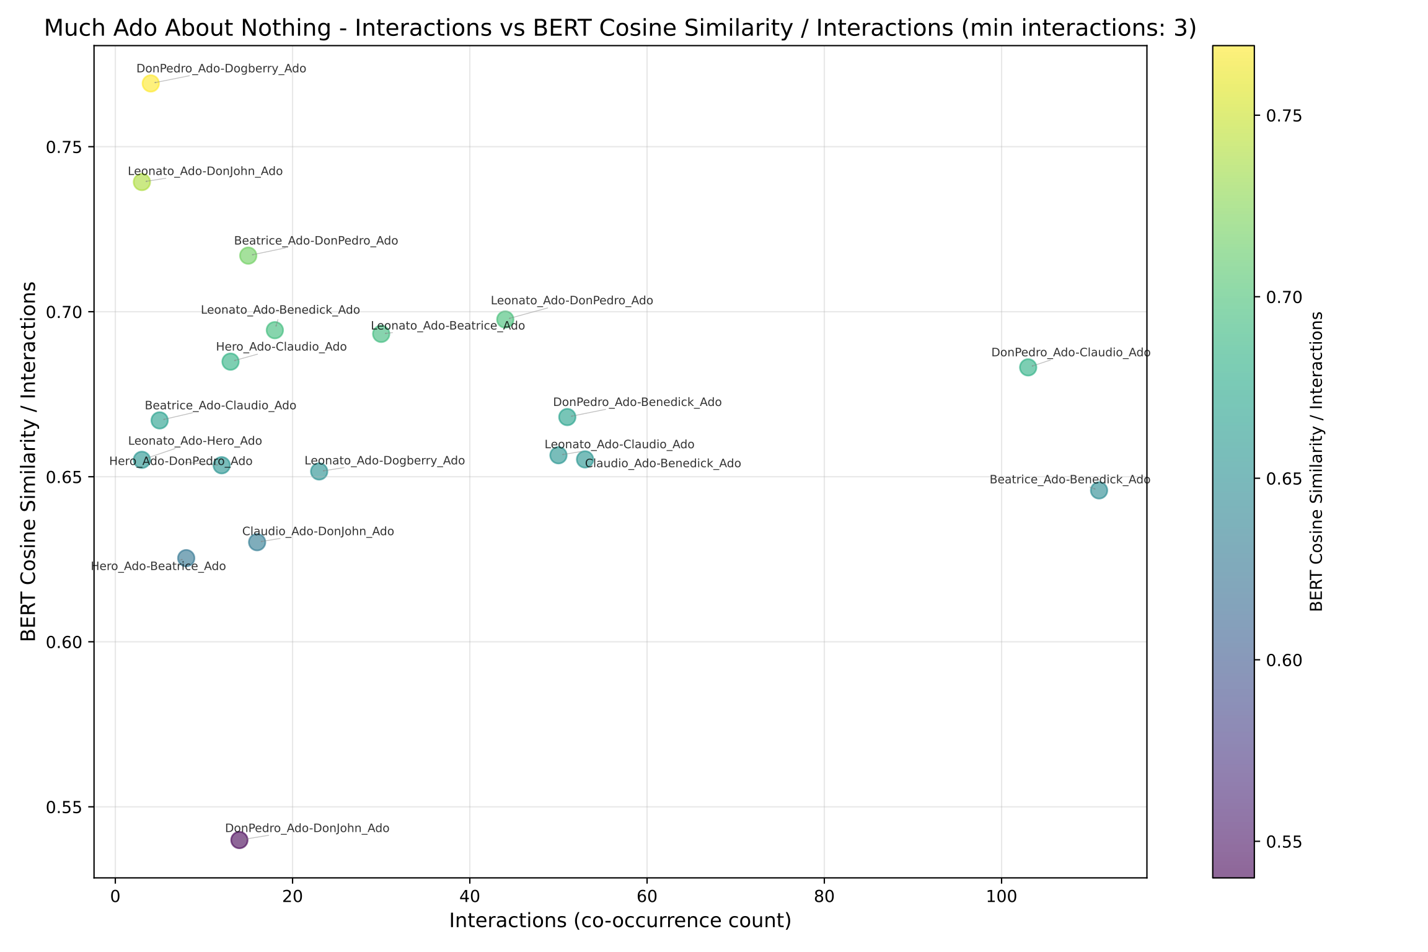
Much Ado About Nothing bert interactions scatter normalized

Slide 8
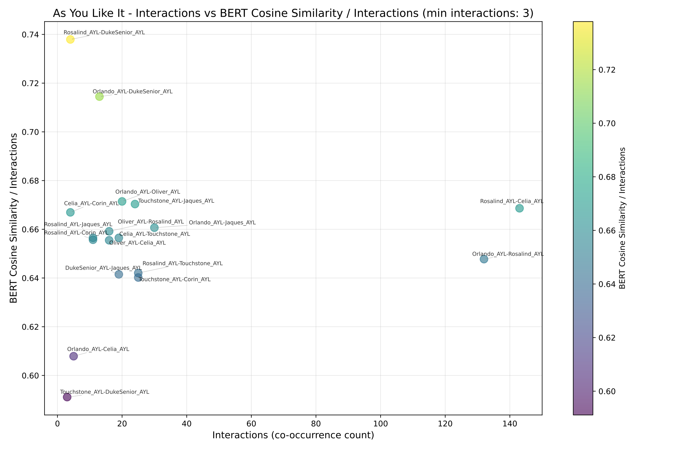
As You Like It bert interactions scatter normalized

