Slide 1
HireHeroes
Matan Tzur
Avital Hozeh Itshar

Slide 2
Agenda
Hiring Cost Issue
Our Solution
Use Case: Adzuna
Teck Flow
ETL
Teck Stack
Presentation
Orchestration

Slide 3
Hiring is Expensive
Recruiting large workforces requires heavy ad spend
Job ads must be published across multiple platforms
Costs grow rapidly with high-volume hiring needs
Example: Amazon hiring warehouse workers nationwide
Monthly ad spend can exceed hundreds of thousands
Cost per applicant becomes unpredictable & inefficient
Lack of optimization leads to wasted budget

Slide 4
Our Solution
AI-powered platform for job ad publishing
Smart budget allocation across campaigns
Lower Cost Per Applicant (CPA) through optimization
Campaign budgets are fully and efficiently utilized
Higher reach with reduced spend per applicant
Companies like Amazon save significantly on hiring costs
Scalable solution for enterprises and SMBs

Slide 5

Metrics Definitions
Budget = Allocated campaign budget per account/campaign
$Spend=\sum{Sum of Clicks cost}$
$CPC=\frac{Spend}{\#Clicks}$ The average cost per click
$CPA=\frac{Spend}{\#Applicants}$ The average cost per applicant
$CVR=\frac{Applicant}{Clicks}$ The conversion rate of how many applicants out of clicks
$Budget Utilization=\frac{Spend}{Budget}$ How much we spent out of the budget?
$CPA Achievement=\frac{CPA}{CPA Target}$ How close are we to the campaign’s CPA target

Slide 6

Metrics Example
Budget = 3500
$Spend=100$
$CPC=\frac{Spend}{\#Clicks}=\frac{100}{100}=1$
$CPA=\frac{Spend}{\#Applicants}=\frac{100}{3}=33.33$
$CVR=\frac{Applicant}{Clicks}=\frac{3}{100}=0.03=3\%$
$Budget Utilization=\frac{Spend}{Budget}=\frac{100}{3500}$= 2.86%
$CPA Achievement=\frac{CPA}{CPA Target}=\frac{33.33}{25}=133\%$

Slide 7
Use Case Demonstration: Adzuna Job Board
Adzuna = global job board with millions of listings
Companies publish ads to attract job seekers
HireHeroes integrates directly with Adzuna’s API
We detect & manage ads across campaigns
Optimize spend for job ads published there
This is *not* the only platform we support
Other boards can be integrated in the same way

Slide 8
Adzuna API
Extracts live job postings from Adzuna board
Captures job title, salary ranges, description, etc.
Provides contract type & time (full-time/part-time)Collects company & category details
Extracts detailed location (country, state, city, etc.)
Stores geospatial data (latitude/longitude)
Enables us to build structured campaign datasets

Slide 9
Tech Stack
Adzuna API – Source of live job ads
Python – Data extraction & processing scripts
Amazon S3 – Storage for raw & processed data
Nominatim API – Enrich missing location details
PySpark – Large-scale data transformation
Amazon Glue – Schema definition & ETL support
Airflow – Workflow orchestration & scheduling
Amazon Redshift – Data warehouse for analytics
Metabase – Dashboard & campaign insights

Slide 10
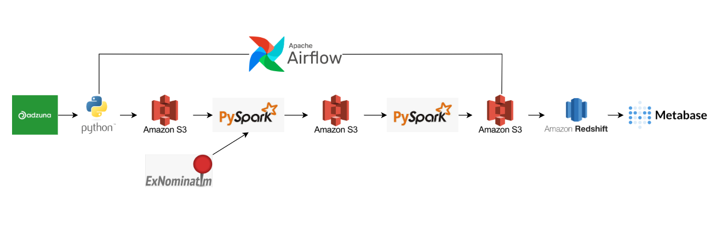
Flow

Slide 11
ETL
Stage 0: Extract raw job ads → S3
Stage 1: Clean schema, rename, reformat
Stage 2: Enrich missing locations via Nominatim
Stage 3: Transform data & engineer features
Stage 4: Add initial bid for each ad
Stage 5: Generate entities: Campaign, Job, Click →S3

Slide 12
Orchestration: Glue
Used at the start of the project
Provided serverless orchestration for ETL
No need to manage EC2 servers
Automated data extraction & transformation jobs
Triggered workflows on a daily schedule
Helped build early data pipelines quickly
Ideal for prototyping & cost-efficient setup

Slide 13
Orchestration: Airflow
Migrated orchestration from Glue → Airflow
Airflow offers flexibility and customization
Manages complex, multi-step workflows
Better control over retries, dependencies & monitoring
Suited for scalable & production-ready pipelines
Can integrate multiple data sources & APIs
Set up for hypothetical live production environment

Slide 14
Glue Tables
Defined structured schemas for job data
Enabled querying raw S3 data directly
Served as an intermediate layer before Redshift
Standardized column names, types & partitions
Allowed faster access for transformations
Redshift view built on top of Glue tables
Made campaign analytics more consistent & reliable

Slide 15
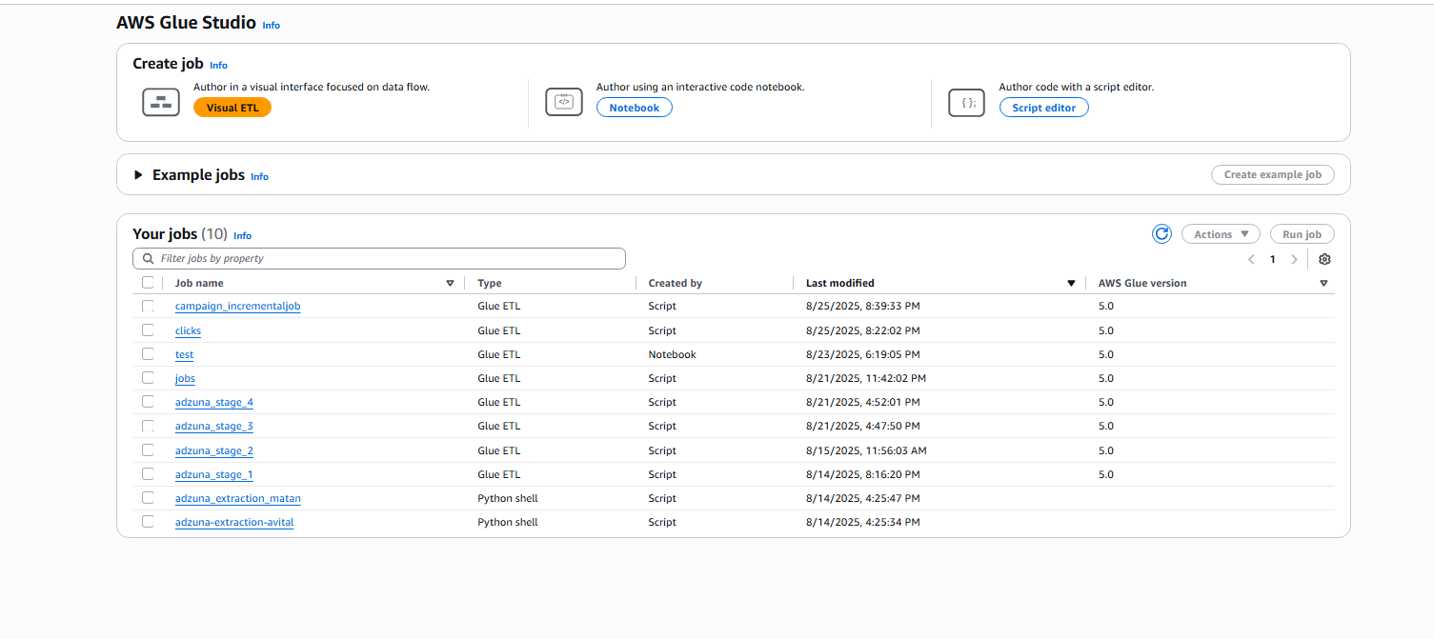
Glue Jobs

Slide 16
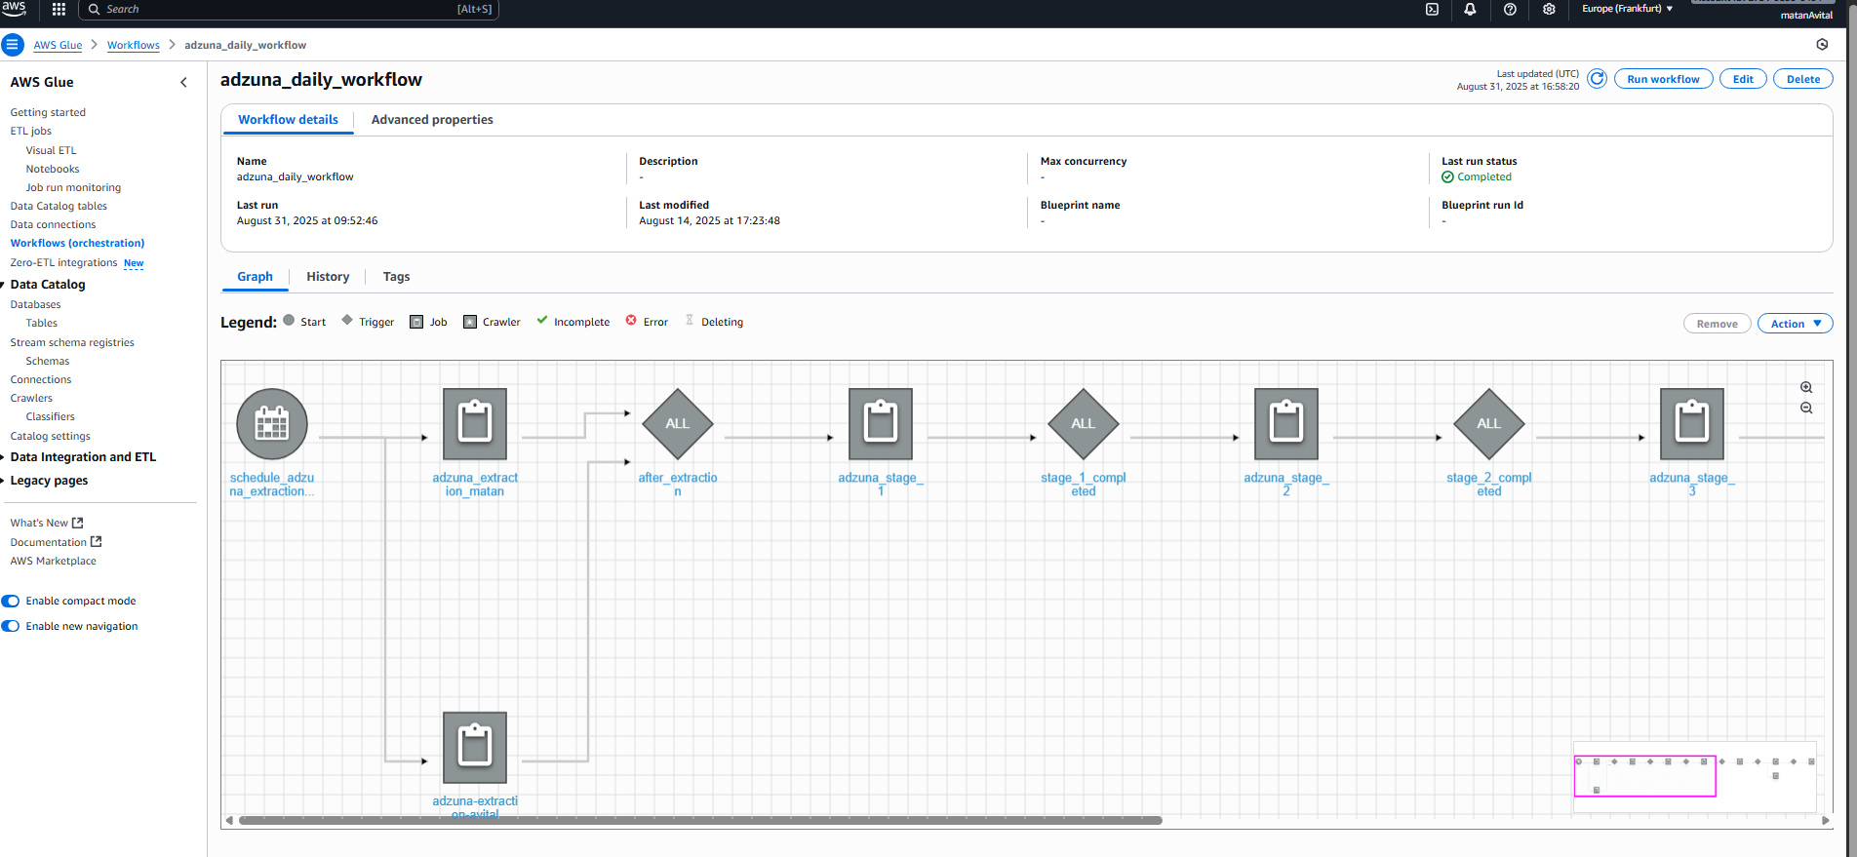
Glue Workflow

Slide 17
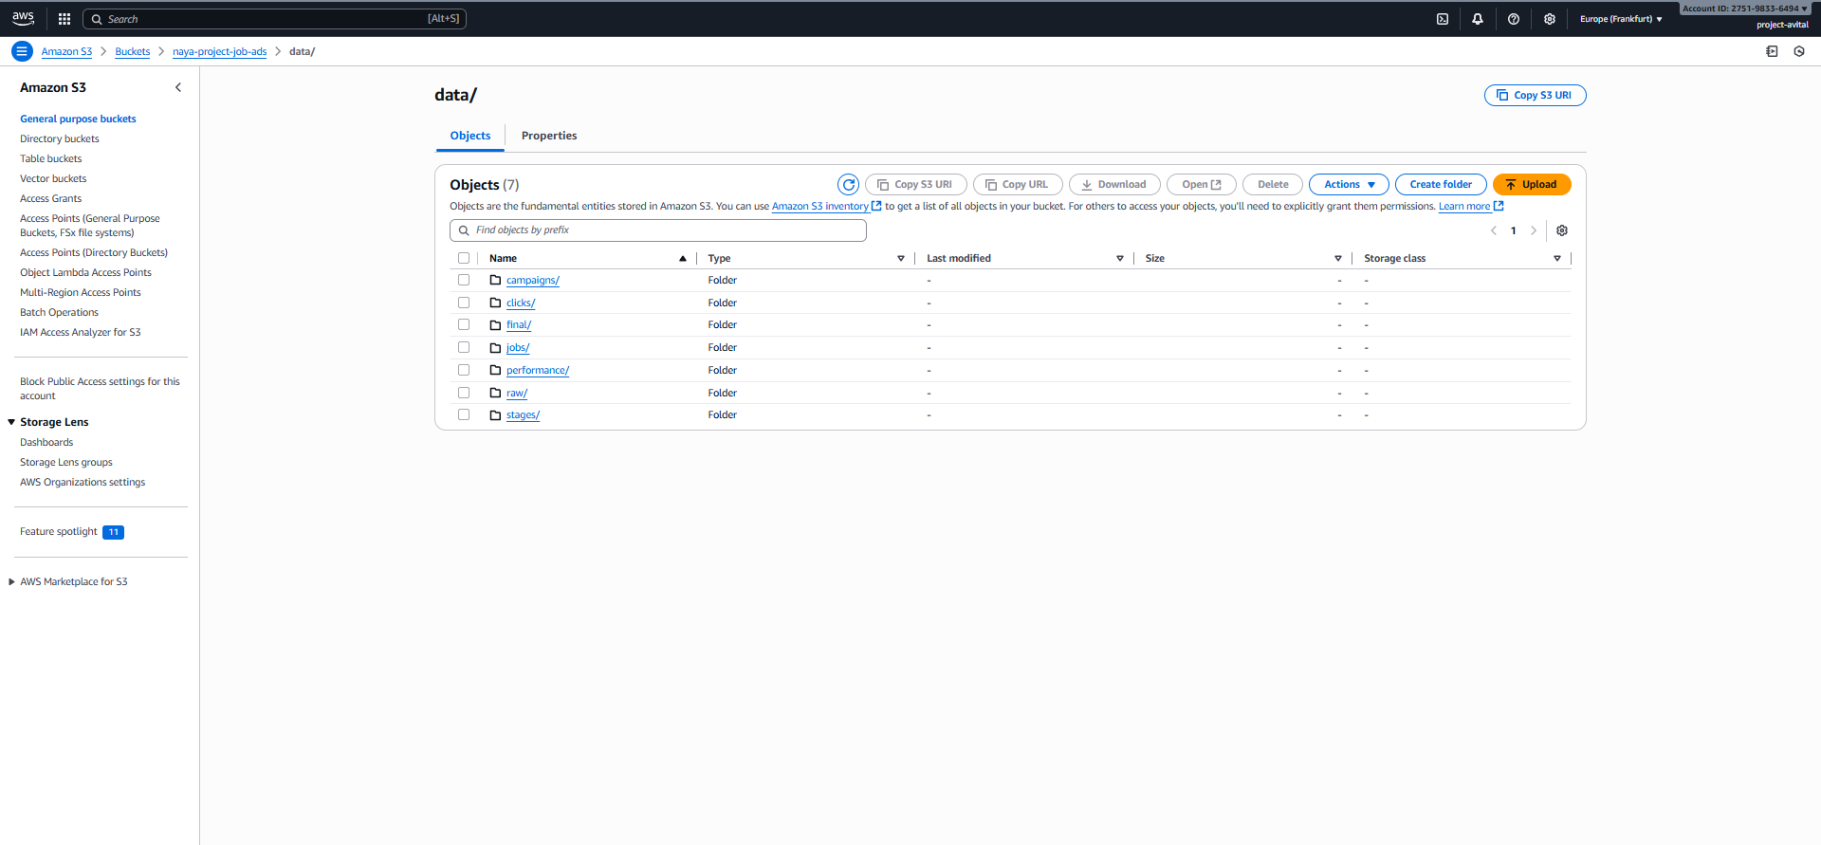
S3 Buckets

Slide 18
Airflow

Slide 19
MetaBase
Redshift views expose structured job data
Metabase connects directly to Redshift
Dashboards track campaign traffic & performance
Monitor cost per click & cost per applicant
Visualize campaign budget utilization
Enable reactive campaign adjustments
Drive data-informed hiring cost savings

Slide 20
