Slide 1
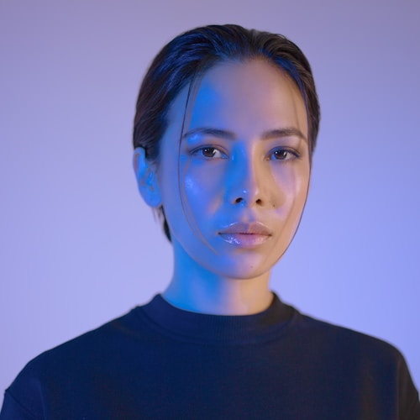
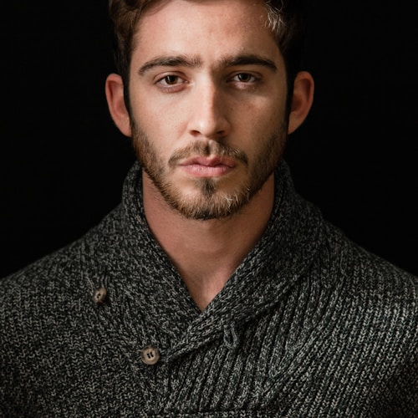
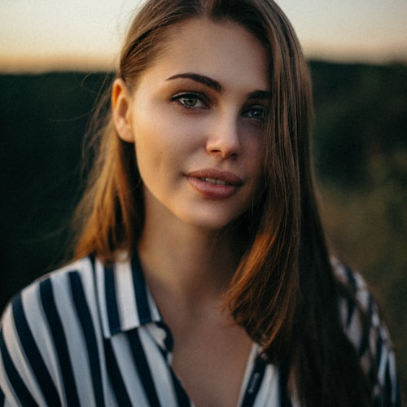
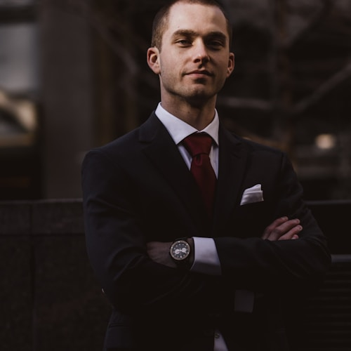
Our Creative Team
Olivia Chen
Ben Carter
Aisha Khan
Leo Martinez
Lead Designer
Photographer
Content Strategist
Illustrator

