Slide 1

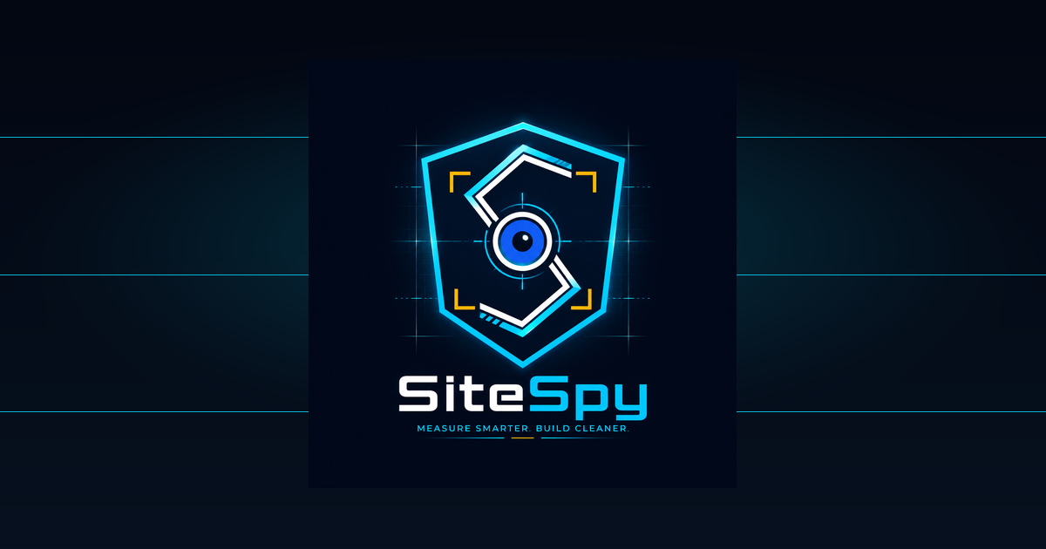
SiteSpy System Presentation
Client Demonstration and Technical Overview
Prepared for Group 2 / client team
7 June 2026
SiteSpy System Presentation | 01

Slide 2
Executive Summary
What was built and why it is ready to present
• SiteSpy is an Expo React Native Android app for masonry wall project estimation.
• The app supports sign-in, project records, manual estimates, image records, and BOQ-style summaries.
• Firebase stores user-owned project, estimate, and wall-image records with owner-based access rules.
• The repository includes collaborator ownership, testing, Firebase setup, and final submission documentation.
SiteSpy System Presentation | 02

Slide 3
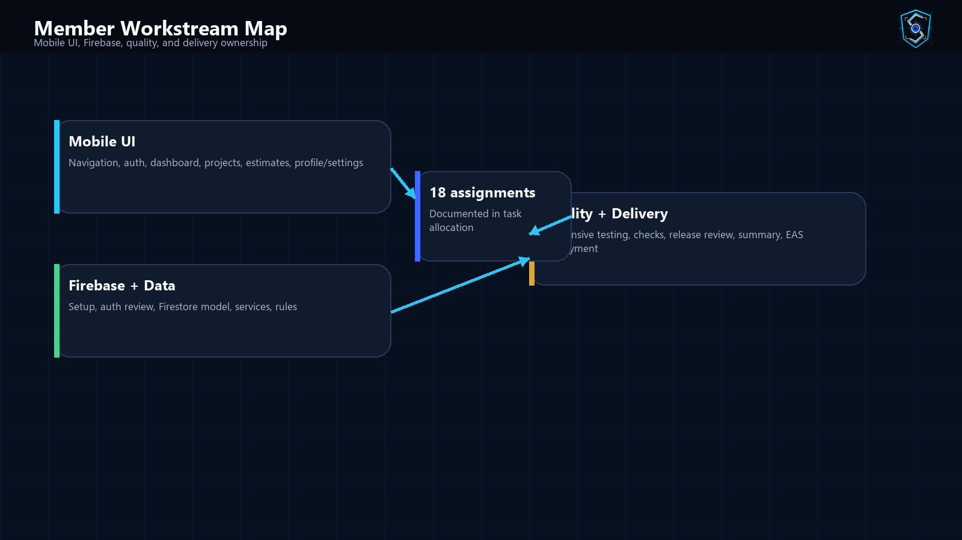
Presentation Roadmap
How the client walkthrough is organized
• Problem and project objectives
• Solution overview and target users
• App walkthrough and core workflows
• Architecture, Firebase, data, and security
• Member contributions and Git workflow
• Testing, build process, demo script, and Q&A
SiteSpy System Presentation | 03

Slide 4
Problem Statement
The practical need SiteSpy addresses
• Manual construction estimation can be slow, inconsistent, and difficult to present clearly.
• Students need visible ownership across a shared project and assigned branches.
• Project records must be stored securely and tied to the correct signed-in user.
• Presenters need a technical explanation that is accurate and understandable.
SiteSpy System Presentation | 04

Slide 5
Project Objectives
What the team set out to deliver
• Build a mobile-first Android app using Expo and React Native.
• Use Firebase for authentication and user-owned backend records.
• Support project creation, manual estimation, image records, and report-ready summaries.
• Document collaborator responsibilities, branches, testing, and final submission steps.
• Prepare the project for Android demonstration and continued student work.
SiteSpy System Presentation | 05

Slide 6
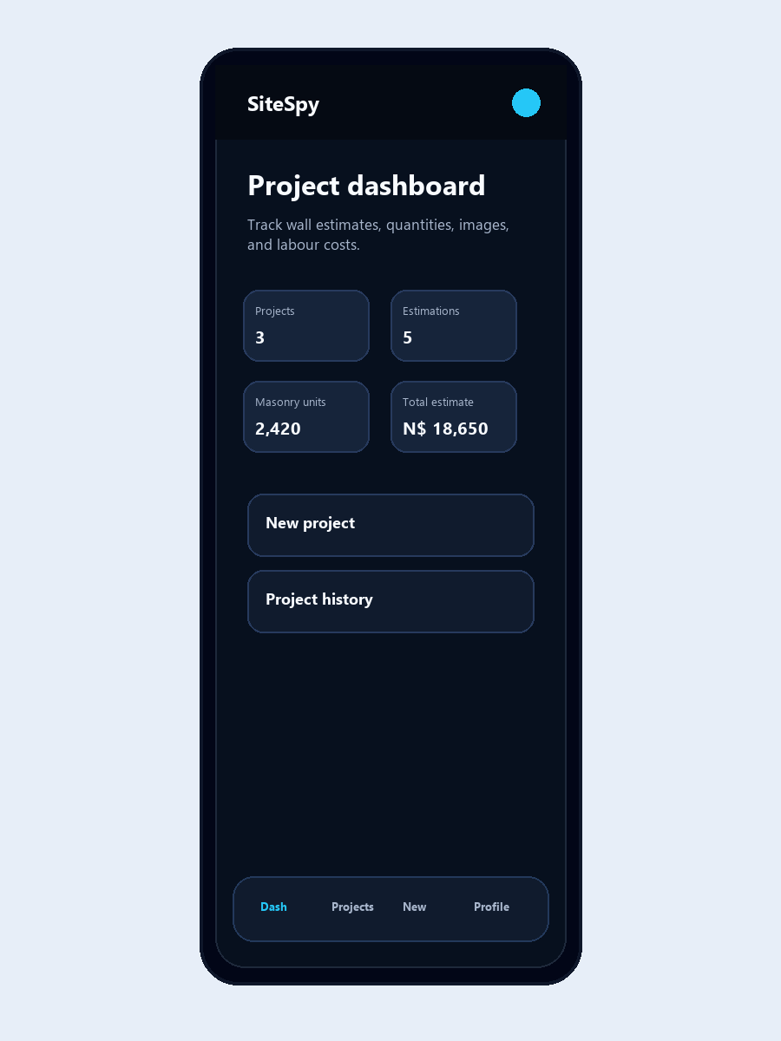
What SiteSpy Does
Core app workflow in client language
• The user signs in to a protected workspace.
• The user creates a project for a wall or construction task.
• The app captures wall dimensions, unit type, prices, and labour values.
• The calculation workflow produces unit counts, mortar allowance, labour, and total cost.
• Saved projects and estimates can be reviewed later through history and detail screens.
SiteSpy System Presentation | 06

Slide 7
Target Users and Use Cases
Who benefits from the system
• Students presenting a working mobile app and team contribution structure.
• Small builders or estimators who need quick wall quantity and cost estimates.
• Demonstration panel members reviewing system design, quality, and maintainability.
• Future maintainers continuing from documented branches and service boundaries.
SiteSpy System Presentation | 07

Slide 8
Basic Programming Concepts
Client-friendly technical vocabulary
• Frontend: the visible mobile interface users tap and read.
• Screens: full views such as Login, Dashboard, Manual Estimate, Project Details, and Settings.
• Components: reusable UI pieces such as cards, buttons, headers, inputs, and status states.
• Services: modules that connect screens to Firebase, storage, reports, and calculations.
• Database: Firestore collections that store user-owned app records.
• Build process: commands that prepare the app for local use and Android delivery.
SiteSpy System Presentation | 08

Slide 9
Technology Stack
Actual stack found in the repository
• Expo Managed Workflow and React Native for Android app delivery.
• JavaScript and JSX for screens, services, components, and utilities.
• React Navigation for auth flow, bottom tabs, project stack, and profile stack.
• Firebase Auth, Firestore, and Storage for backend behaviour.
• EAS Build profiles for preview APK and production app-bundle paths.
• Expo image, font, file-system, image-manipulator, and build-properties libraries.
SiteSpy System Presentation | 09

Slide 10
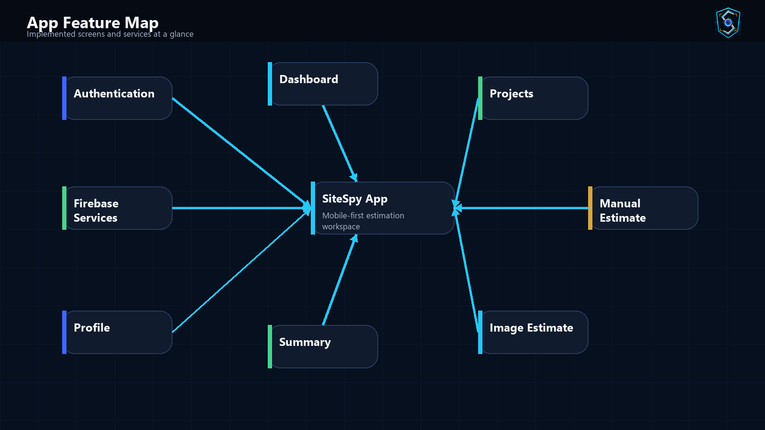
App Feature Map
Major implemented areas at a glance
SiteSpy System Presentation | 10

Slide 11
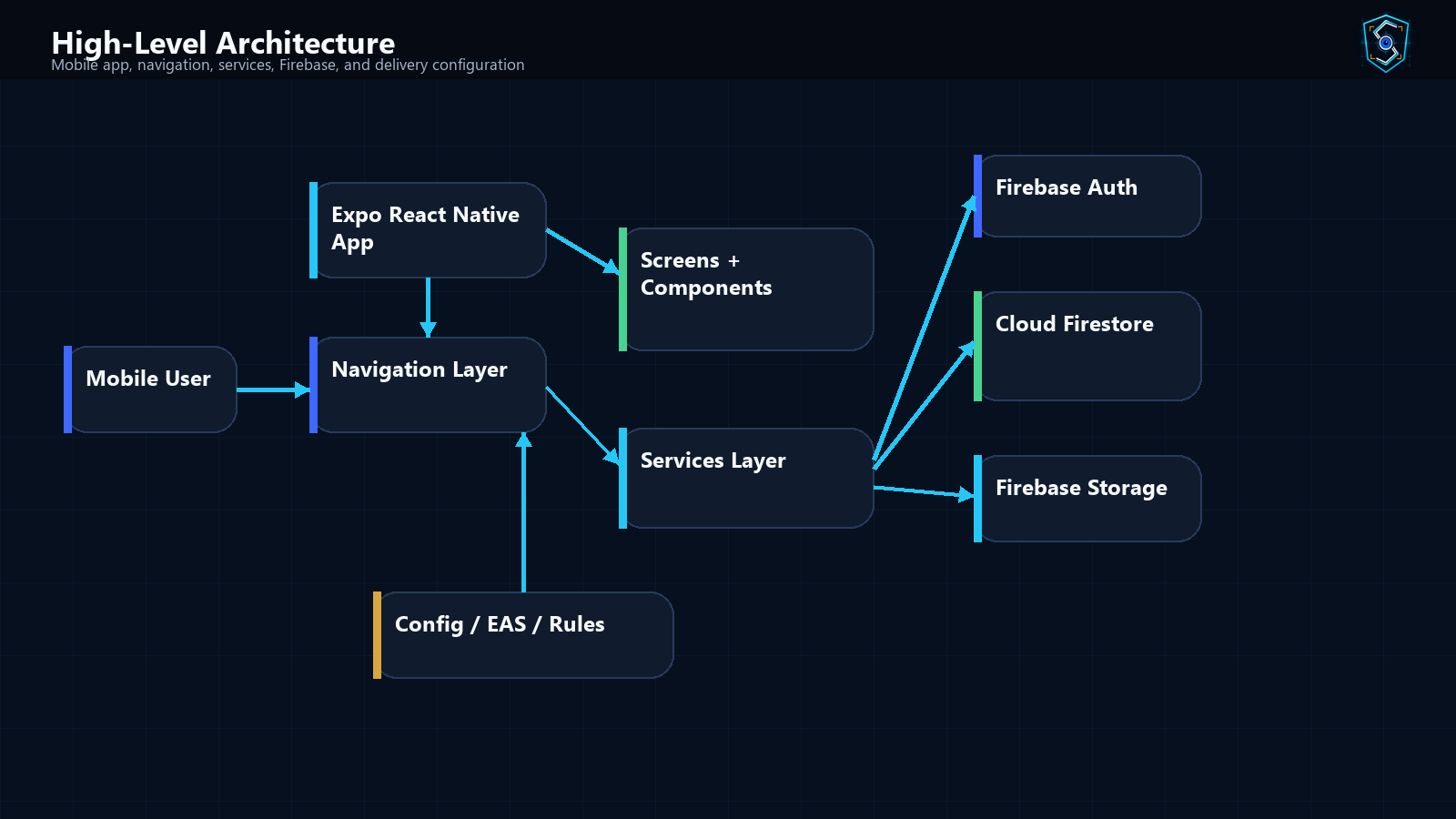
High-Level Architecture Diagram
How the system fits together
SiteSpy System Presentation | 11

Slide 12
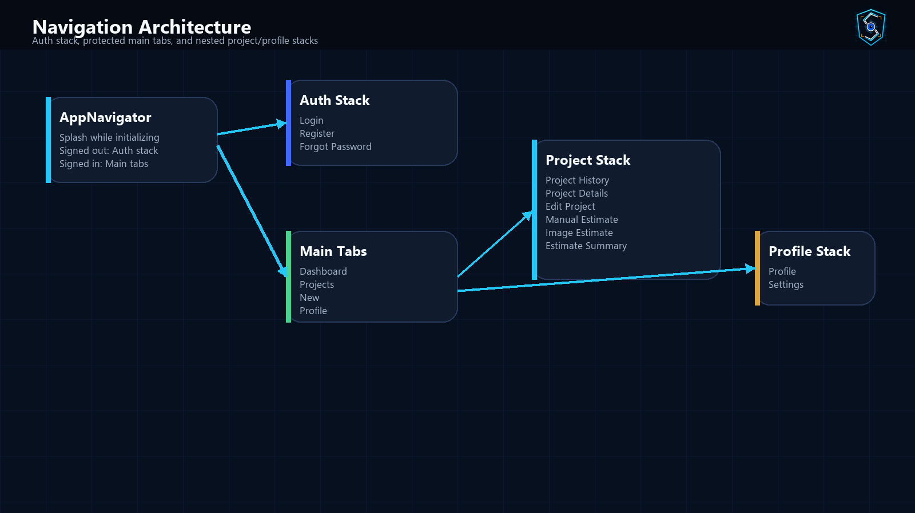
Navigation Architecture
Actual navigation files and flows
SiteSpy System Presentation | 12

Slide 13
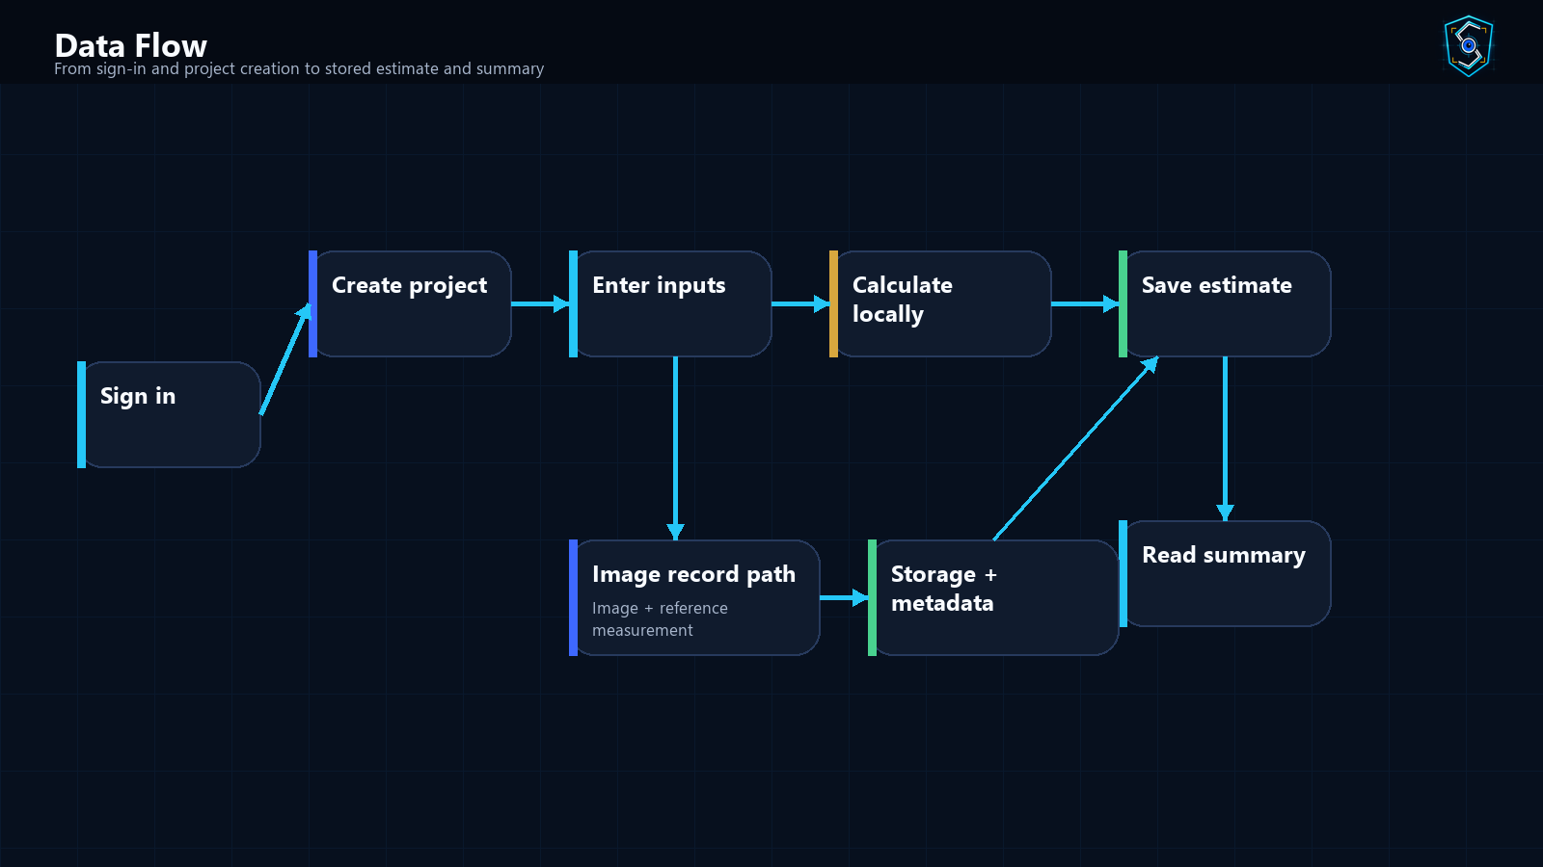
Data Flow Diagram
From input to stored result
SiteSpy System Presentation | 13

Slide 14
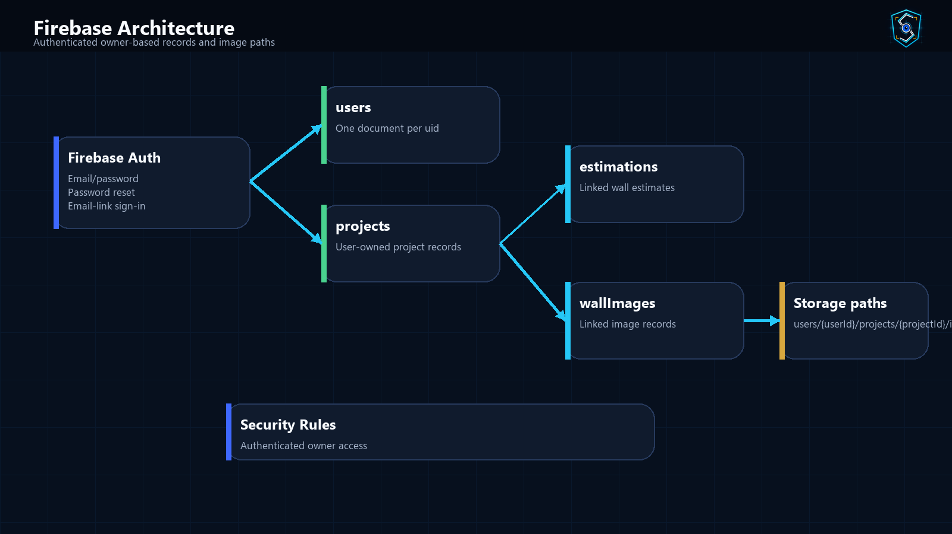
Firebase Architecture
Authentication, records, and storage
SiteSpy System Presentation | 14

Slide 15
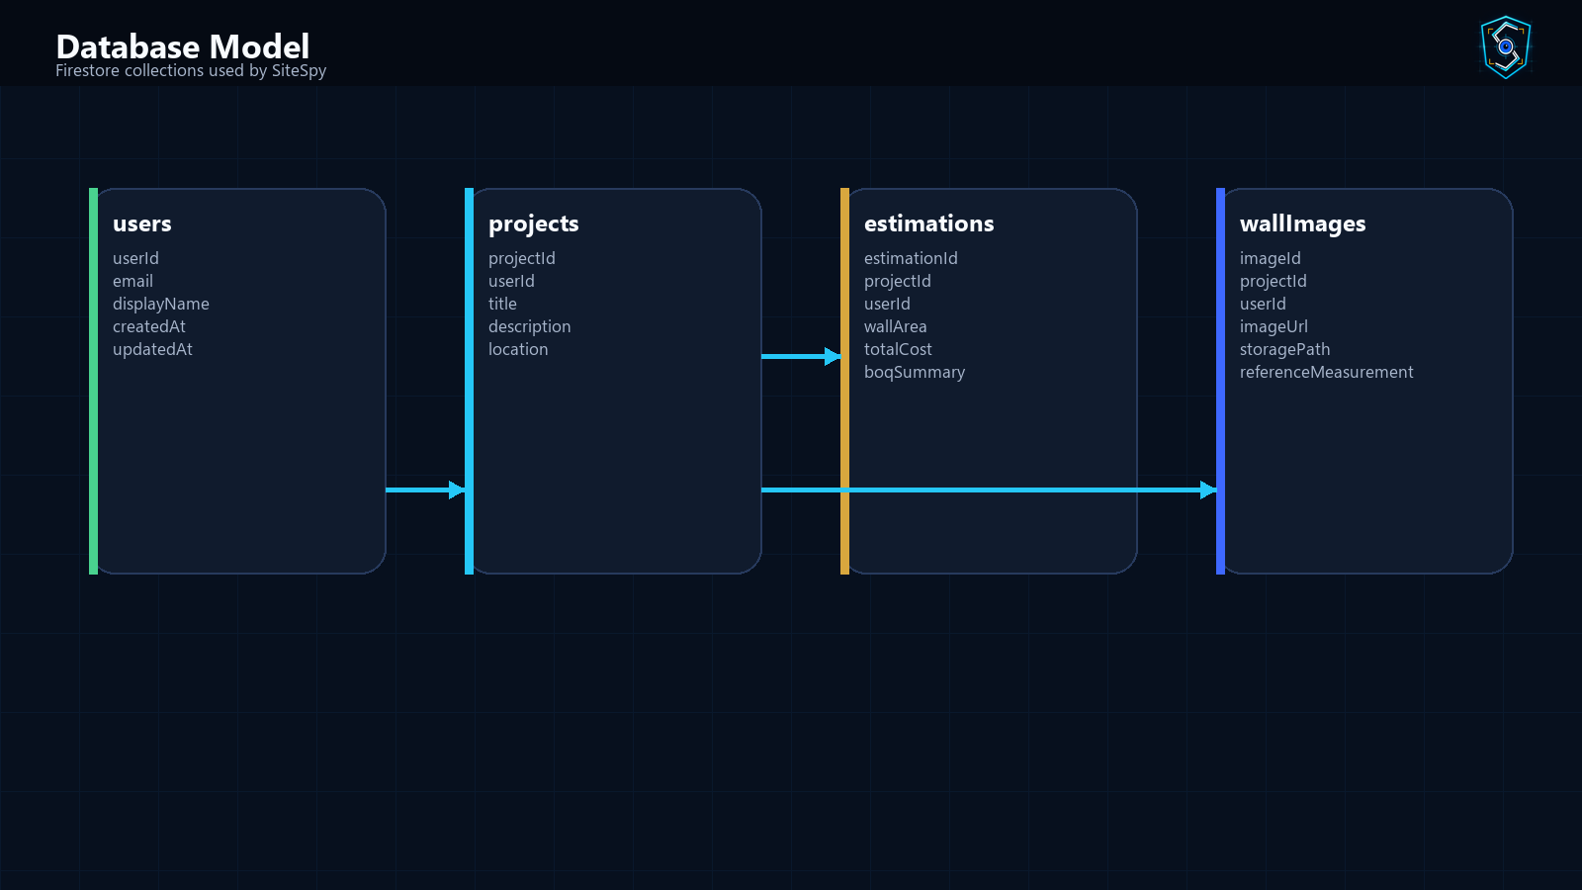
Database / Collection Design
Firestore collections used by the app
SiteSpy System Presentation | 15

Slide 16
Security Model
How project records are protected
• Firestore rules require authentication before app records can be read or written.
• Project, estimation, and wall-image records are restricted to the matching userId.
• Storage paths are scoped to the authenticated user.
• The project check blocks private files such as environment values, credentials, tokens, and raw collaborator secrets.
• Firebase values are kept in local .env and loaded through app configuration.
SiteSpy System Presentation | 16

Slide 17
Folder and Codebase Structure
Important repository areas
• src/navigation: auth gate, stacks, and bottom tabs.
• src/screens: auth, dashboard, project, estimate, image, profile, and settings screens.
• src/components: shared mobile UI building blocks.
• src/services: Firebase, project, storage, report, auth, and estimate services.
• src/utils and src/theme: calculations, validation, formatting, colors, spacing, typography.
• docs, assets, functions, hosting, and Firebase config files support delivery and documentation.
SiteSpy System Presentation | 17

Slide 18
User Flow Walkthrough
Typical demonstration sequence
• Splash opens while startup state is checked.
• Signed-out users choose login, account creation, or password recovery.
• Signed-in users land in Dashboard and navigate through bottom tabs.
• New Project starts a project file and moves into estimation.
• Manual Estimate saves calculations and Estimate Summary presents BOQ lines.
• Image Estimate records a wall image and reference measurement.
• Profile and Settings close the demo with account and app information.
SiteSpy System Presentation | 18

Slide 19
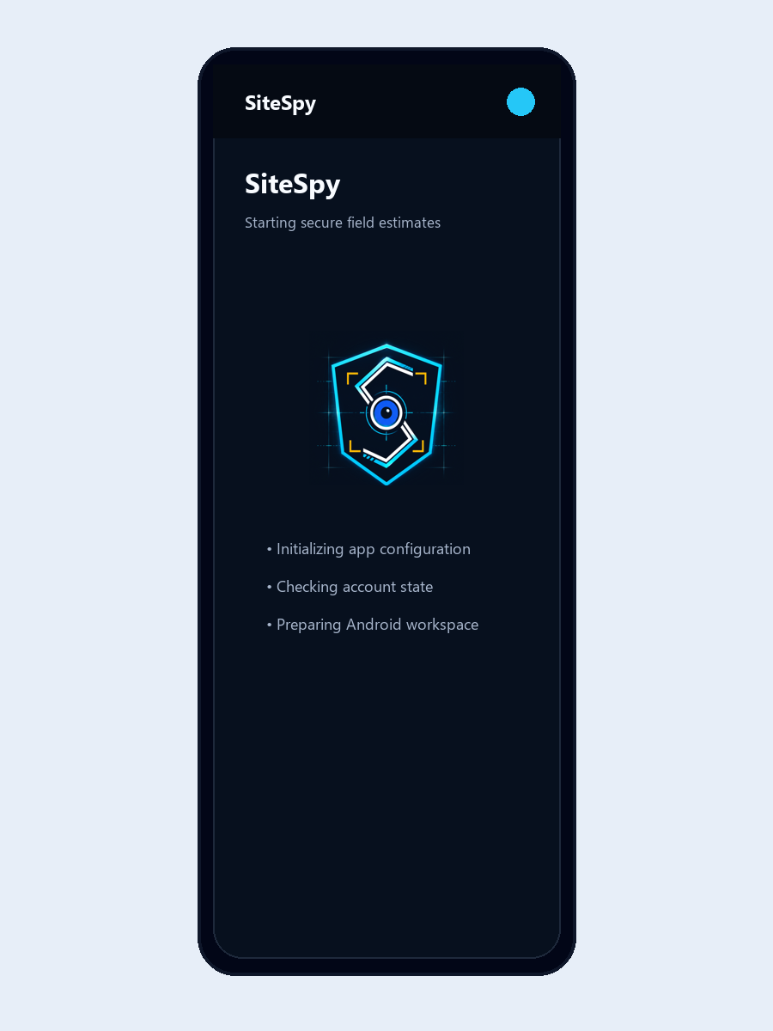
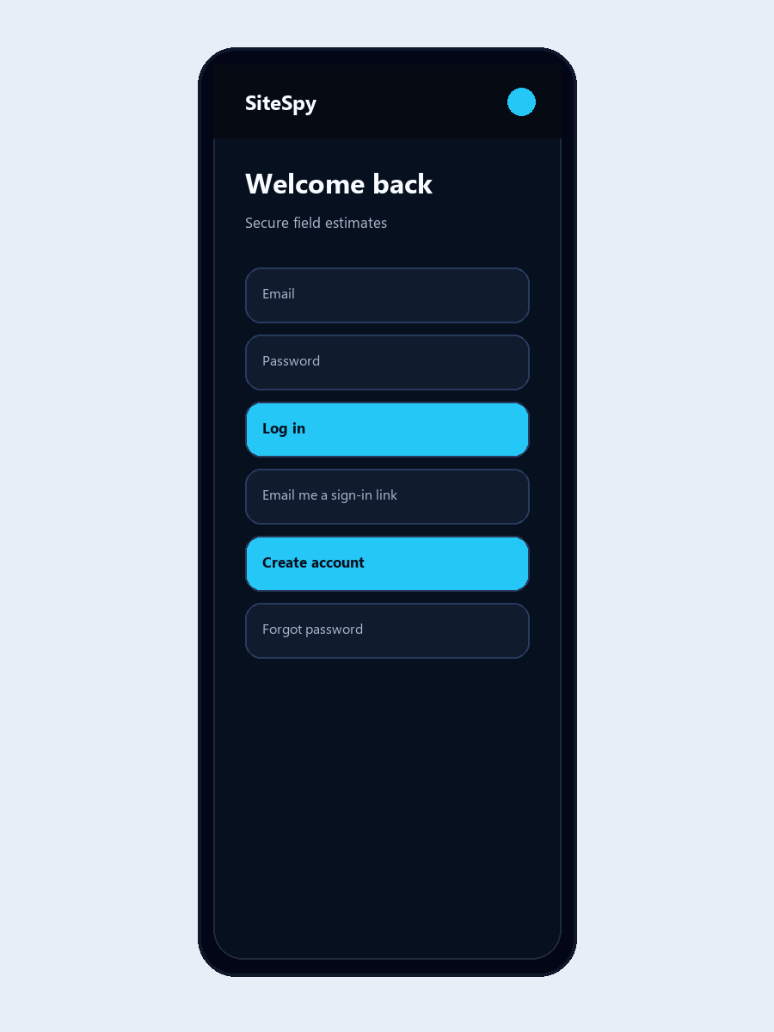
Screenshot Walkthrough 1 - Authentication
Splash, login, account creation, and recovery
• Splash prepares app startup.
• Login supports email/password and email-link sign-in.
• Register creates a Firebase-backed account profile.
• Forgot Password sends a Firebase reset email.
SiteSpy System Presentation | 19

Slide 20
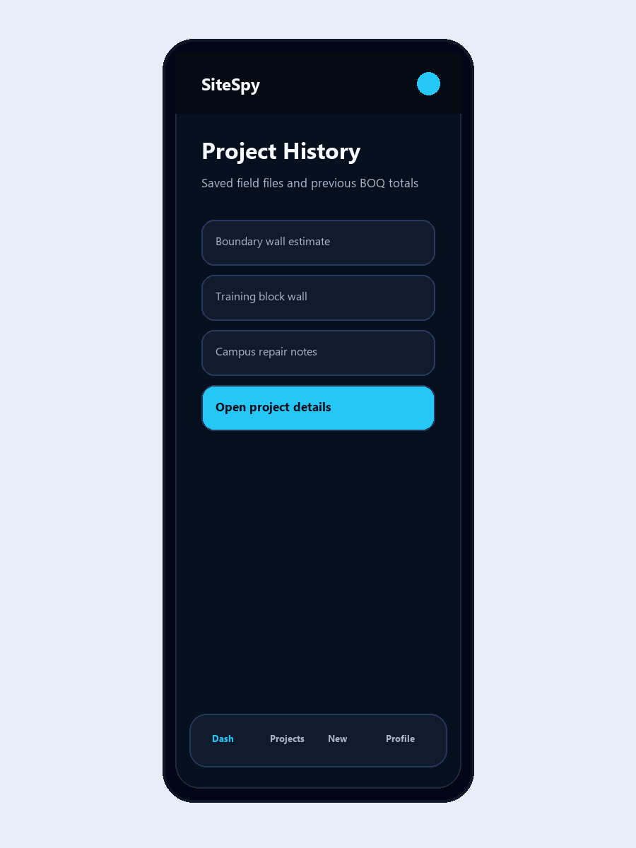
Screenshot Walkthrough 2 - Dashboard and Projects
Project visibility after sign-in
• Dashboard summarizes projects, estimations, masonry units, and total estimate value.
• Project History lists saved project files.
• Project Details connects project notes, saved estimates, image records, and actions.
SiteSpy System Presentation | 20

Slide 21
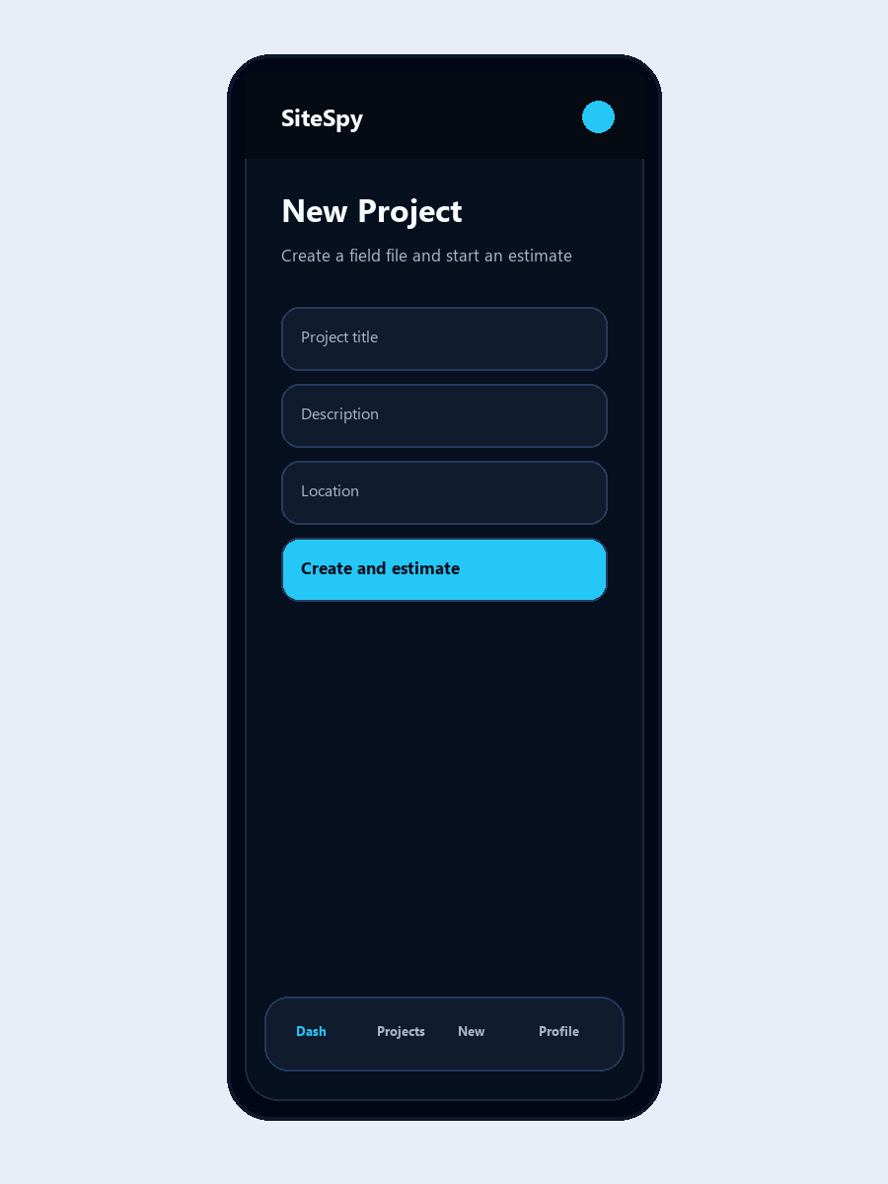
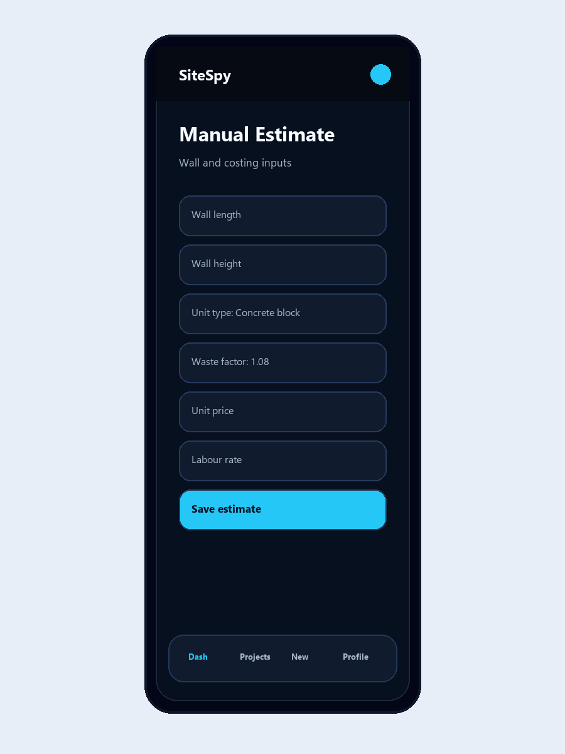
Screenshot Walkthrough 3 - Estimation Workflow
Project creation, manual estimate, and summary
• New Project captures the field file.
• Manual Estimate collects wall and costing inputs.
• Estimate Summary presents BOQ-style line items and totals.
SiteSpy System Presentation | 21

Slide 22
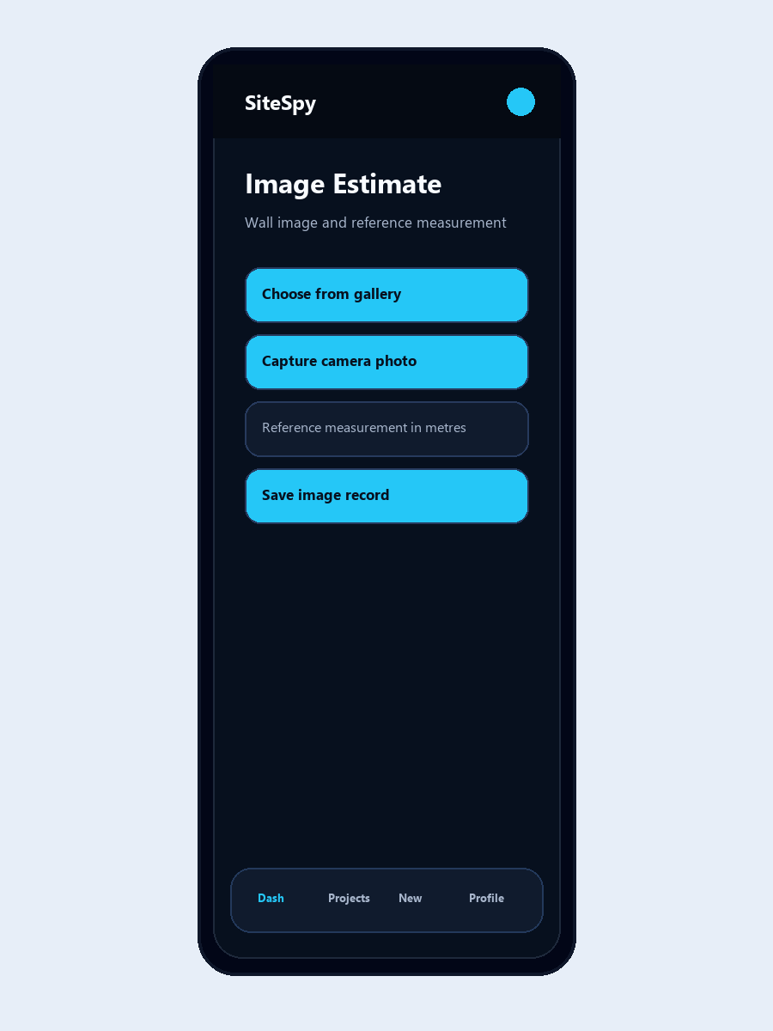
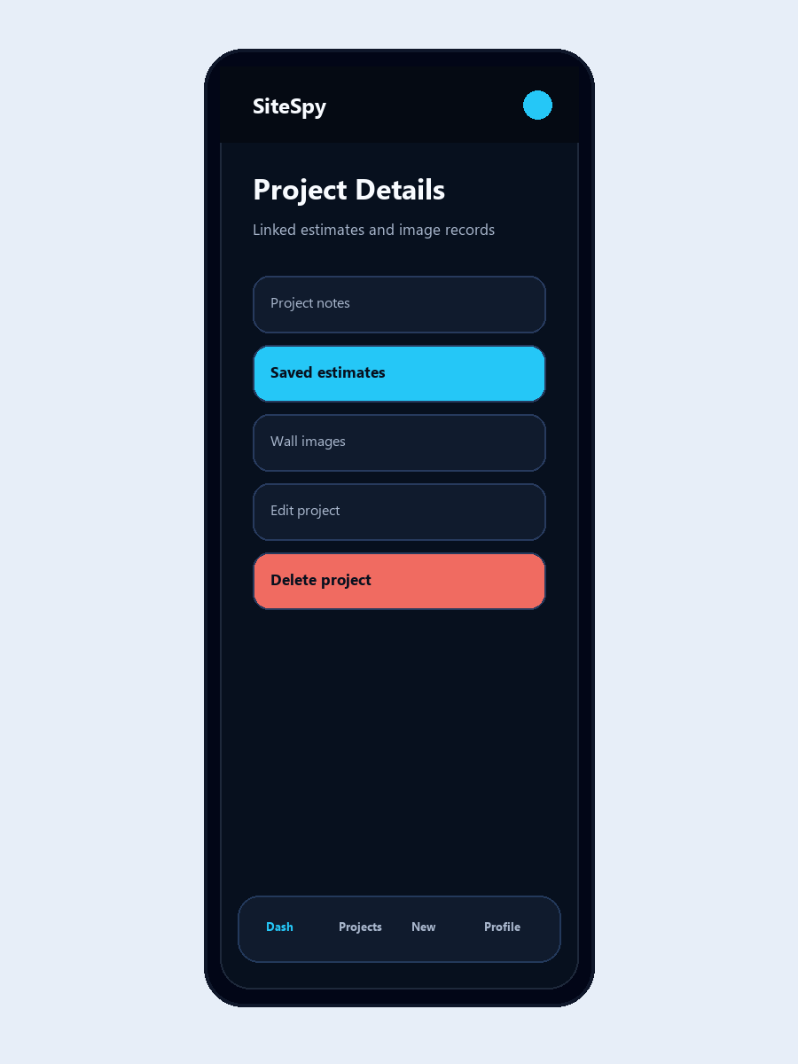
Screenshot Walkthrough 4 - Image Estimate and Records
Image-assisted project evidence
• The image screen supports gallery or camera selection.
• A real reference measurement is captured with the image record.
• The app stores image metadata linked to the project and user.
SiteSpy System Presentation | 22

Slide 23
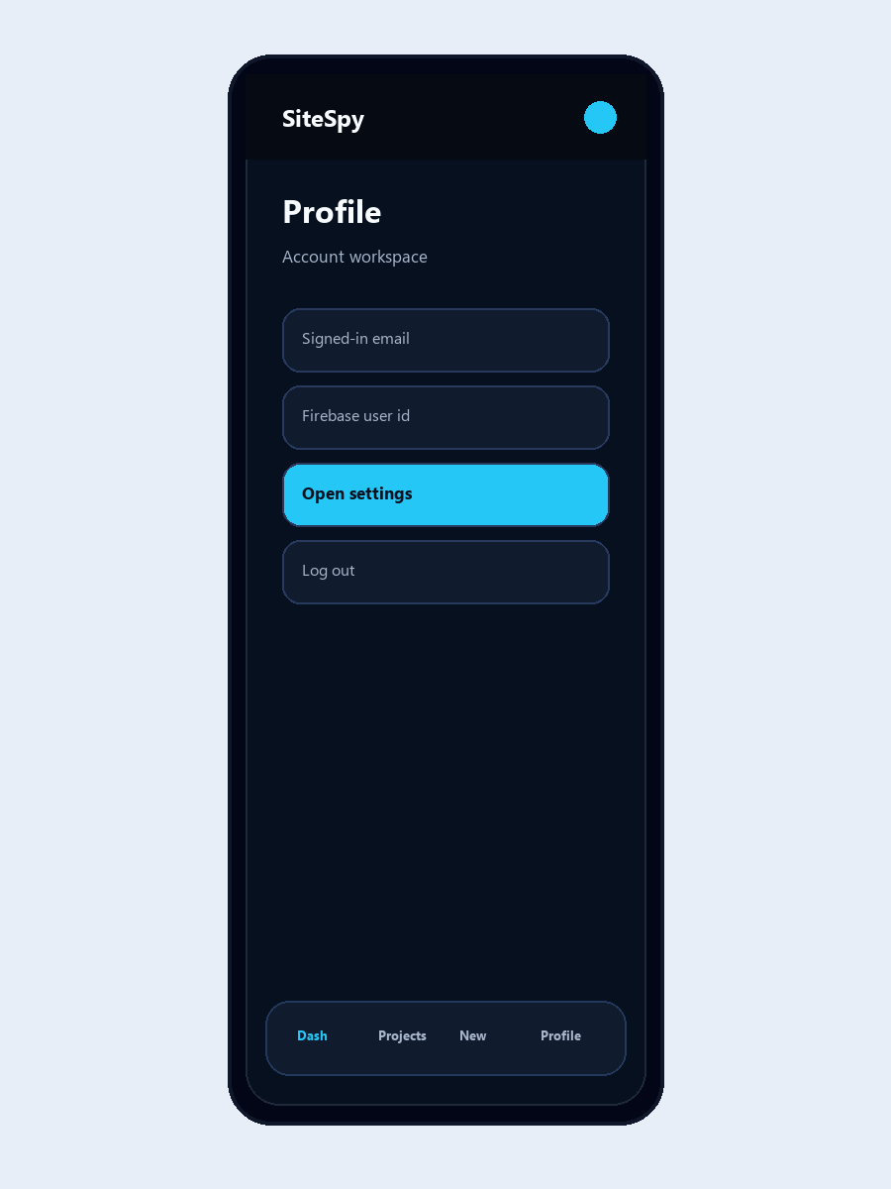
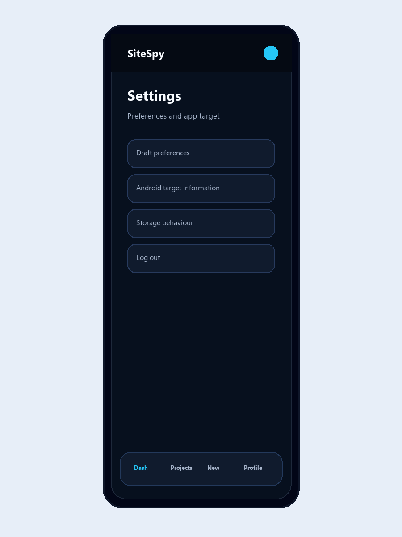
Screenshot Walkthrough 5 - Profile and Settings
Account and app information
• Profile shows account identity details.
• Settings includes preferences and Android target information.
• Logout clears the signed-in session and sensitive local state.
SiteSpy System Presentation | 23

Slide 24
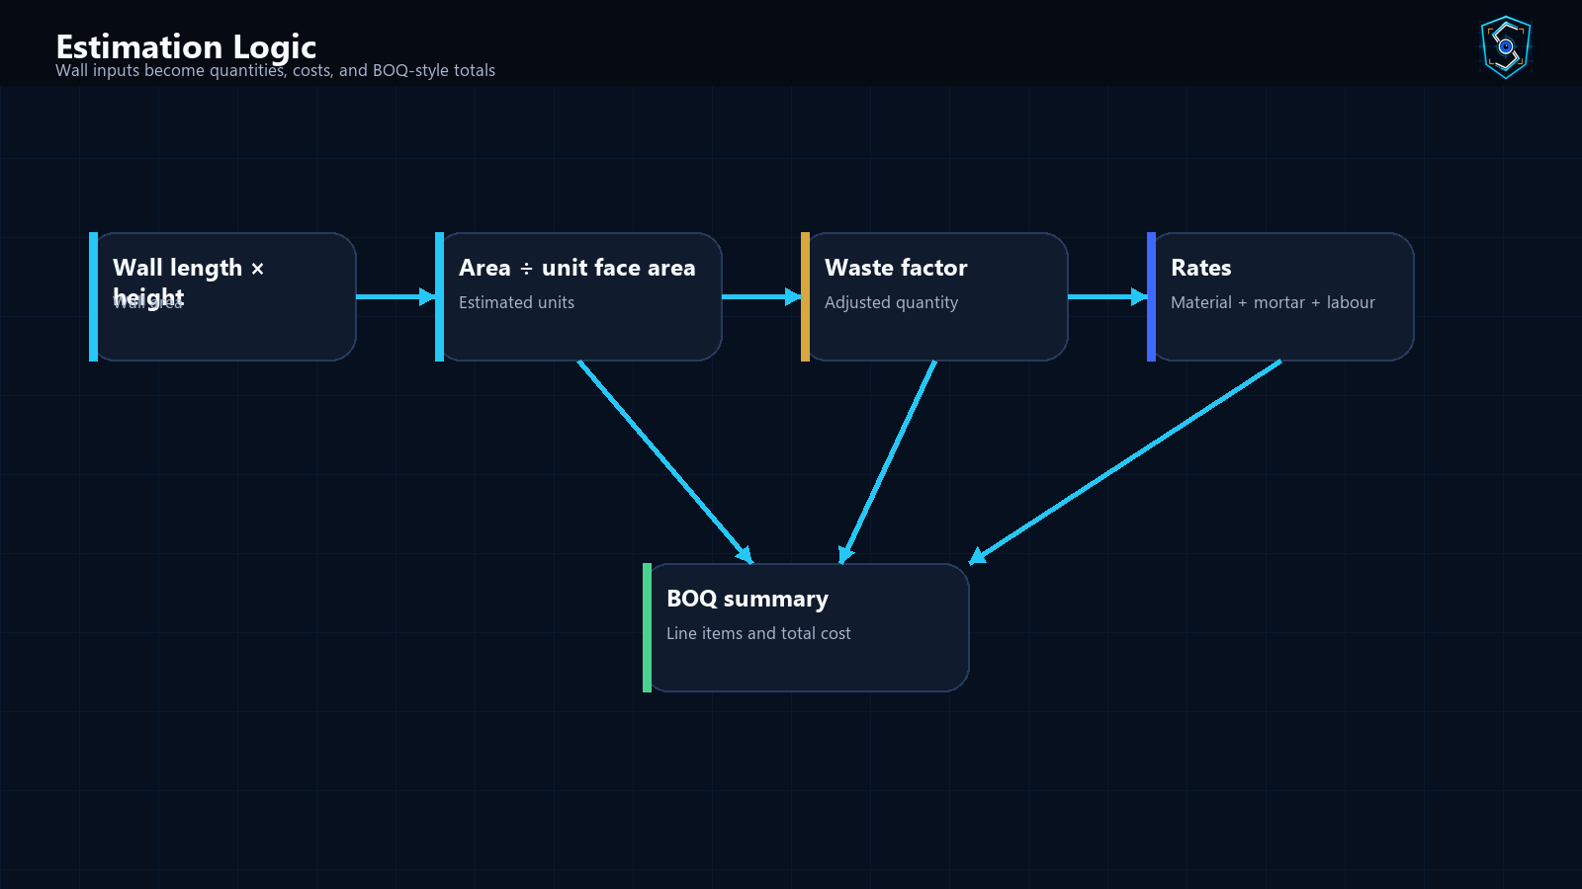
Estimation Logic Explained
How calculations are produced
SiteSpy System Presentation | 24

Slide 25
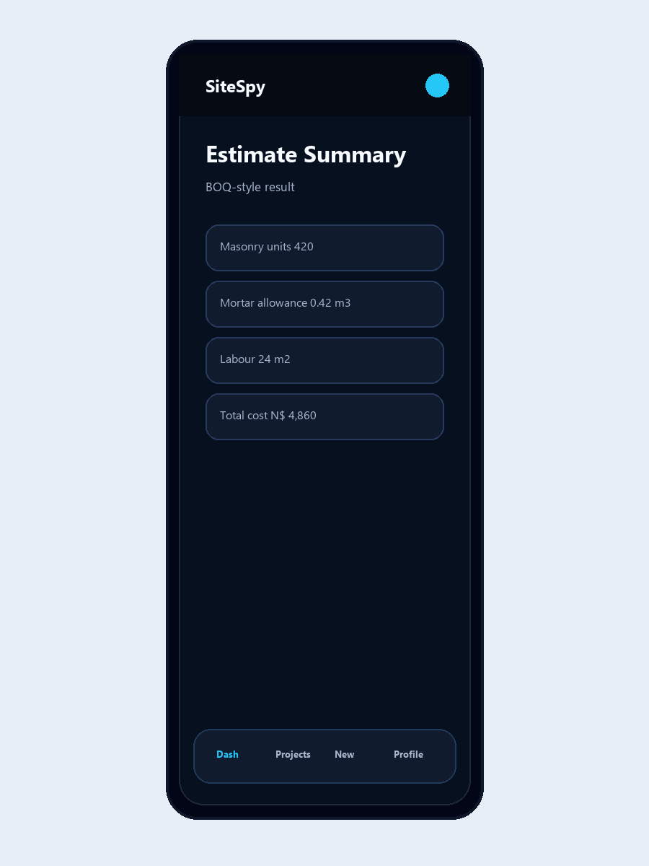
BOQ / Report Summary Explained
Why the result is presenter-friendly
• Masonry units are listed as a material line item.
• Mortar allowance is calculated and priced separately.
• Labour is calculated from wall area and labour rate.
• The total cost is the sum of material, mortar, and labour costs.
• The summary format helps presenters discuss project cost in a structured way.
SiteSpy System Presentation | 25

Slide 26
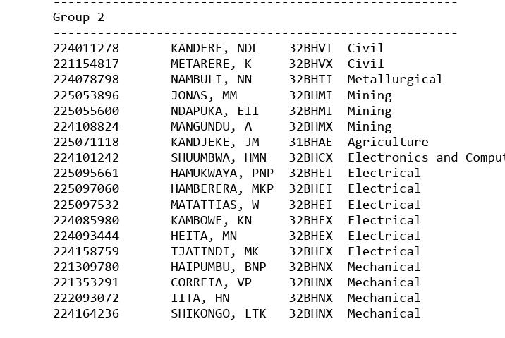
Collaboration System
How student ownership is documented
• Collaborator mapping stores names, GitHub identities, emails, and departments where recorded.
• Task allocation maps each student to a branch, workstream, contribution area, and deliverable.
• Git workflow notes define branch and pull request expectations.
• Private values such as passwords and tokens are redacted and excluded from presentation content.
SiteSpy System Presentation | 26

Slide 27
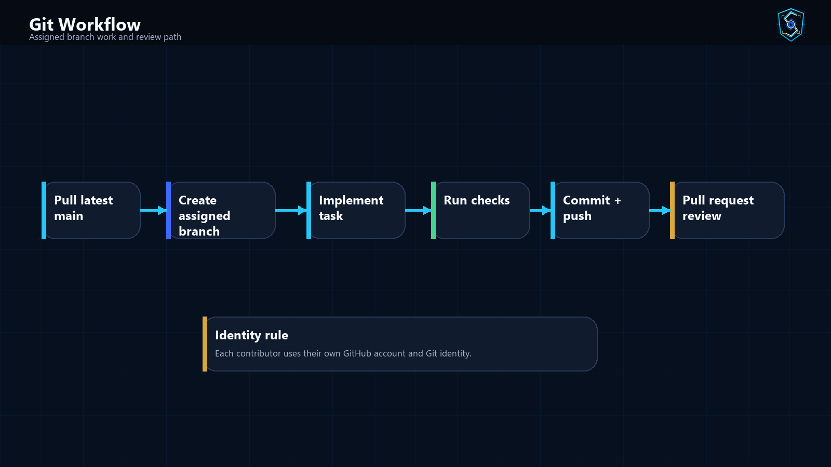
Git Workflow
How students continue work safely
SiteSpy System Presentation | 27

Slide 28
Member Contribution Overview
Documented branch ownership by workstream
Member
GitHub / identity
Branch
Member
Area
GitHub / identity
Branch
Area
Tunacky Kandere
tunackykandere-lab
mobile/kandere-ndl-navigation-shell
Karl Hamberera
Navigation shell and app layout
Karlhamberera
firebase/hamberera-mkp-firestore-models
Firestore data model
Kavakuru Metarere
Kavakuru-Metarere7
mobile/metare-k-auth-screens
Washington Matattias
Authentication screens
matattiasw-ai
firebase/matattias-w-integration-review
Repository and release review
Nambuli NN
documented branch owner
mobile/nambuli-nn-dashboard
Klaudia Kambowe
Dashboard experience
kambowe
firebase/kambowe-kn-project-services
Project services
Mathias Jonas
Mathias4040
mobile/jonas-mm-project-history
Martha Heita
Project history and details
marthandilimengungo-dotcom
firebase/heita-mn-validation-errors
Validation and errors
Emilly Ndapuka
emilly20-06
mobile/ndapuka-eii-manual-estimation
Michael Kazundire
Manual estimation forms
IcyBeibi68023
firebase/tjatindi-mk-security-review
Firebase rules review
Amalia Mangundu
amaliamangundu-tech
mobile/mangundu-a-profile-settings
Beatha Haipumbu
Profile and settings
beathapawana-dot
firebase/haipumbu-bnp-estimation-workflow
Estimation workflow
Johannes Kandjeke
Kandjekejohannes54
mobile/kandjeke-jm-responsive-testing
Valentina Correia
Android responsive testing
Valentina-Correia
firebase/correia-vp-summary-export
Summary formatting
Hilma Shuumbwa
hilma-shuumbwa
firebase/shuumbwa-hmn-project-setup
Hilda Iita
Expo and Firebase setup
next-GenCoder
firebase/iita-hn-quality-checks
App checks
Petrus Hamukwaya
ramuntu
firebase/hamukwaya-pnp-auth-rules
Linus Shikongo
Authentication rules
Linus45-blid
firebase/shikongo-lik-eas-deployment
EAS deployment
SiteSpy System Presentation | 28

Slide 29
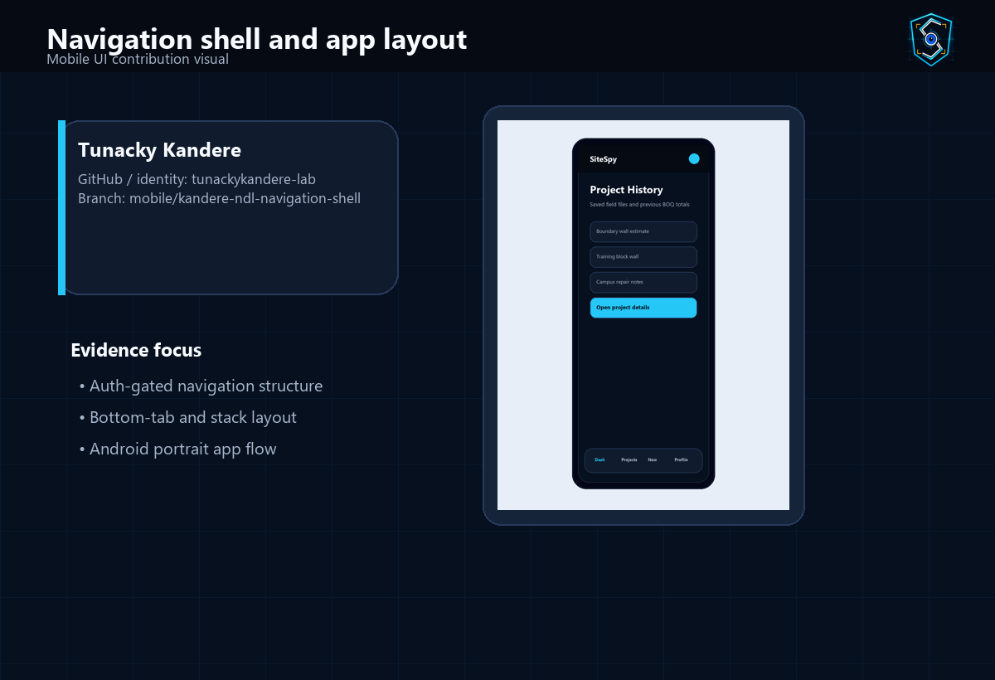
Member Contribution: Tunacky Kandere
Navigation shell and app layout
Profile
What this member worked on
GitHub / identity: tunackykandere-lab Branch: mobile/kandere-ndl-navigation-shell Workstream: Mobile UI Status: Assigned
• Auth-gated navigation structure
• Bottom-tab and stack layout
• Android portrait app flow
Why it mattered
• makes the app easy to move through
• separates auth, project, and profile workflows
Visual evidence: assigned app area or subsystem view
Presenter note: Explain that this contribution supports makes the app easy to move through.
SiteSpy System Presentation | 29

Slide 30
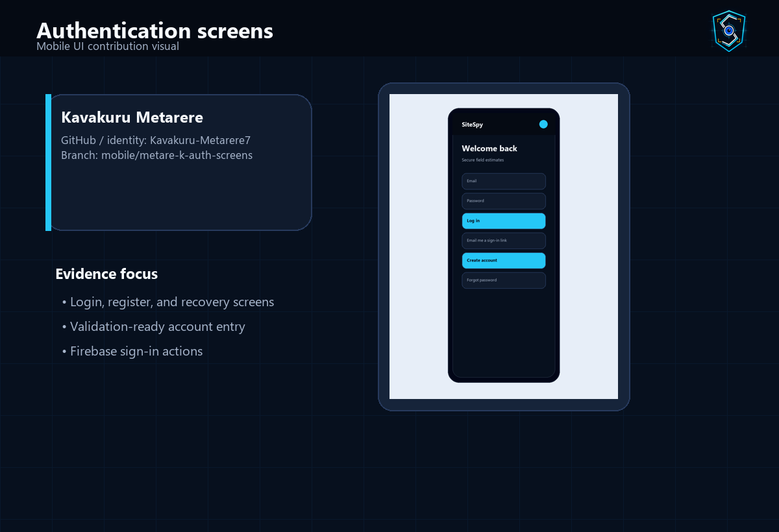
Member Contribution: Kavakuru Metarere
Authentication screens
Profile
What this member worked on
GitHub / identity: Kavakuru-Metarere7 Branch: mobile/metare-k-auth-screens Workstream: Mobile UI Status: Assigned
• Login, register, and recovery screens
• Validation-ready account entry
• Firebase sign-in actions
Why it mattered
• protects access to user-owned records
• gives the demo a complete account flow
Visual evidence: assigned app area or subsystem view
Presenter note: Explain that this contribution supports protects access to user-owned records.
SiteSpy System Presentation | 30

Slide 31
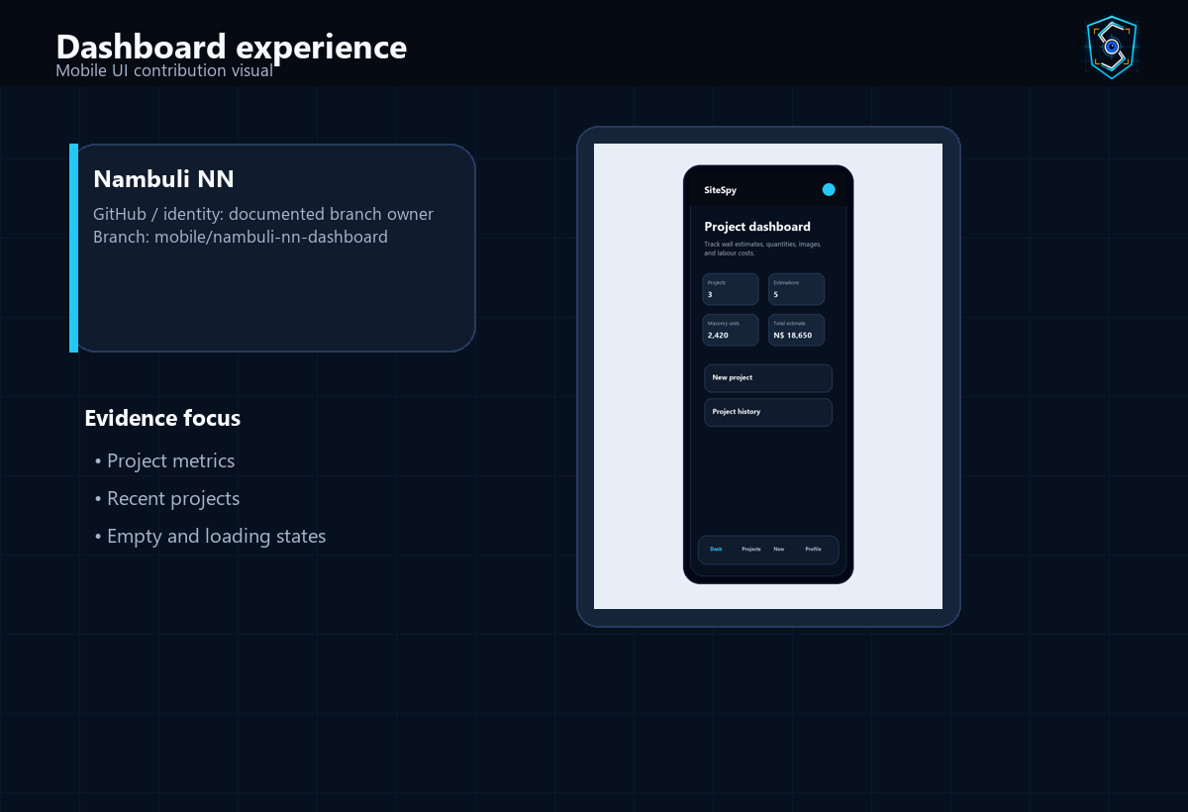
Member Contribution: Nambuli NN
Dashboard experience
Profile
What this member worked on
GitHub / identity: documented branch owner Branch: mobile/nambuli-nn-dashboard Workstream: Mobile UI Status: Assigned
• Project metrics
• Recent projects
• Empty and loading states
Why it mattered
• shows system value immediately after sign-in
• turns saved data into presentation metrics
Visual evidence: assigned app area or subsystem view
Presenter note: Explain that this contribution supports shows system value immediately after sign-in.
SiteSpy System Presentation | 31

Slide 32
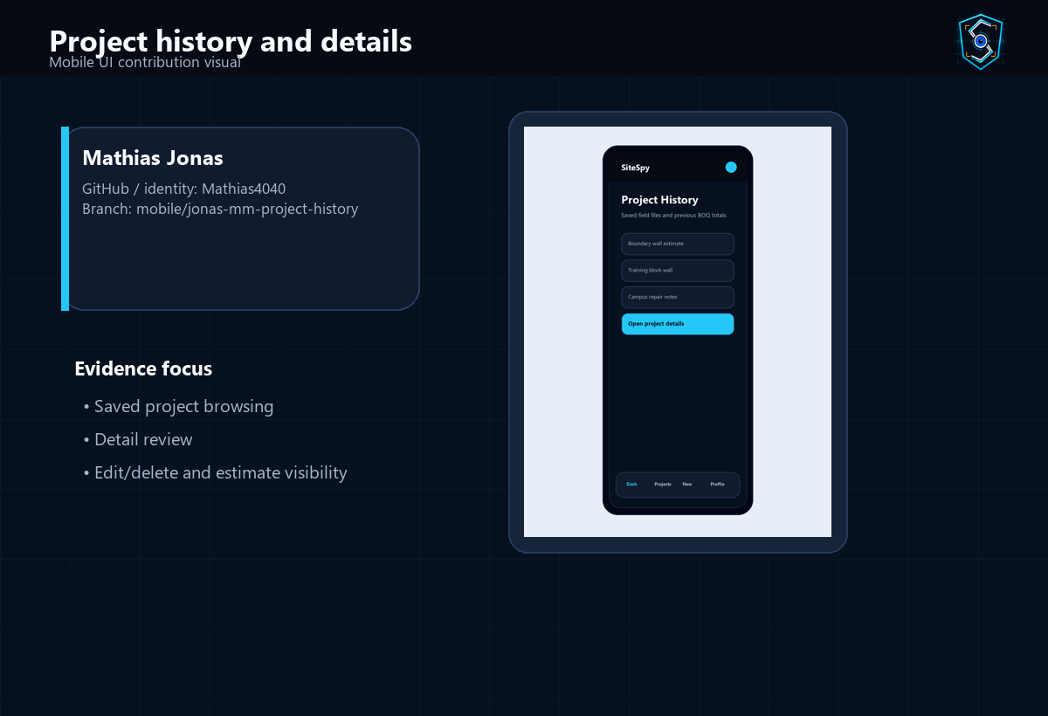
Member Contribution: Mathias Jonas
Project history and details
Profile
What this member worked on
GitHub / identity: Mathias4040 Branch: mobile/jonas-mm-project-history Workstream: Mobile UI Status: Assigned
• Saved project browsing
• Detail review
• Edit/delete and estimate visibility
Why it mattered
• lets users reopen and manage saved field files
• connects estimates and images to each project
Visual evidence: assigned app area or subsystem view
Presenter note: Explain that this contribution supports lets users reopen and manage saved field files.
SiteSpy System Presentation | 32

Slide 33
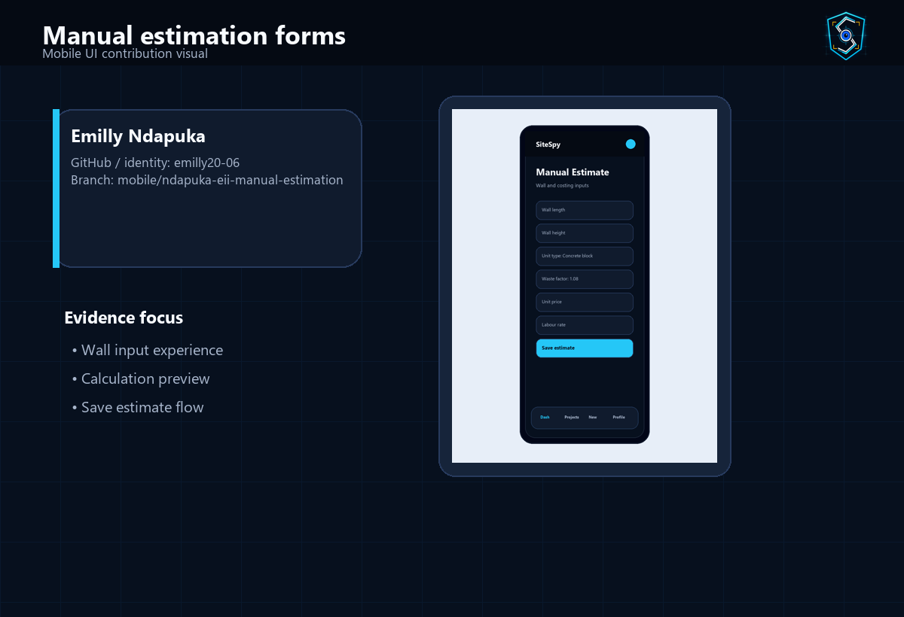
Member Contribution: Emilly Ndapuka
Manual estimation forms
Profile
What this member worked on
GitHub / identity: emilly20-06 Branch: mobile/ndapuka-eii-manual-estimation Workstream: Mobile UI Status: Assigned
• Wall input experience
• Calculation preview
• Save estimate flow
Why it mattered
• turns construction inputs into repeatable calculations
• supports the main value of the app
Visual evidence: assigned app area or subsystem view
Presenter note: Explain that this contribution supports turns construction inputs into repeatable calculations.
SiteSpy System Presentation | 33

Slide 34
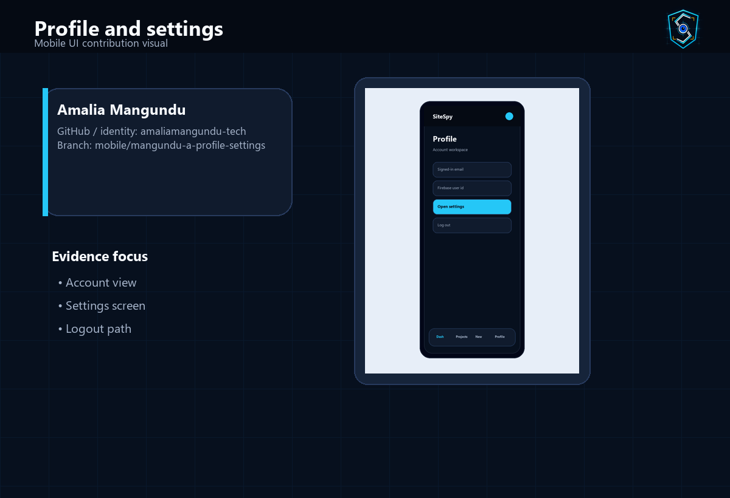
Member Contribution: Amalia Mangundu
Profile and settings
Profile
What this member worked on
GitHub / identity: amaliamangundu-tech Branch: mobile/mangundu-a-profile-settings Workstream: Mobile UI Status: Assigned
• Account view
• Settings screen
• Logout path
Why it mattered
• gives users account control and logout access
• rounds out the protected app experience
Visual evidence: assigned app area or subsystem view
Presenter note: Explain that this contribution supports gives users account control and logout access.
SiteSpy System Presentation | 34

Slide 35
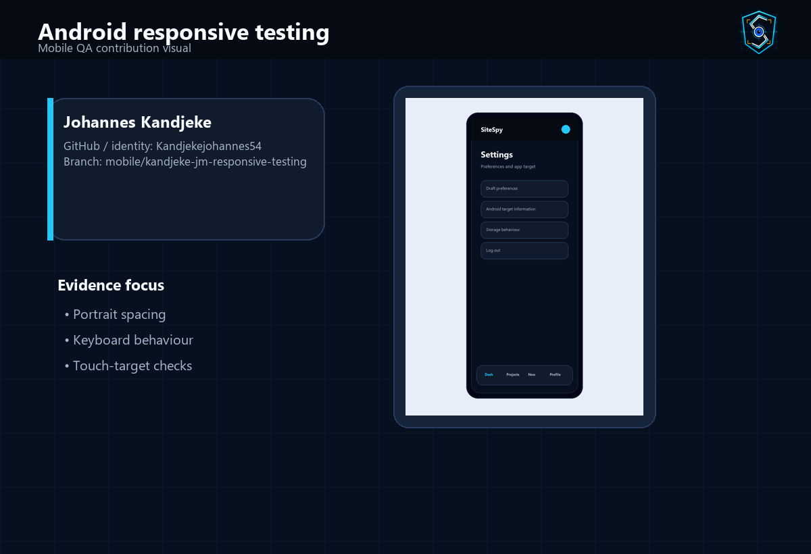
Member Contribution: Johannes Kandjeke
Android responsive testing
Profile
What this member worked on
GitHub / identity: Kandjekejohannes54 Branch: mobile/kandjeke-jm-responsive-testing Workstream: Mobile QA Status: Assigned
• Portrait spacing
• Keyboard behaviour
• Touch-target checks
Why it mattered
• improves readability on portrait Android screens
• supports reliable live demonstration
Visual evidence: assigned app area or subsystem view
Presenter note: Explain that this contribution supports improves readability on portrait Android screens.
SiteSpy System Presentation | 35

Slide 36
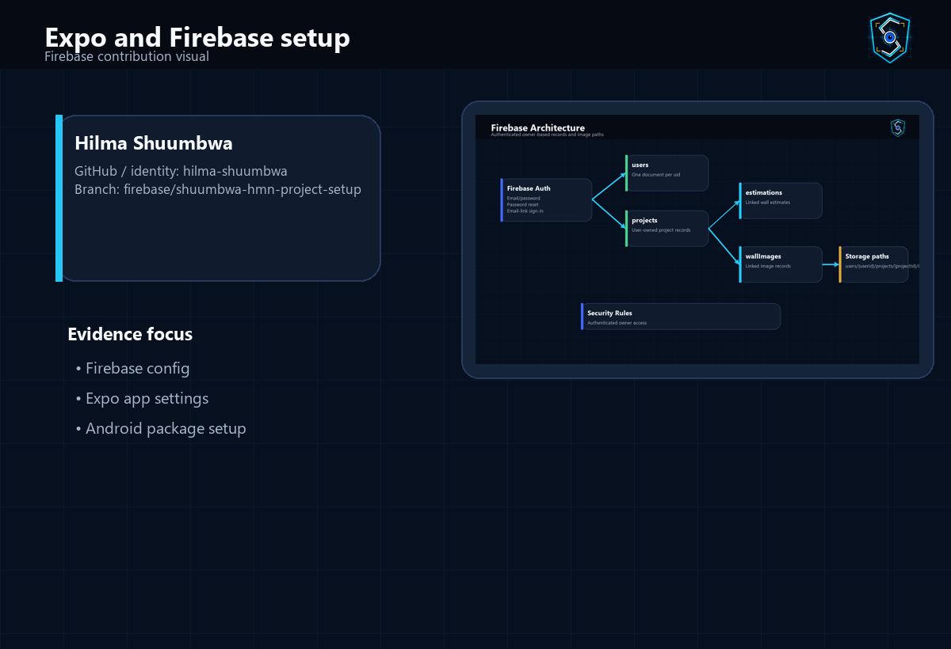
Member Contribution: Hilma Shuumbwa
Expo and Firebase setup
Profile
What this member worked on
GitHub / identity: hilma-shuumbwa Branch: firebase/shuumbwa-hmn-project-setup Workstream: Firebase Status: Assigned
• Firebase config
• Expo app settings
• Android package setup
Why it mattered
• provides the foundation for app startup and backend connection
• makes configuration traceable
Visual evidence: assigned app area or subsystem view
Presenter note: Explain that this contribution supports provides the foundation for app startup and backend connection.
SiteSpy System Presentation | 36

Slide 37
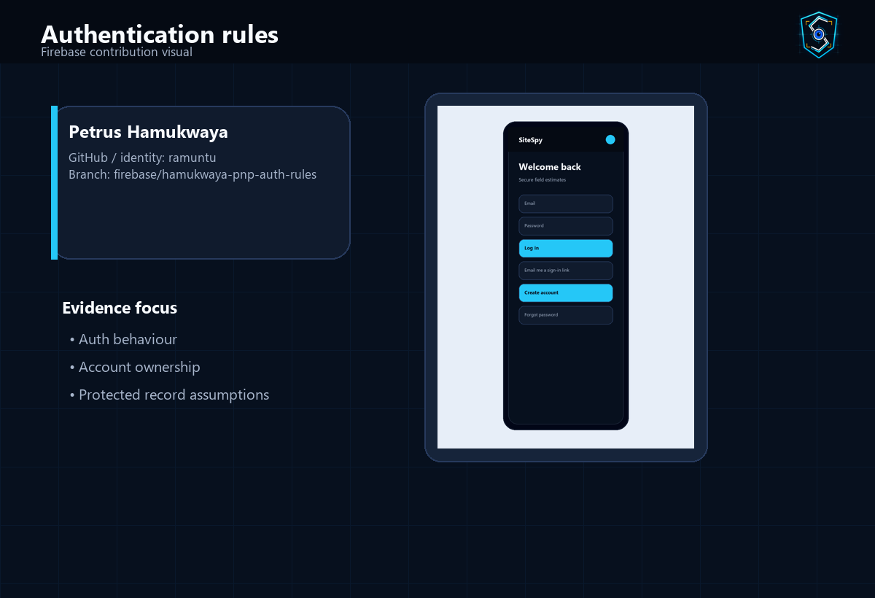
Member Contribution: Petrus Hamukwaya
Authentication rules
Profile
What this member worked on
GitHub / identity: ramuntu Branch: firebase/hamukwaya-pnp-auth-rules Workstream: Firebase Status: Assigned
• Auth behaviour
• Account ownership
• Protected record assumptions
Why it mattered
• keeps sign-in behaviour aligned with Firebase Auth
• supports secure account-linked data
Visual evidence: assigned app area or subsystem view
Presenter note: Explain that this contribution supports keeps sign-in behaviour aligned with Firebase Auth.
SiteSpy System Presentation | 37

Slide 38
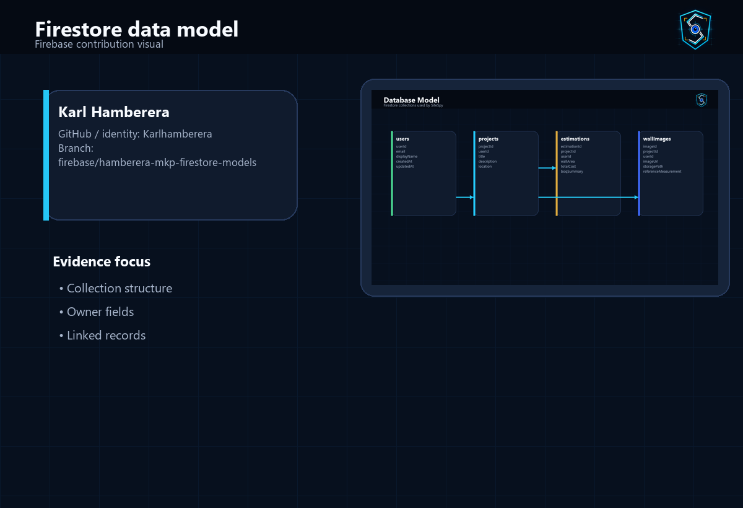
Member Contribution: Karl Hamberera
Firestore data model
Profile
What this member worked on
GitHub / identity: Karlhamberera Branch: firebase/hamberera-mkp-firestore-models Workstream: Firebase Status: Assigned
• Collection structure
• Owner fields
• Linked records
Why it mattered
• defines how records are organized and linked
• supports project history and summaries
Visual evidence: assigned app area or subsystem view
Presenter note: Explain that this contribution supports defines how records are organized and linked.
SiteSpy System Presentation | 38

Slide 39
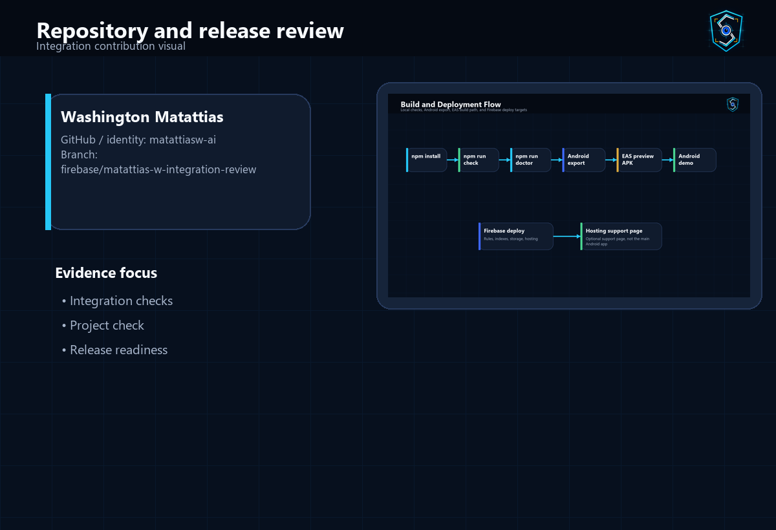
Member Contribution: Washington Matattias
Repository and release review
Profile
What this member worked on
GitHub / identity: matattiasw-ai Branch: firebase/matattias-w-integration-review Workstream: Integration Status: Assigned
• Integration checks
• Project check
• Release readiness
Why it mattered
• keeps integration checks visible
• reduces risk before presentation and build
Visual evidence: assigned app area or subsystem view
Presenter note: Explain that this contribution supports keeps integration checks visible.
SiteSpy System Presentation | 39

Slide 40
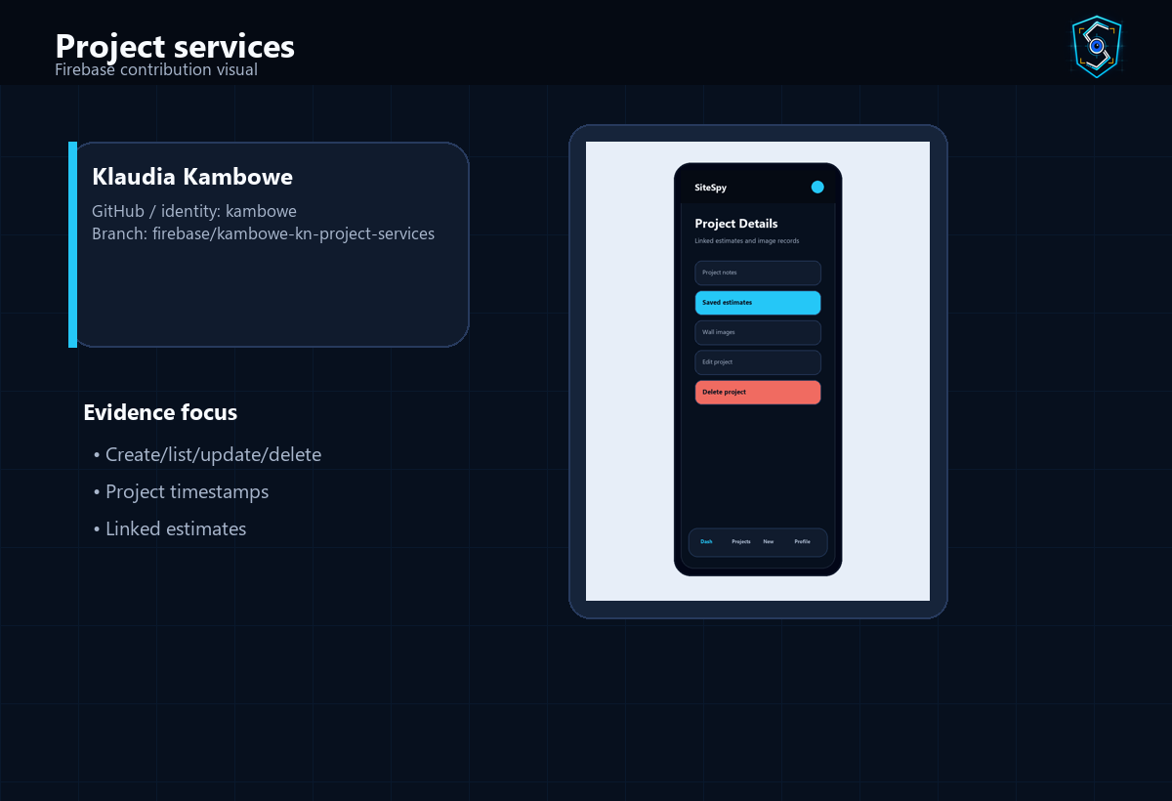
Member Contribution: Klaudia Kambowe
Project services
Profile
What this member worked on
GitHub / identity: kambowe Branch: firebase/kambowe-kn-project-services Workstream: Firebase Status: Assigned
• Create/list/update/delete
• Project timestamps
• Linked estimates
Why it mattered
• provides data operations behind project screens
• keeps screen code focused on user experience
Visual evidence: assigned app area or subsystem view
Presenter note: Explain that this contribution supports provides data operations behind project screens.
SiteSpy System Presentation | 40

Slide 41
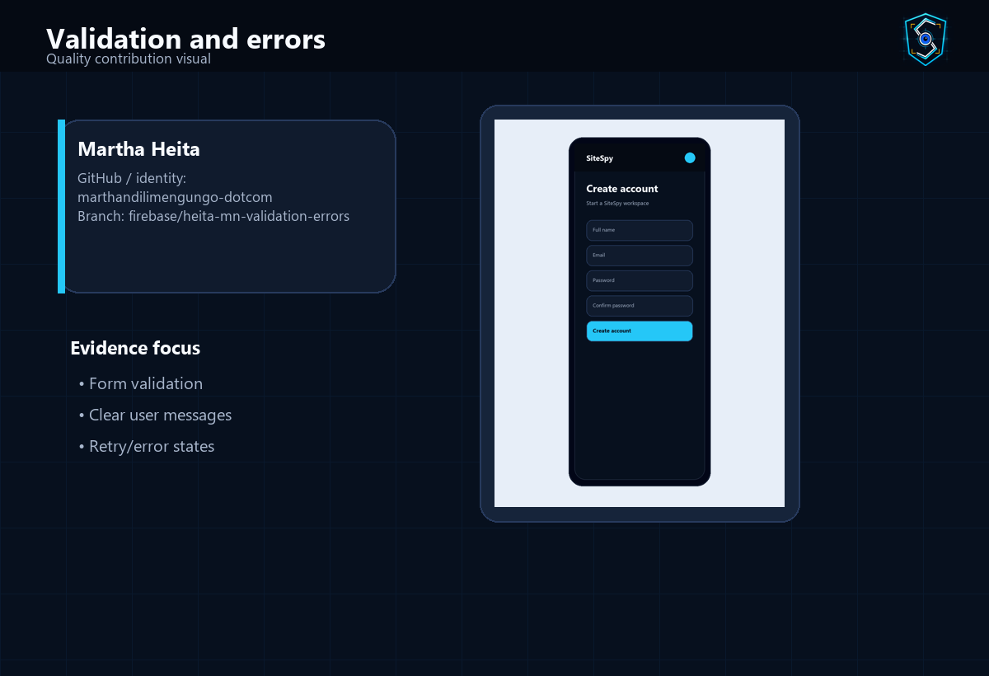
Member Contribution: Martha Heita
Validation and errors
Profile
What this member worked on
GitHub / identity: marthandilimengungo-dotcom Branch: firebase/heita-mn-validation-errors Workstream: Quality Status: Assigned
• Form validation
• Clear user messages
• Retry/error states
Why it mattered
• helps users correct mistakes before saving
• makes failures easier to explain and retry
Visual evidence: assigned app area or subsystem view
Presenter note: Explain that this contribution supports helps users correct mistakes before saving.
SiteSpy System Presentation | 41

Slide 42
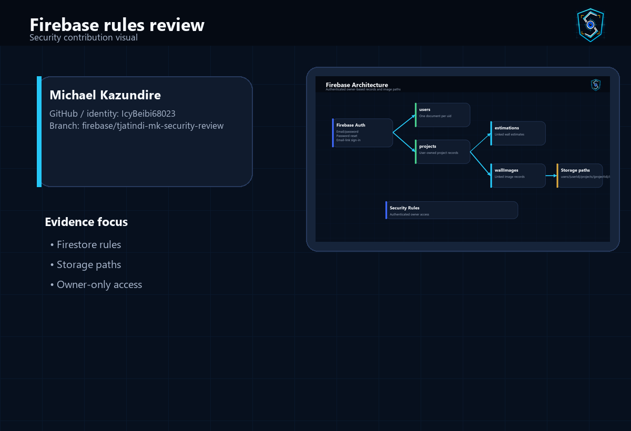
Member Contribution: Michael Kazundire
Firebase rules review
Profile
What this member worked on
GitHub / identity: IcyBeibi68023 Branch: firebase/tjatindi-mk-security-review Workstream: Security Status: Assigned
• Firestore rules
• Storage paths
• Owner-only access
Why it mattered
• protects records through owner-only rules
• supports a defensible security explanation
Visual evidence: assigned app area or subsystem view
Presenter note: Explain that this contribution supports protects records through owner-only rules.
SiteSpy System Presentation | 42

Slide 43
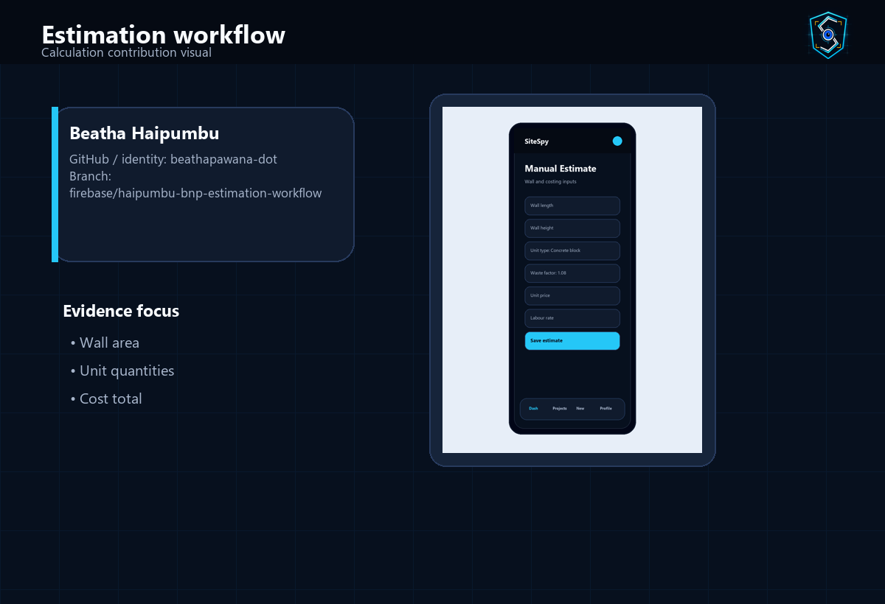
Member Contribution: Beatha Haipumbu
Estimation workflow
Profile
What this member worked on
GitHub / identity: beathapawana-dot Branch: firebase/haipumbu-bnp-estimation-workflow Workstream: Calculation Status: Assigned
• Wall area
• Unit quantities
• Cost total
Why it mattered
• connects form inputs to saved cost summaries
• supports the main construction-estimation use case
Visual evidence: assigned app area or subsystem view
Presenter note: Explain that this contribution supports connects form inputs to saved cost summaries.
SiteSpy System Presentation | 43

Slide 44

Member Contribution: Valentina Correia
Summary formatting
Profile
What this member worked on
GitHub / identity: Valentina-Correia Branch: firebase/correia-vp-summary-export Workstream: Reporting Status: Assigned
• BOQ line items
• Cost breakdown
• Presenter-friendly totals
Why it mattered
• makes calculation results easier to present
• turns estimates into BOQ-style outputs
Visual evidence: assigned app area or subsystem view
Presenter note: Explain that this contribution supports makes calculation results easier to present.
SiteSpy System Presentation | 44

Slide 45
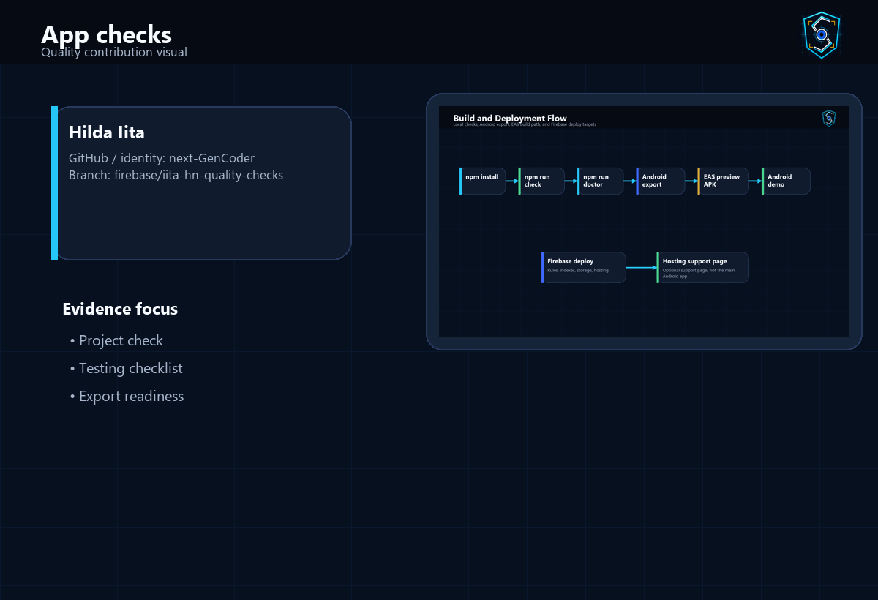
Member Contribution: Hilda Iita
App checks
Profile
What this member worked on
GitHub / identity: next-GenCoder Branch: firebase/iita-hn-quality-checks Workstream: Quality Status: Assigned
• Project check
• Testing checklist
• Export readiness
Why it mattered
• confirms required files and quality commands
• supports final submission confidence
Visual evidence: assigned app area or subsystem view
Presenter note: Explain that this contribution supports confirms required files and quality commands.
SiteSpy System Presentation | 45

Slide 46
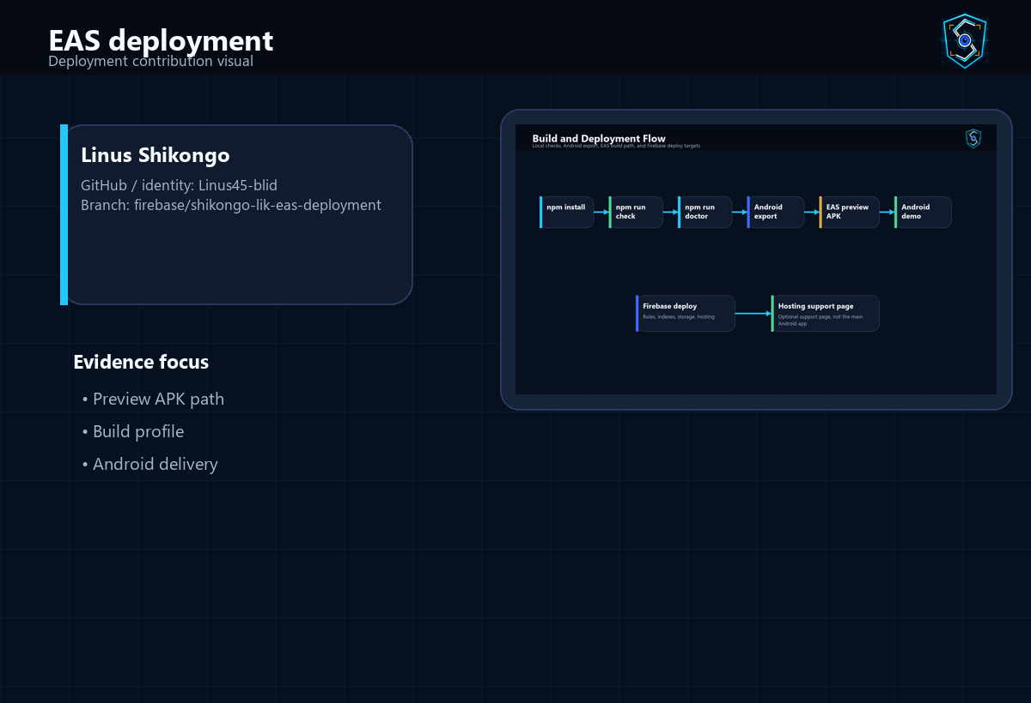
Member Contribution: Linus Shikongo
EAS deployment
Profile
What this member worked on
GitHub / identity: Linus45-blid Branch: firebase/shikongo-lik-eas-deployment Workstream: Deployment Status: Assigned
• Preview APK path
• Build profile
• Android delivery
Why it mattered
• defines the Android APK delivery path
• supports installable demo readiness
Visual evidence: assigned app area or subsystem view
Presenter note: Explain that this contribution supports defines the Android APK delivery path.
SiteSpy System Presentation | 46

Slide 47
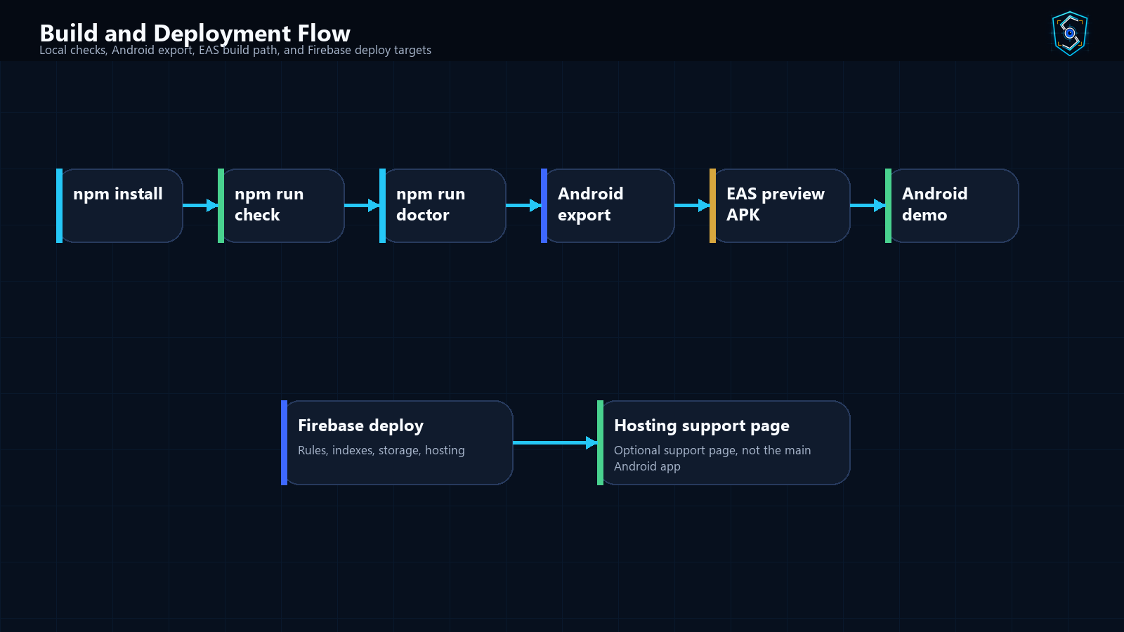
Testing and Quality Assurance
Checks documented for the project
• npm run check verifies required files and blocks private or wrong-stack files.
• Expo Doctor is configured as npm run doctor for Expo project health checks.
• Android export is configured through npm run export:android.
• Testing checklist covers auth, project workflow, estimation, image workflow, and Android UI.
• Firebase rules and storage paths are reviewed as part of the quality story.
SiteSpy System Presentation | 47

Slide 48
Debugging Work Completed
Evidence of runtime and quality review
• The repository includes crash logs before and after fixes.
• Runtime configuration has guard behaviour for missing Firebase values.
• Auth state initialization shows a splash screen before routing.
• Project check confirms required files and secret-safety expectations.
• Final submission checklist tracks Expo Go, EAS, Firebase, and branch readiness.
SiteSpy System Presentation | 48

Slide 49
How to Run the Project
Verified commands from package.json and docs
• Install dependencies: npm install
• Create local environment file: cp .env.example .env
• Start Expo: npm start
• Run Android target: npm run android
• Run project check: npm run check
• Run Expo Doctor: npm run doctor
• Export Android bundle: npm run export:android
• Build preview APK: npm run build:apk
SiteSpy System Presentation | 49

Slide 50
How Students Continue Work
Branch and portfolio continuation path
• Configure Git identity with the student’s own name and email.
• Check out the assigned branch from the task-allocation document.
• Work only on the assigned app section or service area.
• Run checks before committing.
• Push the branch and prepare review evidence.
• Use portfolio notes to explain contribution, learning, challenges, and validated files.
SiteSpy System Presentation | 50

Slide 51
Demo Script for Monday
Recommended presentation sequence
• Introduce SiteSpy as a mobile-first wall-estimation app.
• Explain the estimation and collaboration problem.
• Show login and account flow.
• Show dashboard and project history.
• Create or open a project.
• Run a manual estimate and show the BOQ summary.
• Show image estimate and project details.
• Explain Firebase, data model, and security.
• Summarize member contributions.
• Close with testing, build readiness, and Q&A.
SiteSpy System Presentation | 51

Slide 52
Likely Questions and Answers
Panel preparation
• What problem does SiteSpy solve? It makes wall project estimates and saved records easier to produce and present.
• Why mobile-first? The app is designed for Android field-style use and student demonstration.
• Why Firebase? It provides authentication, Firestore records, storage paths, and deployable rules.
• How is user data protected? Rules require authentication and matching user ownership.
• How does estimation work? Wall dimensions and rates are converted into unit, mortar, labour, and total cost values.
• Can the app expand? Future work can add reporting, offline mode, and additional estimation types.
• How was it tested? Through project checks, testing checklist coverage, Expo checks, and Android export path.
SiteSpy System Presentation | 52

Slide 53
Future Improvements
Clearly separated from current features
• PDF report export for saved estimates.
• Additional construction estimation types beyond masonry walls.
• Offline mode for field use without consistent network access.
• Admin or reviewer mode for classroom assessment.
• Improved image measurement workflows.
• More reporting, charts, and portfolio evidence exports.
SiteSpy System Presentation | 53

Slide 54
Conclusion
What the team can confidently present
• SiteSpy is a working mobile-first estimation app built with Expo React Native.
• The app supports Firebase-backed user records, projects, estimates, images, and summaries.
• The codebase separates screens, components, services, utilities, theme, and configuration.
• The collaboration structure documents member ownership and branch responsibilities.
• The team can present the app workflow, technical architecture, and individual contributions clearly.
SiteSpy System Presentation | 54

Slide 55
Thank You
SiteSpy: secure mobile estimation and project records for the client team.
SiteSpy System Presentation | 55

