Slide 1
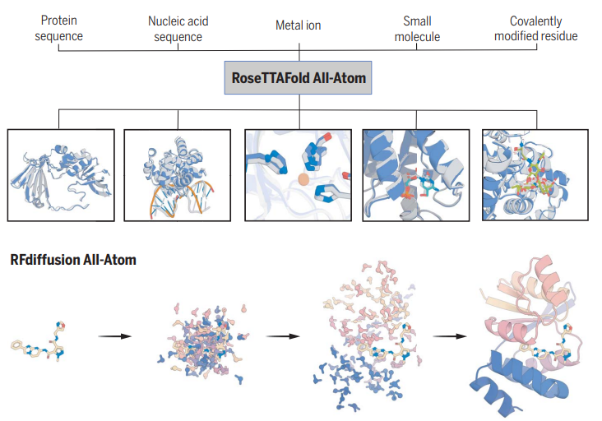
Generalized biomolecular modeling and design with RoseTTAFold All-Atom
RoseTTAFold All-Atom combines a residue-based representation of amino acids and DNA bases with an atomic representation of all other groups to model assemblies that contain proteins, nucleic acids, small molecules, metals, and covalent modifications, given their sequences and chemical structures.

Slide 2
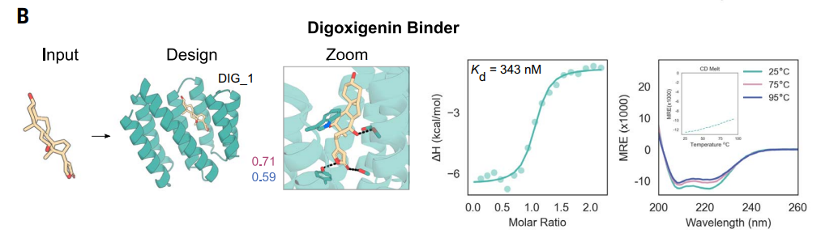
One application
Digoxigenin (DIG) is a small molecule used to treat heart diseases with a narrow therapeutic window
Digoxigenin-binding proteins could help reduce toxicity
Previous attempts rely on protein scaffolds with experimentally determined structures
Sequences were obtained using LigandMPNN and Rosetta FastRelax, and 4416 designs were selected based on consistency with AF2 predictions and Rosetta metrics
Experimental characterization identified the highest-affinity binder has a 343-nM dissociation constant (Kd) for free digoxigenin and is stable at temperatures up to 95°C

