Slide 1
Understanding GPT model through Compression
ZHENG Dihan
2023/05/25

Slide 2
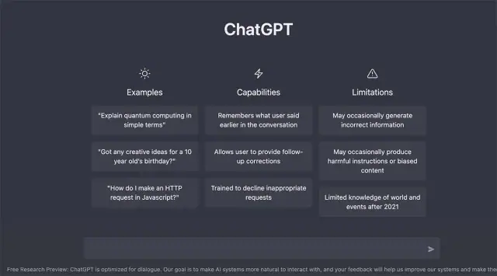
What is GPT model
GPT = Generative Pre-trained Transformer

Slide 3
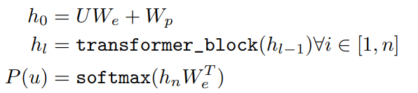

Generative
Maximal likelihood estimation
Auto-regressive model:
$$U=\left\{u_{1},u_{2},…,u_{n}\right\}, L\left(U\right)=\sum_{i=1}^{n}{\log{P\left(u_{i}|u_{i−k},…,u_{i−1};Θ\right)}}$$

Slide 4
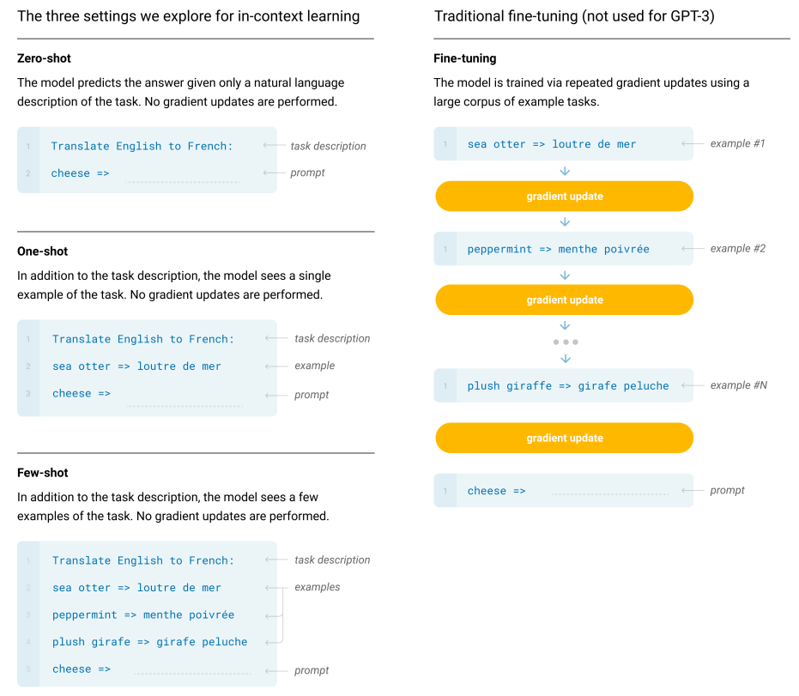
Working paradigm
Zero-shot, one-shot, few-shot paradigm:
no parameter update.
Fine-tuning paradigm:
update parameter.

Slide 5
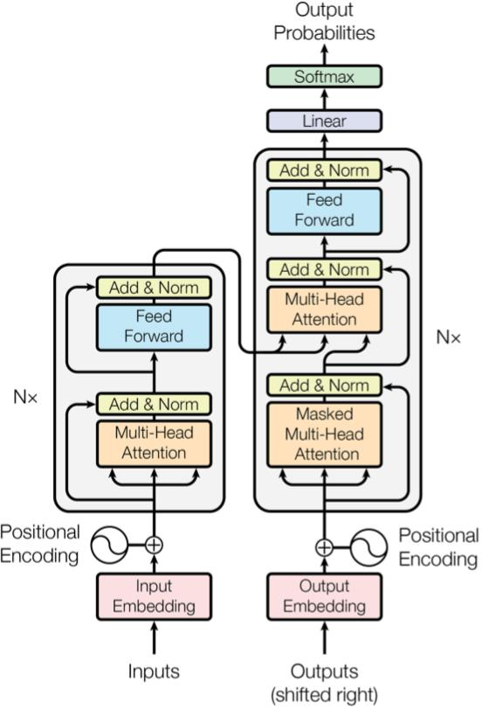
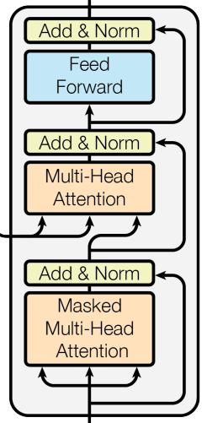
Transformer-decoder-only
Transformer decoder
GPT decoder

Slide 6
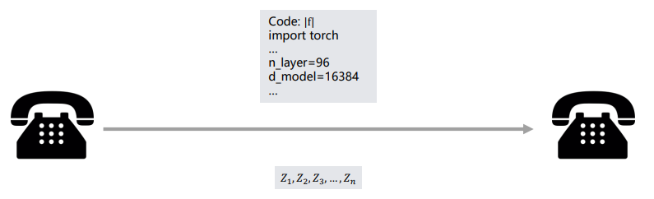
LLM is lossless compression
Alice wants to send a dataset to Bob
They both have supercomputers
Low bandwidth connection
Alice
Bob

Slide 7


Minimum Description Length
Compress dataset $D$ using generative model $f$ :
$$\left|D\right|=−\log{P_{f}\left(D\right)+\left|f\right|}$$
Lossless compression of $D$
Description length of function approximator
Negative log likelihood, from a generative model $f$ over $D$

Slide 8

Lossless compression with LLM
Compressing $D$ amounts to better next-token prediction form an LLM $f$:
$$\left|D\right|=−\log{P_{f}\left(D\right)}+\left|f\right|$$
$$=−\sum_{x_{i}∈D}{\log{P_{f}\left(x_{i}|x_{<i}\right)}}+\left|f\right|$$
Sum of next token prediction loss
Code instance to train a transformer
Note: This does not depend on how large the model is.

Slide 9
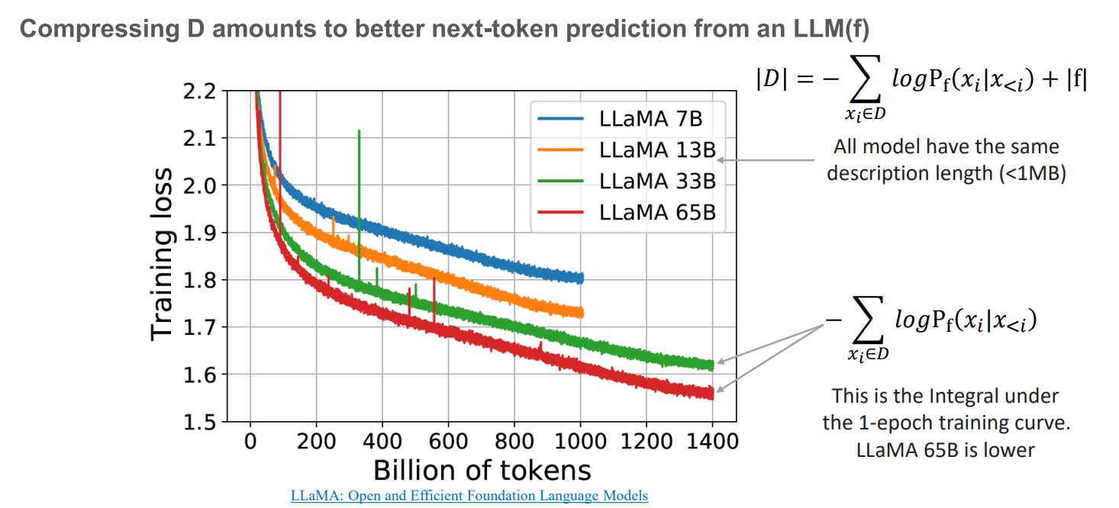
Lossless compression with LLM

Slide 10
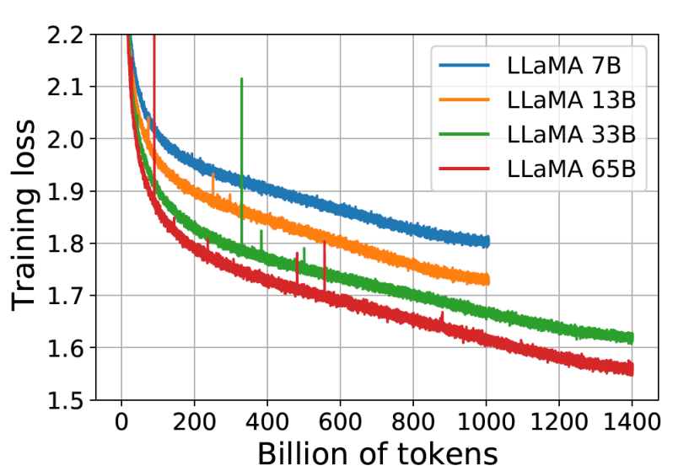
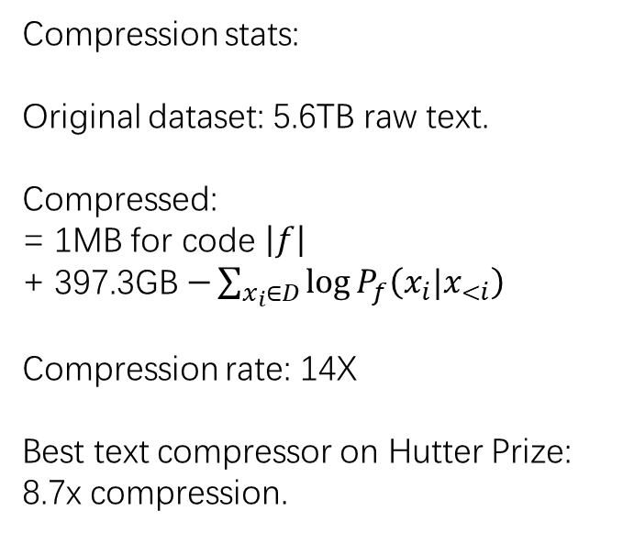
Lossless compression with LLM
Compression stats:
Original dataset: 5.6TB raw text.
Compressed:
= 1MB for code $\left|f\right|$
+ 397.3GB $−\sum_{x_{i}∈D}{\log{P_{f}\left(x_{i}|x_{<i}\right)}}$
Compression rate: 14X
Best text compressor on Hutter Prize:
8.7x compression.

Slide 11
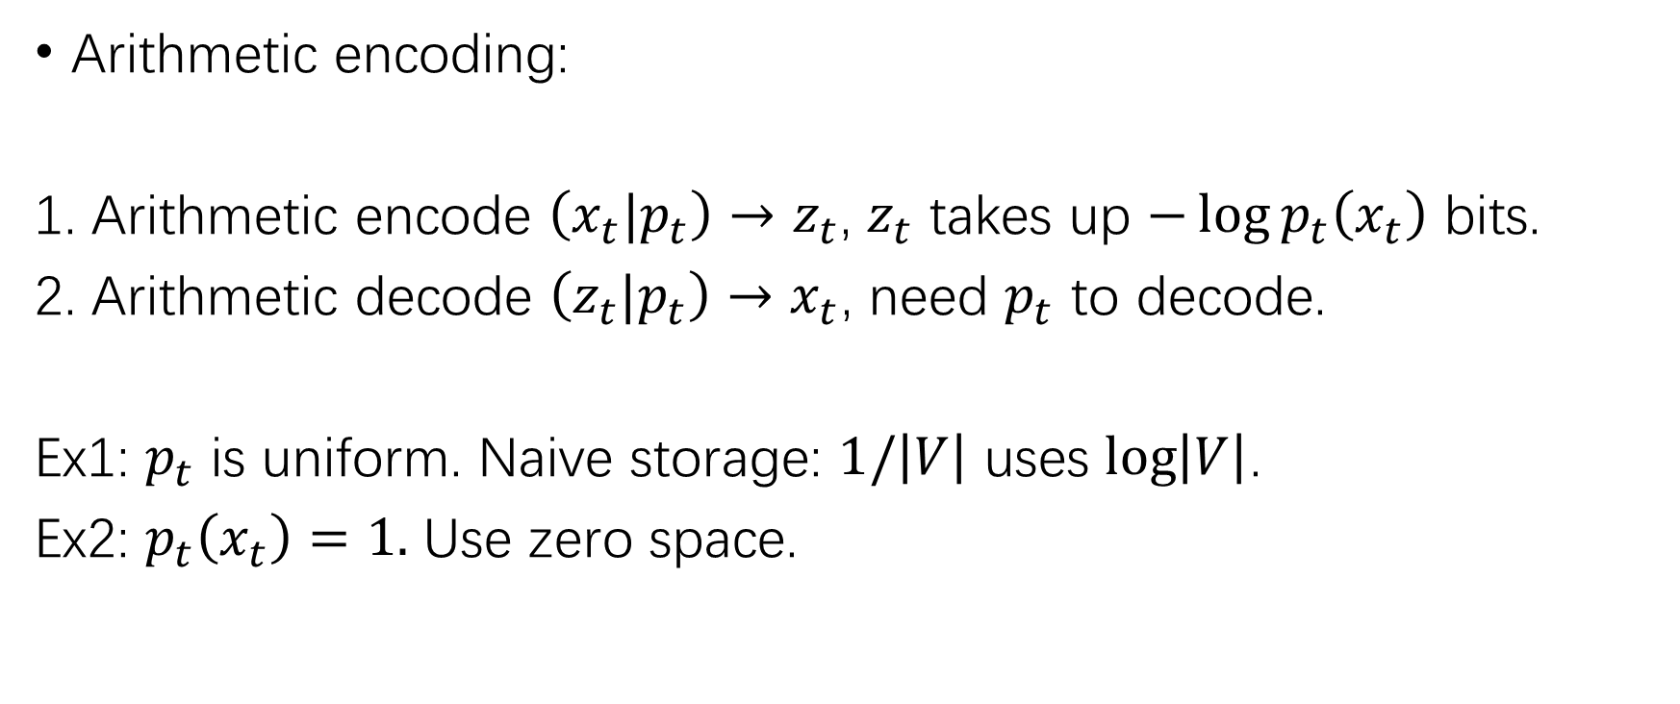
Why LLM is lossless compression
Arithmetic encoding:
1. Arithmetic encode $\left(x_{t}|p_{t}\right)→z_{t}$, $z_{t}$ takes up $−\log{p_{t}\left(x_{t}\right)}$ bits.
2. Arithmetic decode $\left(z_{t}|p_{t}\right)→x_{t}$, need $p_{t}$ to decode.
Ex1: $p_{t}$ is uniform. Naive storage: $1/\left|V\right|$ uses $\log\left|V\right|$.
Ex2: $p_{t}\left(x_{t}\right)=1.$ Use zero space.

Slide 12
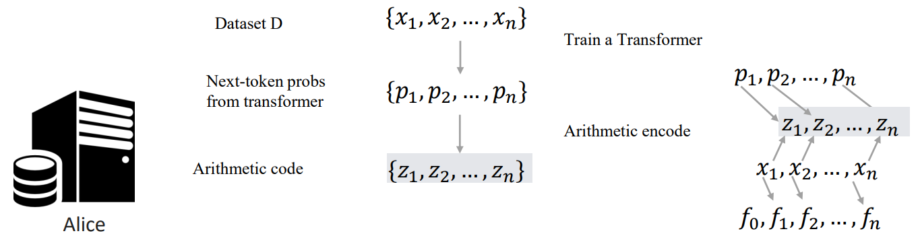
Encoding process

Slide 13
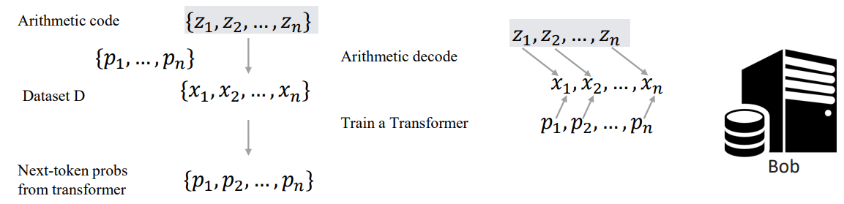
Decoding process

Slide 14
Thanks

