Slide 1
cryoMAE: Few-Shot Cryo-EM Particle Picking with Masked Autoencoders
Jianying ZHU

Slide 2
Two stages
1. Learn particle features from a limited set of cryo-EM particle regions efficiently (a few labeled exemplars (e.g., 15) per protein + unlabeled regions)
2. Detects and extracts particles from query micrographs by comparing the latent features for exemplars

Slide 3
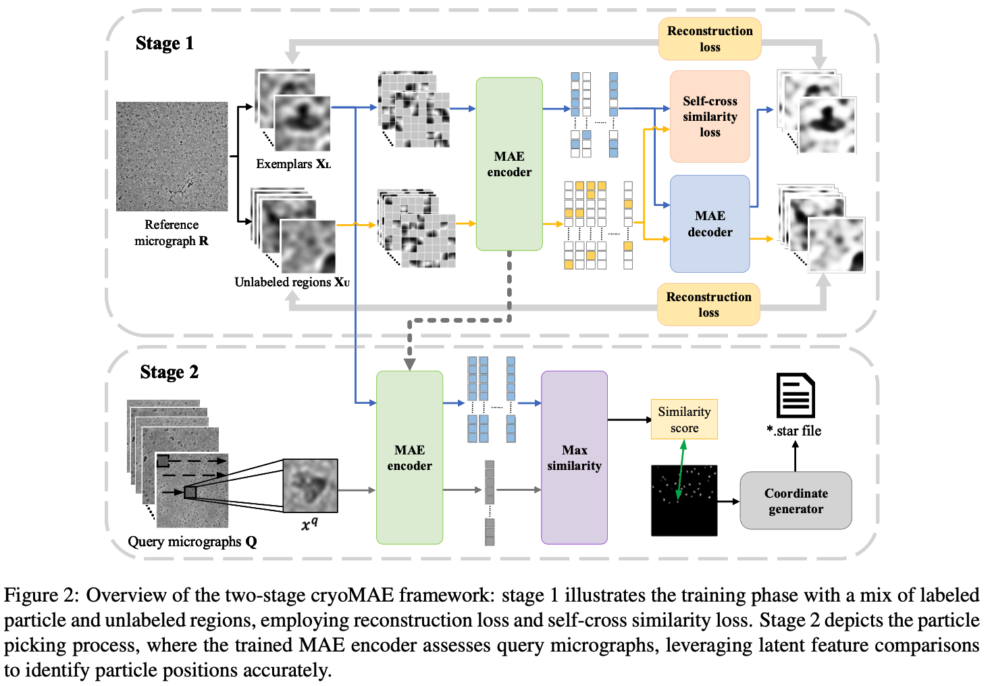

Slide 4
Stage 1: Training on One Reference Micrograph
1. Select a reference micrograph, getting labeled regions and unlabeled regions, resized to 224 * 224 and into 16 * 16 patches, set random masking rate to 75%.
2. Encoder generates latent features, while decoder use them to reconstruct original inputs.
3. To reduce overfitting risks for background noise, pre-train cryoMAE on a broader set of unlabeled regions better represents background variability.

Slide 5
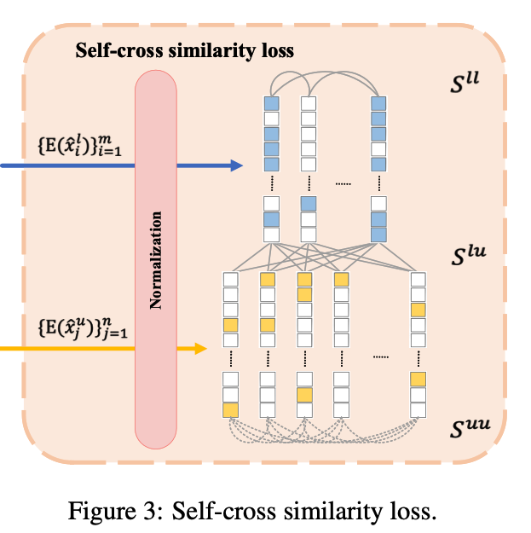



Self-cross similarity
Learn to to differentiate between these regions.
cos similarity：

Slide 6
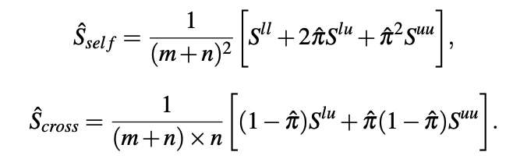

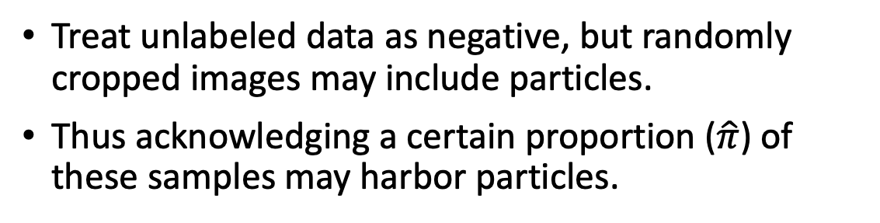
PU Learning
Treat unlabeled data as negative, but randomly cropped images may include particles.
Thus acknowledging a certain proportion ($\hat{π}$) of these samples may harbor particles.
Total loss:

Slide 7
Stage 2: Particle Picking on Query Micrographs
1. Sliding window on a micrograph, the latent features are then matched against exemplars through cosine similarity, assigning similarity scores to each region based on the highest similarity. These similarity scores are ranked.
2. Determine the most suitable cutoff threshold for each micrograph automatically. Calculating the average distance of each score to its k nearest neighbors, and finding the score where the rate of change in these average distances is maximized as the cutoff threshold.

Slide 8
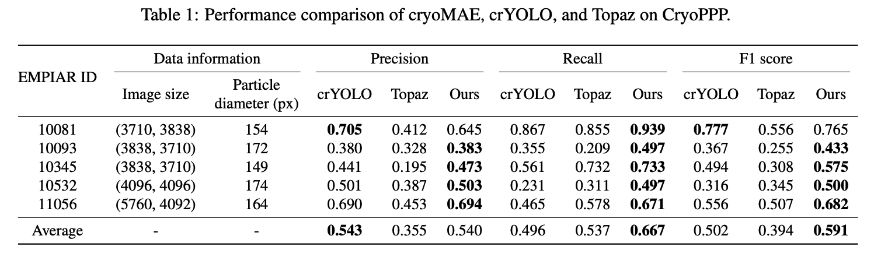
Experiments
Utilized crYOLO1 (pre-trained on more than 40 datasets) and Topaz (pre-trained model based on ResNet trained on large-scale cryo-EM datasets) as baselines.
A true positive occurs when a picked particle overlaps with a ground truth region, achieving an intersection over union (IoU) of 0.5 or higher, with each ground truth accounted for only once.

Slide 9
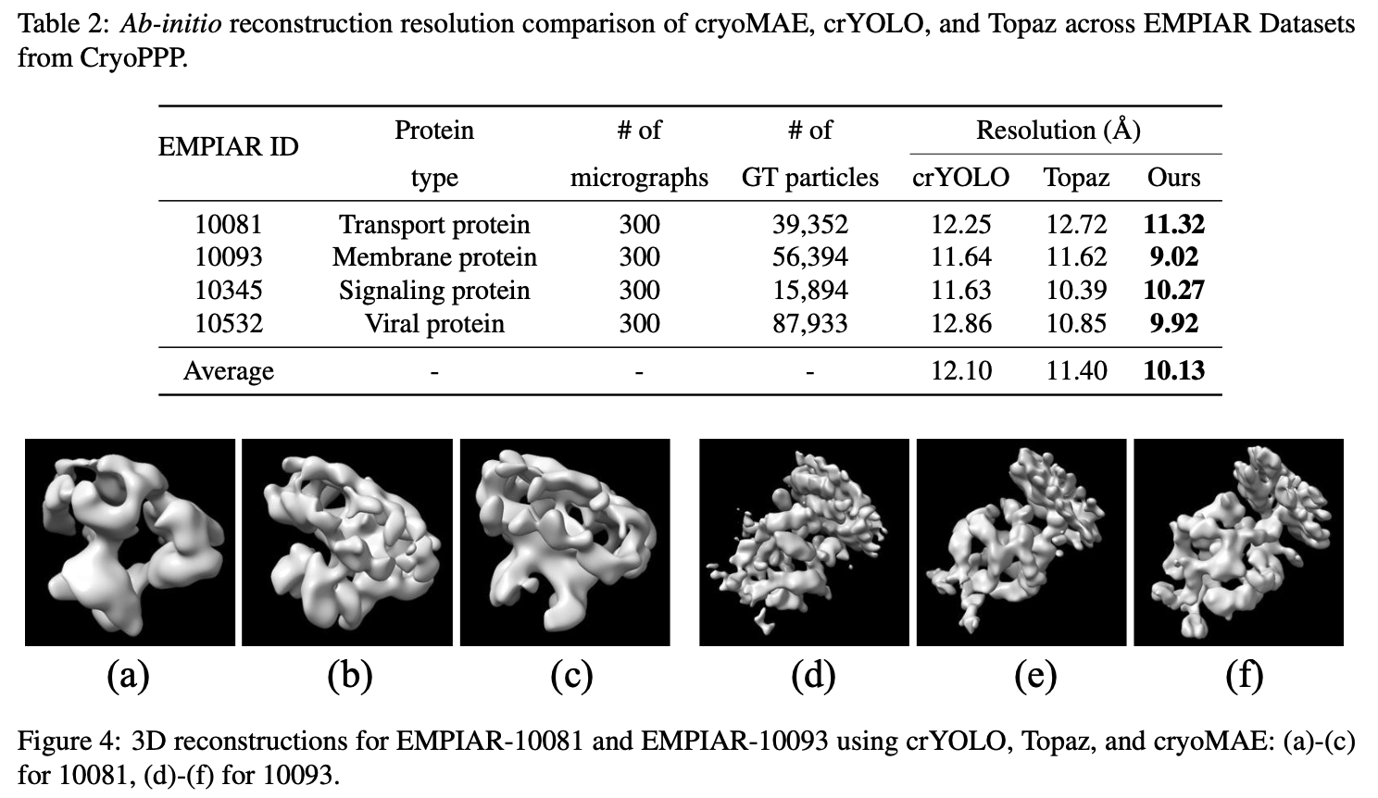
Experiments

Slide 10
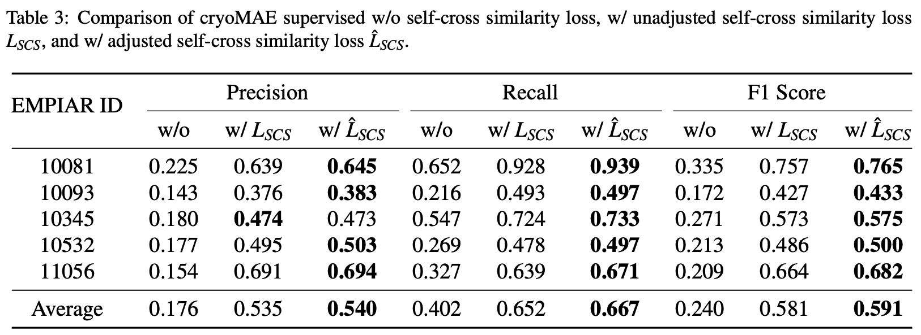
Ablation Study

Slide 11
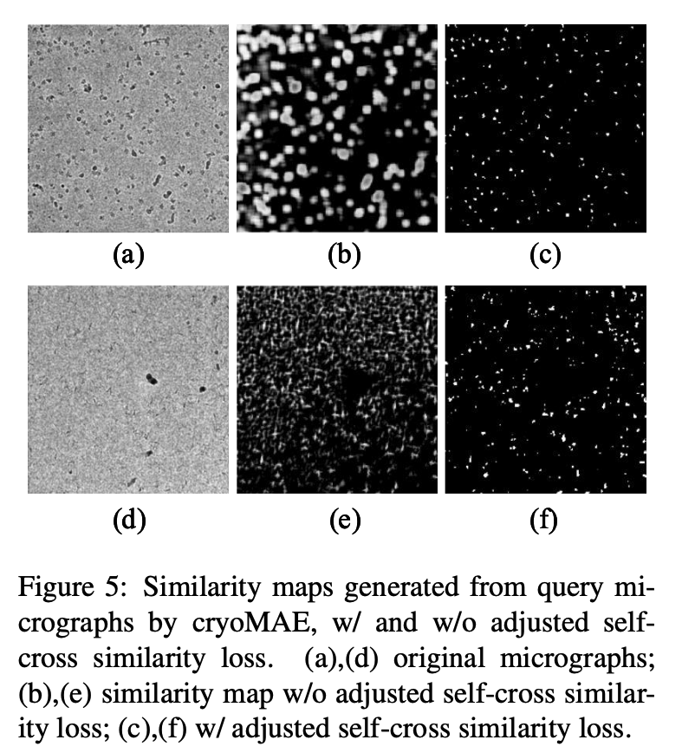
Ablation Study

Slide 12
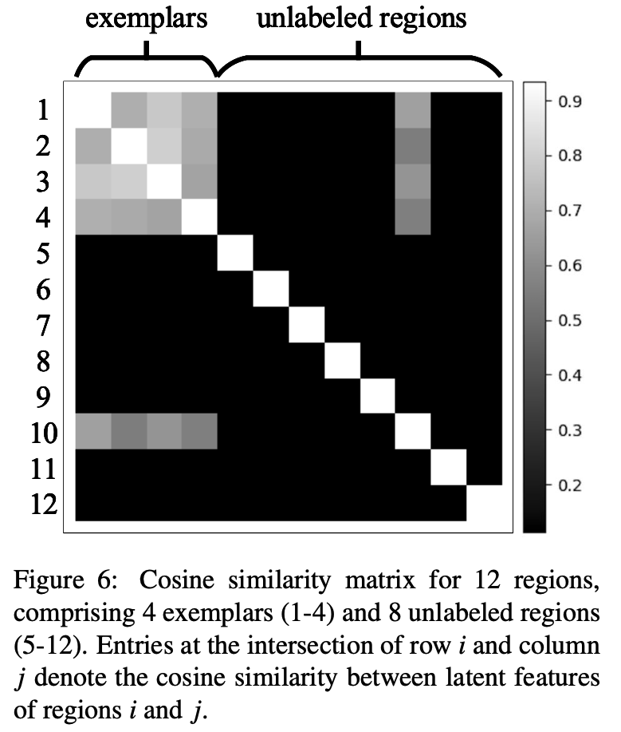
Ablation Study
The matrix demonstrates high similarity among particle regions and lower similarity between particle and background regions, highlighting the model’s ability to group particle regions closely in the feature space and distinguish them from the background.

Slide 13
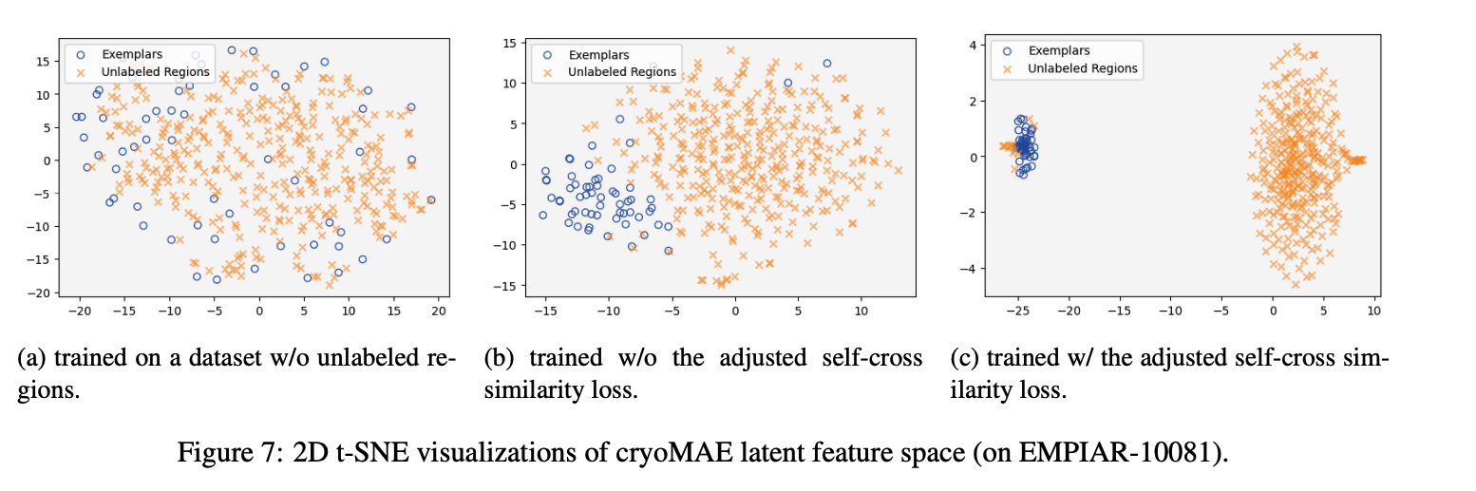
Experiments

