Slide 1
Match HackUTD 2019
Quickly Getting started with ReacT

Slide 2
OR… GOTTA GO FAST

Slide 3
Preparing for React
Node + Npm: go to https://nodejs.org/en/ and download and install node 10.x. This will automatically install npm
Editor: install an editor. We all use VS Code: https://code.visualstudio.com/
Developer tools: add the react developer tools to your browser. https://github.com/facebook/react-devtools or search chrome extensions for react developer tools
Grab our repo: https://github.com/match-com/match-utd-starter

Slide 4



















Who is Match Group
We offer products in 42 languages in 190+ countries
9.6M+ subscribers $2.0 billion Revenue and $740 million Adjusted EBITDA
64% of dates, relationships & marriages that originated on a dating site / app began on a Match Group product³
Things to download
https://nodejs.org/en/ (node/npm)
https://code.visualstudio.com/ (editor)
https://github.com/match-com/match-utd-starter
https://github.com/facebook/react-devtools

Slide 5
Match Web Team
Match.com was launching in 1995
The team responsible for the web platforms for Match
16 Developers and 6 QA engineers
Responsible for a million users a day
Primary platform is in Node/Express/React
Things to download
https://nodejs.org/en/ (node/npm)
https://code.visualstudio.com/ (editor)
https://github.com/match-com/match-utd-starter
https://github.com/facebook/react-devtools

Slide 6
Match Web Technology
Area | Core Web | Micro Sites
React Base | 16.8 – custom webpack + babel setup | 16.8 Create React App
UI Library | Voltron | Voltron
Styling | Emotion (CSS in JS), CSS Modules | Emotion (CSS in JS), Inline, Global…
Routing | Fluxible | React Router v4
UI State | Fluxible | Component state
Data Loading | Fetchr And Graphql | Axios
Server App | Node | .Net Core
Server OS | Centos | Centos
Deployment | Virtual Servers | Kubernetes
Typescript | Yes | Yes

Slide 7
Match Technology
.Net API – Restful
Redis
Kafka
Custom In Memory Caching System
Custom In Memory Search Indexing System
SQL Server
2 Datacenters
Custom Swarm Photo storage
Hadoop
Things to download
https://nodejs.org/en/ (node/npm)
https://code.visualstudio.com/ (editor)
https://github.com/match-com/match-utd-starter
https://github.com/facebook/react-devtools

Slide 8
Quick History of React
Javascript itself
Javascript itself started in the 90s as a way to make the web more dynamic
The standard is actually ECMAScript of which Javascript is the primary implementation
Javascript 1996 to 2009 was competing standards and every browser was different
Now on ES6 or ECMAscript 2015 (yes that is confusing)
In the mid-2000’s jQuery came into existence as a way to unify and simplify development across browsers
React
By 2011 web applications were very complicated with heavy javascript manipulations of html elements
React officially announced in 2013
Other modern choices
Angular
Vue
Things to download
https://nodejs.org/en/ (node/npm)
https://code.visualstudio.com/ (editor)
https://github.com/match-com/match-utd-starter
https://github.com/facebook/react-devtools

Slide 9
React Concepts
Un-opionated (the framework at least)
Virtual DOM
Imperative vs Declarative
Imperative - programming focused on how to do things. OO
Declarative - programming focused on what to do. Functional
F(state) vs F(state, time)
State + Functions lead to predictable renders

Slide 10
Hands on
With DaviD

Slide 11
Tech covered in this repo
Material UI - https://material-ui.com/getting-started/usage/
Axios - https://github.com/axios/axios
MDN - https://developer.mozilla.org/en-US/docs/Web/JavaScript
React Hooks - https://reactjs.org/docs/hooks-intro.html
CSS Docs - https://developer.mozilla.org/en-US/docs/Web/CSS
NPM repository - https://www.npmjs.com/

Slide 12
React More in Depth
React Router - https://reacttraining.com/react-router/web/guides/quick-start
Redux - https://redux.js.org/introduction/getting-started
Typescript - https://www.typescriptlang.org/docs/home.html
Styling
Traditional CSS
SASS/LESS
CSS Modules
CSS in JS

Slide 13
But I want go even deeper
Mongo/Mongoose - https://mongoosejs.com/
Node FS - https://nodejs.org/api/fs.html
Prisma - https://www.prisma.io/
GraphQL - https://graphql.org/, https://www.apollographql.com/
WebSockets - https://socket.io/
Babel- https://babeljs.io/
Webpack - https://webpack.js.org/

Slide 14
Maybe not so deep
Robohash - https://robohash.org/ ex: https://robohash.org/Match?size=300x400
Placekittens - http://placekitten.com/ ex: http://placekitten.com/400/400
React Container Query - https://www.npmjs.com/package/react-container-query
Mockaroo - https://mockaroo.com/
SWAPI - https://swapi.co/documentation
PokeAPI - https://pokeapi.co/docs/v2.html

Slide 15
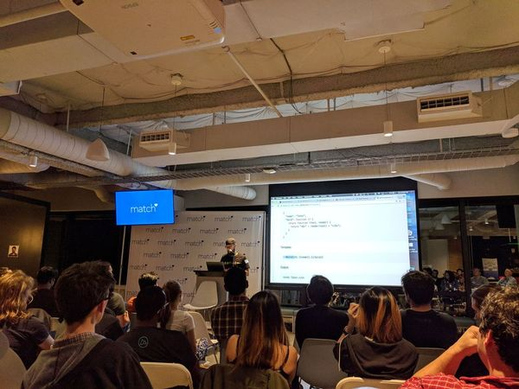
Other resources
Javascript & CSS
https://css-tricks.com/
https://flexboxfroggy.com/
https://cssgridgarden.com/
React Meetup Dallas
https://www.meetup.com/ReactJSDallas/
Tues Nov 12th - Reactjs @USAA
React Devs to follow
https://twitter.com/dan_abramov
https://twitter.com/tylermcginnis
https://twitter.com/ryanflorence
https://twitter.com/acdlite
https://twitter.com/wesbos
Online Courses
https://tylermcginnis.com/courses/
https://wesbos.com/courses/
https://www.pluralsight.com/
https://www.udemy.com/
https://www.freecodecamp.org/

Slide 16
Q&A
Ask Anything

