Slide 1
RNN

Slide 2
Load Map
Vanilla RNN
LSTM
Practice
Toy example (sin wave prediction)
Keras RNN parameter introduction

Slide 3
Vanilla RNN
https://www.youtube.com/watch?v=xCGidAeyS4M
(00:00-17:47)

Slide 4
LSTM
https://www.youtube.com/watch?v=xCGidAeyS4M
(17:48-48:59)

Slide 5
Practice
Sin wave prediction

Slide 6
Generate data
import math
import random
import numpy as np
import pandas as pd
import matplotlib.pyplot as plt
random.seed(0)
random_factor = 0.1
steps_per_cycle = 80
number_of_cycles = 200
df = pd.DataFrame(np.arange(steps_per_cycle * number_of_cycles), columns = ["t"])
df["sin_t"] = df.t.apply(lambda x: math.sin(x * (2 * math.pi / steps_per_cycle) + random.uniform(-1.0, +1.0) * random_factor))
def _load_data(data, n_prev = 100):
docX, docY = [], []
for i in range(len(data)-n_prev):
docX.append(data.iloc[i:i+n_prev].values)
docY.append(data.iloc[i+n_prev].values)
return np.array(docX), np.array(docY)
def train_test_split(df, test_size = 0.1, n_prev = 100):
split_point = round(len(df) * (1 - test_size))
X_train, y_train = _load_data(df.iloc[0:split_point], n_prev)
X_test, y_test = _load_data(df.iloc[split_point:], n_prev)
return (X_train, y_train), (X_test, y_test)
length_of_sequences = 100
(X_train, y_train), (X_test, y_test) = train_test_split(df[["sin_t"]], n_prev = length_of_sequences)

Slide 7
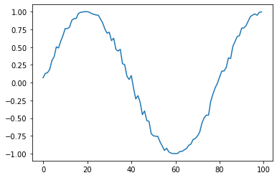
Data review
plt.plot(df[['sin_t']][:100])
plt.show()

Slide 8
Build Model
from keras.models import Sequential
from keras.layers.core import Dense
from keras.layers.recurrent import SimpleRNN, LSTM
inputNode = 1
outputNode = 1
hiddenNode = 10
warmUp = 100
model = Sequential()
model.add(LSTM(hiddenNode, input_shape=(warmUp, inputNode), return_sequences=False))
model.add(Dense(outputNode, activation='linear'))
model.compile(loss='mse', optimizer='adam')
model.summary()
history = model.fit(X_train, y_train, batch_size=128, epochs = 10, validation_split=0.2)

Slide 9
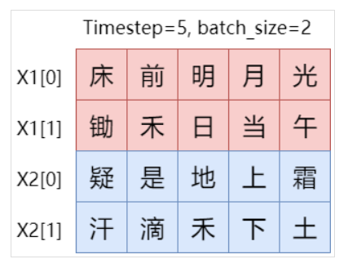
Keras : RNN parameter
units : RNN要output幾個node
return_sequences：True則返回整個序列，否則僅返回output sequence的最後一個輸出(default=False)，疊多個RNN時設為True
stateful：每批sample的 state 將被重新用於下一批sample的初始狀態(default=False)
Model.fit 時 shuffle 需要設為 False
要設定 batch_size
unroll：展開可加速RNN，但memory-intensive，適用於short sequence。
1.光的狀態會傳遞到疑作為初始狀態，也就是用光輸出的(h, c)來初始化疑的(h, c)
2. shuffle = True會在每個epoch開始之前打亂訓練集數據順序，使用stateful LSTM肯定要設置shuffle = False，不然光可能傳給汗就糟糕了
https://www.zydarchen.top/20180925/21_stateful_LSTM/

Slide 10
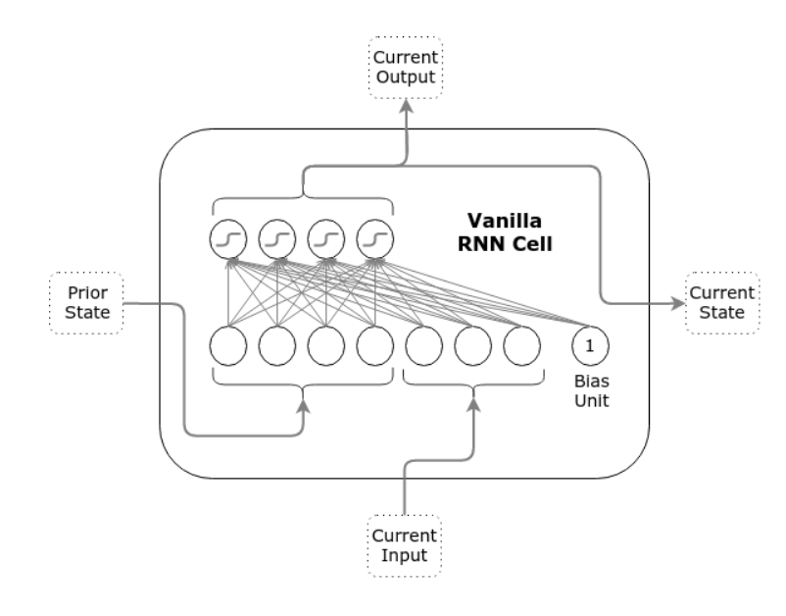
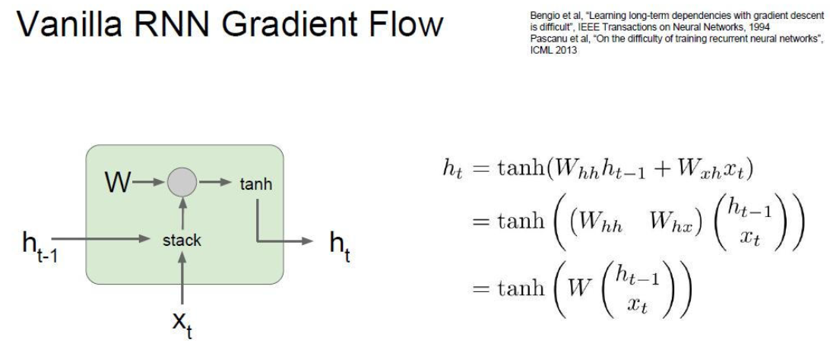
Vanilla RNN parameter

Slide 11
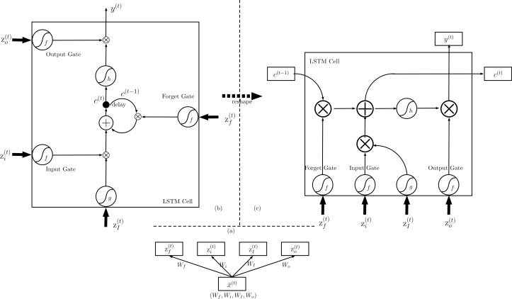
LSTM parameter

Slide 12
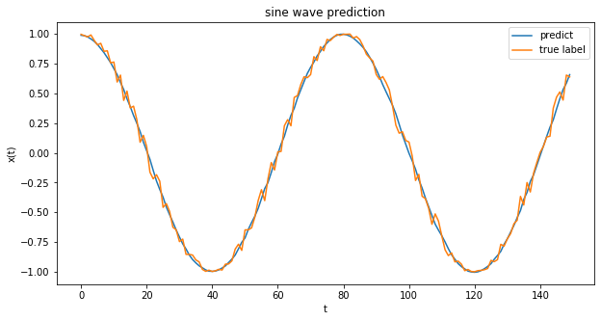
Prediction
predicted = model.predict(X_test)
plt.figure(figsize=(10, 5))
plt.plot(predicted[:150], label='predict')
plt.plot(y_test[:150], label='true label')
plt.xlabel('t')
plt.ylabel('x(t)')
plt.title('sine wave prediction')
plt.legend()
plt.show()

