Slide 1
Beacon
Notes:
Beacon(中文“燈塔)是一種“鄰近系統(Proximity System)”。在該系統中，運行在智能手機、平板電腦、可穿戴或其他計算設備上的應用可以對“Beacon設備”發出的信號進行響應。
Beacon設備自身是一種小巧而廉價的實體設備，你可以將其放置在某些場所，向處於一定距離之內的“響應設備”發送信息。

Slide 2
開啟權限
在manifests/androidmanifest.xml中加入
<uses-permission android:name="android.permission.ACCESS_COARSE_LOCATION" /> <uses-permission android:name="android.permission.BLUETOOTH" /> <uses-permission android:name="android.permission.BLUETOOTH_ADMIN" />
Notes:
AndroidManifest.xml檔案，這個XML格式檔案記錄了這個APP內的重要資料，如package名稱、版本、以及Android版本資訊、權限與所使用到的類別（如Activity、Receiver、Service、Provider等）。

Slide 3
介面
<Button
android:id="@+id/button"
android:layout_width="wrap_content"
android:layout_height="wrap_content"
android:text="Button"
app:layout_constraintTop_toTopOf="parent"
android:layout_marginTop="8dp"
android:layout_marginLeft="8dp"
app:layout_constraintLeft_toLeftOf="parent"
app:layout_constraintBottom_toBottomOf="parent"
android:layout_marginBottom="8dp"
android:layout_marginRight="8dp"
app:layout_constraintRight_toRightOf="parent"
app:layout_constraintVertical_bias="0.138" />
<TextView
android:id="@+id/textView"
android:layout_width="wrap_content"
android:layout_height="wrap_content"
android:layout_marginStart="8dp"
android:layout_marginTop="8dp"
android:layout_marginEnd="8dp"
android:layout_marginBottom="8dp"
android:text="TextView"
app:layout_constraintBottom_toBottomOf="parent"
app:layout_constraintEnd_toEndOf="parent"
app:layout_constraintStart_toStartOf="parent"
app:layout_constraintTop_toTopOf="parent" />

Slide 4
變數
private Button BT_Search; private TextView TV1; private BluetoothAdapter mBluetoothAdapter; private List<String> bluetoothdeviceslist = new ArrayList<String>(); private static final int PERMISSION_REQUEST_COARSE_LOCATION = 1; private String ID_target = "BR517487"; double dis;
Notes:
第2、3步驟在targetSdkVersion大於等於23（6.0）時必須添加，小於23時可以不用添加。所以另外一種處理辦法是只加權限，然後把targetSdkVersion設置到23以下也能達到同樣的效果，不過用戶可以在權限管理中禁止了該權限，一樣會搜不到設備。

Slide 5
OnCreate
BT_Search = (Button) findViewById(R.id.button); TV1 = (TextView) findViewById(R.id.textView); mBluetoothAdapter = BluetoothAdapter.getDefaultAdapter(); checkBluetoothPermission(); SearchBluetooth(); BT_Search.setOnClickListener(new View.OnClickListener(){ @Override public void onClick(View v) { if(mBluetoothAdapter.isDiscovering()){ mBluetoothAdapter.cancelDiscovery(); } mBluetoothAdapter.startDiscovery(); } });

Slide 6
加入藍芽權限確認
private void checkBluetoothPermission() { if (Build.VERSION.SDK_INT >=Build.VERSION_CODES.M) { // Android M Permission check if (checkSelfPermission(Manifest.permission.ACCESS_COARSE_LOCATION) != PackageManager.PERMISSION_GRANTED) { requestPermissions(new String[]{Manifest.permission.ACCESS_COARSE_LOCATION},PERMISSION_REQUEST_COARSE_LOCATION); } } }
Notes:
檢查版本
能不能使用藍芽

Slide 7
加入searchbluetooth功能
public void SearchBluetooth(){
if(mBluetoothAdapter == null){ //沒找到
Toast.makeText(this,"not find the bluetooth",Toast.LENGTH_SHORT).show();
finish();
}
if(!mBluetoothAdapter.isEnabled()){
//藍芽未開無法使用adapter 跳出視窗提示使用者是否開啟藍芽
Intent intent = new Intent(BluetoothAdapter.ACTION_REQUEST_ENABLE);
startActivityForResult(intent,1);
Set<BluetoothDevice> myDevices = mBluetoothAdapter.getBondedDevices();
if(myDevices.size() > 0) {
for(BluetoothDevice device : myDevices)
bluetoothdeviceslist.add(device.getName()+":"+device.getAddress()+"\n"); //藍芽連接的裝置資訊
}
}
//註冊BroadcastReceiver: 用來接收搜尋到的結果
IntentFilter filter = new IntentFilter(BluetoothDevice.ACTION_FOUND);
registerReceiver(myreceiver, filter);
filter = new IntentFilter(BluetoothAdapter.ACTION_DISCOVERY_FINISHED);
registerReceiver(myreceiver, filter);
}

Slide 8
加入broadcastreceiver
private final BroadcastReceiver myreceiver = new BroadcastReceiver() {
@Override
public void onReceive(Context context, Intent intent) {
//收到的廣播類型
String action = intent.getAction();
//發現設備的廣播
if (BluetoothDevice.ACTION_FOUND.equals(action)) {
//從intent中獲取設備
BluetoothDevice device = intent.getParcelableExtra(BluetoothDevice.EXTRA_DEVICE);
int rssi = intent.getShortExtra(BluetoothDevice.EXTRA_RSSI,Short.MIN_VALUE);
double txPower = -59;
double ratio = rssi*1.0/txPower;
if (ratio < 1.0) {
dis = Math.pow(ratio,10);
}
else {
dis = (0.89976)*Math.pow(ratio,7.7095) + 0.111;
}
try{
if (device.getName().equals(ID_target)){
TV1.setText(device.getName().toString()+" "+Double.toString(dis));
}
}
catch(Exception e){
}
}
} };

Slide 9
參考
https://fecbob.pixnet.net/blog/post/35503513-android%E8%97%8D%E7%89%99%E9%96%8B%E7%99%BC http://www.codedata.com.tw/mobile/android-tutorial-the-5th-class-1-broadcastreceiver-alarmmanager/ https://blog.csdn.net/YUZHIBOYI/article/details/8484771 https://ivanliang86.pixnet.net/blog/post/102107617-android-%E4%B8%8A%E7%9A%84-bluetooth

Slide 10
NFC

Slide 11
加入權限
<uses-permission android:name="android.permission.NFC" />

Slide 12
新增變數
private NfcAdapter nfcAdapter;
private PendingIntent mPendingIntent;

Slide 13
OnCreate
nfcAdapter = NfcAdapter.getDefaultAdapter(this);
if (nfcAdapter == null) {
//nfc not support your device.
return;
}
mPendingIntent = PendingIntent.getActivity(this, 0, new Intent(this,
getClass()).addFlags(Intent.FLAG_ACTIVITY_SINGLE_TOP), 0);
Notes:
並沒有nfc adapter

Slide 14
加入OnResume OnPause
@Override
protected void onResume() { //讓Activity啟動時啟動NfcAdapter支持前景模式下處理NFC Intent
super.onResume();
nfcAdapter.enableForegroundDispatch(this, mPendingIntent, null, null);
}
@Override
protected void onPause() { //暫停時關閉NfcAdapter的前景模式
super.onPause();
if (nfcAdapter != null) {
nfcAdapter.disableForegroundDispatch(this);
}
}

Slide 15
加入NFC辨識卡號功能
@Override
protected void onNewIntent(Intent intent) { //辨識卡號
String cardID = ByteArrayToHexString(intent.getByteArrayExtra(NfcAdapter.EXTRA_ID));
if(cardID.equals("25BB9D63")) Toast.makeText(this, "楊雯婷你好",Toast.LENGTH_SHORT).show();
else if(cardID.equals("2*9*6*A*")) Toast.makeText(this, "黃思皓你好" ,Toast.LENGTH_SHORT).show();
else Toast.makeText(this, "你是"+cardID,Toast.LENGTH_SHORT).show();
}
private String ByteArrayToHexString(byte[] inarray) { //轉10進位
int i, j, in;
String[] hex = { "0", "1", "2", "3", "4", "5", "6", "7", "8", "9", "A",
"B", "C", "D", "E", "F" };
String out = "";
for (j = 0; j < inarray.length; ++j) {
in = (int) inarray[j] & 0xff;
i = (in >> 4) & 0x0f;
out += hex[i];
i = in & 0x0f;
out += hex[i];}
return out;
}

Slide 16
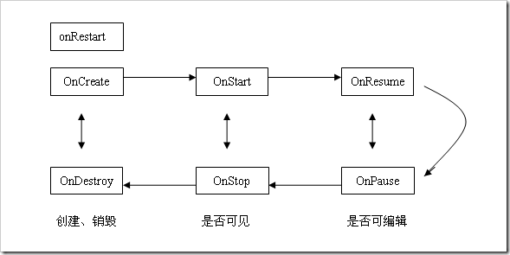
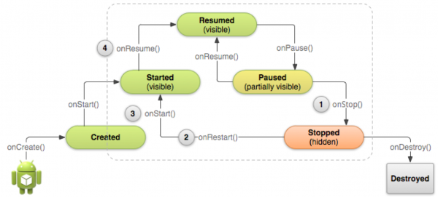
參考
https://dotblogs.com.tw/pou/2013/06/05/105285 https://desolve.blogspot.com/2013/03/android-android-developer-note_21.html https://litotom.com/2017/05/25/ch5-4-activity-lifecycle/ https://blog.csdn.net/hyz5159037/article/details/8151463
看書
打開書
闔上書
取書
放回書架
想看書(Activity)
Notes:
我們把Activity比作一本書，我們要看書，首先從書架上取出書（onCreate），然後放到桌上（onStart），接著打開書（onResume），這樣我們就可以看書並可以在書本上寫字了。如果這時候我們要啟動另一個Activity，也就是要看另一本書，首先我們放下手中的筆或者說合上書（onPause），然後從書架上拿下另一本書（書2：onCreate），然後把書本2放到桌上並打開（書2：onStart、onResume）。

