Slide 1


Slide 2

Hsinchu, Taiwan
3:00 AM
CONVOLUTIONAL NEURAL NETWORK
9:00 AM, GMT

Slide 3
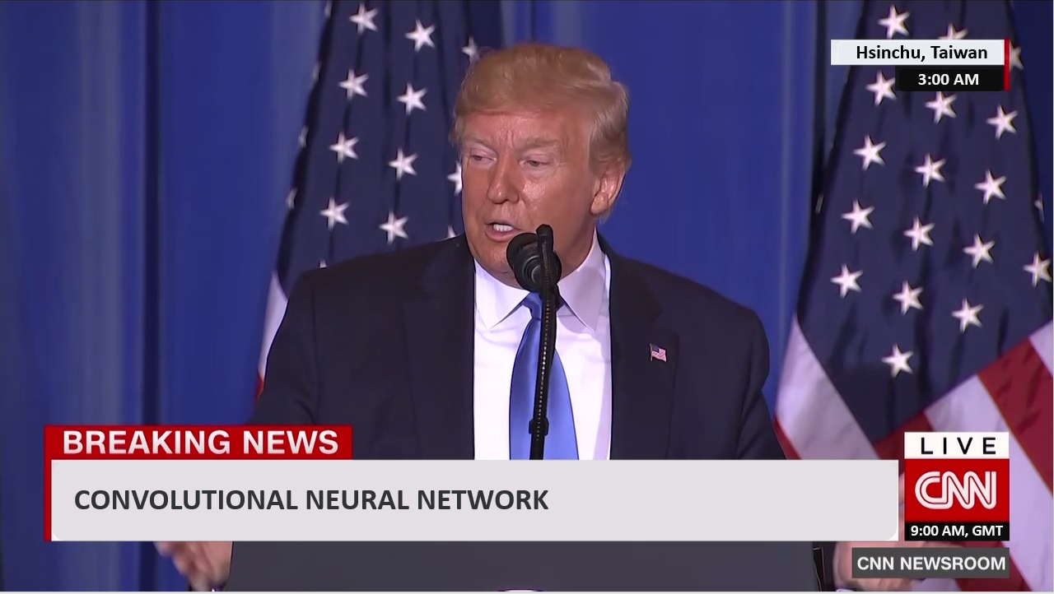
https://www.youtube.com/watch?v=FrKWiRv254g
PPT http://speech.ee.ntu.edu.tw/~tlkagk/courses/ML_2016/Lecture/CNN%20(v2).pdf
https://www.instagram.com/p/BqDFVgRF863/?fbclid=IwAR0pXP7HB0giMVR3uAxr5FtH75hXaUCzBjI-kxmem_k-zzfZfUjPKlhCwQ4

Slide 4

Question???

