Slide 1
股票搓合
2020寒訓

Slide 2
股票交易
委託：
限價委託：投資人自行決定買賣價格
市價委託：依當時市場交易的價格撮合交易 一定要買到或賣到某股票時，採用市價委託

Slide 3
搓合
價格優先
買方(bid)：出價高的優先
賣方(ask)：出價低的優先
時間優先
先下單的先成交
價格優先＞時間優先

Slide 4
股價決定
如果成交在買價賣價相同處，則該價格為成交價
如果成交在買價比賣價高的地方，則賣價為成交價

Slide 5
例子1
順序 | 動作
1 | buy 10 shares at 100
2 | sell 1 shares at 120
3 | sell 20 shares at 110
4 | buy 30 shares at 110
5 | sell 10 shares at 99
6 | buy 1 shares at 120

Slide 6
例子1
順序 | 動作
1 | buy 10 shares at 100
2 | sell 1 shares at 120
3 | sell 20 shares at 110
4 | buy 30 shares at 110
5 | sell 10 shares at 99
6 | buy 1 shares at 120
委買 |  | 委賣
價格 | 股數 | 價格 | 股數
100 | 10
T | Ask | Bid | Price
1 | - | 100 | -

Slide 7
例子1
順序 | 動作
1 | buy 10 shares at 100
2 | sell 1 shares at 120
3 | sell 20 shares at 110
4 | buy 30 shares at 110
5 | sell 10 shares at 99
6 | buy 1 shares at 120
委買 |  | 委賣
價格 | 股數 | 價格 | 股數
100 | 10 | 120 | 1
T | Ask | Bid | Price
1 | - | 100 | -
2 | 120 | 100 | -

Slide 8
例子1
賣方：出價低的優先
委買 |  | 委賣
價格 | 股數 | 價格 | 股數
100 | 10 | 120 | 1
 |  | 110 | 20
順序 | 動作
1 | buy 10 shares at 100
2 | sell 1 shares at 120
3 | sell 20 shares at 110
4 | buy 30 shares at 110
5 | sell 10 shares at 99
6 | buy 1 shares at 120
T | Ask | Bid | Price
1 | - | 100 | -
2 | 120 | 100 | -
3 | 110 | 100 | -
委買 |  | 委賣
價格 | 股數 | 價格 | 股數
100 | 10 | 110 | 20
 |  | 120 | 1

Slide 9
例子1
買方：出價高的優先
買價賣價相同
該價格為成交價
委買 |  | 委賣
價格 | 股數 | 價格 | 股數
100 | 10 | 110 | 20
 |  | 120 | 1
順序 | 動作
1 | buy 10 shares at 100
2 | sell 1 shares at 120
3 | sell 20 shares at 110
4 | buy 30 shares at 110
5 | sell 10 shares at 99
6 | buy 1 shares at 120
T | Ask | Bid | Price
1 | - | 100 | -
2 | 120 | 100 | -
3 | 110 | 100 | -
4 |  |  | 110
委買 |  | 委賣
價格 | 股數 | 價格 | 股數
100 | 10 | 120 | 1
110 | 10

Slide 10
例子1
買方：出價高的優先
委買 |  | 委賣
價格 | 股數 | 價格 | 股數
100 | 10 | 120 | 1
110 | 10
順序 | 動作
1 | buy 10 shares at 100
2 | sell 1 shares at 120
3 | sell 20 shares at 110
4 | buy 30 shares at 110
5 | sell 10 shares at 99
6 | buy 1 shares at 120
T | Ask | Bid | Price
1 | - | 100 | -
2 | 120 | 100 | -
3 | 110 | 100 | -
4 | 120 | 110 | 110
委買 |  | 委賣
價格 | 股數 | 價格 | 股數
110 | 10 | 120 | 1
100 | 10

Slide 11
例子1
買價比賣價高
賣價為成交價
委買 |  | 委賣
價格 | 股數 | 價格 | 股數
110 | 10 | 120 | 1
100 | 10
順序 | 動作
1 | buy 10 shares at 100
2 | sell 1 shares at 120
3 | sell 20 shares at 110
4 | buy 30 shares at 110
5 | sell 10 shares at 99
6 | buy 1 shares at 120
T | Ask | Bid | Price
1 | - | 100 | -
2 | 120 | 100 | -
3 | 110 | 100 | -
4 | 120 | 110 | 110
5 | 120 | 100 | 99
委買 |  | 委賣
價格 | 股數 | 價格 | 股數
100 | 10 | 120 | 1

Slide 12
例子1
買方：出價高的優先
委買 |  | 委賣
價格 | 股數 | 價格 | 股數
100 | 10 | 120 | 1
順序 | 動作
1 | buy 10 shares at 100
2 | sell 1 shares at 120
3 | sell 20 shares at 110
4 | buy 30 shares at 110
5 | sell 10 shares at 99
6 | buy 1 shares at 120
T | Ask | Bid | Price
1 | - | 100 | -
2 | 120 | 100 | -
3 | 110 | 100 | -
4 | 120 | 110 | 110
5 | 120 | 100 | 99
6 | - | 100 | 120
委買 |  | 委賣
價格 | 股數 | 價格 | 股數
100 | 10

Slide 13
例子2
順序 | 動作
1 | sell 10 shares at 100
2 | buy 1 shares at 80
3 | buy 20 shares at 90
4 | sell 30 shares at 90
5 | buy 10 shares at 101
6 | sell 1 shares at 80

Slide 14
例子2
順序 | 動作
1 | sell 10 shares at 100
2 | buy 1 shares at 80
3 | buy 20 shares at 90
4 | sell 30 shares at 90
5 | buy 10 shares at 101
6 | sell 1 shares at 80
委買 |  | 委賣
價格 | 股數 | 價格 | 股數
 |  | 100 | 10
T | Ask | Bid | Price
1 | 100 | - | -
2
3
4
5
6

Slide 15
例子2
委買 |  | 委賣
價格 | 股數 | 價格 | 股數
80 | 1 | 100 | 10
順序 | 動作
1 | sell 10 shares at 100
2 | buy 1 shares at 80
3 | buy 20 shares at 90
4 | sell 30 shares at 90
5 | buy 10 shares at 101
6 | sell 1 shares at 80
委買 |  | 委賣
價格 | 股數 | 價格 | 股數
 |  | 100 | 10
T | Ask | Bid | Price
1 | 100 | - | -
2 | 100 | 80 | -
3
4
5
6
T | Ask | Bid | Price
1 | 100 | - | -
2
3
4
5
6

Slide 16
例子2
委買 |  | 委賣
價格 | 股數 | 價格 | 股數
80 | 1 | 100 | 10
順序 | 動作
1 | sell 10 shares at 100
2 | buy 1 shares at 80
3 | buy 20 shares at 90
4 | sell 30 shares at 90
5 | buy 10 shares at 101
6 | sell 1 shares at 80
委買 |  | 委賣
價格 | 股數 | 價格 | 股數
90 | 20 | 100 | 10
80 | 1
T | Ask | Bid | Price
1 | 100 | - | -
2 | 100 | 80 | -
3 | 100 | 90 | -
4
5
6
T | Ask | Bid | Price
1 | 100 | - | -
2 | 100 | 80 | -
3
4
5
6

Slide 17
例子2
委買 |  | 委賣
價格 | 股數 | 價格 | 股數
90 | 20 | 100 | 10
80 | 1
委買 |  | 委賣
價格 | 股數 | 價格 | 股數
80 | 1 | 100 | 10
順序 | 動作
1 | sell 10 shares at 100
2 | buy 1 shares at 80
3 | buy 20 shares at 90
4 | sell 30 shares at 90
5 | buy 10 shares at 101
6 | sell 1 shares at 80
委買 |  | 委賣
價格 | 股數 | 價格 | 股數
80 | 1 | 90 | 10
 |  | 100 | 10
T | Ask | Bid | Price
1 | 100 | - | -
2 | 100 | 80 | -
3 | 100 | 90 | -
4
5
6
 | 90 | 80 | 90

Slide 18
例子2
委買 |  | 委賣
價格 | 股數 | 價格 | 股數
80 | 1 | 90 | 10
 |  | 100 | 10
順序 | 動作
1 | sell 10 shares at 100
2 | buy 1 shares at 80
3 | buy 20 shares at 90
4 | sell 30 shares at 90
5 | buy 10 shares at 101
6 | sell 1 shares at 80
委買 |  | 委賣
價格 | 股數 | 價格 | 股數
80 | 1 | 100 | 10
T | Ask | Bid | Price
1 | 100 | - | -
2 | 100 | 80 | -
3 | 100 | 90 | -
4 | 90 | 80 | 90
5
6
 | 100 | 80 | 90

Slide 19
例子2
委買 |  | 委賣
價格 | 股數 | 價格 | 股數
80 | 1 | 100 | 10
順序 | 動作
1 | sell 10 shares at 100
2 | buy 1 shares at 80
3 | buy 20 shares at 90
4 | sell 30 shares at 90
5 | buy 10 shares at 101
6 | sell 1 shares at 80
委買 |  | 委賣
價格 | 股數 | 價格 | 股數
 |  | 100 | 10
 | 100 | - | 80
T | Ask | Bid | Price
1 | 100 | - | -
2 | 100 | 80 | -
3 | 100 | 90 | -
4 | 90 | 80 | 90
5 | 100 | 80 | 90
6

Slide 20
練習
# 處理列印
if not sell: # 如果空了
print('-', end=' ')
else:
print(sell[0][0], end=' ')
if not buy:
print('-', end=' ')
else:
print(buy[0][0], end=' ')
if stockprice == -1:
print('-')
else:
print(stockprice)
http://140.113.87.172:8080/ShowProblem?problemid=a095
T = int(input())
for t in range(T):
N = int(input())
buy = []
sell = []
stockprice = -1
for n in range(N):
sth. to write

Slide 21
Pseudo code
for 每筆委託單:
處理委託單字串: split, 委託單價, 量
if 委託單 == 'buy':
while 委賣list有東西:
可搓合 = 委賣list[0]
if 可搓合價>委託單價格: 不交易
成交量 = min(可搓合量, 委託單量)
成交價 =可搓合價
可搓合量, 委託單量 -= 成交量
if 可搓合量 == 0: del 委賣list[0]
if 委託單量 == 0: 交易結束
if 委託單量 > 0:
if 委託單價格 == 委買單裡的某價格:
該委買單量 +=委託單量
else:
委買單.insert(位置, [委託單價,委託單量])
else: #委託單 == 'sell'
…

Slide 22
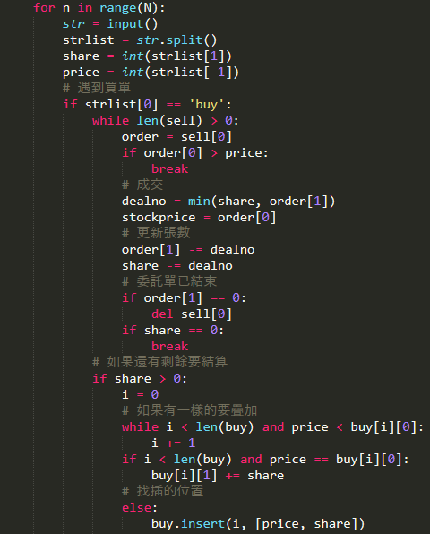
Part of the answer
只要互換buy和sell即可？

Slide 23
Hints
如果委託單是賣， 可搓合價 委託單價格：不做交易？
成交價是可搓合價or委託單價格？
結算剩餘時，隨著i增加， 委賣價格會越大/小？
>
<

Slide 24
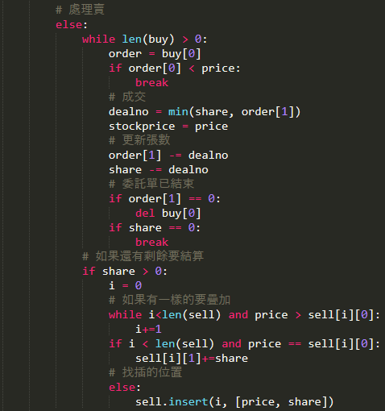
The rest part of the answer
The final code is here.

