Slide 1
Exercise1
104403512 吳宛儒
2017.10.17
01

Slide 2
Homework
struct stack { /* a stack of integers */
int top; /* indicate the position of the
current stack top within the array */
int items [STACKSIZE];
};
struct stack s;
s.top = 0; /*initiate a stack and the stack is
empty */
Please implement IsEmpty(s), IsFull(s), Add(s), and Delete(s)
02

Slide 3
Answers
Implement IsEmpty(s), IsFull(s), Add(s), and Delete(s)
Using C++
03

Slide 4
IsEmpty(s)
↓stack *s 指標
指向s這個堆疊
int IsEmpty(stack *s){
if(s->top==0){
return 1;
}else{
return 0;
}
}
← s->top==0
代表空堆疊
← 回傳整數1代表空堆疊
0代表不是空的堆疊
04

Slide 5
IsFull(s)
int IsFull(stack *s){
if(s->top>=MAXLEN){
return 1;
}else{
return 0;
}
}
← s->top>=MAXLEN
代表堆疊已達最大容量上限
← 回傳整數1代表滿了
0代表堆疊未滿
05

Slide 6
Add(s)
↓int item代表
要加入的元素
void Add(int item,stack *s){
if(IsFull(s)){
printf("Stack is full!\n");
}
else{
s->top++;
s->items[s->top]=item;
}
}
← 如果堆疊滿了
← 如果堆疊還沒滿
← top指向新的頂端
← 將item放入新的頂端
06

Slide 7
Delete(s)
int Delete(stack *s){
if(IsEmpty(s)){
printf("Stack is empty!\n");
}else{
int data = s->items[s->top];
s->top--;
return data;
}
}
← 如果堆疊為空
← 如果堆疊不是空的
← 將堆疊最上層放入data變數
← top-1 堆疊少一個元素
← 回傳剛剛從堆疊拿出來的data
07

Slide 8
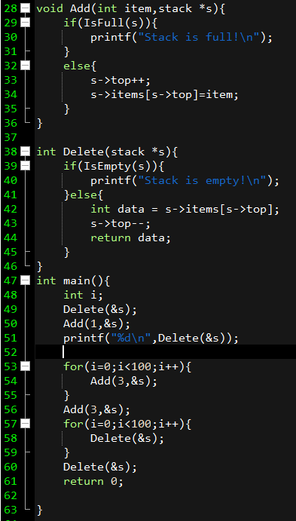
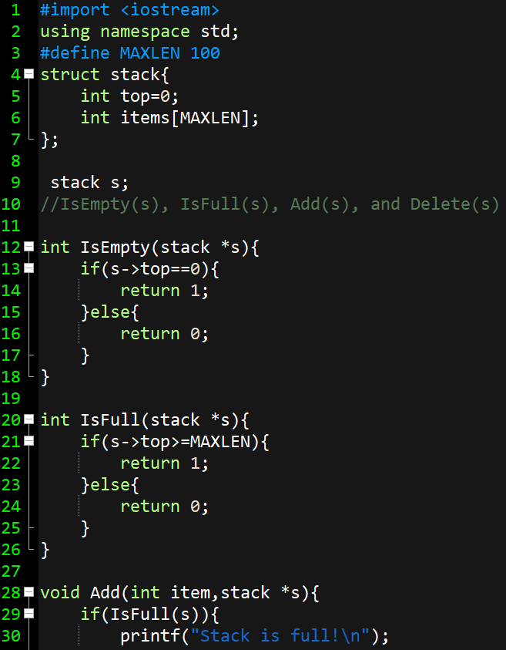
Complete Code
定義stack結構:
  top初始值為零、
  items陣列
宣告stack s
主程式main()
08

