Slide 1
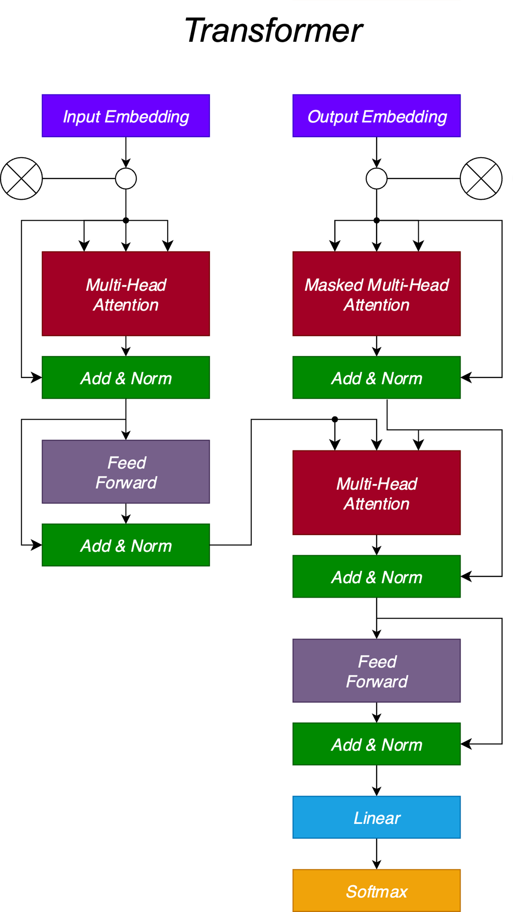
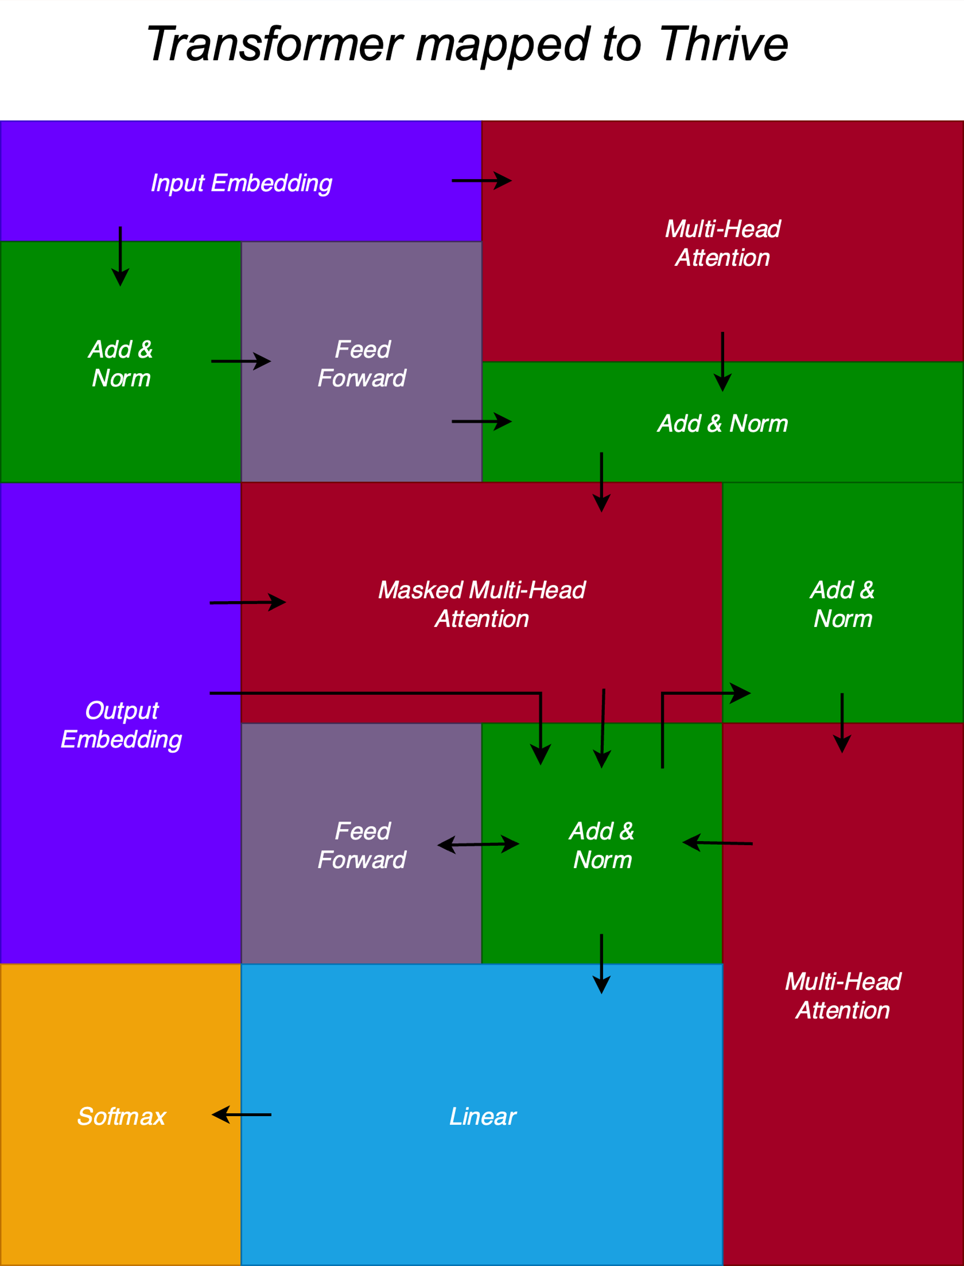

Slide 2
Input Embedding
Input Embedding
Multi-head Attention
Masked
Multi-head Attention
Add & Norm
Add & Norm
Feed Forward
Multi-head Attention
Add & Norm
Add & Norm
Feed Forward
Add & Norm
Linear
Softmax

