Slide 1
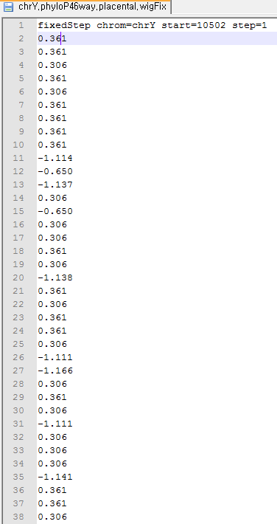
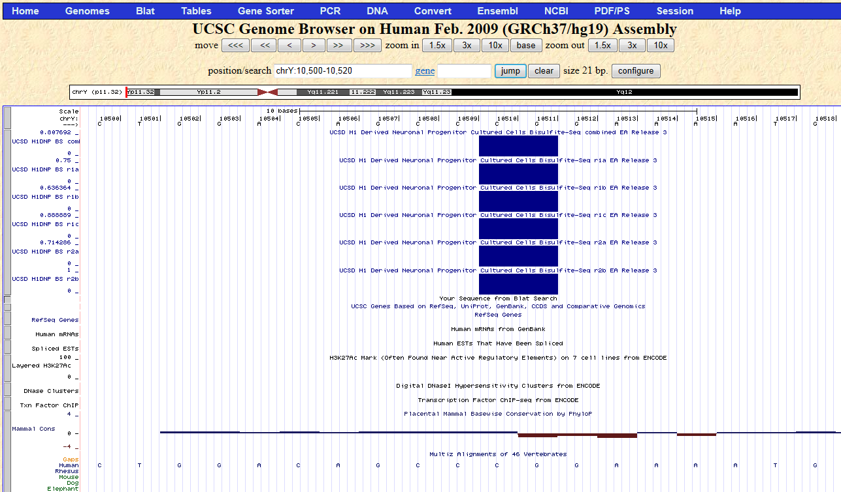
Zero-Based vs. One-Based Coordinates

Slide 2
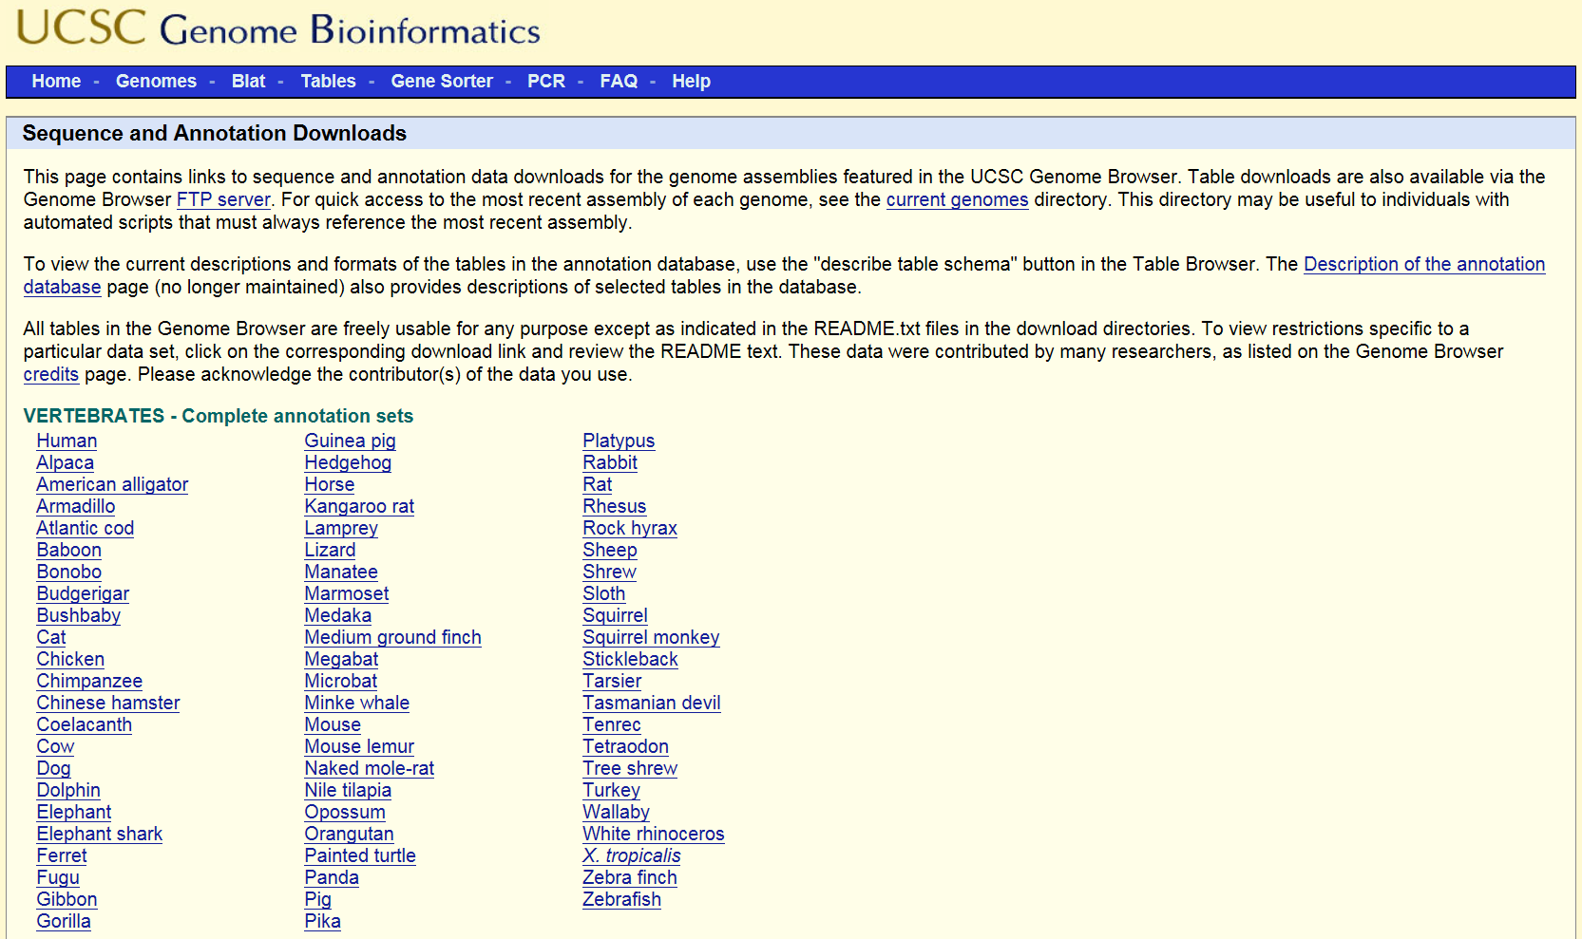
Annotation Files

Slide 3
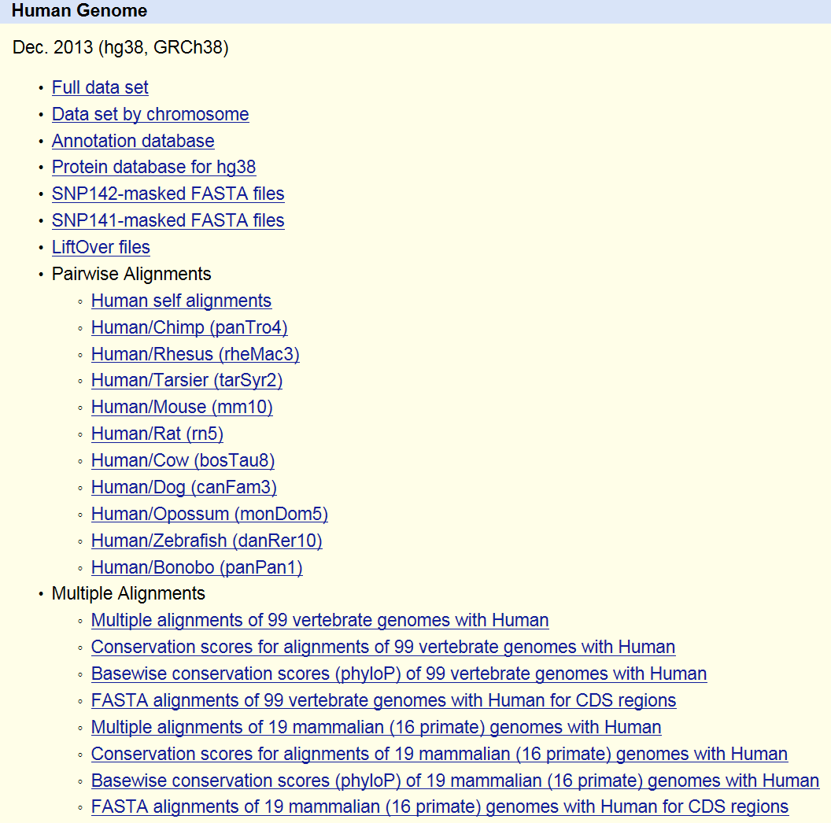
Annotation Files

Slide 4
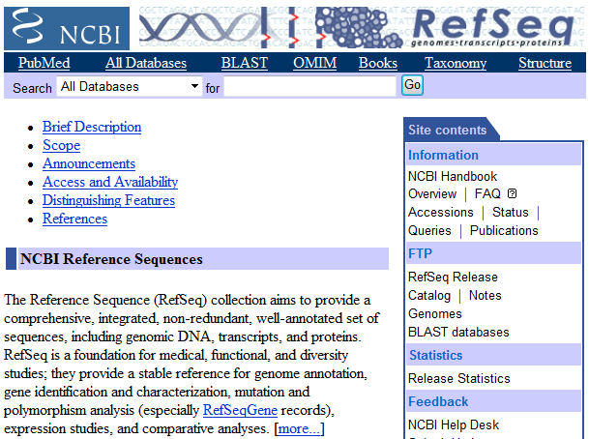
RefSeq

Slide 5
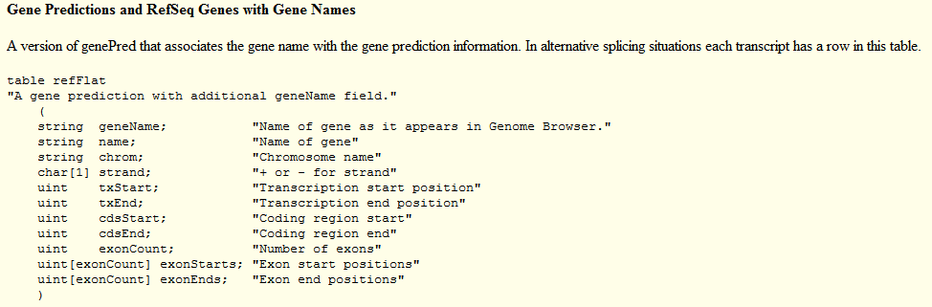
RefFlat: RefSeq Alignment by BLAT

Slide 6
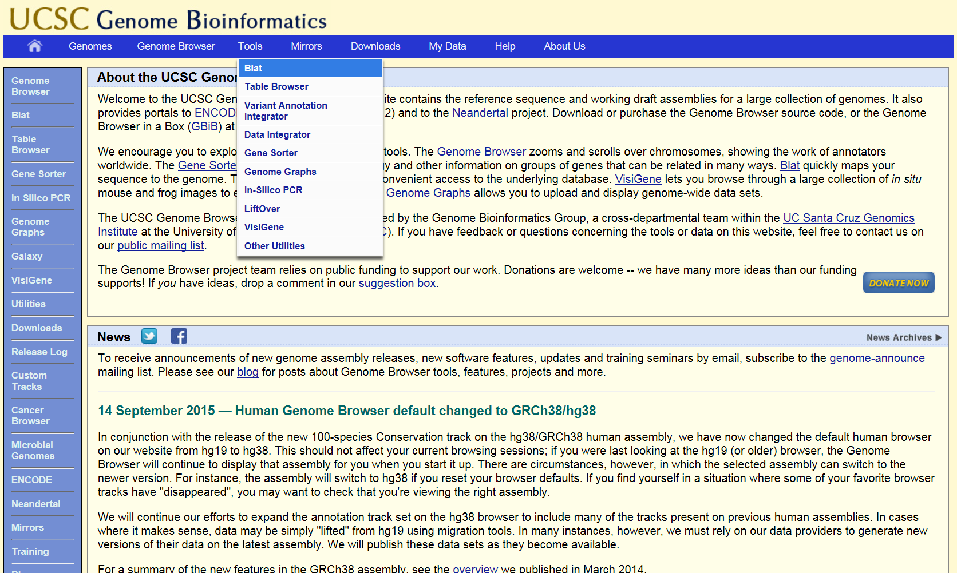
BLAT Alignment

Slide 7
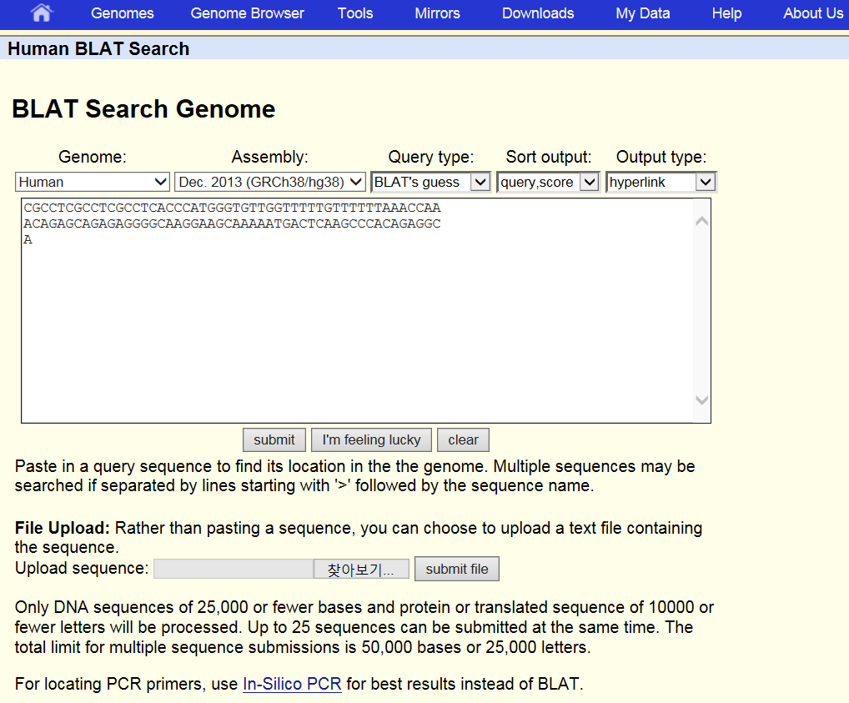
BLAT Alignment

Slide 8
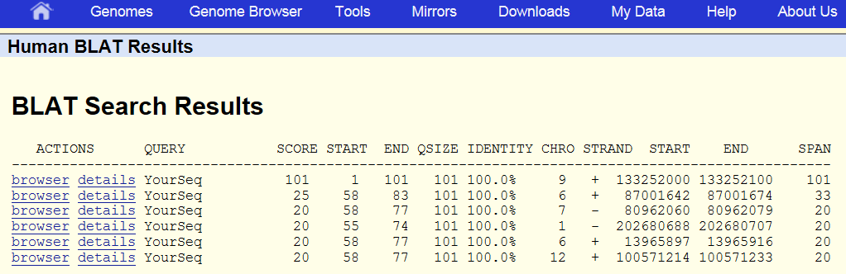
BLAT Alignment

Slide 9
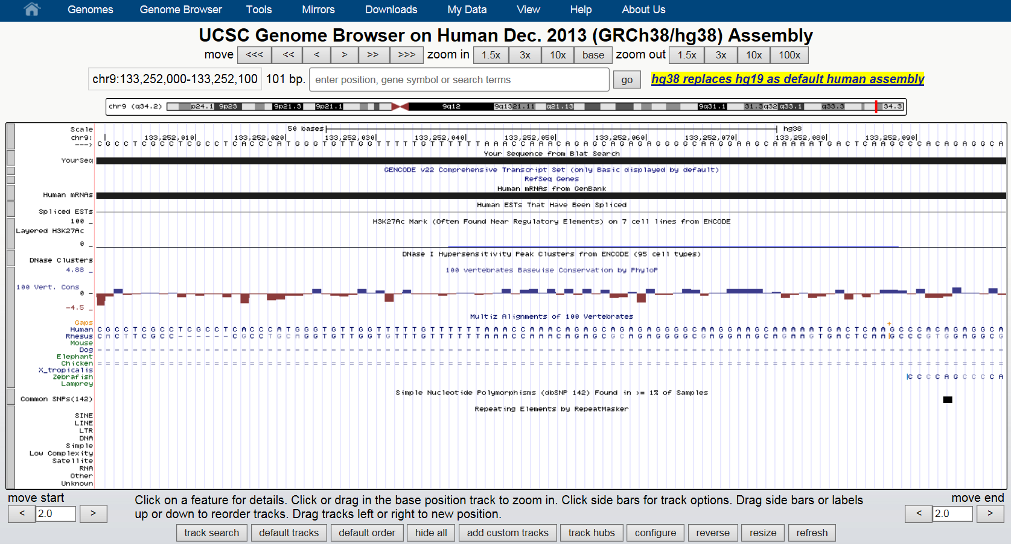
BLAT Alignment

Slide 10
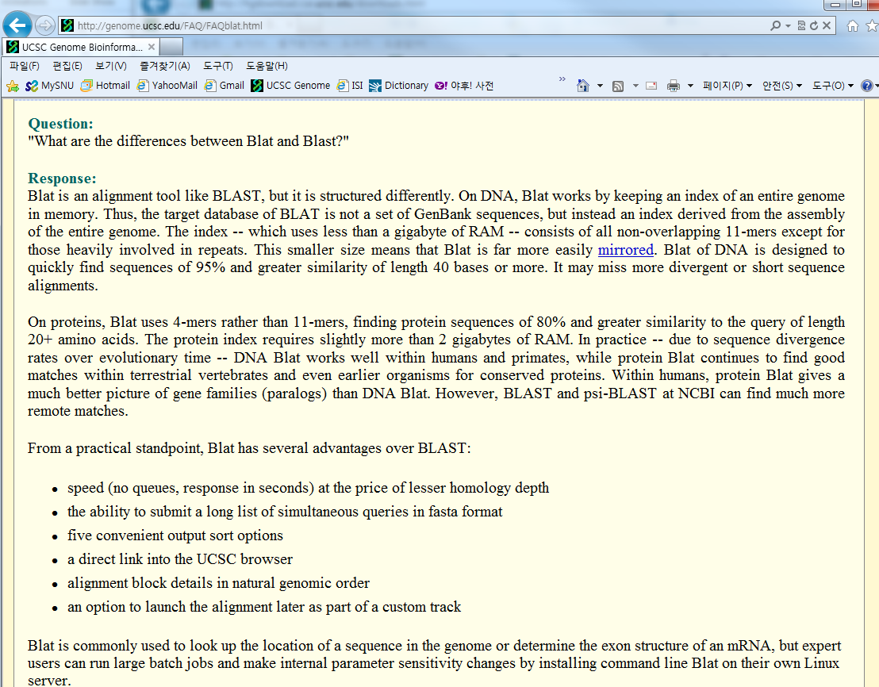
BLAT

Slide 11
Mission 2
Due April 21st Sunday 11:59pm
1. Use the provided mission 2 template.
3. Submit a single source code file.
4. Observe the Programming Suggestions.
Submit your files via email to baek@snu.ac.kr
Please make sure to use the following header.
[생물정보학] Mission2
Please make sure to include your name in the file names that you submit.
Mission2_DBaek_백대현.xlsx
Mission2_DBaek_백대현.py

Slide 12
Mission 2
Read the RefFlat file, and parse the information, and store them into a list of class objects with your own design of instance variables and methods.
Your class should include instance variables that correspond to the following data structure.
[Data Structure]
RefSeq ID
Gene Symbol
Chromosome ID (e.g., 1,2,…,22,23 for X, and 24 for Y)
Strand
Num of Exons
*Exon Start Positions,
*Exon End Positions

Slide 13
More Details on Mission 2
Use the RefFlat file provided on 11/25/18. Count the number of entries in the RefFlat file. ➔ Answer 1
Remove non-NM sequences and keep the ones aligned only on chr 1-22, X, or Y. Count the number of entries left. ➔ Answer 2
Remove NM sequences that have multiple entries in the RefFlat file. Count the number of entries left. ➔ Answer 3
Sort the list of the RefSeq class objects by the ascending order of the RefSeq ID (not a string but an integer), and store the RefSeq ID and the Gene Symbol in the provided template file.

Slide 14
Useful Tips
Estimated run time: <1 min
class cRefSeq:
def __init__(self):
self.sGeneSym = ‘NULL’
self.sNMID = ‘NULL’
self.nChrID = 0
……
def parse_refflat_line(self, sReadLine):
……
def get_NMID(self):
return self.sNMID
……
cRefSeqList = []
for sReadLine in InFile.readlines():
cReadRefSeq = cRefSeq()
cReadRefSeq.parse_refflat_line(sReadLine)
cRefSeqList.append(cReadRefSeq)
……
……
cRefSeqList.sort(key = cRefSeq.get_NMID) ……
OutFile = open(sOutFileName, ‘w’)
for cRefSeq in cRefSeqList:
print( cRefSeq.sNMID, cRefSeq.sGeneSym,
sep=‘\t’, end=‘\n’, file=OutFile )
……

