Slide 1
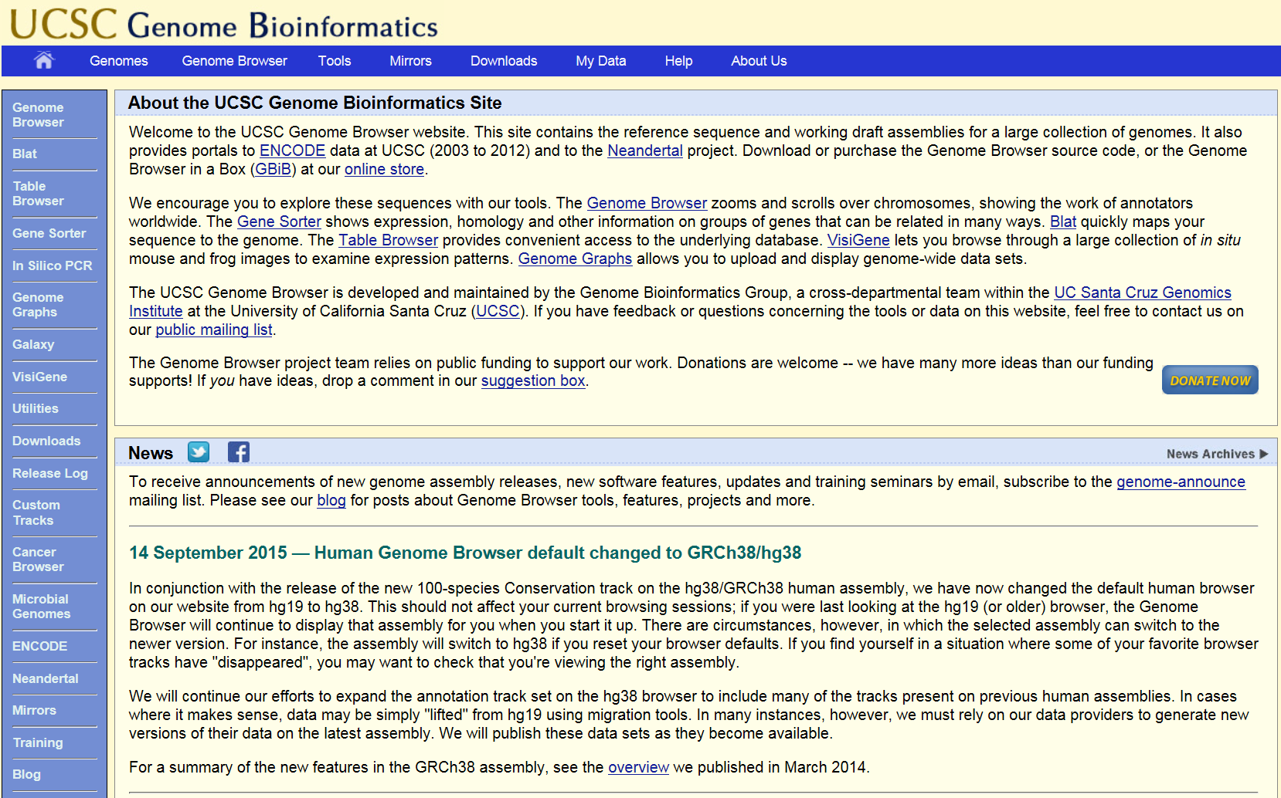
UCSC Genome Browser

Slide 2
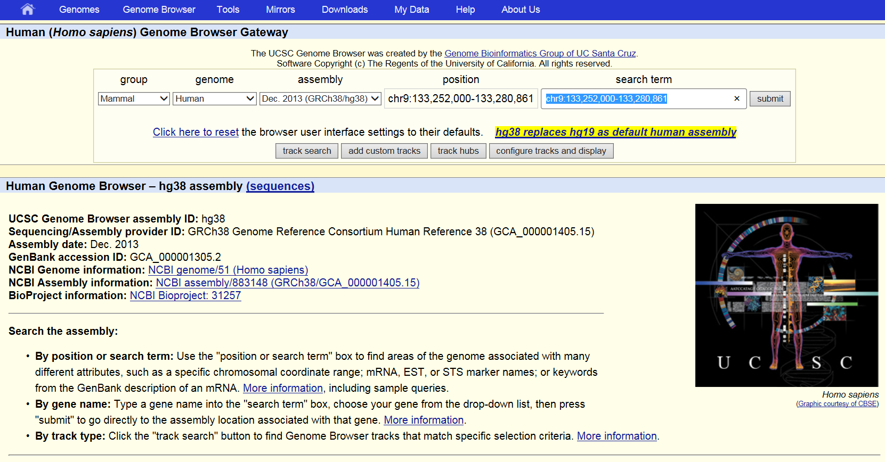
UCSC Genome Browser

Slide 3
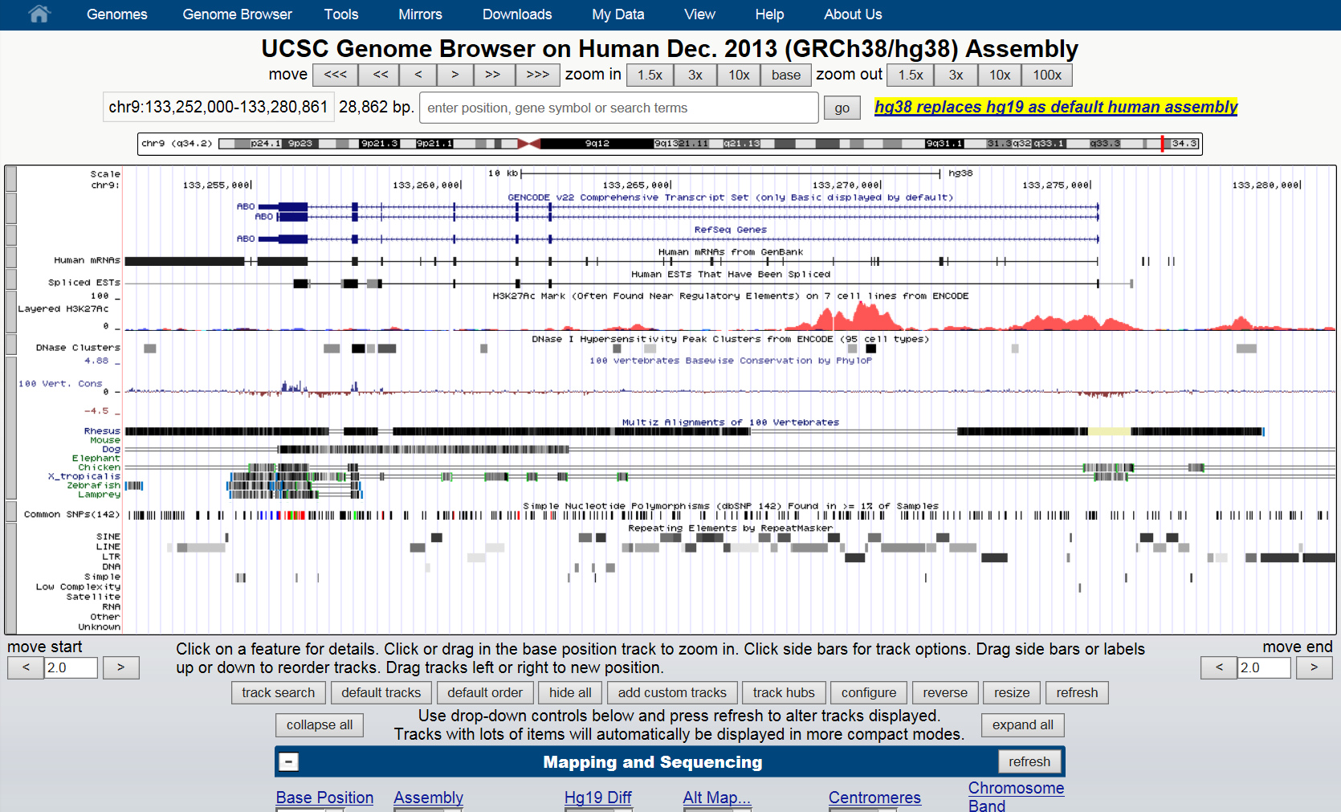
UCSC Genome Browser

Slide 4
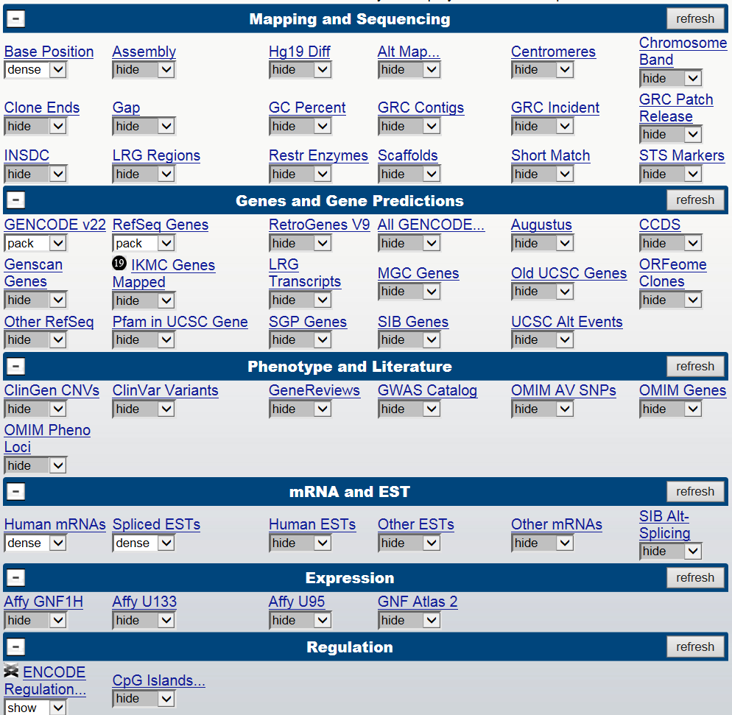
UCSC Genome Browser

Slide 5
Annotation Files

Slide 6
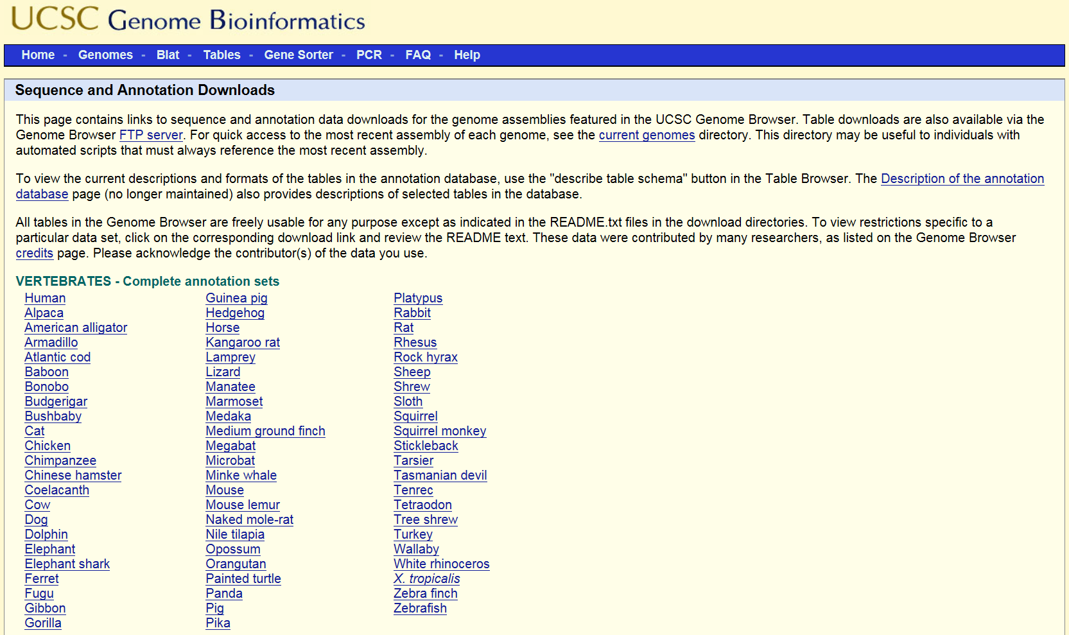
Annotation Files

Slide 7
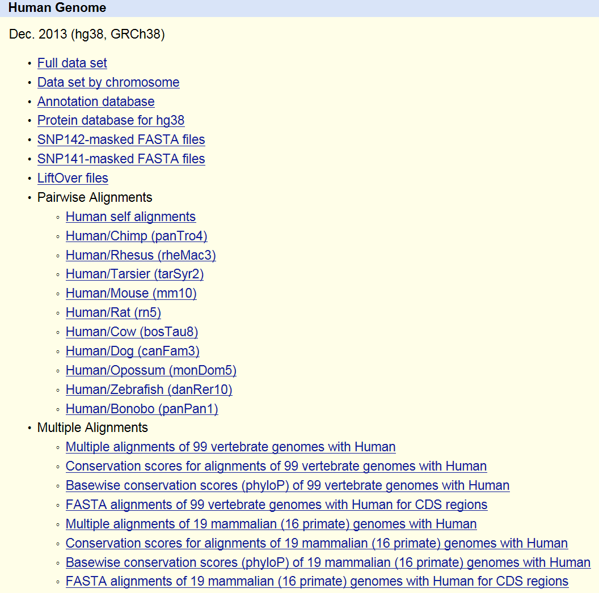
Annotation Files

Slide 8
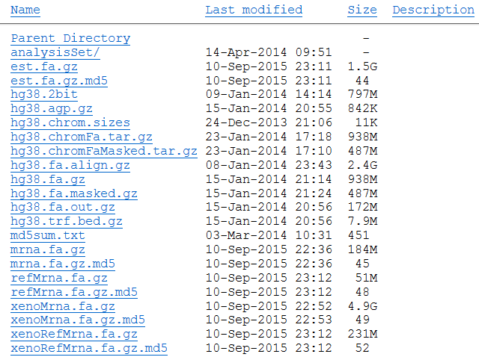
Full Dataset

Slide 9
Mission 0
Count the numbers of mono-nucleotides present in the human chromosome 2 and compute their relative frequencies. Use the unmasked sequence of hg38.
Do not use the built-in Python count function.

Slide 10
Mission 0
Due April 7th Sunday 11:59pm
1. Use the provided mission 0 template.
2. Submit a single source code file.
3. Observe the Programming Suggestions.
Submit your files via email to baek@snu.ac.kr
Please make sure to use the following header.
[생물정보학] Mission0
Please make sure to include your name in the file names that you submit.
Mission0_DBaek_백대현.xlsx
Mission0_DBaek_백대현.py

Slide 11
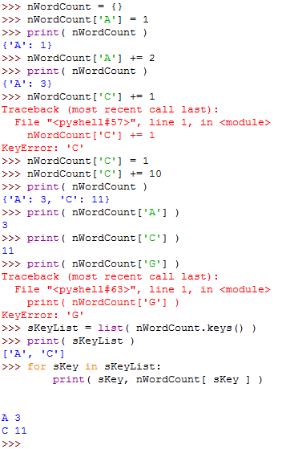
Useful Tips - Python Dictionary

Slide 12
Useful Tips
Estimated run time: <10 mins
import sys, time
sys.exit(sErrorMessage)
print( time.ctime() )
file.readline() vs.
file.read() ➔ much faster for larger files
sSeq = ‘AAACCCGGGTTT’
nDic = {}
for sNuc in sSeq:
/// USE DICTIONARY HERE ///
sKeyList = sorted(nDic.keys())
print(sKeyList)
for sKey in sKeyList:
print( sKey, nDic[sKey] )

Slide 13
Programming Suggestions
Think carefully first! Write down your plans and pseudo-codes.
Data structure
Algorithms
Available tools and existing modules
Resources: CPU, RAM, and HDD space
Sanity and validity checks
Modular programming
Variable names: e.g., nChrID, fConScore, bFoundFlag, cResidue, sGeneSym, …
Comments and explicit ends of loops
Consistent indentation and spacing
Toy examples

