Slide 1
Mission 1
1. Perform the following analyses.
Compute the number of mono-nucleotides and their relative frequencies in the human genome (22 autosomes only. Use unmasked sequences.)
Compute the number of di-nucleotides, their relative frequencies, and their expected frequencies inferred from the mono-nucleotide frequencies. Indicate substantially over- or under-represented di-nucleotides if there exist.
2. Repeat the analyses for the following 4 organisms.
Organisms Chromosomes to analyze
Human(hg38): 22: 1~22
Chicken(galGal3): 29: 1~28, and 32
D. melanogaster(dm3): 5: 2R, 2L, 3R, 3L, and 4
C. elegans(ce10): 5: I, II, III, IV, and V
3. Briefly discuss about the biological reasons for the results that you observed.

Slide 2
Mission 1
Due April 14th Sunday 11:59pm
1. Use the provided mission 1 template.
3. Submit a single source code file.
4. Observe the Programming Suggestions.
Submit your files via email to baek@snu.ac.kr
Please make sure to use the following header.
[생물정보학] Mission1
Please make sure to include your name in the file names that you submit.
Mission1_DBaek_백대현.xlsx
Mission1_DBaek_백대현.py

Slide 3
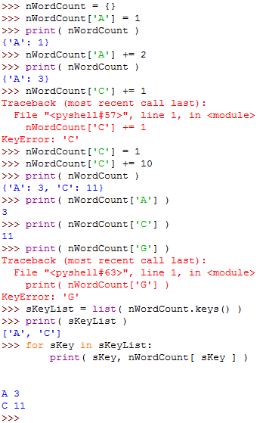
Useful Tips - Python Dictionary

Slide 4
Useful Tips
Estimated run time for human: <100 mins
import sys, time
sys.exit(sErrorMessage)
print( time.ctime() )
file.readline() vs.
file.read() ➔ much faster for larger files
sSeq = ‘AAACCCGGGTTT’
nDic = {}
for sNuc in sSeq:
try: nDic[sNuc] += 1
except KeyError:
nDic[sNuc] = 1
sKeyList = sorted(nDic.keys())
print(sKeyList)
for sKey in sKeyList:
print( sKey, nDic[sKey] )

Slide 5
Programming Suggestions
Think carefully first! Write down your plans and pseudo-codes.
Data structure
Algorithms
Available tools and existing modules
Resources: CPU, RAM, and HDD space
Sanity and validity checks
Modular programming
Variable names: e.g., nChrID, fConScore, bFoundFlag, cResidue, sGeneSym, …
Comments and explicit ends of loops
Consistent indentation and spacing
Toy examples

