Slide 1
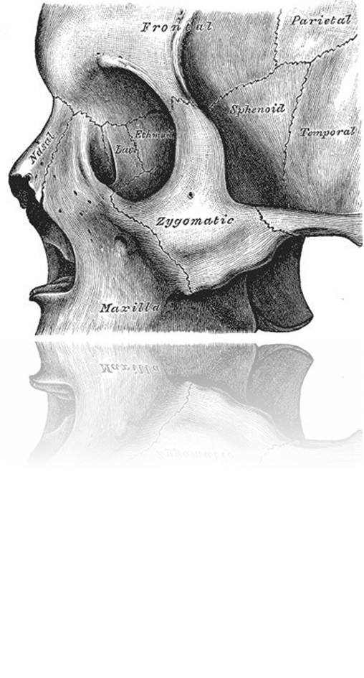
ANATOMICAL CONSIDERATIONS
Small quadrangular bone
Situated at the upper lateral part of the face
Lateral wall and floor of the orbit
Prominence of the cheek
Articulation with the frontal, sphenoidal, temporal and maxilla bones

