Slide 1
Presented by
M Divya
RECEIPT AND INVOICE DIGITILISER

Slide 2
Introduction
An OCR-based system to digitize receipts and invoices
Technology: Python, Streamlit, OCR
Automated system to digitize receipts and invoices
Uses Optical Character Recognition (OCR)
Extracts key billing information automatically
Stores data securely and provides analytics
Built using Python and Streamlit

Slide 3
Technologies Used
Python
Streamlit
Tesseract OCR
SQLite

Slide 4
Vault & Upload
Allows users to upload receipts in Image or PDF format
Supports formats: JPG, PNG, JPEG, PDF
Securely stores uploaded files for processing
Converts PDF receipts into images for OCR
Acts as the entry point of the system

Slide 5
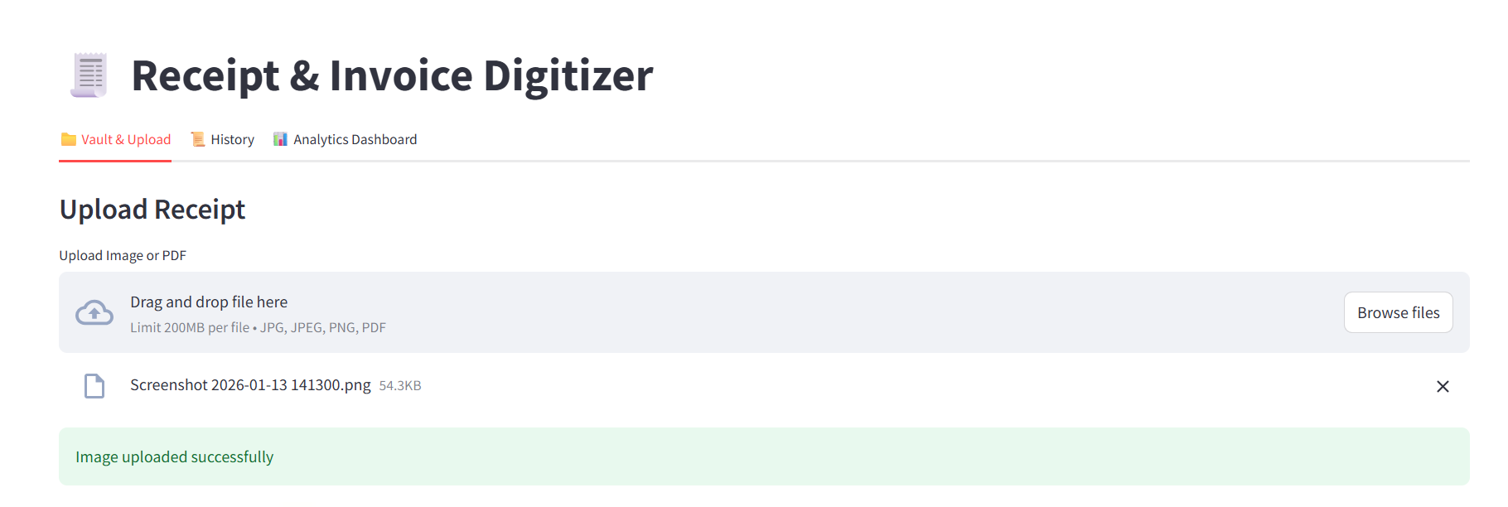
.

Slide 6
.
Original Image
Shows the uploaded receipt image or PDF page
Helps users verify the uploaded document
Maintains transparency in processing
Supports both scanned and photographed receipts
Pre-Processed Image
Image is converted to grayscale for clarity
Noise reduction is applied to improve text visibility
Image resizing improves OCR accuracy
Preprocessing enhances text recognition performance

Slide 7
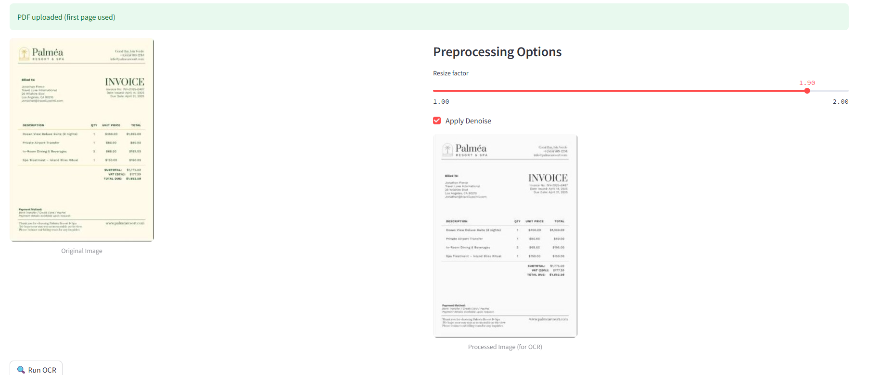
.

Slide 8
OCR (Optical Character Recognition)
.
OCR converts images containing text into machine-readable text
Tesseract OCR engine is used in this project
Helps extract text from scanned receipts
Eliminates manual data entry
Improves speed and accuracy of processing Text Extracted from OCR
OCR extracts raw text from receipt images
Extracted text includes:
  Vendor name
  Date
  Total amount
Text is processed using regular expressions
Structured data is generated from unstructured text

Slide 9
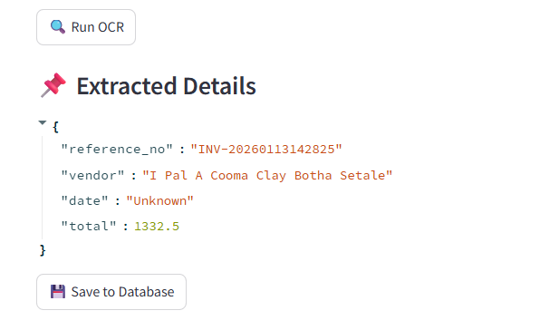
.

Slide 10
Database
Uses SQLite as the backend database
Stores extracted invoice details securely
Database fields include:
  Reference Number
  Vendor Name
  Date
  Total Amount
Lightweight and easy to integrate with Python
Ensures persistent storage of invoice data

Slide 11
.

Slide 12
History
Displays all stored invoices in a tabular format
Data is fetched directly from the database
Helps users review past transactions
Supports tracking and auditing of expenses
Improves transparency and record management

Slide 13
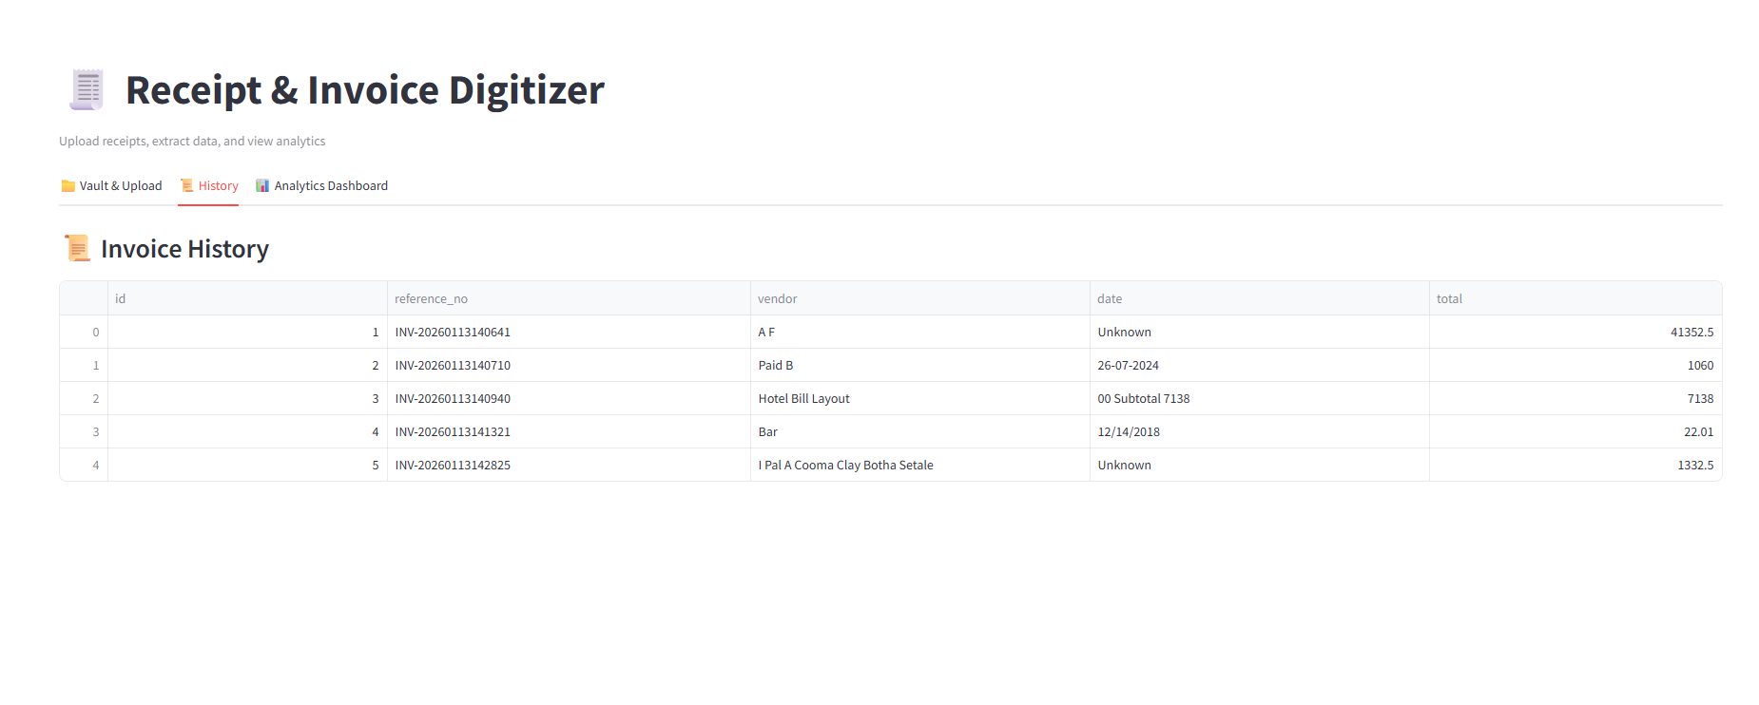
.

Slide 14
Analytical Dashboard
Provides a visual summary of stored invoice data
Uses interactive charts for better understanding
Includes:
  Pie Chart – shows spending distribution by vendor
  Bar Chart – compares total expenses across vendors
  Line Chart – displays spending trends over time
Helps identify high-spending vendors
Supports data-driven financial decisions

Slide 15
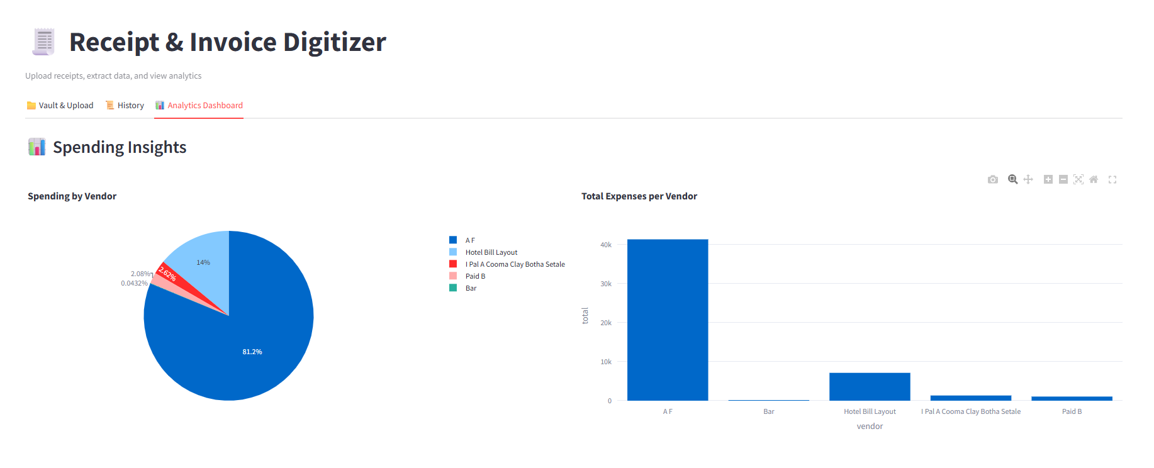
.

Slide 16
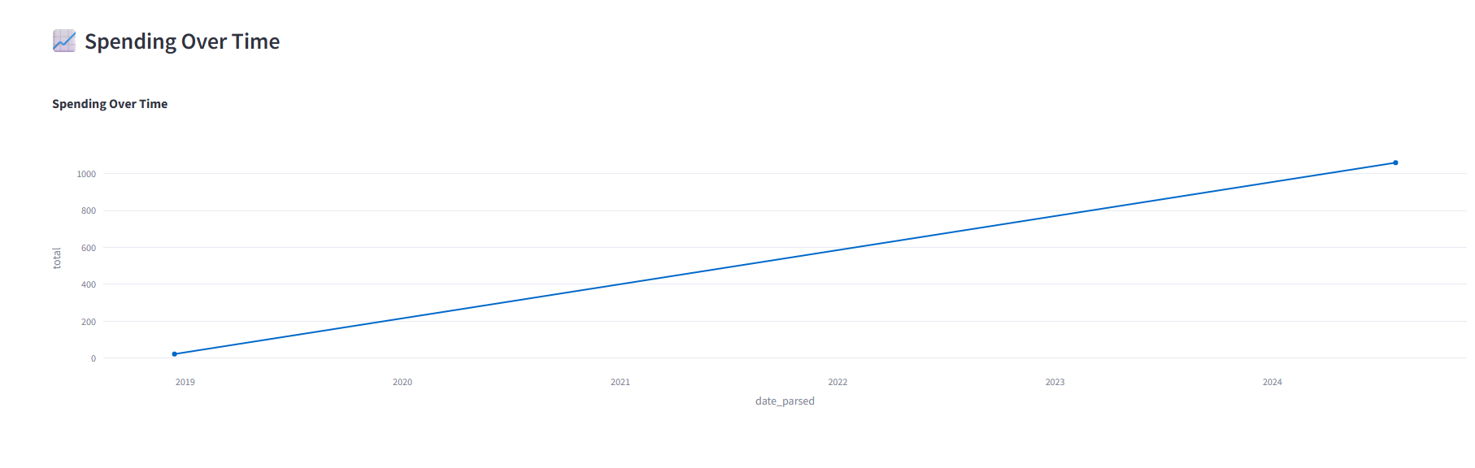
.

Slide 17
THANK YOU

