Slide 1
Death by a Thousand Shadows: Caching and Cost-Cutting on AWS IoT Core
AWS Community Day Switzerland
Matia Rašetina
He/him
Senior Software Engineer
Elixirr Digital

Slide 2
Agenda
AWS IoT Core: Devices, messages, rules and shadows
Story time: the POC that worked too hard
Pattern 1: Layered shadow reads
Pattern 2: Project smaller downstream events
Pattern 3: Migrating to Named Shadows
Key Takeaways and Q&A

Slide 3
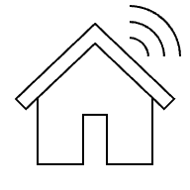



Areas of IoT
Smart Homes
Industrial
equipment
Vehicles
Healthcare

Slide 4

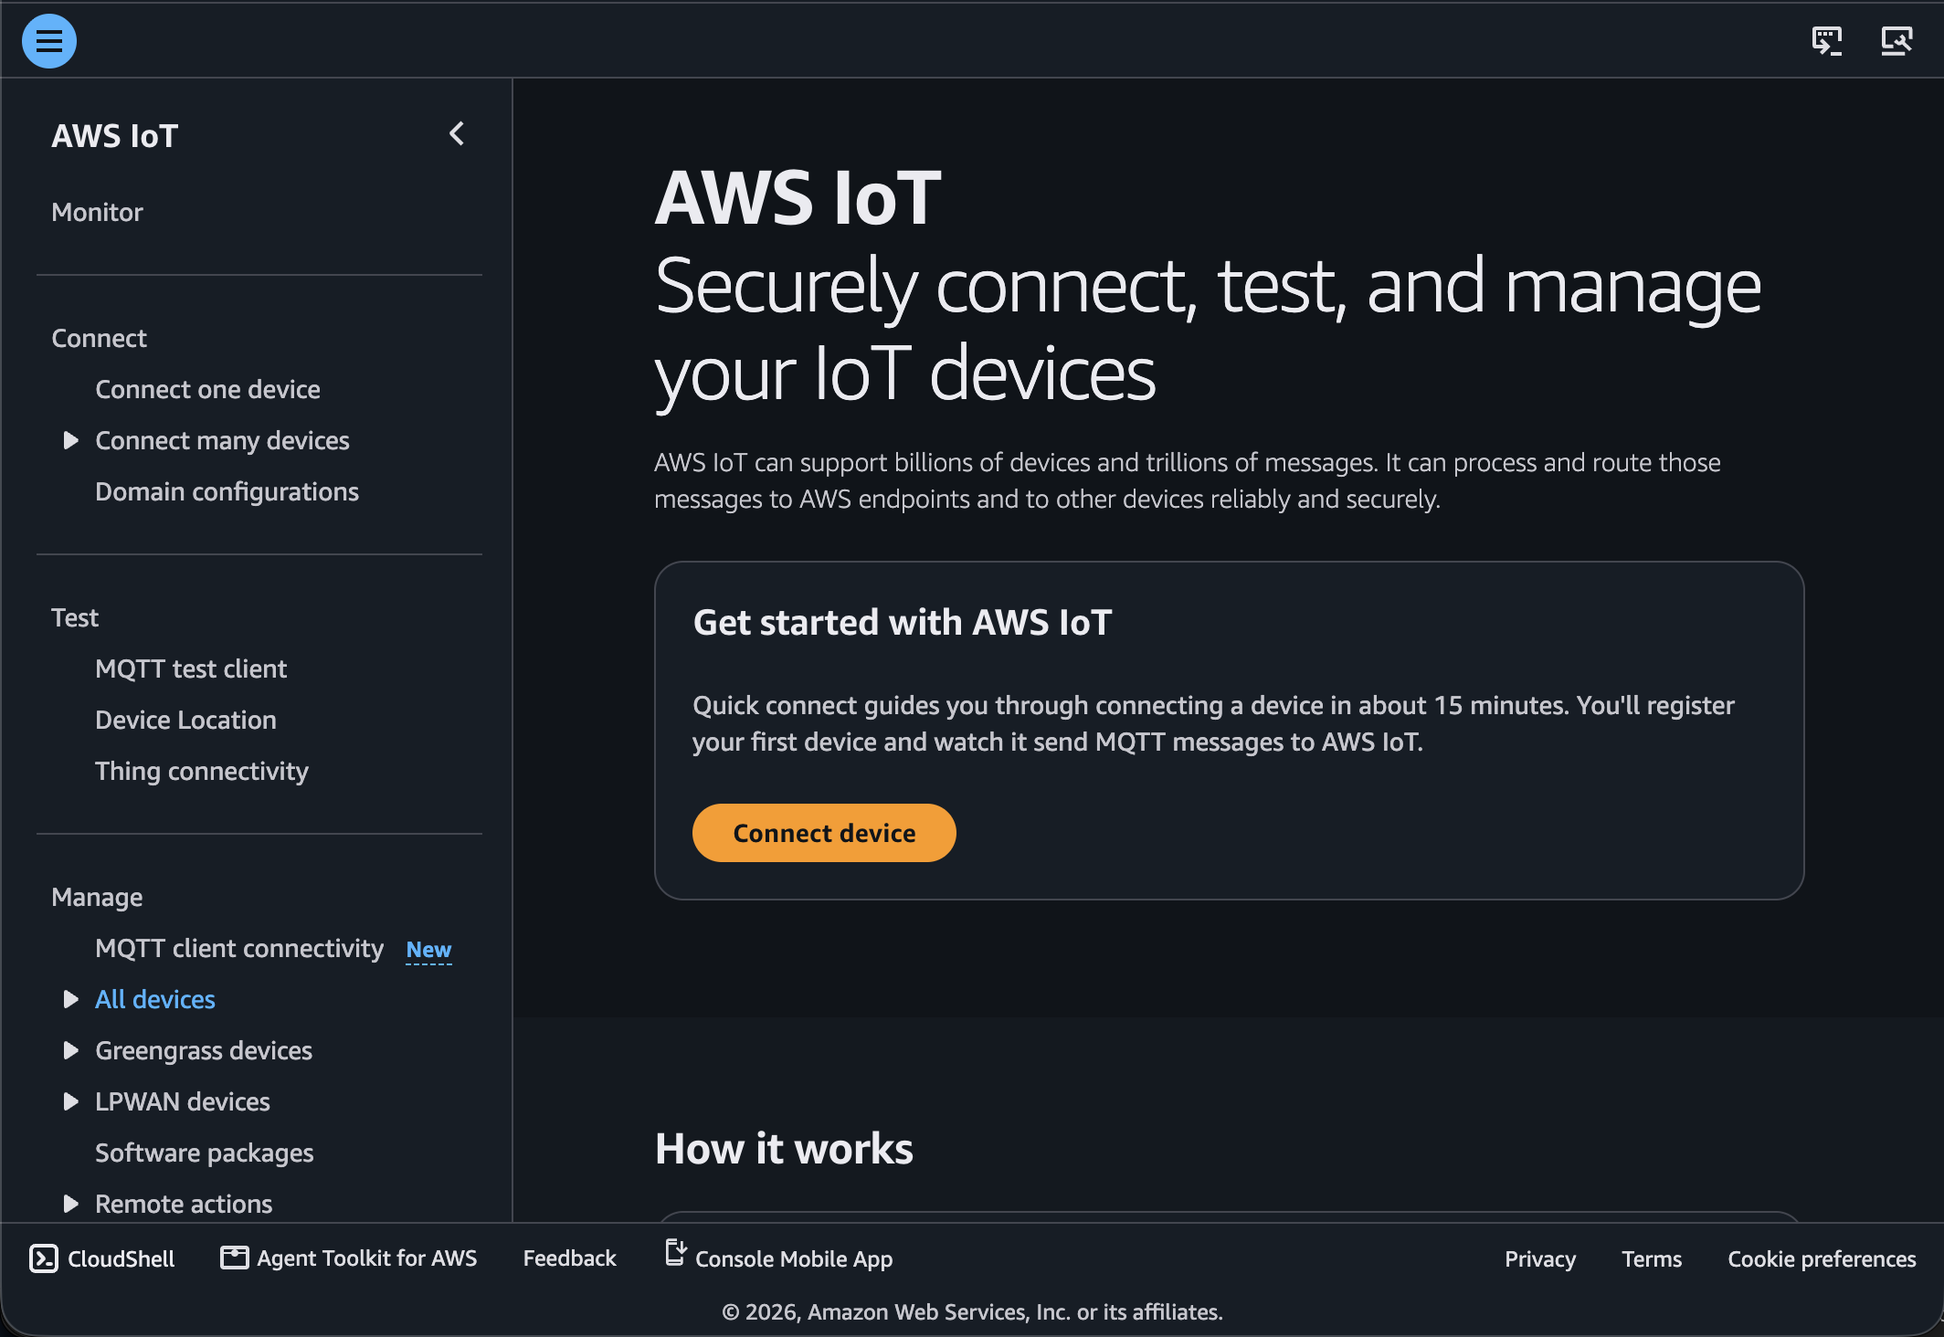
AWS IoT Core
Fully managed service to connect, manage, and secure billions of IoT devices, no infrastructure to setup
Lets devices and AWS services talk to each other through a simple, rules-based message routing system (no custom glue code)
Keeps a synced "shadow" of each device's last known state, so your app can read/write to it even when the device itself is offline

Slide 5
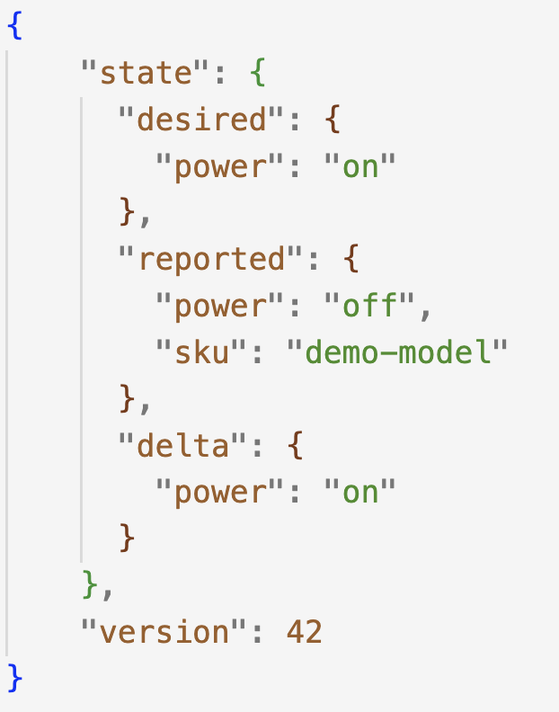
Device Shadow Anatomy
Desired State
“What we want the device to be”
Cloud/app writes the target state
Reported State
What the device says it currently is
Device publishes its actual state
Delta
“What still needs to change”
AWS IoT automatically calculates the difference between “desired” and “reported”
Version
“Which revision of the Shadow this is“
Incremented whenever the Shadow document changes, useful for detecting stale updates

Slide 6
AWS IoT Core Pricing
What is billed | Unit | Example
Device Shadow | 1 KB of record | 1.5 KB record = 2 operations
MQTT messaging | 5 KB of message | 16 KB republish = 4 messages
Rules Engine | 5 KB of message | 8 KB + one action = 2 rule units + 2 action units

Slide 7






Story time – the project we inherited
AWS Cloud
READ
API Lambda
GetThingShadow
READ
Notification Lambda
GetThingShadow
READ
Mission Lambda
GetThingShadow
IoT Device
AWS IoT Core
IoT rule A
/shadow/update/documents
Complete
shadow
document
IoT rule B

Slide 8
The evidence appeared in three places
Repeated reads
Independent workflows fetched the same robot state
We saw an opportunity to eliminate redundant GetThingShadow calls
One classic record for many concerns
Older devices kept state, settings, and software information in the classic shadow
An operation on one field was metered against that shadow’s record size
Oversized routed events
Shadow document size was getting out of hand (15kB+)
The documented MQTT republish crossed four 5 KB message units
Another opportunity to cut down on cost

Slide 9
Three architecture improvements
Use nearby state and a selected-field cache before fetching the shadow
Move classic fields into smaller named shadows through a staged migration
Send consumers the fields they use instead of the whole document

Slide 10
Pattern 1: Layered Shadow Reads

Slide 11
Pattern 1: Layered Shadow Reads
Caller
IoT Core
GetThingShadow
Repeated for stable reads

Slide 12
Pattern 1: Layered Shadow Reads
Request-local state
Payload supplied by caller
Caller
IoT Core
GetThingShadow
DynamoDB <device_id>:<shadow_field>
Repeated for stable reads
IoT Core GetThingShadow

Slide 13
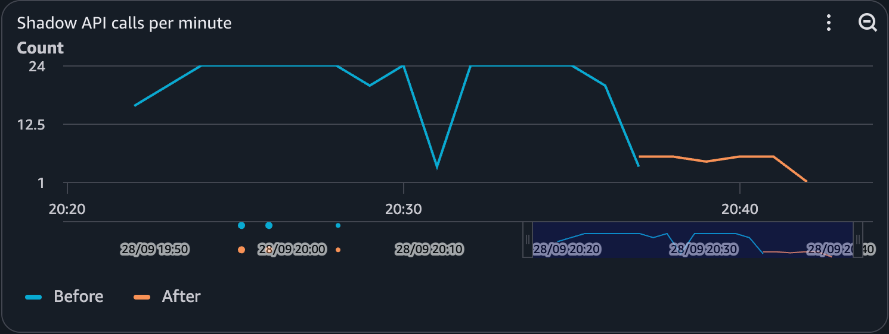
Pattern 1: Layered Shadow Reads - Results

Slide 14
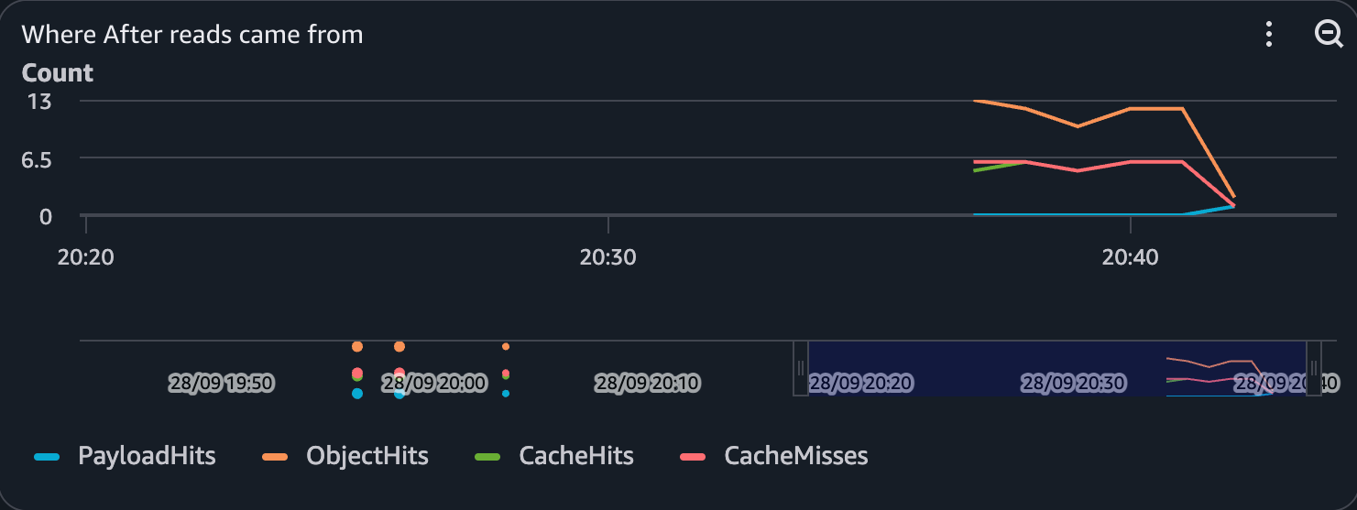
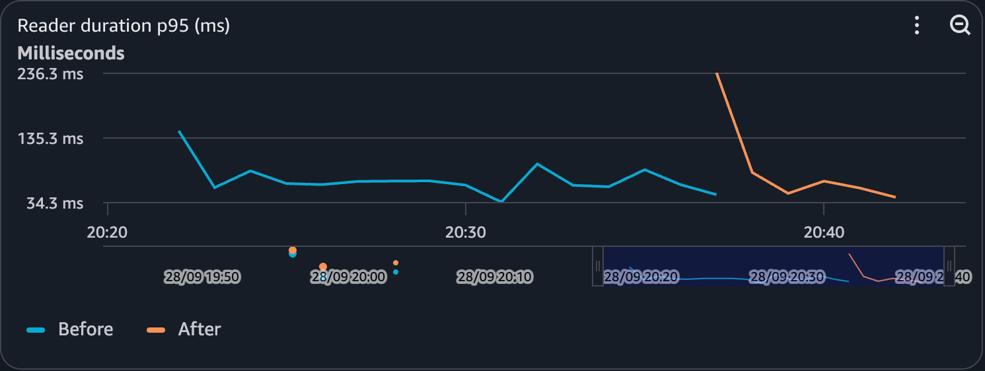
Pattern 1: Layered Shadow Reads - Results

Slide 15
Why DynamoDB for this cache?
The access pattern is a small key lookup
One item per robot, with selected reported fields
The SDK needs GetItem and UpdateItem, and already uses DynamoDB
DynamoDB fits this path
On-demand request billing
IAM Access through the AWS SDK
Durable entries with TTL cleanup
When does ElastiCache (Redis) become attractive?
a tighter latency target
when Redis data structures or atomic commands are needed
a shared cache already in the VPC

Slide 16
Pattern 1:
Layered Shadow Reads
Reuse close to the caller
The first access resolves the field and retains the fetched state inside the ThingShadow object.
Later accesses on the same object avoid another IoT Core request.
Fresh objects check the shared DynamoDB cache before calling GetThingShadow.
Cache tradeoffs
DynamoDB reads and writes replace some of the removed Device Shadow operations.
A normal cache miss fetches from IoT Core and selectively writes the field back.
TTL provides eventual cleanup; strict freshness requires a read-time age or version policy.
Worst case: cache unavailable
Cache errors fall through to IoT Core, allowing the application workflow to continue.
A prolonged outage returns fleet traffic to the origin and increases latency and cost.

Slide 17
Pattern 2: Project smaller downstream events

Slide 18


CURRENT ARCHITECTURE
Projection at the routing boundary
SELECT required fields
BEFORE
Device Shadow
/shadow/update/documents
Shadow documents event
Downstream rules
over 15 KB
complete document
IoT Topic Rule
AWS::IoT::TopicRule
SQL SELECT
4 × 5 KB units
documented MQTT republish
Kinesis
Data Streams
Downstream consumer Lambda

Slide 19
Projection code and payload trace
SELECT topic(3) AS robot_id,
current.version AS current.version,
current.state.reported.sku,
previous.state.reported.bin,
current.state.reported.bin
FROM '$aws/things/+/shadow/update/documents'
if reported_changed(old, new):
for check in checks_per_shadow[shadow_name]:
check(robot_id, old, new, ...)
16 KB
SQL projection
1.3 KB
Bin check
same result
new field omitted → contract failure
projection v2 → field restored
Payload sizes are documented source values; current rule action writes the projection to Kinesis

Slide 20
Why projection happens in IoT SQL
The rule selects fields before Kinesis
The transformation is a field selection in CloudFormation
Kinesis and downstream consumers receive the smaller event
Simple projection needs no additional Lambda invocation
When does implementing a Lambda become useful?
External lookups
Complex enrichment
Logic beyond the IoT SQL contract
The cost is contract ownership
retain previous and current values
add a new consumer fields to the rule
test the projected event

Slide 21
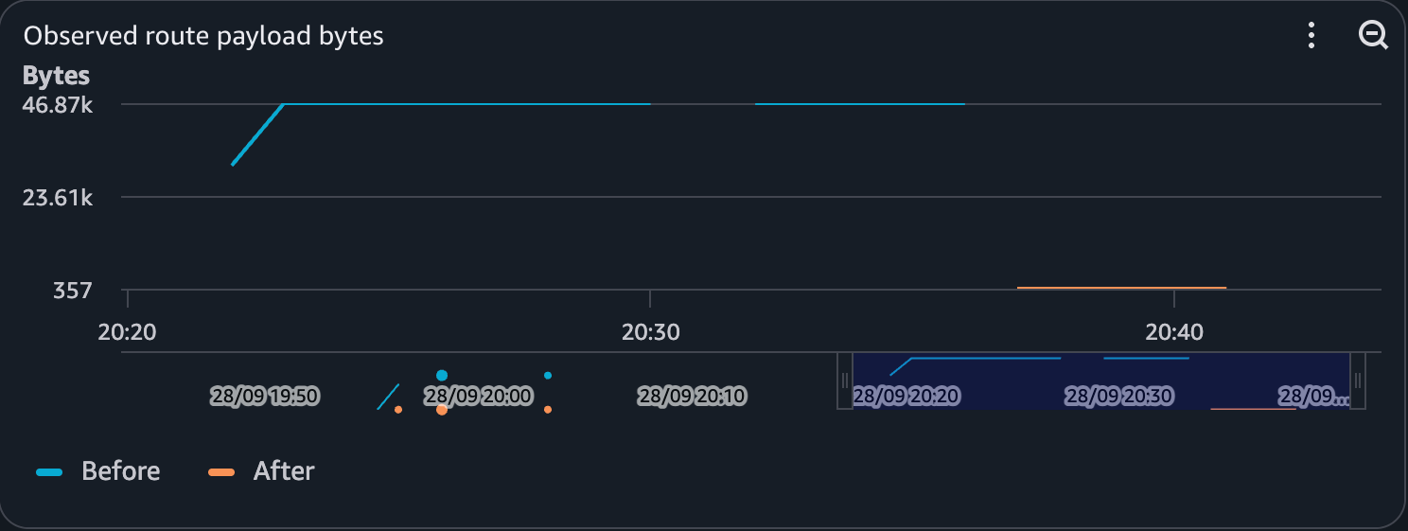
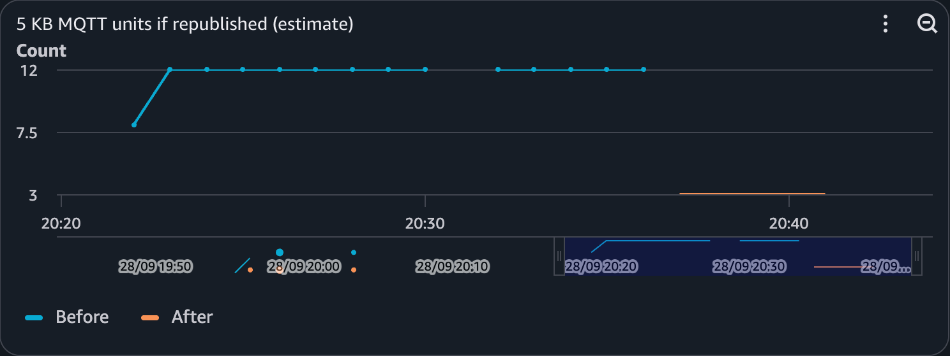
Pattern 2: Boundary Projection - Results

Slide 22
Pattern 2:
Boundary Projection
Payload reduction
The documented complete shadow exceeded 15 KB, equalling four 5 KB MQTT messaging units.
The projected payload was approximately 1.3 KB, fitting within one unit on that messaging leg.
Business behavior and ownership
The projection retains the robot ID and previous and current values required by downstream checks.
The IoT SQL statement becomes a shared contract that teams must document, version and test.
Worst case: contract drift
A consumer requires a field that was not added to the projection and cannot complete correctly.
The failure remains visible until the projection is updated and the missing field is restored.

Slide 23
Pattern 3: Classic vs Named Shadows

Slide 24
Are named shadows necessary?
The client really wanted to migrate to named shadows
existing setup – one IoT thing had classic shadow only
client wanted to organize shadow data into multiple named shadows
they were also willing to adapt their codebase and let us handle the migration process
The question before the migration
Would smaller records justify the change?
In some cases, extra calls and operational complexity can outweigh the savings
Benchmark
We proposed a benchmark: replay most common operations against their data and both architectures
Comparing one single classic shadow to 10 named shadow partitions
Run 300 logical actions per architecture: 48% writes and 52% reads.

Slide 25
Named shadows change the unit economics
ILLUSTRATIVE • ONE CLASSIC RECORD
State change
Classic shadow
One update
IoT Core
6 KB record
6 metered units
PARTITIONED BY CHANGE PATTERN
Same change
SDK routes field
State shadow
IoT Core
2 metered units
one hot field
cap.ns + schema
2 KB record
one update
Extra calls?
Count full path
reads + writes
Illustrative sizes · AWS IoT Core pricing: shadow operations use 1 KB record-size increments

Slide 26
Results of the classical vs named shadow experiment
Classic: 7,831 bytes. Settings: 1,559 bytes. Each stored record rounds to 1,024-byte units.

Slide 27
Results of the classical vs named shadow experiment
Estimated units per logical action
46.1%
fewer estimated units
over the same 300 actions
Classic: 7,831 bytes. Settings: 1,559 bytes. Each stored record rounds to 1,024-byte units.

Slide 28
Results of the classical vs named shadow experiment
API calls per logical action
Observed action p95, ms

Slide 29
Pattern 3:
Migrating from one classic shadow to named shadows
Meter the touched record
AWS meters both shadow reads and updates in 1 KB increments of the shadow record size
Illustrative: one update to a 6 KB classic record counts as six shadow operations; an update to a 2 KB named record counts as two.
Migration and compatibility
Group fields by how they are read and updated, so frequent operations touch smaller records.
Compare total shadow operations and record sizes before claiming a saving.
Worst case: migration or access adds work
A stalled migration needs a retry path and a clear intermediate state.
Reading every named shadow to rebuild the old full view can cost more than the original read.

Slide 30
Calculator Mindset
Architecture change | Remove or reduce | Add or retain
Layered reads | Repeated shadow reads | DynamoDB reads, writes, and fallback capacity
Classic -> Named shadow | Metered units on frequent shadow operations | Migration work, capability lookups, and extra shadow calls
Boundary Projection | MQTT units and unused bytes | Rule action, Kinesis, and schema ownership

Slide 31
Best Practices and
Suggestions
Cache with a field policy
select fields with an explicit freshness tolerance
distinguish missing from false-like values
treat TTL cleanup and read-time freshness separately
Partition and migrate deliberately
group fields by how they are read and updated
copy fields to named shadows before clearing classic; retry incomplete migrations.
Make projections testable
maintain the projection as a consumer contract
test every required field and business outcome
Count every replacement cost
separate shadow, messaging, rules and downstream services
model origin load when the cache is unavailable

Slide 32
Thank you

