Slide 1

Pie: A General-Purpose Code Editor
Focused on Simplicity
Mario-Mihai Mateaș
Cosmin Marșavina

Slide 2
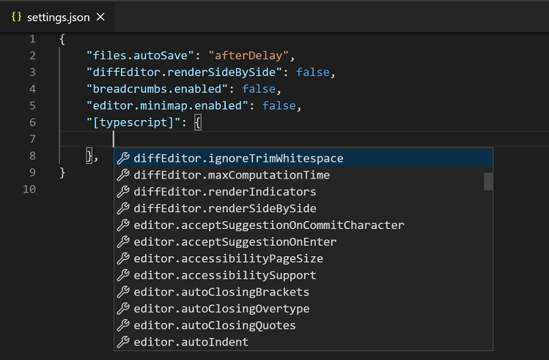
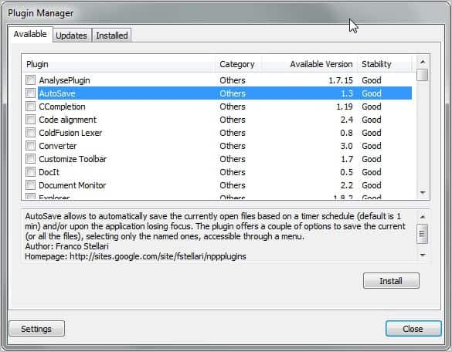
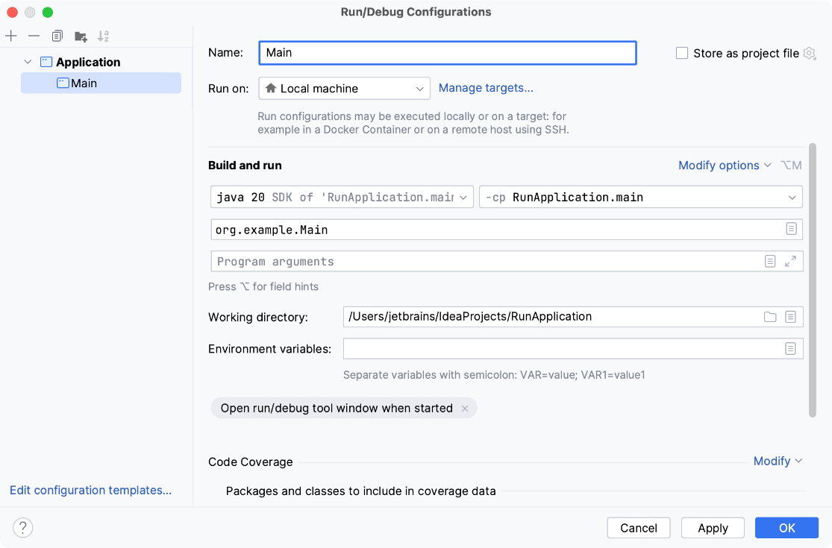
IDEs are getting too complex…

Slide 3
The problem…
People do not always work on big projects!

Slide 4

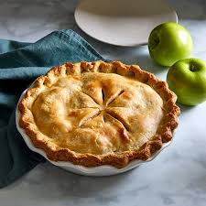
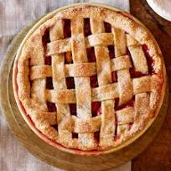
The solution…

Slide 5

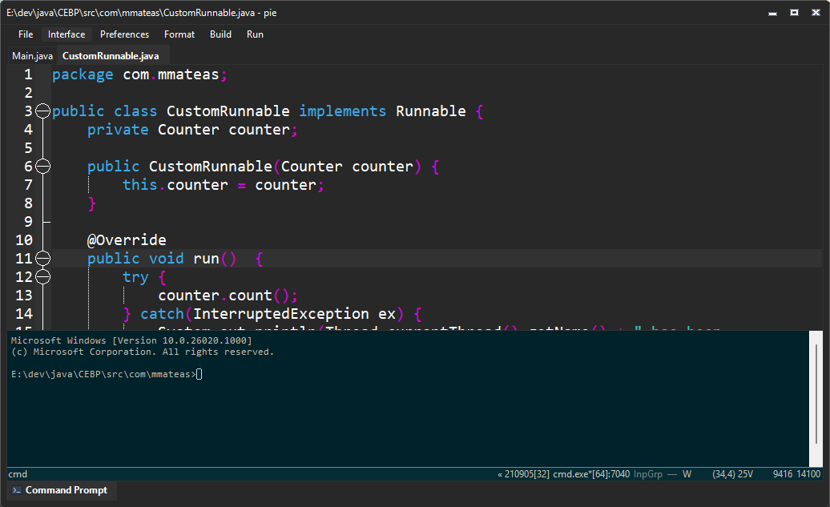
This is Pie.

Slide 6
Tool structure / Features
Code Editor
Build Manager
Theme Manager
Database Manager
VCS Support System

Slide 7

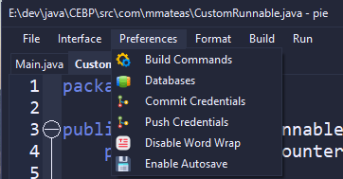
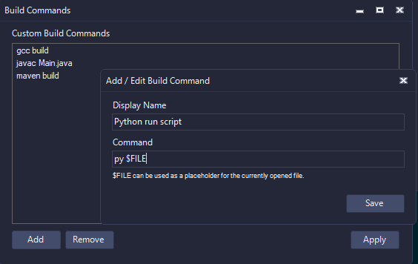
Build Commands

Slide 8
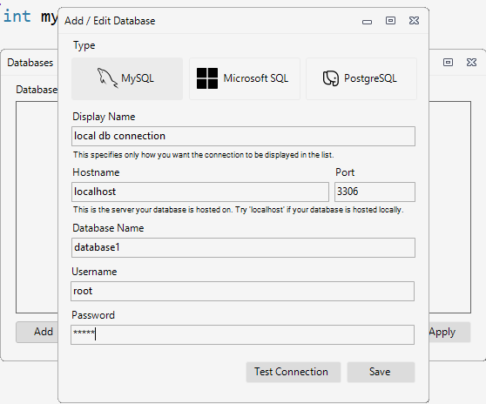
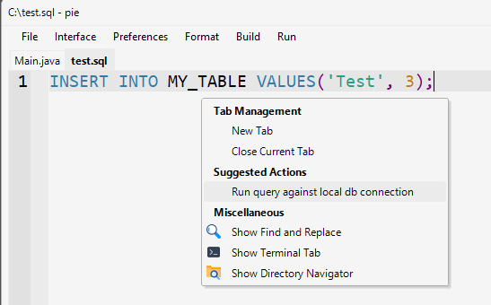
Database Connections

Slide 9
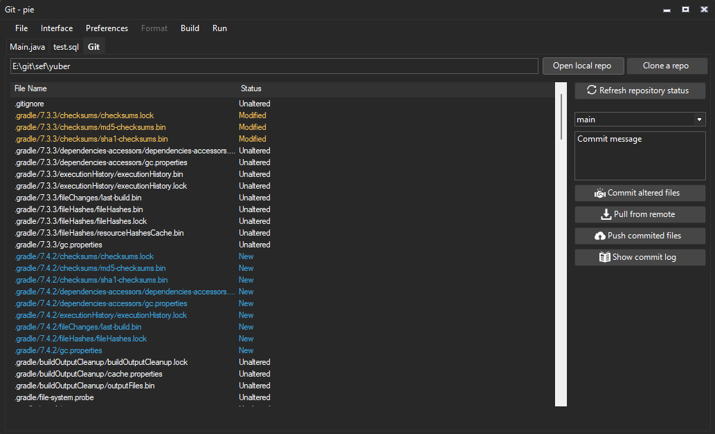
VCS Management System

Slide 10
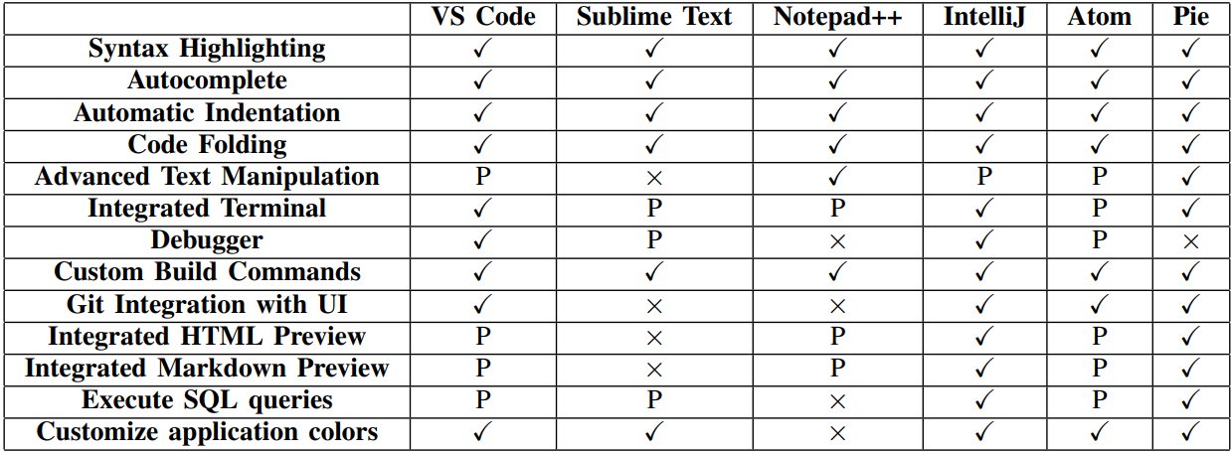
Feature comparison

Slide 11
Currently available for Windows.
Free to download (and fork):
github.com/mateasmario/pie

Slide 12
Conclusions
Pie offers minimality.
It doesn’t lack important features.
It is entirely open-source
Will get improved over time, and can also be improved by the community

Slide 13
Thank you!

