Slide 1

Heart Attack Treatment Prediction Using Random Forest classifier
Data Exploration and System Management Using AI/ML(13906) - WiSe 24/25
Prof. Dr. hab. Jablonski, Ireneusz
Muhammad Mateen Ali Hashmi
M.Sc. Artificial Intelligence

Slide 2
Introduction:
Heart attacks remain a global health crisis, and effective treatment decisions can save lives.
Objective:
Identify key factors influencing heart attack treatment outcomes.
Utilize machine learning to enhance predictive accuracy in healthcare.
Provide actionable insights for clinicians to improve patient care.

Slide 3
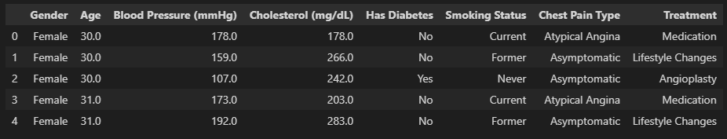
Dataset Overview
Dataset: 1,037 patients (who experienced heart attack)
Features: Gender, Age, Blood Pressure, Cholesterol, Diabetes, Smoking Status, Chest Pain Type, and Treatment
Head of the dataset:

Slide 4
Data Preprocessing
Initial Exploration and Summary Statistics:
To understand data structure and identify potential issues such as missing and incorrect values
Handled missing values:
Numerical: Filled with mean
Categorical: Filled with mode
Removed rows where Treatment variable missing

Slide 5
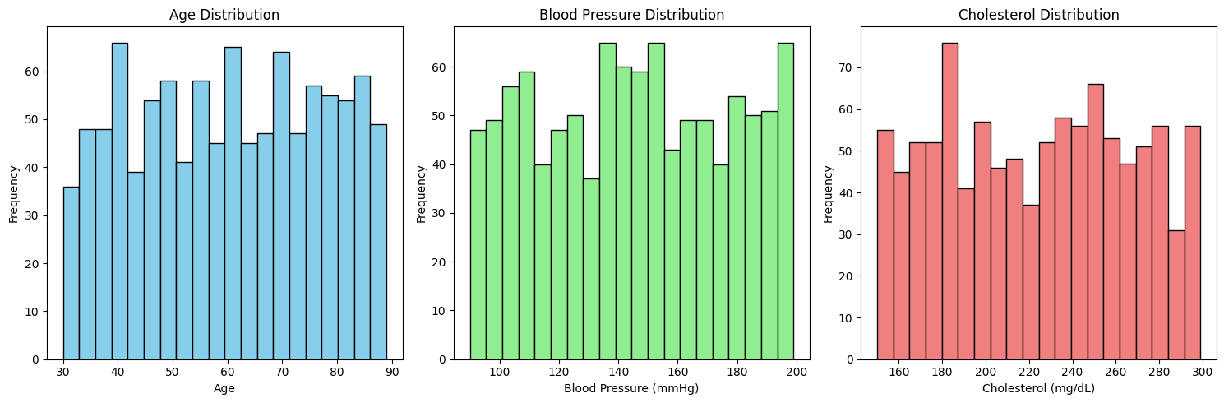
Exploratory Data Analysis (EDA)
Distribution of Numerical variables:
Age: Most patients are older, with an average age of around 60. Age is a major risk factor for heart disease.
Blood Pressure: The average blood pressure is 145.2 mmHg, which is above the normal range of 120/80 mmHg.
Cholesterol:
Cholesterol levels are generally high, with an average of about 224 mg/dL, and many patients have levels over 240 mg/dL.

Slide 6
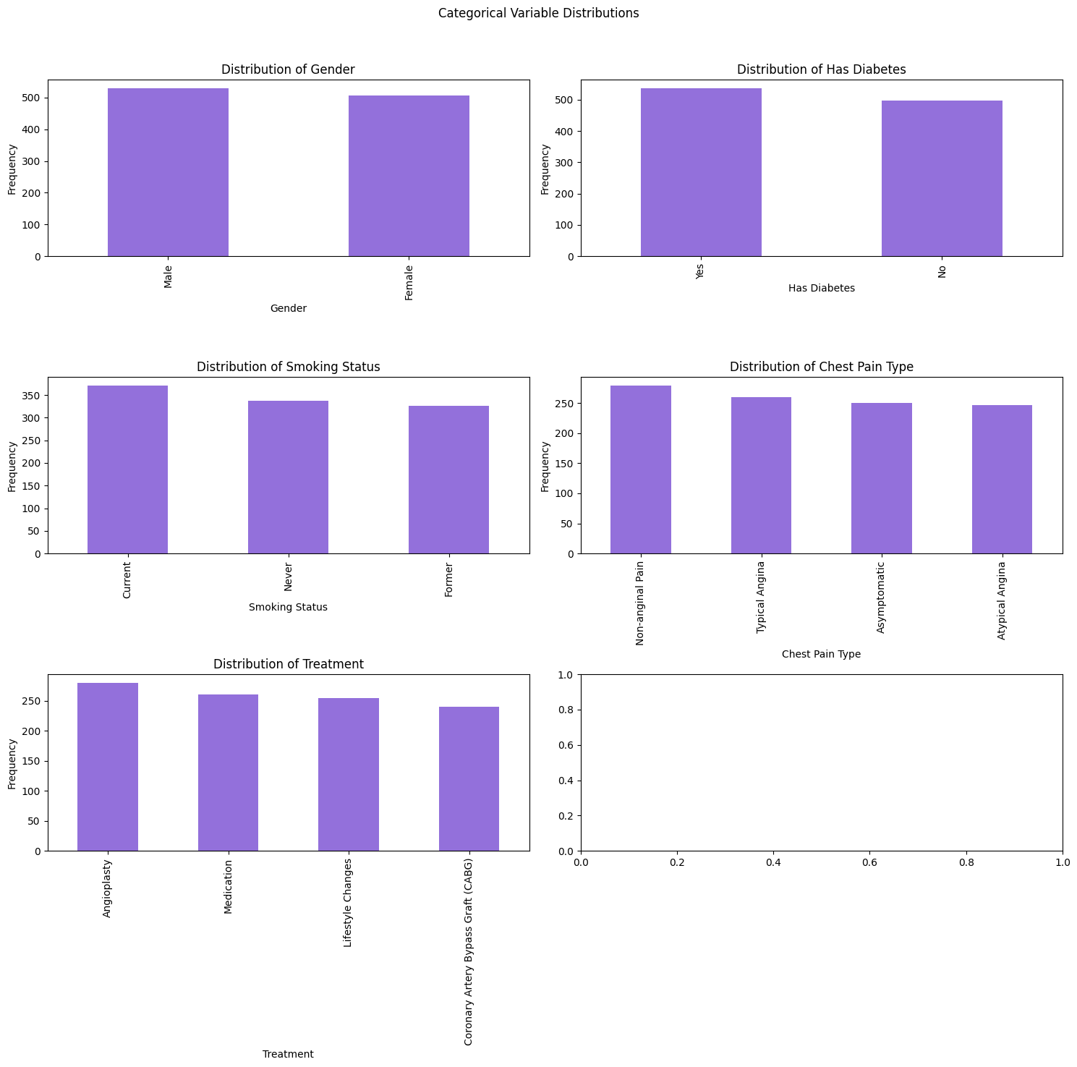
EDA: Categorical variables Distribution

Slide 7
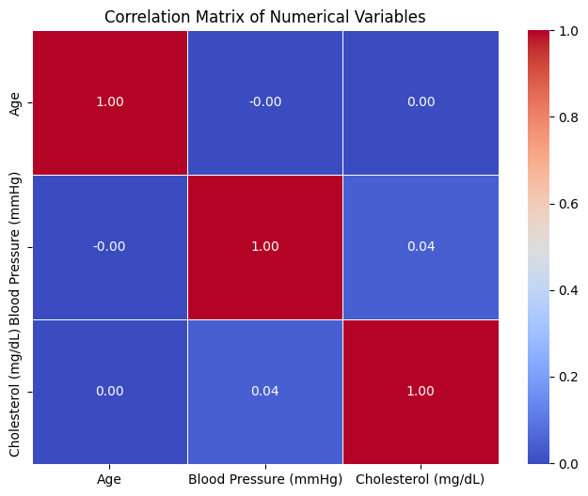
Exploratory Data Analysis (EDA)
Correlation Analysis of Numerical Variables
These weak correlations suggest that age, blood pressure, and cholesterol are mostly independent of each other in this dataset.

Slide 8
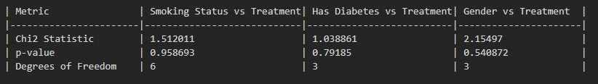
Exploratory Data Analysis (EDA)
Chi-Square Test:
To examine the relationships between categorical variables and treatment types
As observed, none of the categorical variables (Smoking Status, Diabetes Status, Gender) show a statistically significant link to the treatment type.

Slide 9
Modelling
Feature Engineering: Feature Encoding and Scaling
Handling Imbalance
Splitting Data (Training 80%, Testing 20%)
Random Forest Model Training
Hyperparameter Tuning

Slide 10
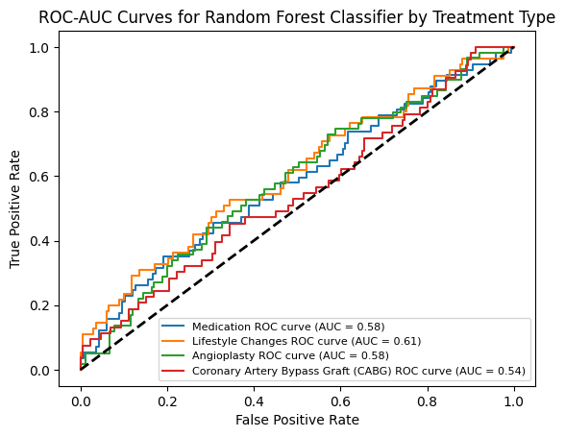
Results and Insights
Accuracy: 34.37%, ROC-AUC: 0.57
The low accuracy and ROC-AUC score show that the Random Forest model is not performing well in predicting treatment types.
This could mean that the available features are not strong predictors for treatment decisions

Slide 11
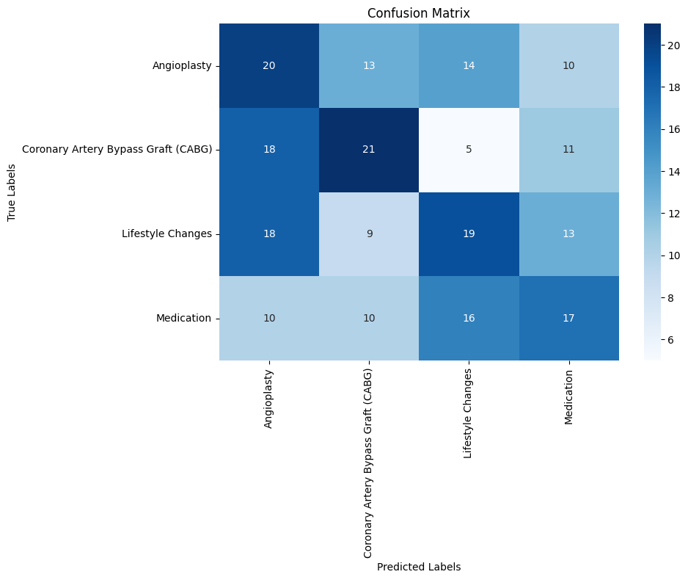
Results and Insights
Confusion Matrix:
The model correctly predicted the treatment type. 20 true positives for “Angioplasty.” , 21 true positives for “Coronary Artery Bypass Graft (CABG).” , 19 true positives for “Lifestyle Changes.” , 17 true positives for “Medication.”

Slide 12
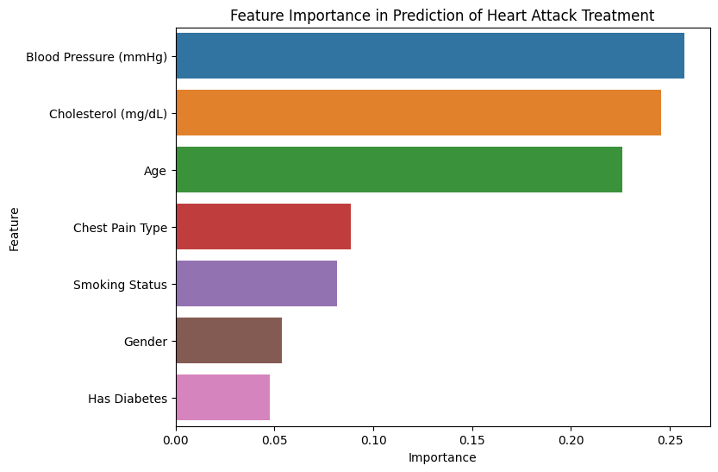
Results and Insights
Important Features (Contribute more for prediction ):
Top Features: Blood Pressure (mmHg): 25.03% , Cholesterol (mg/dL):24.96%, Age: 24.80%. These three numerical variables are the most influential, collectively contributing about 74% to the model’s predictions.

Slide 13
Conclusion
Random Forest model shows potential for improving treatment decisions.
Numerical features like age, blood pressure and cholesterol are key predictors while categorical variables appear less impactful.
Next Steps:
Expand the Dataset (add more features, get more data)
Improve the Model: Try Advanced Models (XGBoost, or even deep learning
models) and fine-Tune the Model

