Slide 1
CSCI 205 Final Project
Notes:
Mateen

Slide 2
Hello!
We’re The Lean Mean Netbean Machine!
Laura Poulton
Mateen Qureshi
Morgan Muller
Omar El-Etr
Notes:
Mateen

Slide 3
Omar has a struggle to go to his 8 AM class at Breakiron everyday.
— Mateen
(His roommate)
Notes:
Mateen

Slide 4
Introducing..
Super Omar.io
Notes:
Mateen

Slide 5
Background
Super Omar.io needs to defeat the blue screens of death stopping him from going to Breakiron. He uses the superpower of Starbucks to fight his way to class
Notes:
Mateen

Slide 6
DEMO TIME
Notes:
Mateen/Laura

Slide 7
Let’s Talk Scrum!
Scrum was a necessary element for the success of our project and team management. Here’s how we used Scrum to manage our team.
Notes:
Morgan

Slide 8
User Stories
As a user, I want a background with a variety of objects.
As a user, I want to move my character and change something in the environment.
As a user, I want to move my character back and forth across the screen.
As a user, I want my character to run and jump like a real person.
As a user, I want the game to have enemies and obstacles.
As a user, I want to win or lose this game.
As a user, I want to play a well-developed game with a coherent flow.
Notes:
Morgan

Slide 9
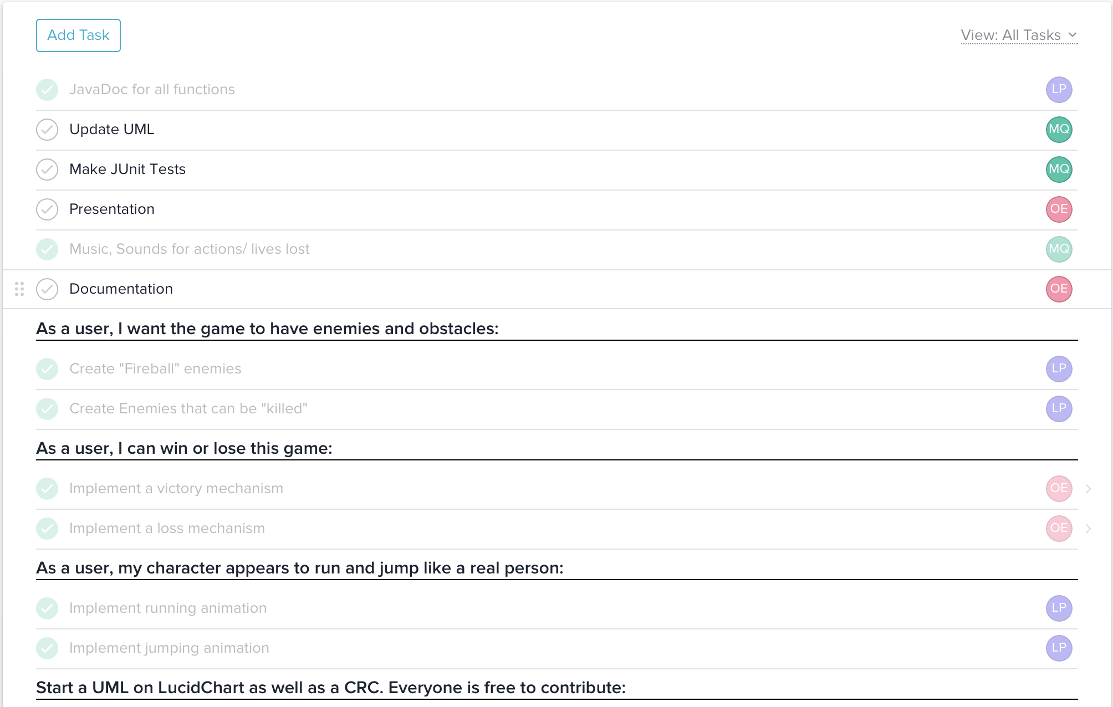
Tasks
We utilised Asana’s task manager to assign tasks to different members of the team and track them.
Notes:
Morgan

Slide 10
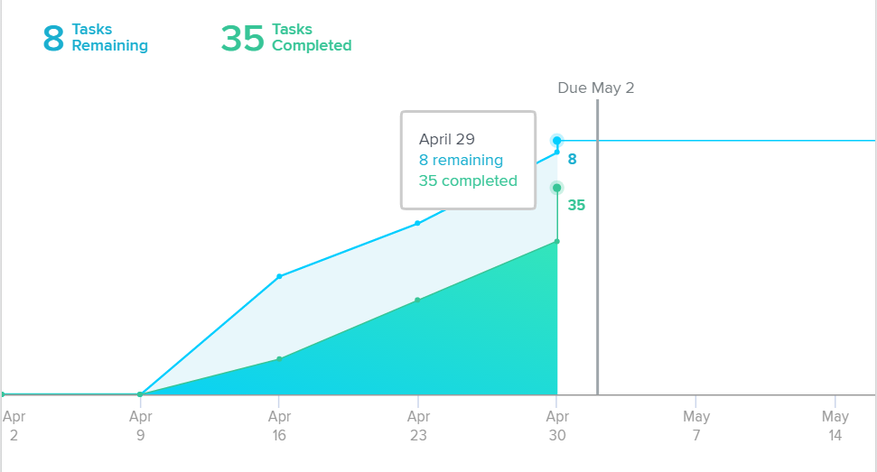
Burndown(?) Chart
We utilised Asana’s backlog feature, which generates that backlog chart based on the tasks
Notes:
Morgan

Slide 11
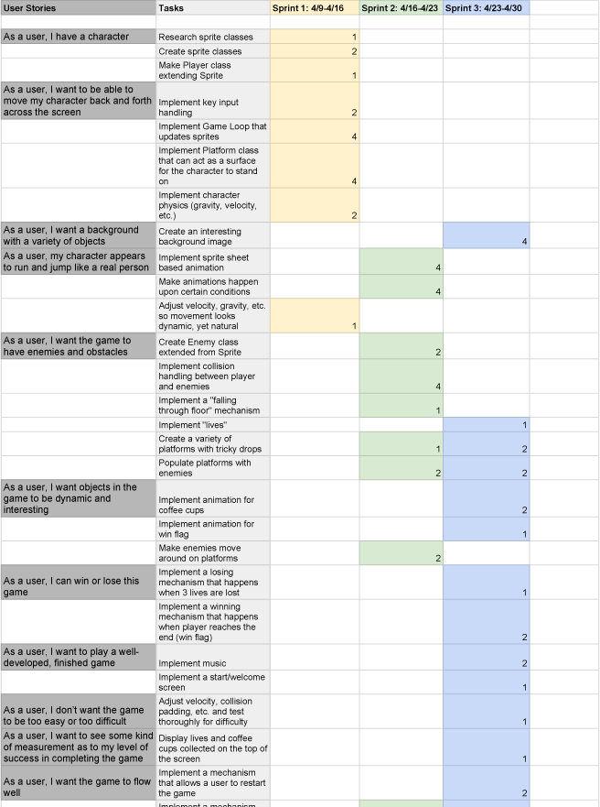
Sprint Backlog
We used Google Spreadsheets to document our sprint backlog
Notes:
Morgan

Slide 12






Tools We Used
Asana
This was our main team management tool. It integrates scrum, allowing us to seamlessly focus on our work, instead of managing it.
Facebook Messenger
This was our main for communication and sending messages that needed a quick response from team members.
Google Drive
We used google slides, google docs, and google spreadsheets for different parts of our project.
Adobe Creative Cloud
We used Adobe Photoshop and Illustrator to create the graphics for our game.
JavaFX
This was the software platform that we used to manipulate graphics in our game.
Our Brains!
These were some necessary elements to the success of our project.
Notes:
Omar: brief intro don’t reveal everything

Slide 13
Team/Project Dynamic
Areas of Strength
Git Gurus
Graphic Designers
Wide range of different experience
Areas of Improvement
Getting started faster
Use Asana consistently
Notes:
Laura

Slide 14
Design
and Implementation
We used Google Spreadsheets to design our game elements and then implemented them as classes in JavaFX
Notes:
Omar

Slide 15
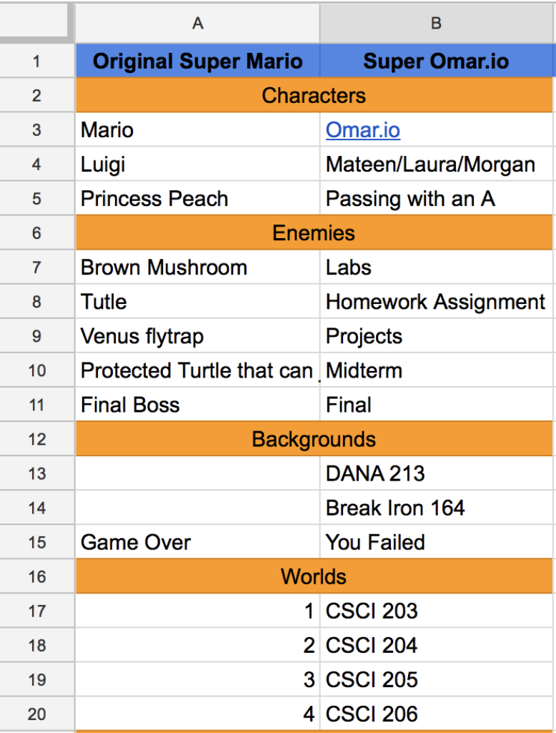
Game Elements
We designed the elements of our game at the beginning and we were hoping to achieve all of that.
Notes:
Omar

Slide 16
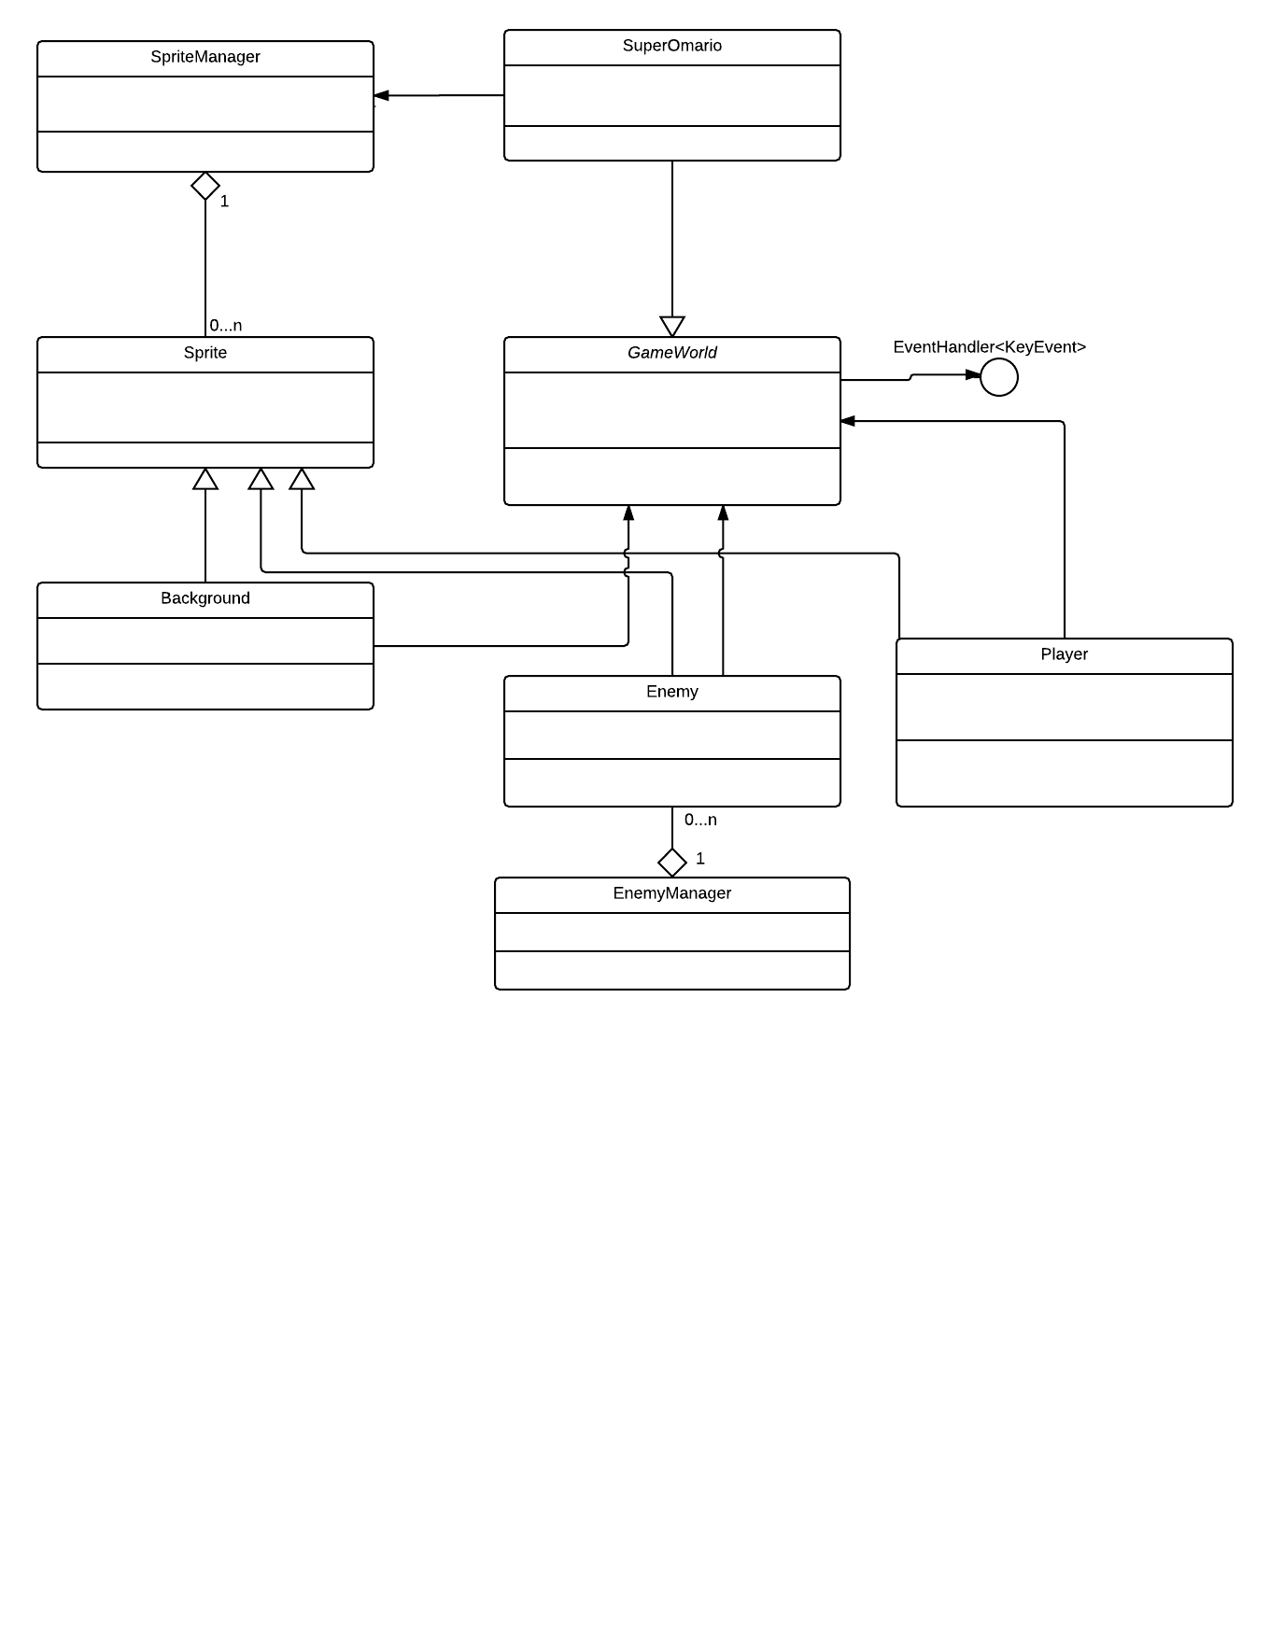
UML Class Diagram
Show and explain your web, app or software projects using these gadget templates.
Notes:
Mateen

Slide 17
User Interface
We utilized some of Adobe’s Creative Cloud softwares to create the start screen, background, and winning and losing screens.
Notes:
Morgan

Slide 18
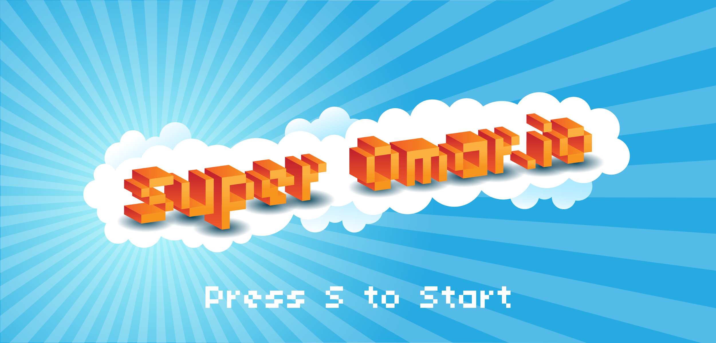
Start Screen
This is the screen you get when you first open the game
Notes:
Omar

Slide 19
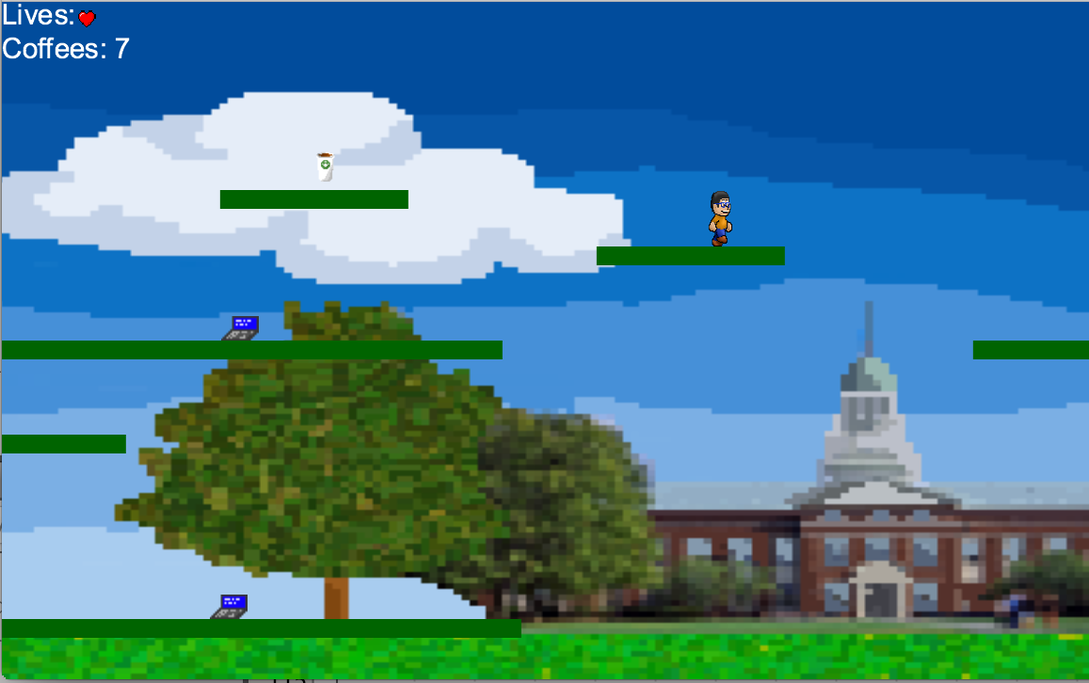
Game Screen
This is the screen you see as you are playing the game.
(Oh that’s Bertrand Library btw!)
Notes:
Morgan

Slide 20

Winning Screen
This is the screen you get when you win the game.
Notes:
Omar

Slide 21

Losing Screen
This is the screen you get when you lose the game.
Notes:
Omar

Slide 22
So, What’s Next?
There’s a long way to go until we’re ready with the perfect game we had in mind. Here are some of the improvements we’re considering.
Notes:
Mateen

Slide 23
Super Omar.io V 2.0
Introduction of more levels
More character/enemy types
Implementing everything we had in our game elements
Using a game-development framework
Professor Dancy as a boss
Notes:
Mateen

Slide 24
Thanks!
Any questions?
Notes:
Laura

